Slide 1
IDENTIFYING PRIORITY HEALTH ISSUES
Students lean about:
Social justice principles
Priority population groups
Prevalence of condition
Potential for prevention and early intervention
Costs to the individual and community
STUDENTS LEARN TO:
Argue the case for why decisions are made about health priorities by considering questions such as:
How do we identify priority issues for Australia's health?
What role do the principles of social justice play?
Why is it important to prioritise?

Slide 2
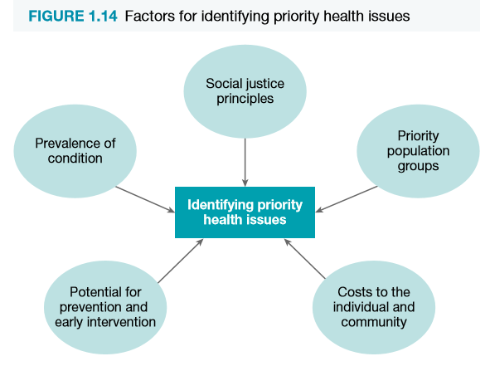
IDENTIFYING PRIORITY HEALTH ISSUES - OVERVIEW
Government uses the following to identify priority health issues:
The principles of social justice
Considers the costs of the issue for individuals and the community
Considers the prevalence of the condition
Considers the potential for prevention or early intervention that will reduce the impact or occurrences of the issue
Government also considers particular population groups that may need to be prioritised because of gaps in quality of health.
Is important to prioritise health issues and population groups – ensures:
Productive use of resources (they can make a difference)
Reduce costs to individuals and the community
Reduce the prevalence by reducing the incidence of disease
Help particular population groups, while being equitable in the process by utilising the social justice principles

Slide 3
SOCIAL JUSTICE PRINCIPLES
Social justice principles refer to values:
“that favours measures that aim at decreasing or eliminating inequity; promoting inclusiveness of diversity; and establishing environments that are supportive of all people.”
Social justice principles include:
Equity
Diversity
Supportive environments

Slide 4
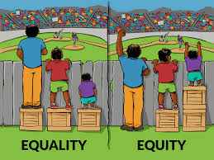
SOCIAL JUSTICE PRINCIPLES CONT…
EQUITY
Resources are allocated in accordance with the needs of individuals and populations - the desired goal of equality of outcomes.
Results in particular groups within Australia receiving more funding and being identified as priority groups in Australia because they have poorer health outcomes than other Australians.
ATSI are an example of a people group who require additional funding and resources in order to improve health outcomes.

Slide 5
SOCIAL JUSTICE PRINCIPLES CONT…
DIVERSITY
Refers to differences that exist between individuals and people groups.
Australia is a multicultural/diverse country. Requires a number of measures to be implemented to ensure each group within our diversity has access to health care and achieves good health outcomes.
Providing brochures in multiple languages/having interpreters in hospitals are examples of being inclusive of diversity.

Slide 6
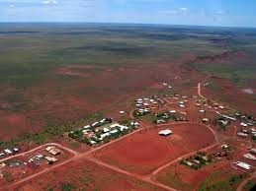
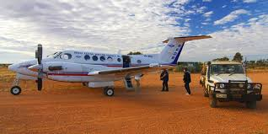
SOCIAL JUSTICE PRINCIPLES CONT…
SUPPORTIVE ENVIRONMENTS
Are environments where people live, work and play that protect people from threats to health and increase their ability to make health-promoting choices.
Government looks to create supportive environments for all people, but also looks at the environments of particular people groups to determine if these might be reasons for poorer health outcomes.
Rural and remote people are an example of people whose environment is not as supportive as other environments.
The social justice principles seek to recognise and address both the health outcomes, such as: incidence and prevalence of disease, and death rates, and the factors that influence health, such as: socioeconomic status, environment, and cultural factors.

Slide 7
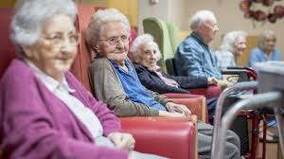
PRIORITY POPULATION GROUPS
There are particular priority population groups that are achieving significantly poorer health outcomes compared to the rest of Australia.
Cultural - such as Aboriginal and Torres Strait Islanders
Their health statistics match developing worlds.
Environmental - such as rural and remote living people
Have limited access to health care facilities and services.
Age based - such as the elderly
Economical standing - such as those with low socioeconomic status

Slide 8
PRIORITY POPULATION GROUPS CONT…
Epidemiology provides statistics on these population groups
Allows the government to identify priority population groups that need extra resources to reduce/remove the gap in health outcomes.
Further advances our knowledge of the sociocultural, socioeconomic and environmental determinants of health.
Some examples of epidemiology include:
Males have higher rates of cancer than females
ATSI males and females can expect to live 10 years less than the non-ATSi population
People in remote areas have higher death rates than urban dwellers
Lower oral health is found in people of lower socioeconomic status
Priority population groups then become the focus of health promotion initiatives.
Receive more funding and health programs are developed to meet their particular needs.
For example the Royal Flying Doctors Service that functions in remote areas.

Slide 9
PREVALENCE OF THE CONDITION
Prevalence is the number of cases/instances in a population at a given time.
In relation to cancer - prevalence refers to the number of people alive who had been diagnosed with cancer.
This is different to incidence - refers to the number of new cases diagnosed in a specific time period.
The prevalence of a condition is used to determine the number of people affected by the health issue. Higher the prevalence = greater the health issue (may then be identified as a priority health issue in Australia).
There are many current conditions that are high in prevalence and have become priority health issues, such as:
Cardiovascular disease – has been a priority health issue for a long time in Australia and will continue to be long into our future.
Cancers – have been a growing priority in Australia, although the decreased smoking rate is helping.
Dementia and Alzheimer’s disease – affect many Australians today, particularly the elderly.
Diabetes – is not only prevalent in Australia, but has an increasing incidence, making it a very high priority issue for Australia’s health.
Cerebrovascular disease – like cardiovascular disease continues to be a major health issue and has similar underlying causes as cardiovascular disease.

Slide 10
POTENTIAL FOR PREVENTION AND EARLY INTERVENTION
Priority health issues need to have the potential for prevention and early intervention - will make treatment more successful.
Easier it is to prevent a disease - more likely health promotion will have an impact on the burden of the disease and reduce its incidence.
If prevention cannot occur - early intervention is preferable, with higher rates of survival for those diagnosed and treated early for the condition.
Examples of diseases that have high potential for being prevented include:
Type II diabetes
Hypertension
Cardiovascular disease
Obesity.
These are lifestyle diseases - caused by inactivity and poor dietary choices (not always).
Preventative action – to reduce smoking to reduce diseases that are linked to and caused by smoking, such as: COPD, cerebrovascular disease, and lung cancer.
Other diseases have higher rates of successful treatment when identified and treated early - they have potential for early intervention. Eg:
all cancers
cardiovascular disease
musculoskeletal conditions such as arthritis.
In relation to health priorities in Australia, the more potential for prevention and early intervention the more likely the health issue will be made a priority. This is particularly the case if the condition has both potential for prevention and potential for early intervention.

Slide 11
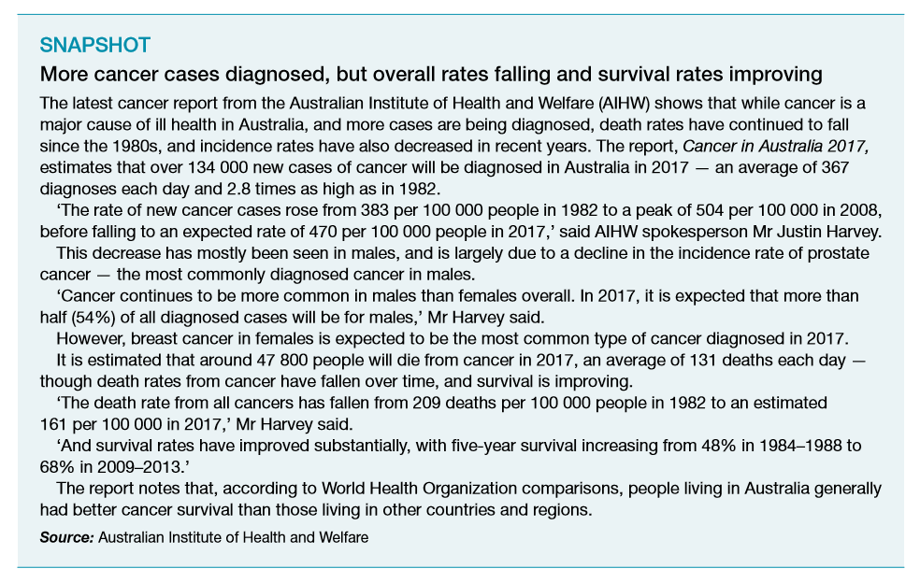

Slide 12
COSTS TO THE INDIVIDUAL AND THE COMMUNITY
Disease and illness can place a great economic and health burden on the individual. This can be measured in terms of:
Financial loss
Loss of productivity
Diminished quality of life
Emotional stress
Treatment, medication and rehabilitation can be expensive and unaffordable
Injury and disease may affect the individual’s ability to be productive
Illness, disease and premature death all place an economic burden on the community
Illness results in both direct and indirect costs:
Direct costs – money spent on diagnosing, treating and caring for the sick and the money spent of prevention (For eg: hospital admissions, pharmaceutical prescriptions, prevention initiative, research, screening and education)
Indirect costs – the value of the output lost when people become too ill to work or die prematurely (For eg: cost of forgone earnings, absenteeism and the retraining of replacement workers).

Slide 14
APPLICATION
Read the article Cardiovascular diseases top Australian health care spending (link on my Weebly) then answer the following questions: 1. What was the estimated health-care expenditure on cardiovascular diseases in 2008-09? 2. Was the cost of treating and managing cardiovascular diseases higher in males or in females? 3. On which age group in the population is health-care spending highest?

Slide 15
APPLICATION
Using information presented in the section of Australia’s Health 2018 – In Brief (on my Weebly), identify two priority population groups that are represented.
1. Outline some of the inequities each group experiences with regards to health status.
2. What impact do the principles of social justice have on identifying priority population groups?

Slide 16
APPLICATION
Using the AIHW health report Australia's Health 2018 Report (located on my Weebly), outline the prevalence of the following chronic health conditions;
Prevalence means how common a condition is in the community/the number of cases of disease that exists in a defined population.
Coronary heart disease – p. 111
Cancer – p. 103
Diabetes – p. 118
Chronic Respiratory Conditions – p. 128
Injury – p. 142
Mental Health – p. 132

Slide 17
APPLICATION
Prioritising Conditions
1. Based on prevalence statistics, how would you prioritise each of these conditions?
2. Which should get the most funding? Why?

Slide 18
APPLICATION
Preventing Cancer
Copy and complete the table below describing how the specific cancers can be prevented and/or treated and the potential for change in incidence and prevalence over time.
Condition | Prevention, detection and potential for change
Lung Cancer
Breast Cancer
Melanoma

Slide 19
APPLICATION
Students learn to:
Argue the case for why decisions are made about health priorities by considering questions such as:
how do we identify priority issues for Australia’s health?
what role do the principles of social justice play?
why is it important to prioritise?
Why is it important to prioritise issues for health?
How do we identify health priority issues?
The link below on my Weebly page will help you answer the following question:
AIHW National Health Priority Areas
Explain what the National Health Priority Areas initiative is and what it hopes to achieve?

Slide 20
PRACTISE QUESTION
2013 HSC Question: Why is it important to prioritise particular health issues in Australia? Include examples in your answer.
(5 Marks)
1.8 minutes (1 min and 48 secs) per mark
1.8 x 5 = 9 minutes - GO!
Refer to the marking criteria/sample answer and peer mark once you have finished.

Slide 21
PRACTISE QUESTION ANSWER

