Slide 1
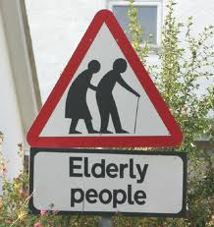
A Growing and Ageing Population

Slide 2
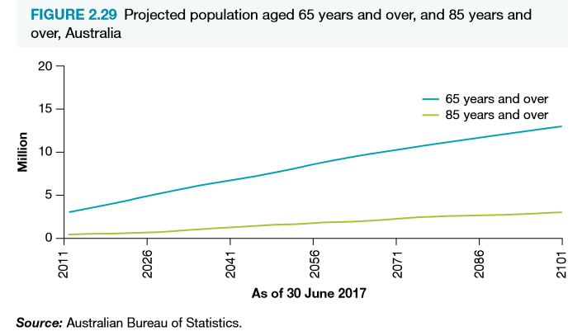
A Growing and Ageing Population
Australia’s population is growing and ageing (older Australian’s are people aged 65yrs and over)
This growing and ageing population is one of Australia’s health priorities because with a growing and ageing population comes an increase in disease burden and health care demand – Approx 2% of our population is aged 85yrs or older. This is expected to double by 2036.
Is a product of increased life expectancy at birth
Increased survival rates for chronic diseases means the elderly have greater prevalence of major diseases such as:
Cancer, CVD, diabetes, musculoskeletal disorders and greater levels of disability
As the growing ageing population increases – the population living with chronic disease and disability places increase demand on health services
This causes workforce shortages and a greater need for carers and volunteers

Slide 3
Growing and ageing population – Healthy ageing
Health ageing is a process that involves various behaviour and choices that affect health, such as:
Regular physical activity
Good dietary choices
Regular family contact
Social activities as well as resilience to life’s circumstances
Aim of healthy ageing is to enable elderly to maintain health into old age. Allows them to contribute to the workforce longer and engage in society. They will contribute more to their communities and have fewer healthcare needs.
They will experience less chronic disease and disability and place less pressure on the national health budget and health care system
As the government seeks to promote healthy ageing it aims to:
Prevent disease
Reduce illness and illness periods
Maintain economic contributions
Maintain social participation

Slide 4
A growing and ageing population – healthy ageing
Health care professionals provide advice about lifestyle, managing disease and avoiding complications
Other programs aim improve balance to avoid falls and fractures.
Many are opting to remain in their own home as long as possible – requires independence and health and social services in the community
Better health is associated with employment, current trend is an increasing number of elderly stay in employment beyond retirement age.
Governments are promoting good health and prevention throughout life. It has appointed an Ambassador for Ageing who is responsible for:
Promoting positive and active ageing
Encouraging the contributions made by older people
Promoting community government programs and initiatives to the public
Assisting older people to access these programs
Government Aged Care Programs

Slide 5
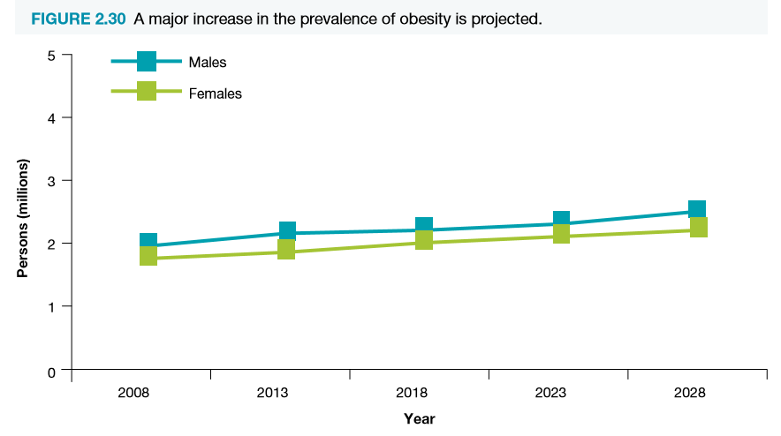
Increased population living with chronic disease and disability
As well as significant improvements in the number of people surviving heart attacks, strokes and cancers, our ageing population has led to an increase in the number of Australians with a chronic disease or disability.
Chronic, non-communicable diseases account for approximately 80% of the total burden of disease in Australia and it is estimated that they will be responsible for about three-quarters of all deaths by 2020.
The future levels of chronic diseases could be reduced if younger people control the more significant risk factors for developing chronic disease, such as smoking, obesity, excessive drinking, and physical inactivity.
Obesity, for example, is a major risk factor for diabetes.

Slide 6
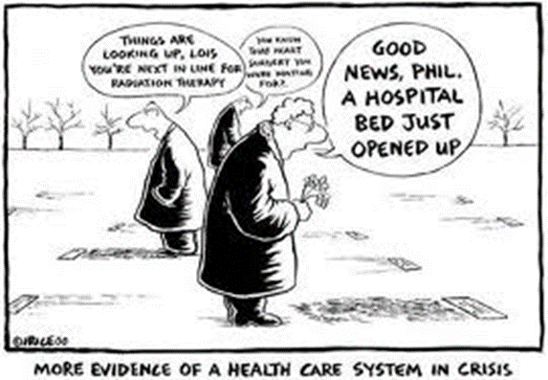
Demand for health services and workforce shortages
THE HEALTH SYSTEM AND SERVICES
Due to an increase in the Australian population living with a chronic disease or disability, the demand for health and aged care services has risen.
The government has introduced a number of initiatives to meet the needs of a growing number of older Australians, including:
increased residential aged care places
more funding for dementia care in aged care
incentives for people to remain in their homes
attracting, retaining and training aged care workers

Slide 7
Demand for health services and workforce shortages
There has been a concern that many people suffering poor health are unable to contribute to the workforce, thus leading to general shortages of labour.
The government has taken action in response to this concern by improving Australia’s retirement income system in the following ways:
A means-tested age pension is available to provide income for people after retirement
All Australian employers are required to provide compulsory superannuation cover for all eligible employees. Under the superannuation guarantee, the minimum level of superannuation cover made by employers is nine per cent of an employee’s gross salary
Voluntary, private superannuation contributions and other forms of private savings, made by employees, are also encouraged.
These initiatives encourage people to plan for financial security and independence for their late years of life
This reduces the economic burden on the government as Australia’s population ages.

Slide 8
Demand for health services and workforce shortages
HEALTH SERVICE WORKFORCE
The increase in aged care facilities also require an increase in workforce training in aged care and issues surrounding chronic diseases and disability.
An ageing population requires an adequate health workforce. This relates to not only the number in the workforce, but their distribution and skills as well.
Of particular concern is the increased demand for workforce in the aged care sector and specialists.
One way to address this growing demand for health services and workforce shortages is to focus on efficient coordination of care. Focus on safe use of medication would decrease the demand for health services and workforce shortages.
Such a focus would reduce duplication of tests, medicating and medical records. Further efficiency might be achieved through greater interaction with aged care services, with focus on both the care and the setting in which it is provided.

Slide 9
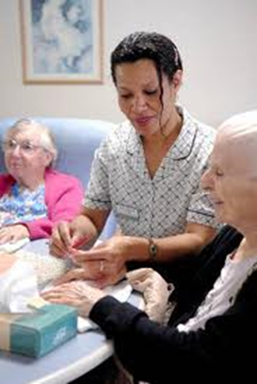
Availability of carers and volunteers
Most older Australians prefer to stay in their own homes, so there are a number of programs available to help with daily living activities that may have become harder for these people to manage on their own.
This is called ‘community care’. The Home and Community Care (HACC) program and Community Aged Care Packages (CACP) are two such programs, with services speciﬁcally designed for older Australians who would qualify for at least low-level care in an aged care home.
HACC services aim to meet basic needs to maintain a person’s independence at home and in the community. They include community nursing, domestic assistance, personal care, Meals on Wheels, home modiﬁcation and maintenance, transport and community-based respite care.
For the older person who can no longer live at home because of ageing, illness or disability, there are publicly funded places in aged care homes. This is called ‘residential aged care’.
There are two types of residential aged care in Australia: high-level and low-level care. High-level care provides nursing care when required, meals, laundry, cleaning and personal care, while low-level care gives the person assistance with meals, laundry and personal care.
Other services includes, personal care, home helpers, home maintenance and/or modiﬁcation, food delivery, transport services and community health centres.

Slide 10
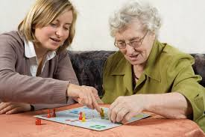
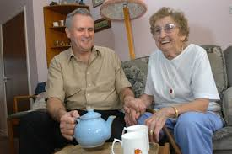
Availability of carers and volunteers
Australia’s workforce consists not only of paid workers, but also carers and volunteers, who are ageing with the rest of the population.
Older Australians can contribute to society in myriad ways, such as by being paid workers, carers, volunteers or family members.
Australians over the age of 55, for example, contribute approximately $75 billion per annum in unpaid caring and volunteering activities.
Over 50% of this amount is contributed by people aged over 65.
Demonstrates that caring and volunteering activities are beneficial to the economy and that older Australians make a substantial contribution as volunteers and carers.
In 2016, 3.6 million (19%) Australians over 65 volunteered.
The paid and unpaid work of older Australians is essential to a well-functioning and caring society, which ultimately enhances the quality of life for all Australians.
Projected that there will be little growth in the number of available carers, compared to the anticipated rise in demand for home-based support - this is likely to result in a shortage of carers in the future.

