Slide 1
Adult and aged athletes
Students learn about:
Heart Conditions
Fractures/Bone Density
Flexibility/Joint Mobility
STUDENTS LEARN TO:
Explain the sports participation options available for aged people with medical conditions

Slide 2
Adult and aged athletes - overview
Adult and aged athletes are not the same group of people, though the aged are still adults, the aged are usually associated with the elderly, while adult athletes are those who are no longer young athletes, usually 21+.
This dot point requires you to understand the different types of medical conditions listed and how they impact sport availability for adult and aged athletes.
This includes a range of heart conditions, how they impact the athlete and limit their choice of sport.
The same goes for bone density, which leads to fractures and how a decrease in flexibility or joint mobility also affects sport choice.
It is worth noting that you need to relate the content here back to the critical question and explain how sports medicine addresses these demands in order to provide some sports choices for these athletes.
Sports participation options are also specific to the medical condition listed and should be presented with each condition for adult and aged athletes.

Slide 3
Heart conditions
Heart conditions is a broad term used to refer to a number health issues including:
High blood pressure
Cardiovascular disease
Angina
Survivors of heart attacks
Heart valve disease (e.g. leaky valve) etc
Although heart conditions are generally on the decrease in Australia, they are still prevalent, especially among aged athletes.
It is important to know how heart conditions impact the choice of sport available to the person who has one, especially since exercise is a useful form of treatment for the underlying causes of most heart conditions.
Adult and aged athletes with heart conditions can still adapt to exercise, including improvements in heart and circulatory health.
Before beginning any sport or exercise an adult or aged athlete with a heart condition should get medical clearance first.
If a heart condition is already known, the athlete may also be asked to complete a stress test to check that it is safe to participate in sport and what intensities are safe to be performing at.

Slide 4
Heart conditions – cont…
The following recommendations for adult and aged athletes with heart conditions are amended from the American College of Sports medicine:
Contact a GP for approval
Include a proper 5-7 minute warm-up and cool-down
Never exercise to the point of chest pain or angina
Exercise with a friend in case of emergency
Exercise should be stopped immediately if dizziness, nausea, unusual shortness of breath or irregular heart beats occur during or immediately after exercise. A GP should be contacted immediately, although you may simply need to slow down a bit.
Do not exercise outdoors when it is too cold, hot, or humid, as this weather may increase the likelihood of complications with the condition.
Exercise 5 times a week for 30+ min at a moderate intensity (brisk walk)
Light weight resistance training (NO isometric or less than 10 RM)

Slide 5
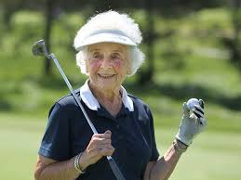
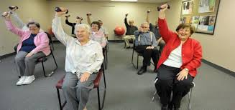
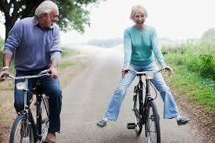
Heart conditions - cont…
Sports participation options for adult and aged athletes with heart conditions:
Adult and aged athletes with heart conditions cannot participate in sports that require a high intensity. Instead they are advised to participate in sports and physical activities that can be done using low intensities such as:
Golf
Cycling
Tennis
Dancing
Brisk walks
Aerobics
These sports and physical activities will be beneficial and provide opportunity to develop relationships, improve mental health and independence.

Slide 6
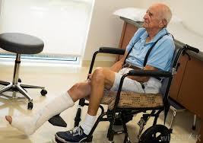
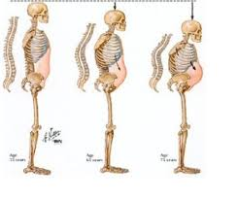
Fractures/bone density
Fractures is the term used for any break of a bone in the body
More likely to occur in people who have poor bone density.
Poor bone density can lead to osteoporosis.
Predisposition to poor bone density and fractures include:
Genetics
Female
Early menopause
Small size
Inadequate diet
Poor physical activity levels (particularly weight bearing exercise)
Fractures and bone density are greatly influenced by diet.
Should eat plenty of fruit and vegetables in order to get all the nutrients in appropriate amounts that are required for health bone density and to avoid fractures.
Among the key nutrients for good bone health are:
Calcium
Vitamin D
Phosphorus – help to build strong bones and teeth along with Calcium
Sodium
Protein

Slide 7
Fractures/bone density – cont…
Poor bone density and osteoporosis limit the sport choices for adult and aged athletes.
People with poor bone density should avoid contact sports or sports that involve powerful changes in direction that place large stress on bones such as:
Martial Arts
Rugby League
Football
Ice-Hockey
The following sports are examples of options available for adult and aged athletes with bone density issues:
Cycling
Walking
Golf
Tennis
Swimming

Slide 8
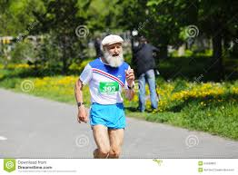
Fractures/bone density – cont…
There are particular forms of physical activity that are beneficial for people with poor bone density that will improve bone density and help avoid unwanted fractures.
Weight bearing exercise such as:
Walking
Running
Have a positive effect on bone density as the weight going through the bones causes a physiological adaptation – increased bone strength through increased bone density.
Just like your muscles, bones adapt to the stress placed on them.
It is important that this stress only be enough to cause an adaptation and not enough to cause a fracture.
Resistance training is very beneficial for bone density, and when performed with proper supervision and correct technique, poses minimal risk to the adult and aged athlete with bone density issues.

Slide 9
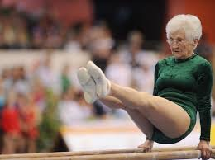
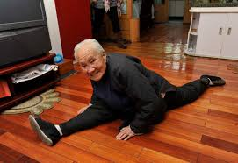
Flexibility/joint mobility
Flexibility and joint mobility both refer to the joints ability to move through its full range of motion.
Flexibility is often used to refer to the range of motion across multiple joints or to refer to the entire body
Joint mobility is used to refer to specific joints.
Although flexibility and joint mobility does not automatically change with age, it does change according to use.
For Eg - As adult and aged athletes begin to decrease their movement at particular joint or across their entire body, their flexibility decreases.
Decreased flexibility and joint mobility leads to increased injury risk, particularly of sprains and strains.

Slide 10
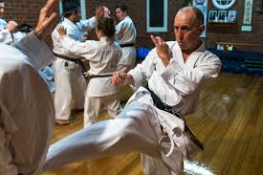
Flexibility/joint mobility
Sports participation options for adult and aged athletes with poor flexibility and joint mobility:
Poor flexibility and joint mobility is often a result of a decrease in sport and exercise participation.
Those with poor flexibility can increase their flexibility and joint mobility by slowly increasing the range of motion at each joint through regular exercise.
Start at low intensities and speeds and gradually increase as joint mobility increases.
Particular sports that require good flexibility include:
Gymnastics
Dance
Martial Arts
Many other sports require joint mobility for particular actions such as:
Kicking
Bowling
Hitting etc.
Adult and aged athletes with poor flexibility and joint mobility are not limited in their choice of sport, but should begin at a low level and gradually increase their activity.
For Eg – Someone with poor flexibility may begin to participate in tai chi, or yoga at a beginners level and slowly move up in difficulty according to the instructor.
They then may choose to start running before progressing to dribbling and then passing, shooting, and changing direction. The aim is to slowly increase flexibility and joint mobility so that all sports can be participated in.

