Slide 1
Human resources slide 1
ANXIETY & AROUSAL
STUDENTS LEARN ABOUT:
Trait and state anxiety
Sources of stress
Optimum arousal
STUDENTS LEARN TO:
Explain the difference between anxiety and arousal in terms of the effects on performance

Slide 2
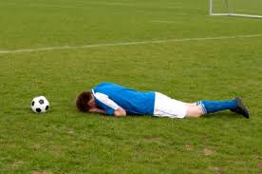
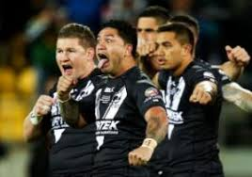
ANXIETY & AROUSAL
ANXIETY
Is predominantly a psychological process characterised by fear or apprehension in anticipation of confronting a situation perceived to be potentially threatening.
Anxiety is extremely complex emotion identified by various levels of agitation
Caused by a reaction to a threat or perceived threat that generates a ‘fight’ or ‘flight’ response.
At the top of anxiety – it disrupts focus, concentration and can affect muscular control
There is a fine line between ‘psyched up’ and ‘psyched out’. A person’s state of mind depends almost entirely upon their perceptions and expectations.

Slide 3
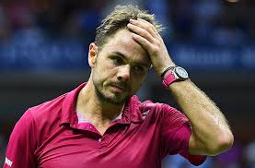
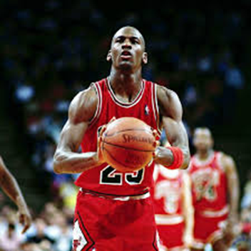
TRAIT & STATE ANXIETY
TRAIT ANXIETY
The general level of stress that an individual can handle.
It is evident in day to day activities we deal with
It ranges from one person to another
If well trained in public speaking (no probs) if not then anxiety will set in
Can be controlled by relaxation techniques or progressive muscular relaxation
Support, positive comments and encouragement positively affect a player’s level of trait anxiety
STATE ANXIETY
Is a more specific type of anxiety - it can fluctuate - eg when an athlete has a penalty goal.
It comes from a fear of failure (nerves/shaking)
It can contribute to a feeling of mental and physical paralysis preventing normal actions – eg missing easy shots in basketball, breaking in a swimming race
Relaxation, slow breathing, changing the pattern of thinking and engaging in through distractions are commonly used anxiety techniques suggested by coaches

Slide 4
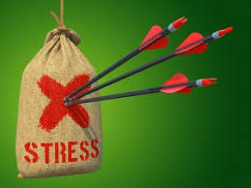
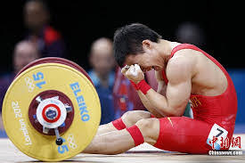
SOURCES OF STRESS
Stress is a non-specific response by the body when a demand has been placed upon it.
Stress has the potential to cause body reactions (shaking and nausea)
Felt by all participants but particularly individual sports – feeling of isolation and exposure
So what causes stress - an increase in adrenaline
It is characterised by:
Increased blood supply to skeletal muscles
More oxygen to lungs
Increased glucose production – provide extra fuel
Increased sweat production to cool body
Tightened muscles to prepare for action

Slide 5
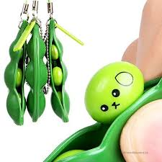
SOURCES OF STRESS CONT…
Can be real or imaginary
Real – spiders in your bed
Imaginative – Just thinking about spiders in your bed
Both can cause immediate body changes
The mind finds it very hard to differentiate between real or imagined experience
Imaginative stress can cause increased sweat and HR

Slide 6
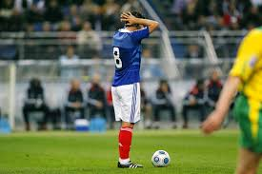
SOURCES OF STRESS CONT…
Stress depends on the individual = meaning genetic make up and coping strategies.
A lot of people go to the toilet to relieve anxiety or chew gum
How a person can handle stress will reflect the following attributes:
Past experience
Routines
Expectations
Amount of support
Frequency of stress
Stress can come from:
Lack of income
Family problems
Relationship problems
Illness

Slide 7
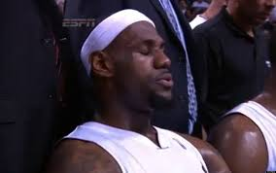
SOURCES OF STRESS CONT…
In sport stress can come from:
Personal pressure - desire to win
Competition pressure - exerted by competition
Social pressure - from coaches, parents or other athletes
Physical pressure - having to perform learned skill under pressure
How to deal with it:
Relaxation techniques
Practice of focusing on the skill not the result (concentration skills)
By developing confidence in your skills
Planning strategies

Slide 8
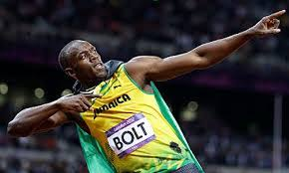
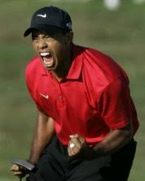
OPTIMAL AROUSAL
Arousal is the level of anxiety before or during a performance.
Arousal is different to anxiety as arousal is essentially a physiological process.
Arousal is necessary for athletes to have.
It can increase performance or decrease it depending on the level.
Levels of arousal are very much dependant on the athlete.
Two examples:
A surfer performs really poor due to a lack of motivation and energy due to poor performance prior – low arousal
A golfer performs a putt poorly due to a high level of motivation and anxiety (they become to tense) high arousal
Those athletes who have high anxiety usually will require less arousal
Those athletes who have a low anxiety level will require more arousal

Slide 9
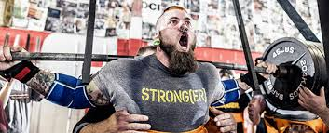
OPTIMAL AROUSAL CONT…
Both a high and a low arousal will result in a poor performance.
Optimum Arousal can be reached by achieving a middle ground (this changes for different skills and for different people)
Motivation, reinforcement and anxiety all affect arousal and how an athlete reaches their optimum arousal.
It is the coaches and athletes job to know about their levels of arousal and how they can achieve their optimal arousal.

Slide 10
OPTIMAL AROUSAL CONT…

Slide 11
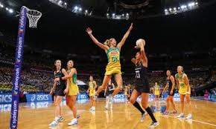
OPTIMAL AROUSAL CONT…
Arousal varies from one skill to another
Hard skills (multi muscular = archery, golf) need a lower arousal
Easy skills (large muscle groups running = weight lifting) need high arousal.
Optimal arousal depends on:
Self expectation
Expectation by others
Experience
Financial pressures
Level of competition
Degree of difficulty
Skills finesse
When arousal is controlled it will produce quality performances.

