Slide 1
ASSESSMENT OF SKILL AND PERFORMANCE
STUDENTS LEARN ABOUT:
Characteristics of skilled performers (kinaesthetic sense, anticipation, consistency, technique)
Objective and Subjective Performance Measures
Validity and Reliability of Tests
Personal versus Prescribed Judging Criteria
STUDENTS LEARN TO:
Develop and evaluate objective and subjective performance measures to appraise performance

Slide 2
ASSESSMENT OF SKILL AND PERFORMANCE - OVERVIEW
Assessment of skill and performance is important for monitoring progress and providing guidance for future training.
Knowing the characteristics of skilled performers helps to guide the coach in skill assessment to ensure performance is moving towards mastery of the particular skill.
Assessment of skill and performance often uses objective and subjective measures to determine how well the skill or performance was executed.
For HSC PDHPE it is important to know the difference between objective and subjective performance measures as well as how reliability and validity of test increased their objectivity.

Slide 3
ASSESSMENT OF SKILL AND PERFORMANCE - OVERVIEW
There are a number of sports that require particular criteria to be used to assess performance.
However, even at the basic level, most people watch a performance with particular bias and personal expectations, which they use as criteria in judging a performance.
Finally, you are required to apply this knowledge and create your own subjective and objective performance measures, which you then evaluate.

Slide 4
CHARACTERISTICS OF SKILLED PERFORMERS
Skilled performers are autonomous performers, and have a particular look to their movement.
These observable features of skilled performers include:
Kinaesthetic sense
Anticipation
Consistency
Good technique.

Slide 5
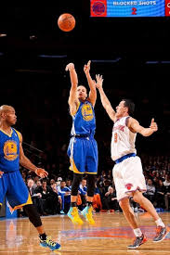
KINAESTHETIC SENSE
Refers to the skilled performers proprioception
Relies on information from various sensors in the muscles and other organs that provide information about body position and movement without the need to see it.
Skilled performers can feel the movement and even correct movements mid-performance.
Kinaesthesis develops as a direct result of practice, as it develops “muscle memory”.
An example would be a basketballer adjusting their shot after being fouled to ensure the shot still is successful.

Slide 6
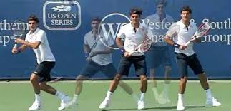
ANTICIPATION
Is the skilled performer’s ability to read the play, or his opponent and respond accordingly.
Ability to predict their opponent’s next move.
Good anticipation comes by learning to read an opponent’s body positioning and being familiar with their preference of style or shot.
This is particularly important for externally paced skills.
An example is when a tennis player anticipates a backhand down the line after reading the body positioning of their opponent. This gives the skilled performer more time to cover the court, cover the shot and decide which return they will select.

Slide 7
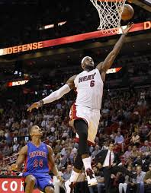
CONSISTENCY
Refers to the skilled performer repeating good performances.
This is easily observed in sports such as basketball and tennis, where a skilled performer continually gets the shot in or hits their shot over the net and near the lines.
Roger Federer and Lebron James are examples of skilled performers who are consistent in their performances.

Slide 8
TECHNIQUE
Refers to the technical aspects of skill execution; the result is efficient and consistent movement.
Skilled performers have good technical execution of a skill which:
Saves energy
Produces better and more consistent results
Holds up better under pressure
Provides less chance of injury
and is a large determinant of elite success.
Correct technique is particularly vital in sports such as swimming and running
Correct technique helps generate more power and slim line and saving energy for later in the performance, particularly vital for long distance endurance events.

Slide 9
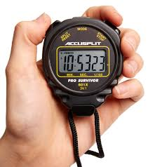
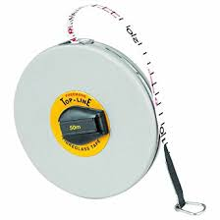
OBJECTIVE AND SUBJECTIVE PERFORMANCE MEASURES
Objective and subjective performance measures are used to classify the various different types of performance measures.
Objective performance measures are independent of the observer.
That means the measurement is done using something other than the person observing.
This independent measure can include:
A stop-watch
Measuring tape
or record of goals.
The objectivity of the performance measure is increased through measures such as:
Time
Checklists
Established criteria.

Slide 10
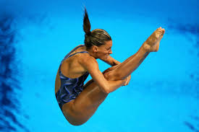
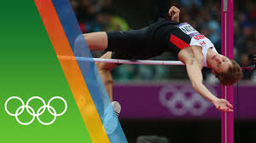
OBJECTIVE AND SUBJECTIVE PERFORMANCE MEASURES
Subjective performance measures are dependent on the observer and based on opinions, feelings, and general impressions.
Subjective measures rely more on the observer than independent measures.
Sports such as dance and gymnastics are more subjective than objective in their measures.
Sports such as high jump use completely objective performance measures of metres and centimetres
Diving tends to use more subject performance measures.
Skills are often measured using both, such that a soccer player’s performance. It was good because it looked good, felt smooth, but also he covered 12Km in the game, made 30 tackles, had 98% success in passing and 85% success in shots, and scored 3 goals in the game.

Slide 11
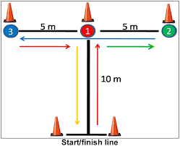
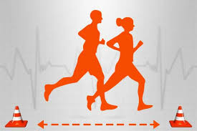
VALIDITY AND RELIABILITY OF TESTS
Validity and reliability of tests is important in the assessment of skill and performance.
Tests are often used to check performance improvements.
These can include various fitness tests such as:
T-run agility test
The beep test.
The validity and reliability of tests varies considerably, and should influence the weight of influence the test has on athletic performance.

Slide 12
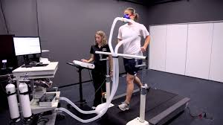
VALIDITY
Validity refers to the test’s ability to measure what it is supposed to measure.
A beep-test is meant to test an athlete’s cardiovascular endurance.
It is valid, because it gives an accurate prediction of an athletes VO_{2 max}, though a VO_{2 max} test
Done in a laboratory would be a more valid test.
Validity is about the strength of this relationship between the skill measured and the test.
Test validity is enhanced if:
Known good performers perform better than known bad performers
If it is reliable in predicting future performances
If the component being tested is included in the test.

Slide 13
RELIABILITY
Reliability refers to the test’s consistency, the ability of the scorer to produce the same result each time for the same performance.
A shuttle run is a reliable agility test if the same tester produces the same result with the same athlete under the same conditions in succession.
The use of similar equipment, checklists, procedures and conditions improves the reliability of the test.
Tests that are both valid and reliable tend to be more objective and are the best tests used to measure performance.

Slide 14
PERSONAL VERSUS PRESCRIBED JUDGING CRITERIA
Personal versus prescribed judging criteria seeks to contrast the personal likes or dislikes of performance, compared to more formal judging through the use of criteria.
It is prescribed judging criteria that refers to the use of criteria to make subjective performance measures more objective.

Slide 15
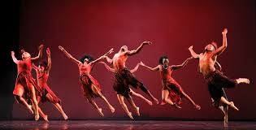
PERSONAL JUDGING CRITERIA
Are the presuppositions brought to the performance by the judge and are very subjective.
These include the judge’s expectations and preconceived ideas about the performance.
Spectators and coaches often use personal judging criteria when judging a performance.
Spectators are especially personal because their judgments rely on feelings and impressions, not prescribed judging criteria.
There is often bias in personal judging criteria and so are more suited to appreciation rather than judgments of performance quality.
Example of personal judging criteria is a person who walks out of a ballet performance thrilled by what they saw, because it was exactly what was expected, compared to the person who leaves disappointed because they were hoping for something in particular that was not provided.

Slide 16
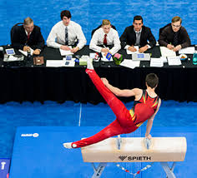
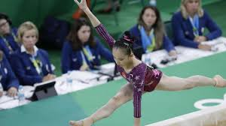
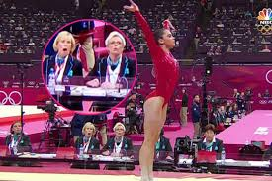
PRESCRIBED JUDGING CRITERIA
Are established criteria created by the sporting body, which are then used to appraise performance.
This often comes in the form of a checklist or rating system and helps to objectify subjective measurements.
The more detailed the judging criteria and stringent the judge the better the objectivity and reliability of the judging criteria.
An example would be the check lists and other prescribed judging criteria used in gymnastics to provide a score for each routine.

Slide 17
PRACTICAL APPLICATION
The HSC PDHPE syllabus requires you to develop and evaluate objective and subjective performance measures to appraise performance.
Your development and application of these performance measures will help you to understand the difference and how objective performance measures can be used to increase the objectivity of often subjective performances.

Slide 18
SUBJECTIVE PERFORMANCE MEASURES
Subjectivity is reliant upon the observer and includes personal judging criteria and other presuppositions, such as:
I hope to see lots of flips and some cool balance moves in this floor routine.
He better use up beat music.
I really like the gymnast from China; he’s such a nice guy.
That skill is difficult
These are very subjective and should not be used for judging performance.
You are required to develop your own subjective performance measures for the appraisal of performance.

Slide 19
OBJECTIVE PERFORMANCE MEASURES
Objective performance measures include prescribed judging criteria, which could include checklists and ratings such as the one below:
Criteria
Number of flips performed
Rate the tightness of the body during the flips
Rate the matching of movement to the music chosen
Performance includes one:
Handstand (held for 5 sec)
Jumping spin
The criteria above help reduce the subjectivity of judgements by improving the objectivity and reducing the room for personal criteria.
You should now develop and evaluate objective and subjective performance measures to appraise performance on your own.
As well as measurements of time, distance and speed. individual performance in team sports are often evaluated using a combination of objective measures such as goals scores, passes made, and time in possession and subjective opinions on the fluidity of movement or execution of particular skills.

