Slide 1
Characteristics of the learner
Personality traits
Hereditary factors
Confidence levels
Prior experiences
Natural ability

Slide 2
CHARACTERISTICS OF THE LEARNER OVERVIEW
HSC PDHPE syllabus has specified five (5) characteristics that you should understand well. These characteristics of a person affect their capacity to and speed at which they learn a new skill:
Personality traits, such as a willingness to learn and accept criticism.
Hereditary factors, such as your height or body type.
Confidence levels will also affect the rate at which a new skill is learnt. An athlete should not be over-confident, but neither should they lack confidence as both are detrimental to skill learning.
Prior experiences
Natural ability.
An athlete with positive experiences in learning skills, especially similar skills will learn new skills faster. As will an athlete who has great natural ability such as the person who naturally has good hand eye co-ordination.

Slide 3
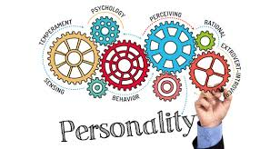
PERSONALITY TRAIT
Personality is the way that someone behaves, thinks and feels.
These characteristic aspects of the person influence their work efforts and mentality towards skill development, which greatly influences skill acquisition.
Someone who a good work ethic and punctuality will develop a skill faster than someone who is not.
Acquiring a skill requires hard work and dedication. If an athlete does not do this, they will not develop the skill as well or as quickly as someone who does.

Slide 4
PERSONALITY TRAIT CONT…
Frequent negative thoughts about skill development and personal ability will diminish ability to acquire skills.
However, positive self talk and self-confidence will positively influence skill acquisition.
How an athlete feels will also impact skill acquisition.
If an athlete feels energetic and focused then they are more likely to succeed in acquiring a new skill.
In contrast, an athlete who is often sad or sluggish will develop the skill much slower and to a lower level.
Traits within a personality that help in the acquisition of skill include:
Determination
Enthusiasm
Dedication
Positive attitude
Cooperation
Patience
Willingness to try something new.
These help the athlete to accept and respond to a coaches feedback, try new ways of completing the skill, or try new skills.

Slide 5
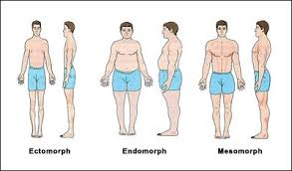
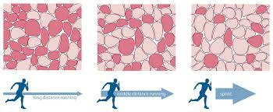
HEREDITY FACTORS
An athlete’s heredity characteristics are those genetically inherited from their parents including:
Gender
Race
Muscle type
Somatotype (body type).
GENDER
Gender is heredity and affects levels of hormones, particularly testosterone, responsible for muscle growth and development.
Males tend to be more muscular, stronger and more powerful than females.
This difference has caused the labelling of some sports as “male” or “female”, though these labels are not justified.
Gender tends to have little affect on competition as sports are normally gender specific, but it does affect performance, with males performing better in sports requiring speed, power and strength such as swimming and rugby league.

Slide 6
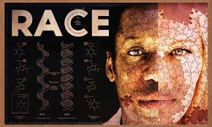
HEREDITARY FACTORS CONT…
RACE
Race is also heredity and particular races can have specific genes that make them more suited to particular sports.
Often dark ethnic groups have higher percentages of fast twitch muscle fibers and are taller than other lighter races (though this is not always the case).
Eg - the domination of dark people in the 100m finals, and basketball.
Though obviously darker ethnic groups can also be suited to other sports such as long distance running.
In comparison, white Caucasian ethnic groups tend to be more suited for sports such as, swimming and hockey.
Though this can also be a product of social upbringing, like South America and soccer.

Slide 7
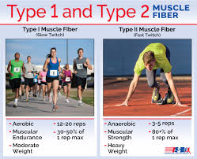
HEREDITARY FACTORS CONT…
Muscle type is heredity and cannot be changed.
The relative balance or percentage of each type of muscle fibre will suit athletes to particular sports.
Athletes with high levels of type II, fast twitch fibres are more suited to:
Fast, powerful sports
such as: 100m sprint, rugby league or shot-put.
Athletes with high levels of type I, slow twitch fibres on the other hand, are more suited to:
longer more enduring sports
such as: marathon running or cross-country skiing.
There are other sports that require a balance of both and suit athletes who have a good number of both types of fibres, these include: Soccer and Australian Rules Football.

Slide 8
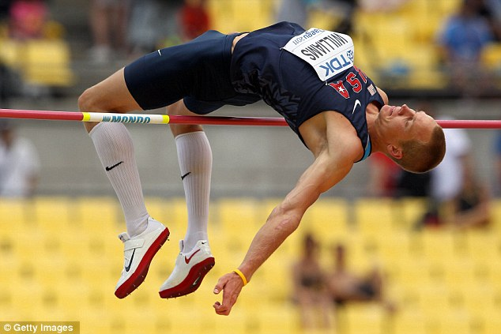
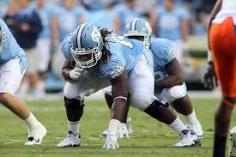
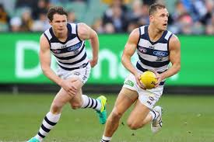
HEREDITARY FACTORS CONT…
Somatotype can help determine an athlete’s suitability for particular sports.
Endomorphs
Carry more weight and tend to hold the weight lower have advantages in sports such as rugby union or blocking in American Football.
Mesomorphs
Very muscular and have low body fat and are best suited to sports such as Australian Rules Football, bodybuilding and rowing.
Ectomorphs
Skinny and are best suited for sports such as long distance running, high-jump and horse racing.

Slide 9
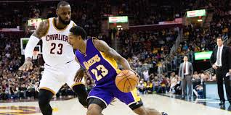
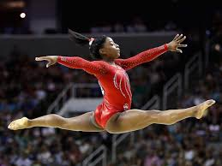
HEREDITARY FACTORS CONT…
Differences in height will also affect which sports the athlete is best suited to.
Tall athletes tend to suit sports such as netball, basketball or volleyball
Shorter athletes are more suited for horse racing, gymnastics, and bike riding.
People can acquire skills quickly and perform them well, while not being suited for the sport, such as a short high-jumper who performs the skill well, but does not jump as high as a taller person, more suited to the sport.

Slide 10
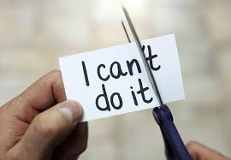
CONFIDENCE
Confidence is a belief in one’s own ability and positively influences skill acquisition.
Grows with success, so successful skill execution will in turn increase confidence making the athlete learn new skills faster.
Important for coaches to provide opportunities for success early on in order to grow the athletes belief in their ability to do the skill well.
Previous experience will affect an athlete’s belief in themselves.
If the athlete has completed similar skills well before, they will have a greater belief that they will master the new skill as well. This means that the coach should progress skill learning moving from easy to harder skills. Faster success in the easier skill will increase confidence and result in faster acquisition of the new harder skill.

Slide 11
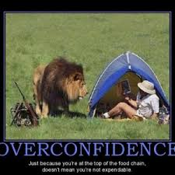
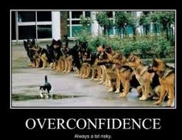
CONFIDENCE CONT…
If skills are not learnt and frequent failure occurs, belief levels will decrease and the rate and level of skill acquisition will decrease.
Over confidence results in poor skill acquisition, as the athlete believes that they are better than they are and begin to try new harder skills before they are ready to do so.
Can lead to the skill never being perfected and so the athlete never moves into the mastery autonomous stage of skill acquisition.

Slide 12
PRIOR EXPERIENCE
Is the transfer of skills from one context to another allowing the athlete to learn new similar skills faster than people who have no prior experience.
Skill transfer can be lateral or vertical.
Lateral transfer is easy and is the transfer of a similar skill from one context to another:
such as tackling in rugby union after learning to tackle in rugby league, or learning to surf after learning to skateboard.
Vertical transfer is the transfer of a skill from a lower order skill to a similar higher order skill:
such as shooting in basketball to doing a lay up, or learning to throw before learning to shoot in netball.
If the prior experience was positive and had successful performances, then the new skill will be acquired more easily.

Slide 13
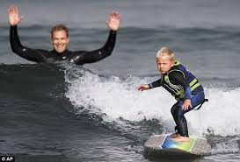
NATURAL ABILITY
An athlete’s ability refers to the ease of performing movements and performances.
It is often known as talent and is characterised by fluid movements and accurate execution of the skill.
It refers to the athlete’s competency in a particular skill, a particular sport, or even exercise in general.
Power or capacity to do well in a particular area.
Ability is used to describe people who are skilled in various areas, from sports, to the arts, to mathematics. A person can have a great ability in many things. Most often the term is used to refer to the person’s natural talent.

Slide 14
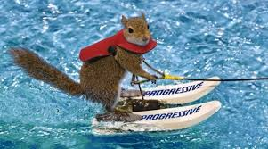
NATURAL ABILITY CONT…
Athlete’s with greater abilities learn and process new skills faster than athlete’s with lower abilities.
They often will reach the higher levels of skill acquisition faster and for a wide variety of skills that are related to each other.
Ability is often a combination of characteristics in the athlete, this includes:
Perception or the capacity to read a game, sport or competition - view things before they happen
Reaction time
Intelligence - smarter athlete’s will often learn a skill faster as they process information provided from the coach and adapt accordingly. Athlete’s with a sense of acuity or sharpness also have greater ability as they refine the skill more thoroughly than those without this characteristic.

