Slide 1
Children and Young Athletes
STUDENTS LEARN ABOUT:
Medical Conditions (asthma, diabetes, epilepsy)
Overuse Injuries (stress fractures)
Thermoregulation
Appropriateness or resistance training
STUDENTS LEARN TO:
Analyse the implications of each of these considerations for the ways young people engage in sport and how each is managed.

Slide 2
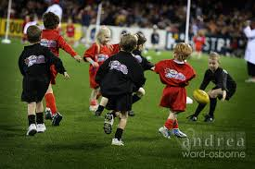
Children and Young Athletes - Overview
Children and young athletes have specific demands that are addressed by sports medicine, such as:
Asthma
Type 1 Diabetes
Epilepsy.
They are more prone to overuse injuries (stress fractures and repetitive strain injuries) as they are growing and developing.
They also have underdeveloped abilities to regulate body temperature, particularly in relation to sweating and having a smaller surface areas to body mass ratio.

Slide 3
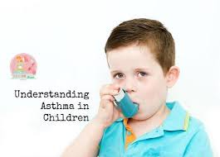
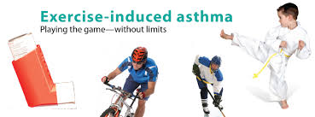
Asthma
Is a medical condition that affects the airways.
Inflammation of the airways leading to contraction of the bronchioles (airway branches) limiting the air flow both into and out of the lungs.
Has various possible triggers including:
Dust
Pollen
Pollution
Exercise.
Implications of Asthma for the ways children and young people engage in sport:
Can be induced by exercise, and is more likely to be triggers in longer duration physical activity than short and intense bursts of activity.
Exercise induced asthma is more likely to occur during a marathon run, than a 100m sprint.
The asthma “attack” is usually proportional to the intensity of the exercise.
Having asthma should not stop them from participating in sport, but there are actions that should be in place to manage this medical condition.

Slide 4
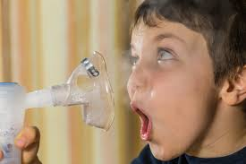
Asthma - Management
Should have an Asthma Management Plan developed with their GP.
This Asthma Management Plan should be provided to those supervising the physical activity for their knowledge and use if and when necessary.
Should have a Ventolin puffer (usually blue or grey) with them for use if an asthma “attack” occurs.
The supervising adult should also know how to address an Asthma “attack” through First Aid training.
Exercise induced asthma can possibly be prevented through a proper warm-up and cool-down.

Slide 5
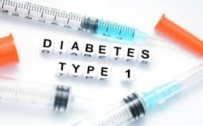
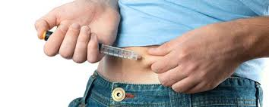
Type 1 Diabetes
There are two (2) types of diabetes.
Type two (2) diabetes - condition caused by lifestyle, often brought on through physical inactivity and poor diet.
It is characterised by a breakdown in the efficiency of insulin activity resulting in high levels of insulin (which is responsible for the transport of glucose from the blood into our tissue cells) and glucose in the blood.
Type one (1) diabetes - known as insulin dependent and early onset diabetes caused by an autoimmune disorder.
The body no longer produces insulin resulting in a build up of glucose in the blood.
Is more prevalent amongst children and young athletes.

Slide 6
Type 1 Diabetes cont…
Implications of Diabetes for the ways children and young people engage in sport:
It relates to the glucose levels in blood, which affects sports engagement because glucose is also an important energy source for ATP production during sport participation.
As a child or young athlete participates in sport, their muscle cells are opened for glucose transport without the need for insulin.
This results in a decrease in blood glucose, which can become problematic for children and young athletes who have diabetes.
If glucose levels are too low it can lead to a hypoglycemic episode, but if they are too high it can cause a hyperglycemic episode.
Both of these can lead to loss of consciousness and death.
Important that those who have diabetes monitor their blood glucose levels closely
Normally means not having an insulin injection before or after sport, and eating meals before and after exercise to help balance blood glucose levels.

Slide 7
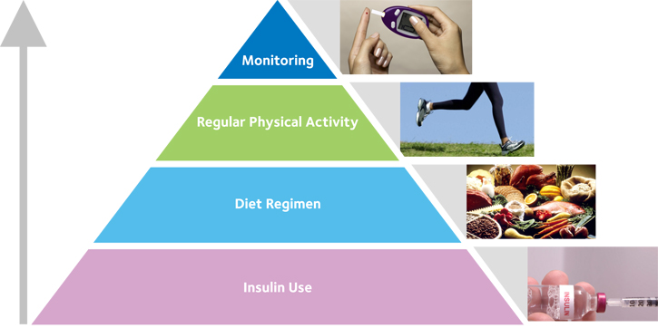
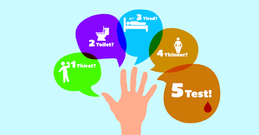
Type 1 Diabetes - Management
Often managed through insulin injections and access to sugary foods.
Children and young athletes who have this medical condition should participate in regular physical activity as it helps manage both types of diabetes and can prevent hyperglycemia.
Should have access to food and sugary drinks during physical activity
Eat before and after sports events.
It is important for those supervising to know the first aid procedures used to manage hyper and hypoglycemic episodes.
Hypoglycemic episodes have a sudden onset and cause:
Rapid heart rate
Sweating
Shaking
Anxiety
Dizziness and unconsciousness.
Managed by providing sugary foods or drinks, such as: jelly beans or juice. Further food should then be consumed afterwards.
Hyperglycemic episodes occur slowly and may cause: thirst, vomiting, weak rapid pulse, rapid breathing and drowsiness. Medical assistance should be sought in the treatment of hyperglycemic episodes.

Slide 8
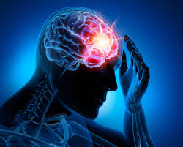
Epilepsy
Disruption of normal brain activity that results in seizures.
A seizure is when the brains nerve cells misfire and generate sudden, uncontrolled burst of electrical activity in the brain.
The orderly communication between nerve cells becomes scrambled and our thoughts, feelings or movements become momentarily confused or uncontrolled.
Epileptic seizures can be subtle - only momentary loss of consciousness, or conspicuous causing sudden loss of body control.
Implications of Epilepsy for the ways children and young people engage in sport:
Should not stop children and young athletes from participating in sport.
Many medications that can be used to reduce the likelihood of seizures occurring.
Should not limit sport choice, but the type and possible triggers should be considered as sports are selected.
Should ensure others are present as they participate in sports, particularly activities such as: water sports, bike and horse riding.

Slide 9
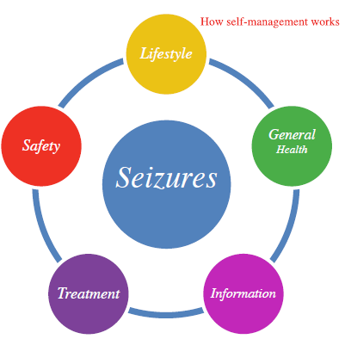
Epilepsy - Management
Epilepsy can be managed through medication, but the supervising adult should be aware of how to manage seizures, in case they occur.

Slide 10
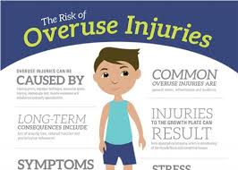
Overuse Injuries
Result from repetitive movements placing repetitive stress upon the body parts involved, such as:
Bones
Muscles
Tendons
Ligaments.
Overuse injuries can be caused by:
Poor recovery
High stress loads
Poor technique
Poor muscular strength or imbalance
Ill-fitted protective equipment
Common overuse injuries in children and young athletes are:
Shin splints
Stress fractures
Tendonitis (golfers or tennis elbow)

Slide 11
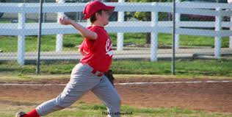
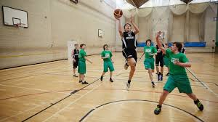
Overuse Injuries cont…
Occur because they are specialising in a sport at a young age, resulting in repetitive movements and muscular imbalance.
Particularly susceptible to overuse injuries as their bodies are growing and developing.
Require longer recovery periods and have greater nutritional requirements.
Often result from small injuries, such as muscle tears, that are not noticed, or not given enough time to fully recover.
Leaves the injured area weak and vulnerable to further injury.
As further stress is placed on this area, re-injury occurs.
This cycle repeats resulting in an overuse injury, which takes longer to recover from and causes more lasting damage than acute injuries.

Slide 12
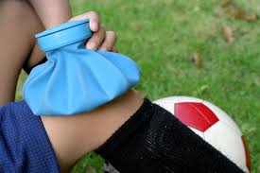
Overuse Injuries cont…
Implications for the ways young people engage in sport:
Overuse injuries such as stress fractures affect the ways young people should engage in sport.
To avoid overuse injuries young athletes are encouraged to engage in a wide variety of sports and not to specialise in a sport at a young age.
This improves the variety of movements, helps ensure development and growth is holistic and balanced, rather than imbalanced.
Ensure they have appropriate rest periods after training and performance to avoid these injuries.
Ensure they fully recover from injuries, both major and minor, before they continue in any sport or training to help avoid overuse injuries.
Coaches and trainers, should be fully qualified to work with children and young athletes.

Slide 13
Overuse Injuries - Management
The management of these injuries should be supervised by a qualified health professional, such as: a physiotherapist, an osteopath, or an exercise physiologist.
Often management is done in conjunction with a GP and information is provided for the coach and trainer to use when administering any further training.
Athlete needs to stop the movement that has caused the injury, and to give the injured area a break.
For Eg - stress fracture to the shin is an overuse injury usually caused by excessive running, particularly on concrete. They would be required to stop running until cleared by their health professional and GP.
For a tennis elbow overuse injury, management would be to stop playing tennis, and rest the elbow.

Slide 14
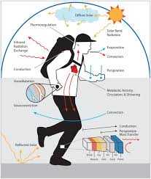
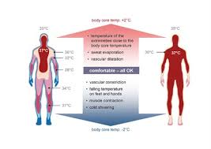
Thermoregulation
Refers to the maintenance of a stable core body temperature.
Is vital for every athlete as maintaining a safe body temperature avoids conditions such as hyperthermia and hypothermia.
A child’s body will overheat 3-5 times faster than an adult.
For children and young athletes, thermoregulation is not as well developed as it is for adults.
Have underdeveloped sweat glands, which means they sweat less and are more affected by their surrounding environments.
Have a small body mass to surface area ratio. This means that they have a large surface area (skin) compared to their body mass (weight). More vulnerable to their surrounding environment than adults.

Slide 15
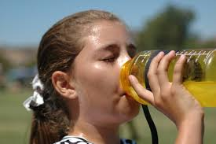
Thermoregulation
Considerations of thermoregulation for the ways children and young people engage in sport:
Need to have their body temperature monitored closely in sports that are performed in the heat or in the cold.
Considerations such as:
Appropriate clothing
Time of day the sport is played
Availability of shade
Access to fluid
Need to be addressed to ensure the safety of children and young athletes during the sport.
For Eg, a game of football (soccer) played on a hot day:
Can be broken into quarters to improve access to fluids.
Can be played in the early morning to avoid the heat of the day
Should have sunscreen applied and wear clothing that allows for greater air flow
For Eg, snowboarding:
Children should wear warm clothing
Have an adequate extended warm-up

Slide 16
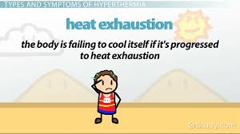
Thermoregulation - Management
How conditions associated with thermoregulation are managed:
Thermoregulation issues such as hyperthermia, or hypothermia need to be managed swiftly and properly.
Hyperthermia refers to any heat-induced condition such as heat exhaustion and heatstroke. The management of heat exhaustion is:
Lie the person in a cool place with circulating air
Remove unnecessary clothing
Sponge with cool water
Give cool water to drink
Seek medical aid

Slide 17
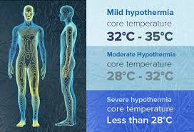
Thermoregulation - Management
Heatstroke is an emergency situation and is managed by:
DRSABCD
Lie the person in a cool place with circulating air
Remove unnecessary clothing
Apply cold packs or ice
Cover with a wet sheet
Ensure 000 has been called
Give water
Hypothermia is a cold-induced condition and is managed by:
DRSABCD
Lie the person in a warm dry place
Avoid wind, rain, sleet, cold, and wet grounds
Remove wet clothing
Warm the athlete with a blanket, head cover and warm drinks
Ensure 000 has been called

Slide 18
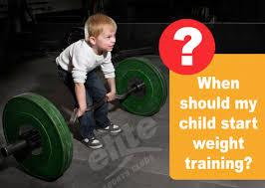
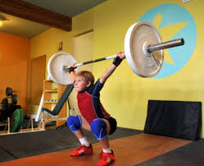
Resistance Training
The appropriateness of resistance training for children and young athletes is a highly debated issue due to many myths around the appropriateness of resistance training.
Some of these myths include:
Resistance training is not safe for children and young athletes
Resistance training is no more dangerous than many other form of physical activity in which children and young athletes participate.
Resistance training will stunt the growth of children and young athletes
There is no evidence that resistance training slows the growth of children and young athletes. In fact, resistance training is more likely to have a positive effect on children’s and young athlete’s growth.
Attached to this myth is the thought that resistance training will break the growth plate of the athlete.
This has never happened when resistance training is done with proper supervision and following appropriate guidelines.

Slide 19
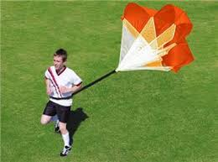
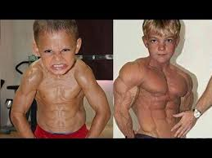
Resistance Training
Implications of resistance training for the ways young people engage in sport:
Resistance training is appropriate for children and young athletes when proper supervision is provided and guidelines are followed
Provides many health and performance benefits.
The American College of Sports Medicine states:
While regular participation in a strength training program can enhance the performance of young athletes and reduce their risk of sports-related injuries, boys and girls of all abilities can benefit from strength training.
Resistance training provides increases in:
Muscular size
Strength
Power
Speed.
Resistance training increases bone strength and helps prevent injury.
The key to safe participation in resistance training is to provide qualified supervision, age-specific instruction and a safe training environment following established training guidelines.

Slide 20
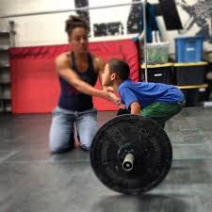
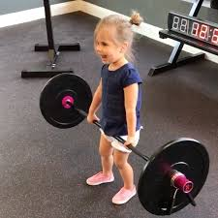
Resistance Training
These guidelines include those from the Australian Strength and Conditioning Association:
Children should be mature enough to follow direction and appreciate the benefits and risks of resistance training, usually age 6.
1 RM should be avoided
Technique should be taught and mastered before increasing resistance
Intensity should be fairly low:
6-9 year olds 15+ RM
9-12 year olds 10-15 RM
12-15 year olds 8-15 RM
15-18 year olds 6-15 RM
Frequency should be 2-3 times per week

Slide 21
Resistance Training
How the appropriateness of resistance training for children and young athletes is managed:
Resistance training should be managed by well trained professionals when being used for children and young athletes.
Anyone conducting resistance training with children and young athletes should follow appropriate guidelines.
If injury occurs, proper first aid and follow up treatment should be sought.

