Slide 1
Complementary & Alternative Health Care Approaches
STUDENTS LEARN ABOUT:
Reasons for growth of complementary and alternative health products and services
Range of products and services available
How to make informed consumer choices
STUDENTS LEARN TO:
Critically analyse complementary and alternative health care approaches by exploring questions such as:
How do you know who to believe?
What do you need to help you make informed decisions?

Slide 2
Complementary & Alternative Health Care Approaches - Overview
Complementary and alternative medicine (CAM) refers to healing practices that do not fall within the area of conventional medicine.
It includes health areas such as:
Hypnosis
Homeopathy
Naturopathy
Meditation
Herbalism
Acupuncture
While many of these types of medicines and practices have existed traditionally as alternatives to mainstream medicine, more recently a growing acceptance of their role in supporting mainstream techniques has given rise to the term ‘complementary’.

Slide 3
Complementary & Alternative Health Care Approaches
Interested in alternative treatments and medicines has steadily grown over the past decade.
Herbal medicines are becoming a popular alternative to modern medicine – resulting in an increase in international trade in herbal medicines.
Australians spend about $4 billion annually on alternative medications or practitioners.
Practitioners of modern medicine are starting to recognise the value of alternative and complementary health-care approaches and are incorporating some of these into their treatments of clients.
The World Health Organization supports countries in their development of national policies on alternative medicine to study its potential usefulness.
Australians are increasingly buying herbal remedies and consulting alternative healthcare practitioners such as chiropractors, homeopaths, naturopaths and Chinese herbalists.

Slide 4
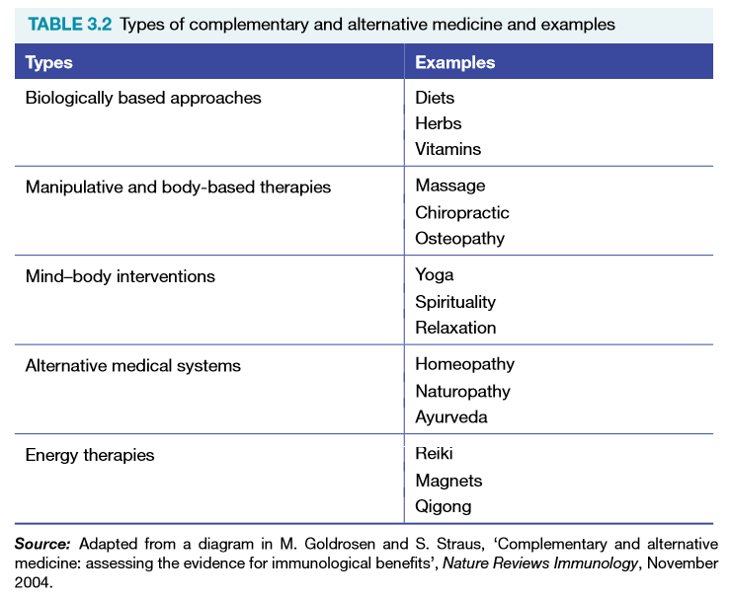
Complementary & Alternative Health Care Approaches

Slide 5
Reasons for Growth of Complementary & Alternative Health Products and Services
Government surveys show that two thirds of Australians are currently using CAM treatments
Has a lot to do with societal trends towards individualism (opportunity to exercise choice, having greater control over their health)
Reasons for the increasing popularity of CAM generally include:
WHO recognition of the usefulness of many alternative approaches. Endorsed a list of medicinal plants to be used for herbal medicines
Recognition that alternative medicines are the traditional medicines of the majority of the world’s population
Effectiveness of treatment when modern medicine has been ineffective
Desire for natural or herbal medicines rather than synthetically produced
The holistic (focus on whole person) nature of alternative medicine
Strength of traditional beliefs for many cultures
Increased migration and acceptance by Australians (multicultural influence)

Slide 6
Range of Products and Services Available
In Australia there is a huge range of products and services available in complementary and alternative health care. These include:
Acupuncture
Aromatherapy
Bowen Therapeutic Technique – muscle and connective tissue movements that realigns the body and balances and stimulates energy flow
Chiropractic
Herbalism
Homeopathy – medicine that recognizes the symptoms unique to each person – stimulate the individual’s healing powers
Iridology
Massage
Meditation
Naturopathy – focus on the holistic treatment – address symptoms of illness as well as resolving underlying causes of illness

Slide 7
Range of Products and Services Available cont…
Range of products and services available
Type | Description
Acupuncture | Uses fine needles to stimulate change in the energy balance of body to restore health. Can be used for pregnancy and stress also http://www.youtube.com/watch?v=WzMUhD8hecU&feature=channel
Aromatherapy | Uses oils from nature (plants, flowers) to stimulate or relax the body. Can also maintain resistance from disease.
Chiropractic | Manipulation of the spine to correct spinal displacements http://www.youtube.com/watch?v=O5wB-iSUsYg&feature=related
Herbal Medicine | Herbs are used following traditional customs as an alternative to pharmaceutical drugs.
Iridology | Diagnoses the state of the body from examination of the iris (eye)
Naturopathy | Based on the belief that the body can heal and maintain itself. Herbs, vitamins, and diet are used to help the person take responsibility for their own health. Many terminal cancer patients try this method. Can be used also for adhd treatment also.
Reflexology | Reflexes in the feet and hands relate to most the body and can promote healing and relaxation. http://www.youtube.com/watch?v=DRtvN6VLw5s&feature=channel
Yoga | Yoga has been found to reduce stress and lower blood pressure through a combination of breathing exercises, physical postures and meditation.
Osteopathy | Osteopathy involves manual deep-tissue massage and the manipulation of the spine, joints and surrounding tissue to alleviate back pain, joint problems and muscular disorders

Slide 8
How To Make Informed Consumer Choices
It is important to investigate the service offered and the credibility of the practitioner.
A client needs to ask the following questions:
What is the treatment you offer? How can it benefit me?
What experience and training do you have?
What are your qualifications?
How much will the treatment cost?
Can this treatment be combined with conventional medication?
To make informed choices:
Gather specific information about the nature of the alternative medicine
Its credibility as an effective type of treatment
Qualifications and experience of practitioners
Ask friends and the community members about their experience/recommendations
Some alternative medicines are considered effective – the WHO recognizes them to be valuable and significant treatments
For eg – chiropractic, naturopathy and acupuncture

Slide 9
How do you know who to believe?
To determine who to believe, there are a range of things a person should look for:
Qualifications
Registrations
Regulations
Research
Government websites can be helpful and provide some information on complementary and alternative health care
A better way to source information is to seek information from academic journals or academic professionals (professors, associate professors and PhD doctors)
Websites with edu in their domain are educational institutions registered with the goverment

Slide 10
PAST HSC QUESTION!!
2013 Question 22
What should consumers consider before choosing complementary and/or alternative health care approaches? 4 Marks

Slide 11
MARKING CRITERIA AND SAMPLE ANSWER
Criteria | Marks
• Provides characteristics and features of what consumers need to consider before choosing complementary and/or alternative health care approaches | 4
• Sketches in general terms what consumers need to consider before choosing complementary and/or alternative health care approaches | 2–3
• Provides an example of complementary and/or alternative health care approaches OR • Provides an example of a consumer consideration when choosing complementary and/or alternative health care approaches | 1
Sample answer:
It is important for consumers to ensure that alternative and complementary health care practitioners have a formal education and are certified by a registered authority. Consumers of these approaches need to know whether they can be combined with conventional medicines and treatments and whether they are likely to improve or decrease health outcomes. A consumer should know there are risks (including death) that may occur by using some alternative and complementary approaches.

