Slide 1
ELEMENTS TO BE CONSIDERED WHEN DESIGNING A TRAINING SESSION
Students learn about:
Health and safety considerations
Providing an overview of the session to athletes
Warm up and cool down
Skill instruction and practice
Conditioning
Evaluation
STUDENTS LEARN TO:
Examine different methods of structuring training sessions
Design and implement a training session for a specific event. Evaluate the session by considering questions such as:
Did the activities match the abilities of the group?
What was the reaction of the group?
How could the session be modified?

Slide 2
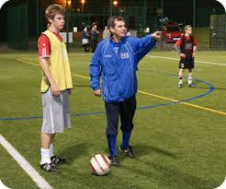
ELEMENTS TO BE CONSIDERED WHEN DESIGNING A TRAINING SESSION
First consideration is always safety - considers the safety of the equipment, facilities and training being designed to meet the levels of the athlete/s.
Other elements to be considered when designing a training session include:
How much time will be allocated to each activity
What the goals or aims of the session will be
How warm up and cool down will be done and
Making sure you leave room at the end to evaluate the session.
The timing of the elements is also important to consider.
How long will the athlete/s spend warming up
Doing conditioning work, or focusing on a skill?
What order will these be done in order to gain the most from the training session?

Slide 3
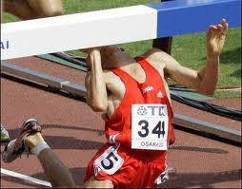
HEALTH AND SAFETY CONSIDERATIONS
Health and safety is the most important consideration.
Training session needs to suit the athlete/s being trained.
Eg - if it’s a child with low levels of fitness, then the training session should match their fitness and skill levels.
Also applies for the adult, training should be done at a level that extends the athlete and develops them for the sport, but not set at a level that could be harmful to them.
Other safety aspects include:
Adequate warm up
All equipment is available and in working order (includes the court/field)
An appropriate venue should be chosen that caters for the specific training session.
Also includes the athlete’s state of health and whether they are ready for training (both mental and physical).
Other health and safety considerations include:
Protective equipment
Clothing
Safety gear (sunscreen, water etc)
First aid kit
Climactic conditions etc

Slide 4
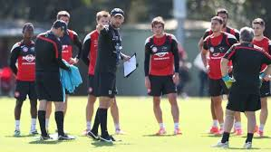
PROVIDING AN OVERVIEW OF THE SESSION TO ATHLETES
Providing an overview of the session is an important aspect of any training session.
When an athlete knows the aims the training session - improves the results of training.
Athlete understands the purpose of each activity, why they are doing it and how it should help them in competition.
A session overview is a short process:
Helps get the athletes on side with the coach
Allows for more effective feedback and session evaluations.
A session overview will be completed just prior to or during a warm up.
Outline what is happening in the training session and link the activities with specific outcomes or goals for the athletes.
Providing an overview allows athletes to have input

Slide 5
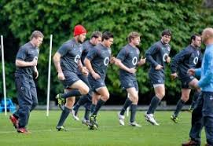
WARM UP AND COOL DOWN – WARM UP
Warm up should be specific to the activities that are going to be completed in the session and the muscles being used.
begin with general whole body low intensity movements and become more specific throughout the warm up.
include some form/s of stretching. The type of stretching used should be specific to the training.
Most commonly used type of stretching in a warm up today is dynamic stretching, though many athletes and coaches still use static stretching.
Warm up prepares the body for the session, improving performance, which during training means improved physiological adaptations and promoting safety in the session.

Slide 6
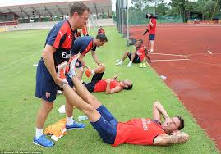
WARM UP AND COOL DOWN – COOL DOWN
Occurs after the training session and needs to be included in order to speed up recovery.
Generally consists of low intensity movements using the same muscle groups and body systems as were used during the training session.
Goal is to help remove waste products, and fluid in order to decrease post exercise oedema (swelling).

Slide 7
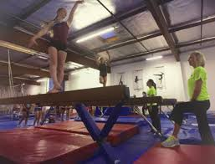
SKILL INSTRUCTION AND PRACTICE
Makes up the greater portion of any training session.
The allocation of time to specific skill related activities needs to be decided, along with how the activities will flow together for best development of the skill.
The selection of skill instruction and practice activities should be determined by the athletes’ stage of skill acquisition.
Skill instruction usually includes:
Demonstration of the skill (may be broken down into its various parts before being combined to perform the entire complex skill).

Slide 8
SKILL INSTRUCTION AND PRACTICE
Skill instruction should be short and to the point.
Need to be clear in delivery giving both specific and useful instruction.
This instruction for practice should be timed appropriately during the session, and where possible include demonstration.
Often the best method for practicing skills relevant for a particular sport is to play the sport.
Modified games are used frequently to practice and teach skills - one of the best ways to continue to develop athletes who are autonomous.
Various drills are also used in sport to develop specific skills that an athlete may need to develop.
Drills can be done using both massed or distributed practice.
Whichever is chosen the most important thing for skill development is frequent use.
Examples:
A triathlete may spend some time on their technique for swimming, riding or running
It will not be the same amount of time as a sport such as Rugby Union or AFL spend on technique and skill development. These sports have a greater variety and emphasis on skill compared to sports that use predominantly health related components of fitness.

Slide 9
CONDITIONING
All sports require conditioning training - It is the base work required for the sport
It is NOT just cardiovascular endurance - It is about bringing the body to the desired state for use in the particular sport, largely occurs during the pre-season and is sport specific.
If the sport has a long competition phase - reconditioning and maintenance of conditioning needs to occur.
An athlete’s condition relates to injury and performance.
Good condition will help to prevent injury and improve performance
Poor condition leaves the athlete vulnerable to injury and leads to poor performance.
Conditioning covers ALL of the components of fitness (health and skill related).
Eg - conditioning required for Rugby League includes high levels of cardiovascular and muscular endurance. Good speed, muscular strength, power and coordination. As well as agility and reaction time. In essence each component needs to be well developed in order for good performance.

Slide 10
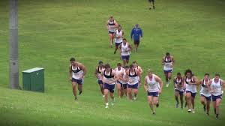
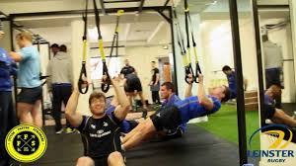
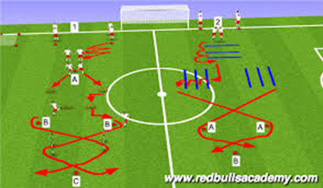
CONDITIONING CONT…
During a training session, the amount of time spent on conditioning should match the requirements during competition and the need of the athletes.
Generally 20+ minutes is set aside during a training session.
If the focus of training is the end of the game and the coach wants the athletes to perform well when fatigued, then conditioning should be done at the beginning.
If focus is on skill development, conditioning should be left until the end of the training session.

Slide 11
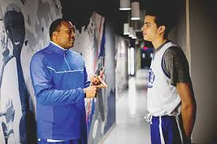
EVALUATION
Must happen at the end of the training session - coach should re-address the goals or aims of the training session that were discussed in the overview.
Athletes should be given a chance to provide feedback to the coach on the training session, as well as the coach providing feedback to the athletes.
Athlete’s feedback should be welcomed, and if needed have follow up for the next training session.
An evaluation will also include some planning for the next session and checking in with the athletes - it is a time to review the training session.
After the training session - further evaluation should occur (between coach and training staff to determine if the session was effective)
The key point to the evaluation is that it focuses on the achievement of goals, and if further actions are needed in order to achieve them.

