Slide 1
Environmental Considerations
Students Learn About:
Temperature regulation (convection, radiation, conduction, evaporation)
Climatic conditions (temperature, humidity, wind, rain, altitude, pollution)
Guidelines for fluid intake
Acclimatisation
Students Learn To:
Evaluate strategies an athlete could employ to support the body’s temperature regulation mechanisms
Analyse the impact of climatic conditions on safe sports participation

Slide 2
Environmental Considerations - Overview
Environmental considerations need to be considered when looking after an athletes’ wellbeing.
These considerations revolve around the safety of the athlete, particularly focusing on the maintenance of body temperature in hot and cold conditions.
In order to enhance athletes wellbeing, a solid understanding of thermoregulation is needed – how our bodies maintain a safe temperature.
With this knowledge it is then possible to understand how the environment may affect body temperature and analyse strategies that may help in temperature regulation.
Fluid intake is a key strategy for thermoregulation
Acclimatisation is vital in any climactic condition in order to promote the safety of the athlete.
Need to ensure you have an excellent understanding of how hot humid conditions affect thermoregulation and strategies that can help promote safe body temperature.
How cold and windy conditions make the body temperature more likely to drop and the best methods to help maintain athlete safety.

Slide 3
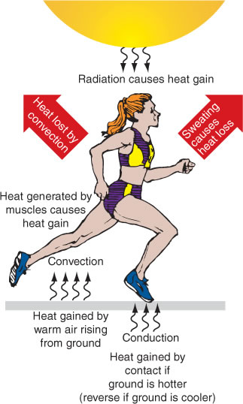
Temperature Regulation
The body uses four mechanism for temperature regulation:
Convection
Radiation
Conduction
Evaporation
Of these, we rely most heavily on evaporation to regulate body temperature through sweat.

Slide 4
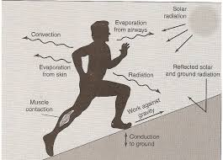
Convection for Temperature Regulation
Convection is defined as:
“heat transferred by mass motion of a fluid, such as air or water, when the heated fluid moves away from the source of heat, taking heat energy with it.”
For our purposes the source of heat is our body, so convection is heat removed by air or water passing over our body removing the heat as it goes.
Convection naturally occurs as the athlete moves, by running, riding etc, through the air, or when a breeze is blowing.

Slide 5
STRATEGIES AN ATHLETE CAN USE TO SUPPORT CONVECTION AS A TEMPERATURE REGULATION MECHANISM
If our body needs to lose more heat – useful strategies to support convection include:
place the athlete in front of a fan
Pouring water over the skin
If the athlete’s body is becoming too cold:
Wearing a wind breaker jacket to prevent the wind from contacting the body surface, preserving heat.

Slide 6
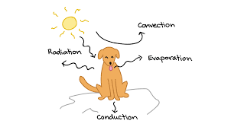
Radiation for Temperature Regulation
Radiation of heat is:
“the transfer of internal energy in the form of electromagnetic waves – usually infrared”.
As the body produces heat, some heat is lost through radiation.
This can be linked with the heat of a fire. The heat given off by a fire is largely done through radiation (light is an example of radiation).
If you stand in the light of the fire, it is warmer, than if there is something blocking the light. This is because is stops some of the radiated heat from reaching you.
The sun also provides heat through radiation. Our bodies, though to a lesser degree than fire, also radiate heat into the environment in order to lose it.
Our bodies will also gain radiated heat if we are performing out in the sun.

Slide 7
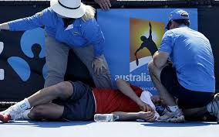
STRATEGIES AN ATHLETE CAN USE TO SUPPORT RADIATION AS A TEMPERATURE REGULATION MECHANISM
If the athlete needs to lose heat, exposing more skin to the environment can help through radiation. However, radiation is one of our bodies least effective mechanisms for temperature regulation.
If the athlete is cold, exposing the athlete to the sun or a warm fire will help to heat the body causing body temperature to rise.

Slide 8
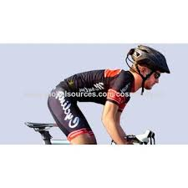
Conduction for Temperature Regulation
Conduction is
“the transfer of heat between two (2) objects in contact with each other”.
Heat transfer is always from the hotter object to the cooler one.
During exercise, our bodies heat up due to the creation o heat when ATP is turned to ADP and P.
If the body is warmer than the bike being ridden, some heat will be lost through conduction. However, if the athlete is cooler than the object, such as running on a hot road, then heat is conducted to the body.

Slide 9
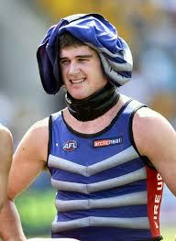
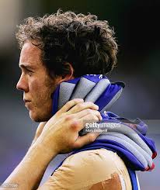
STRATEGIES AN ATHLETE CAN USE TO SUPPORT CONDUCTION AS A TEMPERATURE REGULATION MECHANISM
When an athlete is hot, conduction can be a great way to lose heat.
Exposing the skin and lying down on a cool surface such as a rock, or metal will allow heat to be lost into the cooler object.
The most used form of conduction is an ice-vest.
Ice-vests work as heat is conducted from the body into the ice, warming the ice and removing heat from the body.
Conduction will occur every time two (2) objects are in contact.
This can be two players, or a player and a piece of equipment.
Some equipment works as a better conductor than others. For example, a metal baseball bat will conduct heat well, while a players leg pads will not.
If a sport requires the athlete to be in constant contact with a good conductor, it is important to keep the conductor at a temperature that will improve the safety of the athlete.
For example, motor racing requires the athlete to be in contact with their seat the whole time. If it is a hot day and the conductor is hot, it places the athlete at greater risk, because they will gain more heat from the conducting object.

Slide 10
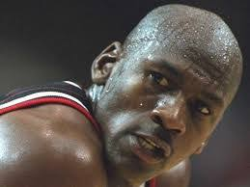
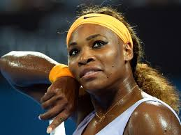
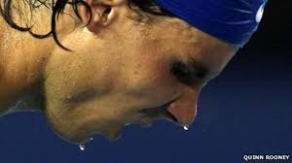
Evaporation for Temperature Regulation
Evaporation is our bodies main mechanism for heat loss.
Evaporation is
“the transfer of heat from our body, to water (sweat), resulting in the water becoming a vapour and taking the heat away with it”.
Our bodies are well designed to sweat in the heat. Trained athletes will even begin to sweat before it is needed because their body knows it will be needed as the athlete continues to move and produce more heat.
Each athlete sweats at their own rate.
The rate of sweat can be found by weighing the athlete before and after exercise, while measuring the fluid consumed.
The sweat rate is the loss of weight in Kg plus the amount of liquid consumed in L divided by the time of exercise in hours. This provides a sweat rate in litres per hour. Many athletes sweat between 1 and 2 L/h.
Evaporation is affected by the humidity of the air - more humid the air the less effective evaporation is at removing heat.
This is because it is harder to convert the sweat into a vapour as the air already has lost of vapour in it.

Slide 11
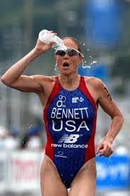
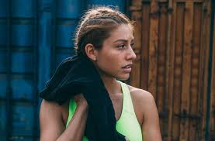
STRATEGIES AN ATHLETE CAN USE TO SUPPORT EVAPORATION AS A TEMPERATURE REGULATION MECHANISM
If an athlete is hot evaporation can be increased by adding water to the surface of the body.
Pouring water over the body will leave more water on the body to evaporate off, taking the heat with it.
Drinking plenty of fluid will also assist the evaporation process as it allows the body to continue to produce sweat without causing dehydration to the athlete.
If the athlete is cold and wet, they will lose heat through evaporation.
Removing the water with a towel or taking off wet clothes, will help prevent heat lost due to evaporation.
Place a barrier over the wet body to prevent the evaporated water from spreading into the atmosphere. For example, wearing a jumper after getting out of a pool will help trap the water vapour, causing a humid environment under the jumper and preventing the loss of heat through further evaporation.

Slide 12
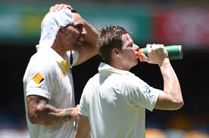
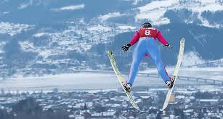
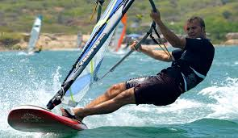
Climate Conditions
Refers to the environmental temperature:
Humidity
Wind
Rain
Altitude
Pollution levels.
Each of these conditions affects athlete safety and need to be considered in order to enhance the wellbeing of the athlete.

Slide 13
Temperature
There are two (2) ways that the environmental temperature can be dangerous to an athletes wellbeing:
Too hot
Too cold
THE IMPACT OF HOT CLIMATIC CONDITIONS ON SAFE SPORTS PARTICIPATION
Hot weather can be dangerous to the athlete.
Every movement an athlete makes uses ATP by breaking into ADP and P while releasing energy as both movement and heat.
This heat needs to be removed from the body for safety. However, on hot days the athlete will also gain heat from the environment.
Hot climatic conditions add heat to the athlete particularly through radiation.
This places the athlete at higher risk of hyperthermia and heat stroke.
Hot conditions make it more difficult for the athlete to maintain their body temperature
Force the athlete to sweat more which can lead to dehydration.
It is vital that the athlete have strategies to help the body lose heat through temperature regulation mechanism.
Strategies such as:
Pouring water over the body
Wearing light lose clothing
Doing physical activity in the cooler times of the day and out of direct sunlight if possible
If weather is too hot, then the event should be rescheduled if possible.

Slide 14
Temperature cont…
THE IMPACT OF COLD CLIMATIC CONDITIONS ON SAFE SPORTS PARTICIPATION
Cold conditions may result in the athlete losing too much heat and the body temperature dropping to unsafe levels.
Athletes will sweat and send blood supply to the skin in order to lose heat when exercising.
If this occurs when the weather is cold, they can lose too much heat.
The body may respond by reducing sweat levels and keeping the blood away from the skin, but heat will still be lost.
There are many sports that are conducted in cold environments, such as:
Ice-hockey
Skiing
Bobsledding.
Other sports, such as football, are played in winter when it can be very cold, or even snow.
Athletes need to have strategies to maintain a safe body temperature – including:
Wearing long sleeves/warm clothes such as snow jackets and pants
Do not stand around in the cold waiting.
Also benefit from longer warm ups to prevent injury.

Slide 15
Humidity
THE IMPACT OF HUMID CLIMATIC CONDITIONS ON SAFE SPORTS PARTICIPATION
Humidity refers to the water concentration in the atmosphere.
The more concentrated or humid the climatic conditions the less effective sweat and evaporation is at removing heat.
Since this is our bodies main temperature regulation mechanism, it places the athlete in danger, especially if the weather is hot.
HOW THE COMBINATION OF HEAT AND HUMIDITY INCREASES THE LIKELIHOOD OF HYPERTHERMIA
Hot humid conditions greatly increase the likelihood of hyperthermia because the body’s temperature regulation mechanisms are hindered and heat loss is minimal.
In a hot environment the athlete will lose less heat through radiation and is more likely to gain heat through this mechanism.
Conduction may work, if the breeze is cool, but a warm breeze can add further heat to the athlete.
Many surfaces will also be warmer than the body, meaning conduction will result in heat being transferred to the body not away from it.
Strategies include:
Availability of cold water and ice
An ice-vest would greatly assist the athlete to maintain a safe body temperature.
Adequate fluid consumption will also help avoid dehydration in these conditions.

Slide 16
Wind
THE IMPACT OF WINDY CLIMATIC CONDITIONS ON SAFE SPORTS PARTICIPATION
Windy conditions greatly increases the loss of heat through convection
A warm wind will add heat to the athlete rather than removing it. Wind will also affect the movement of equipment such as balls, which can make play more dangerous as the ball can move unexpectedly and injury a player.
HOW THE COMBINATION OF COLD AND WIND INCREASES THE LIKELIHOOD OF HYPOTHERMIA
Cold conditions cause greater heat to be lost through radiation, conduction and convection. Wind further increases the heat loss through convection and places the athlete at greater risk of hypothermia.
Strategies that could be implemented include:
Wearing appropriate warm clothing, such as jackets, pants or skins to reduce wind contact with the skin and therefore reduce heat loss through convection.
Warm clothing will also prevent some heat loss from evaporation.
Having a longer warm up, continuing to move in order to generate heat
Having warm water available to drink
Ensure the athlete removes sweat or water with a towel to reduce heat loss by convection and evaporation

Slide 17
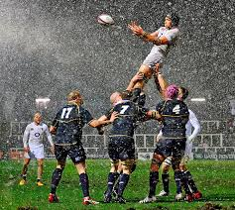
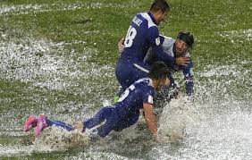
Rain
THE IMPACT OF RAINY CLIMATIC CONDITIONS ON SAFE SPORTS PARTICIPATION
Rain increases the heat lost through convection as water moves across the surface of the skin. This can be particularly dangerous if it occurs in cold and/or windy climatic conditions. Water that sits on thespian will also conduct heat away from the body.
Rain means that humidity is high. If rain occurs on a hot day, reduces heat lost through evaporation.
Rainy conditions also make surfaces slippery - increasing the risk of injury.

Slide 18
Altitude
The altitude at which a sport or physical activity is conducted will influence player safety due to different oxygen concentration in the air.
The higher the altitude the lower the oxygen concentration, the lower the altitude the greater the concentration.
The air at lower altitudes has the pressure of all the air above it pushing down on it forcing the molecules closer together
The air at higher altitude molecules have less other air on top of it so they can spread out more.
This is often spoken of as air pressure.
The greater the air pressure, the higher the concentration of air molecules, with oxygen being one of those molecules.
High altitude has other affects on the athlete as well.
For example, there is greater radiation from the sun
Increased ability to jump. With less molecules on your shoulder, there is less resistance to vertical movement, allowing the athlete to jump higher.

Slide 19
Altitude cont…
THE IMPACT OF ALTITUDE ON SAFE SPORTS PARTICIPATION
If an athlete has been doing physical activity at a low altitude and is then required to perform at a high altitude, their performance will decrease because there is less oxygen in the air, therefore lesson oxygen moving into their blood and being transported to the muscles.
Many athletes will try and acclimatise to the location of their competition 2-4 weeks before competition.
Acclimatisation is when the athlete arrives before competition, normally at a higher altitude in order to adapt to the lower concentrations of oxygen in the air.

Slide 20
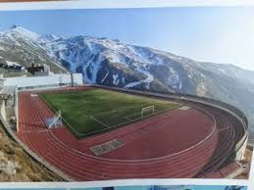
Altitude cont…
The physiological adaptation that occurs is an increase in haemoglobin, which increases the amount of oxygen in the blood at the higher altitude allowing for an improved performance.
If an athlete does not acclimatise to the higher altitude, they may experience hypoxia, which means they do not have enough oxygen and will get dizzy, light headed and lose their balance.
The affects of high altitude have also been used in training programs.
Some athletes will do what is called “live high train low”. The athlete lives at high altitude (either simulated or real) in order to increase their haemoglobin levels, but then train at low altitude, where training can still be done at high intensities.
This gives the aerobic athlete an increase in performance as they have greater oxygen transport available to maintain higher intensities for longer, with less waste product.

Slide 21
Pollution
Pollution is a climatic condition that refers to the presence of contaminants either in the air or the greater environment. The one of most concern for the athlete is air pollution, since they are breathing deeply and frequently as they exercise.
ANALYSE THE IMPACT OF POLLUTION CLIMATIC CONDITIONS ON SAFE SPORTS PARTICIPATION
Pollution can cause health concerns depending on the contaminant. Some contaminants have been linked with:
Cancer
Chronic bronchitis
Or other issues such as asbestosis.
Some contaminants pose fairly minor dangers to the athlete, especially if exposure is minimal.
There are few strategies an athlete can use to enhance safety when pollution is present, other than not participating, or wearing a mask.

Slide 22
Guidelines for Fluid Intake
Guidelines for fluid intake should be individualised as each athlete has a different sweat rate.
General guidelines and principles can still be used to help determine an individuals drinking before, during and after performance.
GUIDELINES FOR FLUID INTAKE BEFORE PERFORMANCE
Before performance:
Ensure that they are properly hydrated
General recommendation - consume 2L a day of water for the average person
Factors such as time since last training/performance can affect athlete hydration and electrolyte levels.
An athlete can check their hydration using a urine colour test (The darker the colour of the urine, the more dehydrated)

Slide 23
Guidelines for Fluid Intake cont…
GUIDELINES FOR FLUID INTAKE DURING PERFORMANCE
Each athlete will not only sweat at different rates, but will only be able to consume certain amounts of fluid as they perform without discomfort.
Other variables include the heat during performance, performance duration, the intensity of the performance and opportunities for the athlete to drink.
An athlete’s rate of sweat can be found by weighing the athlete before and after exercise, while measuring the fluid consumed.
The sweat rate is the loss of weight in Kg plus the amount of liquid consumed in L divided by the time of exercise in hours. This provides a sweat rate in litres per hour.
Many athletes sweat between 1 and 2 L/h.
Just 2% dehydration negatively affects performance.
It is important that hydration rates match sweat rates as closely as possible, especially for events of long duration.
Slight mismatches can lead to dehydration or hyponatraemia (occurs when blood sodium levels are diluted).
Decreases performance, and causes nausea, vomiting, headaches, and swelling.
Sports drinks can help prevent hyponatraemia, which generally only occurs in long duration sports such as marathons, and triathlons.

Slide 24
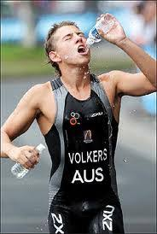
Guidelines for Fluid Intake cont…
General guidelines for fluid consumption during exercise are:
90-240 mL (~150 mL) of water every 15-20 min if exercise is less than 60 min.
90-240 mL (~150 mL) of sports drink every 15-20 min if exercise is more than 60 min.
DO NOT consume more than 1 L per hour of exercise.

Slide 25
Guidelines for Fluid Intake cont…
GUIDELINES FOR FLUID INTAKE AFTER PERFORMANCE
It is vital that an athlete replaces the fluid lost during performance after it is completed.
An athlete should weight themselves post-performance and check their urine to help determine how much fluid needs to be consumed.
It is important for the athlete to avoid over hydration leading to hyponatraemia.
If symptoms begin, the athlete should limit fluid intake and increase salt consumption.
A medical practitioner should also be consulted.

Slide 26
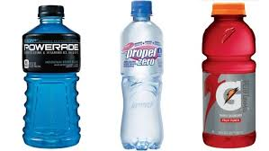
Guidelines for Fluid Intake cont…
General guidelines for fluid intake after performance are:
Replace fluid loss within 2 hours after exercise
Approx 1.5L of fluid should be consumed for every kg of weight loss

Slide 27
Acclimatisation
Acclimatisation is “when an athlete adjusts to a change in environment (such as a change in temperature, humidity, or altitude), allowing them to maintain performance in the new environmental conditions.”
Is needed for any changes in climactic conditions:
Hot
Humid
Cold
Wind
Rain
Altitude
Acclimatisation for the purposes of exercise and safety takes around 2 weeks, longer for children.
Sports Medicine Australia say:
Regular exercise in [the new] conditions will facilitate adaptation to help prevent performance deteriorating, or the athlete suffering from [an] illness, during later competitions. Sixty minutes acclimatisation activity each day for 7-10 days provides substantial preparation for safe exercise in the [new environment].
Acclimatisation can occur by:
Live and train in the new environment where the sporting event will be held
Live and train in another location, but with an environment similar to the host location
Stay at home, but create a simulated training environment. This offers a more controlled environment with little disruption to training and less time away from home.

Slide 28
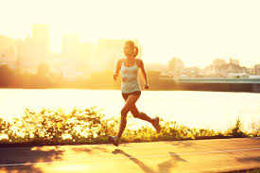
Acclimatising to Heat
Particularly important if the athlete is travelling from a colder climate.
For example, during the FIFA World Cup in Brazil, many athletes had to travel from northern Europe, where football is played during winter in cold conditions. Many countries arrived in Brazil a month before the tournament in order to acclimatise to the warmer conditions. Athletes that have not acclimatised to the heat are at greater risk of heat stroke and hyperthermia.
Acclimatization to heat brings about the following physiological changes:
Earlier onset of sweating at a lower core body temperature
Increased sweat gland distribution
Increased sweat rate
Increased sweat response to changes in core temperature
Increased skin blood flow (increasing heat loss by radiation and convection)
Increased plasma volume
Decreased heart rate
Decreased core body and skin temperature
Altered fuel metabolism
Increased oxygen consumption

Slide 29
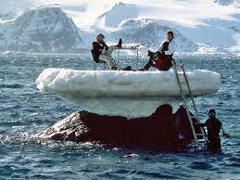
Acclimatisation to Cold
Important for athletes coming from warmer climates.
Acclimatisation is done in much the same way as it is for heat and other climatic conditions. If an athlete is not acclimatised to the cold they are at increased risk of hypothermia.
The physiological adaptations however are different:
Shivering begins at a lower skin temperature
Improved intermittent blood flow to the hands and feet
Increased metabolic rate

Slide 30
Acclimatisation to Altitude
Is particularly vital for an athlete moving from low to high altitude for competition.
Altitudes above 1500m have a significantly lower concentration of oxygen resulting in decreased performance and increased risk of altitude sickness.
The concept of altitude training has existed for a long time with three different methods being used:
Live High – Train High
Requires the athlete to live at altitude and train at altitude for maximum exposure to altitude.
Evidence of a positive effect on performance at sea level is controversial, though for benefits at altitude this method works very well.
Live Low – Train High
This method means the athlete is living at sea level of low altitude, while training at high altitude.
The idea behind this regime is that the athlete is exercising in a low oxygen environment, whilst resting in a normal oxygen environment.
This type of training does not generally provide advantages for the athlete competing at sea-level. In fact, training intensity is reduced so athletes actually lose fitness using this regime. However, it may provide some benefit if competition is at altitude.
Live High – Train Low
Athlete lives at high altitude and trains at low altitude.
The theory is that the athlete will acclimatise to altitude while living there, and in addition the training intensity can be maintained by training at sea level or low altitude.
The benefits of altitude exposure are gained while the training intensity is maintained quite high.
In order for benefits to occur the athlete needs to be at altitude for more than 12 hours a day, for 3+ weeks. This technique improves sea-level performance and high altitude performance, particularly avoiding altitude sickness. Often this method uses a simulated high altitude environment using a high altitude training tent or room.

