Slide 1
FEMALE ATHLETES
STUDENTS LEARN ABOUT:
Eating Disorders
Iron Deficiency
Bone Density
Pregnancy
STUDENTS LEARN TO:
Assess the degree to which iron deficiency and bone density affect participation in sport

Slide 2
FEMALE ATHLETES - OVERVIEW
Female athletes need to manage menstruation along with everything else an athlete may need to deal with.
Menstruation affects the female haemoglobin and iron levels resulting in:
Decreased oxygen carrying capacity
Intensity levels
Motivation
It also causes varying degrees of pain and discomfort for the female athlete.
Female athletes are also under greater pressure to have an “athletic” figure.
Our society places great value on external beauty, especially in relation to women and a female athlete who is in the media is expected to be beautiful.
This can lead the athlete to develop eating disorders, which then affects not just their iron and haemoglobin levels, but their calcium and magnesium levels leading to poor bone density.

Slide 3
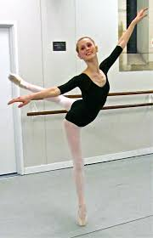
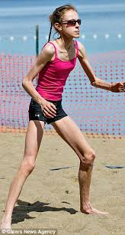
EATING DISORDERS
Female athletes are often under pressure to fit the social pressures of the female physique and beauty, while still being a great athlete.
Eating disorders, such as bulimia and anorexia, can result from these social pressures, or result from the demands of training for some sports, such as martial arts.
Eating disorders decrease energy and nutrient intake, which negatively affects health and sports performance.
Low energy and nutrient intake affects female menstruation and skeletal health, along with many other physiological processes. These other processes include:
cellular maintenance
Growth
Repair
Thermoregulation

Slide 4
EATING DISORDERS – CONT…
Eating disorders also cause iron deficiency.
Eating disorders affect the energy and nutrition available to the female athlete. This lack of energy and nutrition affects both the bone health and menstrual cycle of the athlete. Together this can greatly affect sports performance and choices for the female athlete, especially one with an eating disorder.
Other vital nutrients for sports participation include: calcium, magnesium, potassium and sodium. Of these, calcium and magnesium are particularly important for bone density. This is particularly important for female athletes, because females usually have thinner bones than men, and if oestrogen levels drop so does their bone density.

Slide 5
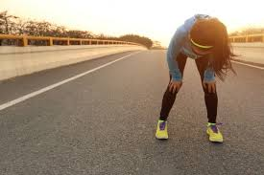
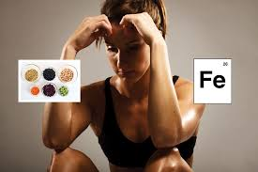
IRON DEFICIENCY
Iron deficiency is caused by decreased nutrient intake and a loss of iron through menstruation (or other forms of bleeding).
Iron is one of the key nutrients for sports performance - required in order to allow haemoglobin to take the right shape so that it can combine with oxygen and transport it around the body.
I.e. the less iron the less oxygen that can be transported and the less the body can use the aerobic energy system.
Iron deficiency or anaemia results from two conditions:
Bleeding
Lack of iron in the athlete’s diet.

Slide 6
IRON DEFICIENCY – CONT…
Anaemia is much more common in female athletes because of menstruation.
Menstruation is one of our factors in the female athlete triad. It is influenced by energy and nutrient availability. If an athlete has amenorrhea (no menstrual cycle) then their oestrogen levels are often low, which will decrease their bone density as well. If they have a normal cycle, it can lead to iron deficiency if they are not eating adequate iron levels.
Iron is a readily available nutrient found in red meats and many vegetables.
A lack of iron will also affect training. Not only will training not be able to be sustained for long durations, the female athlete will also feel lethargic (tired), and less motivated to train at all.

Slide 7
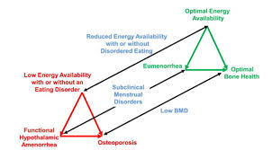
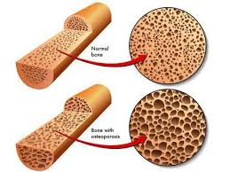
BONE DENSITY
Bone density is a medical measure of the amount of minerals per square centimetre of bone. It is a key measure to help determine the strength or fragility of the bone.
Poor bone density is an indicator of osteoporosis.
Is a particular issue in female athletes as oestrogen levels drop, which leads to lower mineral counts.
Calcium and vitamin D are of particular importance - need to ensure they consume the right amount of calcium for bone development and either produce vitamin D through sun exposure, or take a vitamin D supplement.

Slide 8
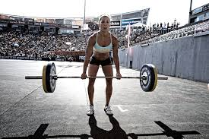
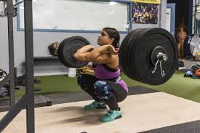
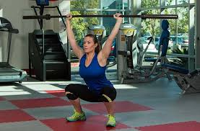
BONE DENSITY – CONT…
Low bone density is more likely in female athletes who have an eating disorder or are post menopause.
A decrease in density causes the bone to become more fragile, making the athlete more prone to fractures.
Bone density can be improved through a proper diet, weight bearing, and resistance training.
Women’s oestrogen levels usually drop when they hit menopause, but for many female athletes, the increase in muscle mass, and decrease in fat, disrupts their hormonal balance. This is because fat produces oestrogen, while muscle produces testosterone. Female athletes often miss their period, which is a sign of low oestrogen, and can therefore suffer lower bone density.

Slide 9
PREGNANCY
Female athletes can and will also be mothers and wish to continue their sport while being pregnant.
Many women show concern about sport during pregnancy, but there is little need to be - generally a female athlete can continue doing any sport that they already do when pregnant, and can start a sport after they become pregnant with proper guidance.
Pregnancy affects the body of a female athlete - including an increase in relaxin (allows for greater flexibility).
This means that a pregnant athlete has a greater range of motion at their joints. This is generally not a problem, as long as the joint is not stretched beyond normal range of motion. However, if the joint is stretched further, dislocation is more likely.
Sports Medicine Australia state:
Care should be taken with any activity that involves jumping, frequent changes of direction and excessive stretching. Jerky ballistic movements should be avoided

Slide 10
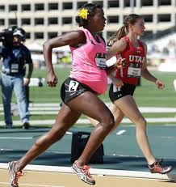
PREGNANCY – CONT…
Pregnant athletes will also put on weight and have their centre of gravity shifting forward. This will make exercise a higher intensity because of the extra weight, and make the woman more unstable.
Blood volume and haemoglobin levels will increase. The result is better oxygen delivery to working muscles during exercise as well. However, any benefits during pregnancy are lost with the increased weight and delivery of blood to the baby. This improved oxygen delivery continues for many weeks after pregnancy and will improve performance post pregnancy.
Currently there is no research to say that exercise during pregnancy will affect the babies birth weight.
There is also a lack of evidence saying contact sports will hurt the baby, however, it is not advisable that a woman late in pregnancy try a new contact sport or dangerous sport for the first time, such as skiing or football.

Slide 11
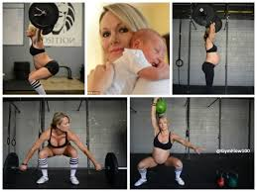
PREGNANCY – CONT…
Female athletes do stand to benefit from sports participation and exercise while pregnant. They will have better weight control, improved mood and will maintain fitness levels.
It will also help prevent gestational diabetes and will be used in the management of gestational diabetes if it does occur.
Pregnant female athletes can continue to participate in sports they are familiar with. Should probably avoid participation during he heat of the day, and not try new contact or dangerous sports, especially late in the pregnancy.

