Slide 1
GROUPS EXPERIENCING HEALTH INEQUITIES
STUDENTS LEARN ABOUT:
Aboriginal and Torres Strait Islander Peoples
Socioeconomically disadvantaged people
People in rural and remote areas
Overseas-born people
The elderly
People with disabilities
STUDENTS LEARN TO:
Research and analyse Aboriginal and Torres Strait Islander peoples and ONE other group experiencing health inequities by investigating:
The nature and extent of the health inequities
The sociocultural, socioeconomic and environmental determinants
The roles of individuals, communities and governments in addressing the health inequities

Slide 2
GROUPS EXPERIENCING HEALTH INEQUITIES
Health is not only the responsibility of the individual. Governments and health authorities recognise that people cannot always choose a particular lifestyle.
Health promotion and illness prevention campaigns attempt to address the determinants that impact on health or affect people’s ability to make good decisions about their health.
These can be classified as:
Sociocultural determinants of health – including family, peers, media, religion and culture
Socioeconomic determinants of health – including employment, education and income
Environmental determinants of health – including geographical location, and access to health services and technology
The main groups that experience health inequities in Australia are:
Aboriginal and Torres Strait Islander peoples
Socioeconomically disadvantaged people
People in rural and remote areas
Overseas-born people
Elderly people
People with disabilities

Slide 3
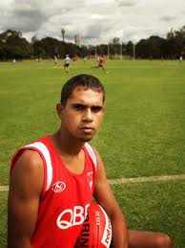
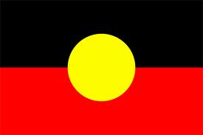
ABORIGINAL AND TORRES STRAIT ISLANDER PEOPLES
THE NATURE AND EXTENT OF THE HEALTH INEQUITIES
No greater contrast in the extremes of health status can be found in Australia than that between Aboriginal and Torres Strait Islander peoples and the rest of the Australian population
ATSI die at a much younger age and are more likely to experience disability and reduced quality of life because of ill-health
The life expectancy of Indigenous Australians is approximately 10 years less than the overall Australian life expectancy
The life expectancy at birth of a male is approximately 67 years and for a female is approximately 73 years.
Death rates for ATSI is 4 times, and the child death rate is twice that of other Australian’s
Infant mortality (estimated at two to three times higher than the overall Australian ﬁgure) and higher mortality rates.

Slide 4
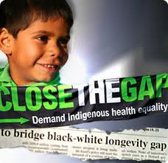
ABORIGINAL AND TORRES STRAIT ISLANDER PEOPLES
THE NATURE AND EXTENT OF THE HEALTH INEQUITIES CONT…
The leading causes of death in the ATSI population are circulatory diseases, cancer, diabetes and respiratory diseases.
ATSI people also suffer from larger death rates from:
Circulatory diseases
Endocrine
Metabolic
and nutritional disorders, with an emphasis in diabetes.
ATSI people are 5 times more likely to die from endocrine, metabolic, and nutritional disorders than other Australians and more likely to die of digestive conditions.
http://www.oxfam.org.au/explore/indigenous-australia/close-the-gap

Slide 5
ABORIGINAL AND TORRES STRAIT ISLANDER PEOPLES
THE NATURE AND EXTENT OF THE HEALTH INEQUITIES CONT…
Trauma and grief related to the history of a new settlement invading Indigenous communities, the impact of colonisation by Europeans, loss of land and culture, high rates of premature mortality, high levels of Jail, family separations and Aboriginal deaths in custody have been identiﬁed as underlying the great burden among Indigenous people of ‘mental health problems’, which may lead to ‘mental illness’.
More likely to suffer from long term health conditions:
Asthma
Diabetes
Arthritis
Hearing problems – with the largest gap in diabetes
Overall ATSI people have an extensive gap in health outcomes compared with other Australians.
This includes 7 times more kidney disease, 3 times more diabetes, 1.5 times more obesity and cancer death rates as well as a youth suicide rate that is 6 times more for females and 4 times more for males. ATSI people are more likely to require assistant with daily living activities as reported in the 2011 census, particularly in the under 65 age groups. There are also large gaps in self-purported mental health.

Slide 6
ABORIGINAL AND TORRES STRAIT ISLANDER PEOPLES
THE NATURE AND EXTENT OF THE HEALTH INEQUITIES CONT…
There is an extensive gap overall between the health of ATSI people compared with other Australians.
This includes:
7 times more kidney disease
3 times more diabetes
1.5 times more obesity and cancer death rates
Youth suicide rate that is 6 times more for females and 4 times more for males.
ATSI people are more likely to require assistant with daily living activities (2011 census) - particularly in the under 65 age groups.
Large gaps in self-purported mental health.

Slide 7
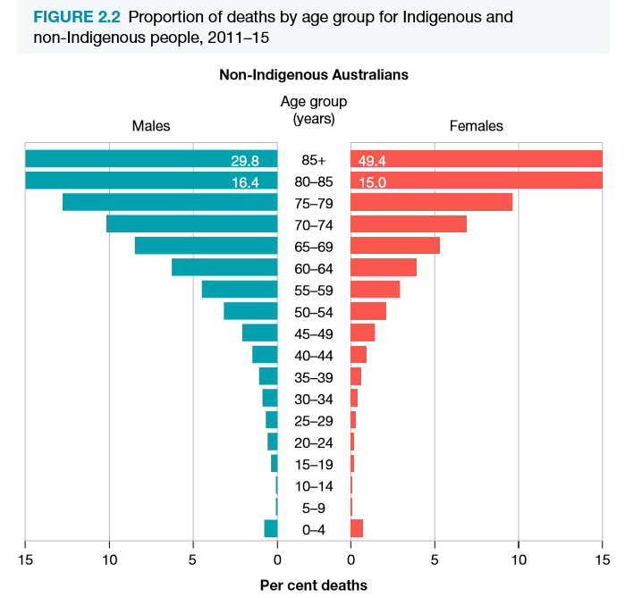
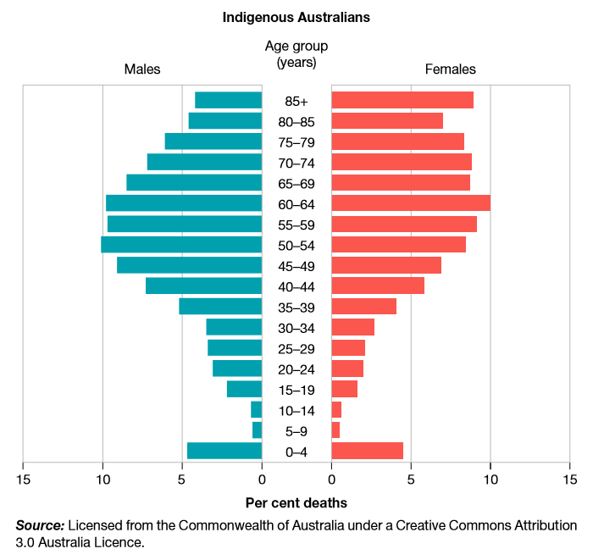

Slide 8
SOCIO-CULTURAL, SOCIO-ECONOMIC AND ENVIRONMENTAL DETERMINANTS FOR ATSI
SOCIO-CULTURAL (family, peers, religion, culture and media)
Low community self esteem
Loss of dignity with community
SOCIO-ECONOMIC (Education, employment and income)
Unemployment is higher – jobless families
Poor literacy – leads to reduced capacity to use health information
ENVIRONMENTAL (Geographical location and access to health services and technology)
Poorer living conditions – rural remote (culture)
Overcrowded and run down housing
Feeling little control over their environment
Restriction to connect with their traditional culture
Racism – stress affecting mental health
History of discrimination
Being poorer leads to lower health care
Lower health care leads to more risk of disease
Indigenous students half as likely to finish yr 12 education.
Lower safe drinking water in remote communities
Living in remote areas often has higher mental issues, less recreational opportunities
Less educated
Less money – contributes to family upbringing
Higher rates of domestic violence
Higher rates of imprisonment
Language barriers and poor access to health services
Lowest income bracket
Poor behavioural choices which increases risk factors (smoking, inactivity)
Limited access to health services due to location
Difficulty accessing dentists and GP’s due to long waiting times/unavailability of services

Slide 9
ROLES OF INDIVIDUALS, COMMUNITIES AND GOVERNMENTS IN ADDRESSING HEALTH INEQUITIES
Individuals
Each individual is responsible to promote their own health and the health of others.
An individual is influenced by factors including:
Age
Family
History
Community support
Education
Role modelling
Access to health services
SES
There are a number of interventions/campaigns available to aid with making informed choices about their behaviour and protective and risk behaviours.
Health services focus on improving the knowledge and skills of community members.

Slide 10
ROLES OF INDIVIDUALS, COMMUNITIES AND GOVERNMENTS IN ADDRESSING HEALTH INEQUITIES
Community
Communities and ATSI leaders were and are involved with the implementation of Close the Gap programs
Indigenous Australians do not access primary healthcare services. Mainly due to:
lack of availability of services,
transport and distance to services,
cost and language or cultural barriers
Community groups include:
Australian Indigenous Doctors Association
National Community Controlled Health Organisation
Aboriginal Community Controlled Health Services
Aboriginal Medical Services
Aboriginal Community Controlled Health Services (ACCHSs)
Aims to deliver holistic, comprehensive and culturally appropriate healthcare to the community that controls it.
Services include clinical care, health education, promotion, screening, immunisation and counselling, as well as specific programs such as men’s and women’s health, aged care, transport to medical appointments, hearing health, sexual health, substance use and mental health.

Slide 11
ROLES OF INDIVIDUALS, COMMUNITIES AND GOVERNMENTS IN ADDRESSING HEALTH INEQUITIES
Government
Main role is larger health promotion and funding.
For Eg - $805 million Indigenous Chronic Disease Package (aims to improve the way the health-care system prevents, treats and manages the chronic diseases that affect Indigenous Australians)
Goal to reduce key risk factors (eg smoking), improve management of chronic disease and follow-up, increase ability of primary care workforce to deliver effective care.
There are two peak agencies which coordinate Indigenous health services at the federal government level, while a third peak body in New South Wales oversees Indigenous health at a state level.
Close the Gap
Statement of intent signed by Australia’s governments (state, territory & commonwealth)
Aims to achieve equality in health by:
Reducing infant mortality
Increasing life expectancy
Closing the gap in education and employment outcomes
Improving accessibility of health care in remote areas
Specific programs/campaigns addressing risk taking behaviours of the individual

Slide 12
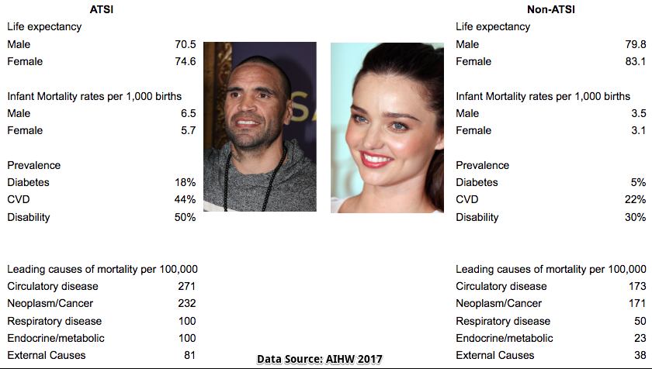
SUMMARY SNAPSHOT

Slide 14
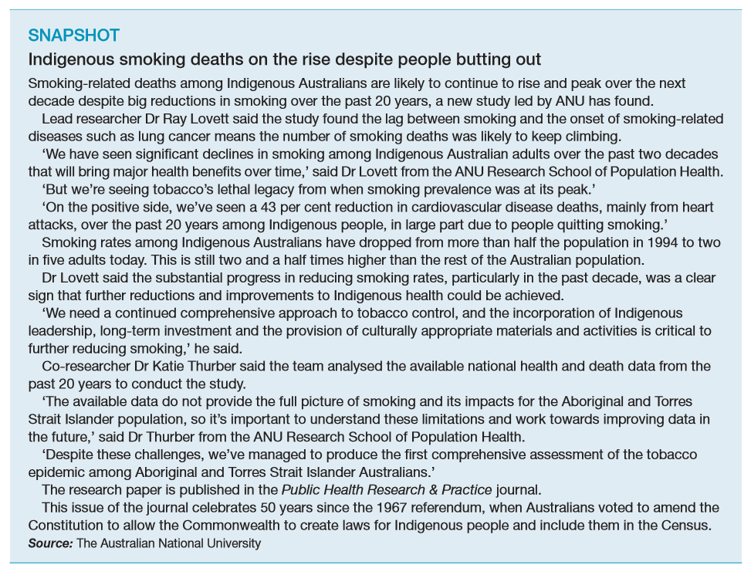

Slide 15
CHOICE OF GROUP EXPERIENCING HEALTH INEQUITIES
We have researched and analysed Aboriginal and Torres Strait Islander peoples, you now need to choose ONE other group experiencing health inequities by investigating:
The nature and extent of the health inequities
The sociocultural, socioeconomic and environmental determinants
The roles of individuals, communities and governments in addressing the health inequities

