Slide 1
What role do health care facilities and services play in achieving better health for all Australians

Slide 2
Health care in Australia
STUDENTS LEARN ABOUT:
Range/types of health facilities and services
Responsibility for facilities and services
Equity of access to health facilities and services
Health care expenditure vs expenditure on early intervention and prevention
Impact on emerging new treatments and technologies on health care eg cost, access
Health insurance
STUDENTS LEARN TO:
Evaluate health care in Australia by investigating issues of access and adequacy in relation to social justice principles. Questions to explore include:
How equitable is the access and support for all sections of the community?
How much responsibility should the community assume for individual health problems?
Describe the advantages and disadvantages of Medicare and private health insurance, eg costs, choice, ancillary benefits

Slide 3
Health care in Australia - overview
Health-care facilities/services play a vital role in achieving better health for all Australians.
They provide essential services of:
Diagnosing,
Treating
and rehabilitating the ill and injured, as well as preventing illness and promoting health
Hospitals and doctors’ surgeries are increasingly being used to provide accurate health information to the public.
State and territory governments provide services specifically aimed at both the prevention of disease and the promotion of health
For example, immunisation programs, anti-smoking campaigns, and school medical and dental health services.
However, the health of Australians also depends on factors such as:
Housing
Employment
Education
Hygiene
Income
Environmental safety
For health-care services and facilities to be effective (both curing and preventing disease), must develop partnerships with other sectors of the community to implement health-related activities that promote health.

Slide 4
Health care in Australia
The health-care system involves complex interrelationships between:
Commonwealth, State and Local Governments
Health insurance funds
Public and private providers of services; for example, doctors
Institutions; for example, hospitals
Other organisations, such as community health services.
The system is both extensive and diverse in nature. Traditionally, it has provided:
Diagnosis
Treatment
Rehabilitation
Care for people with long-term illness or disability
Since the mid 1990’s – Australian government has committed to improving health outcomes and gains (illness prevention and health promotion) rather than just supplying health care services

Slide 5
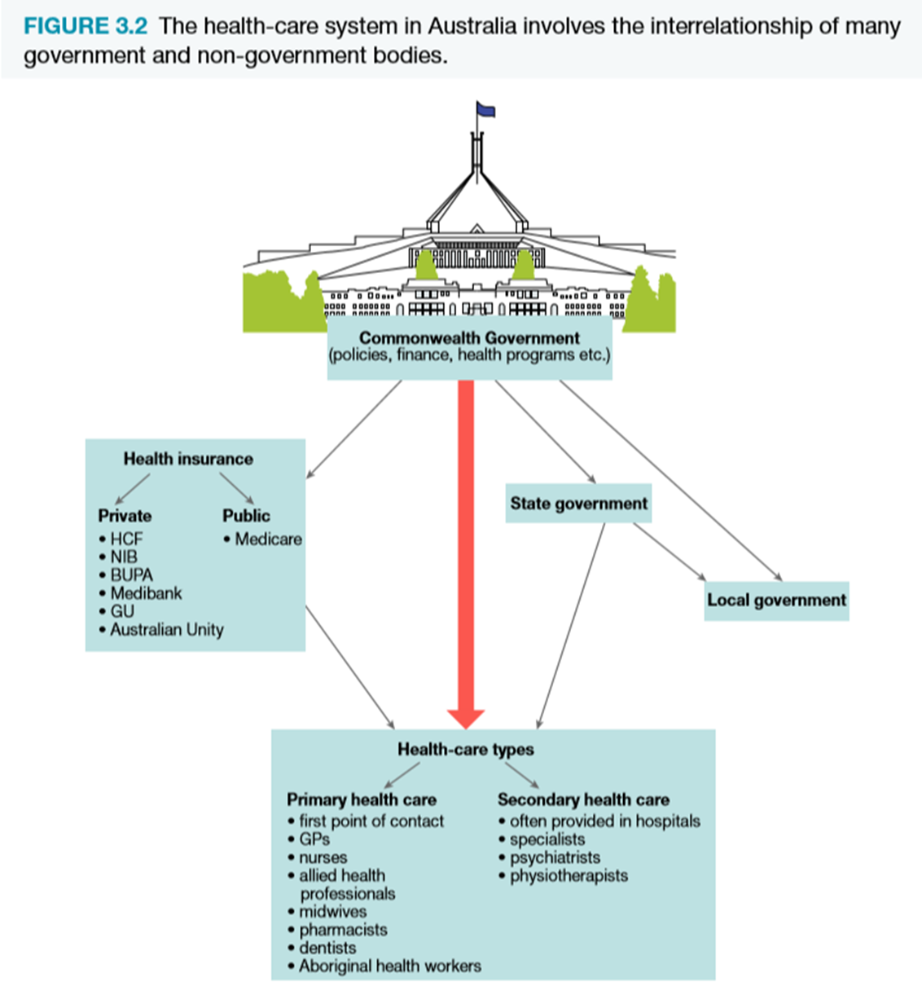

Slide 6
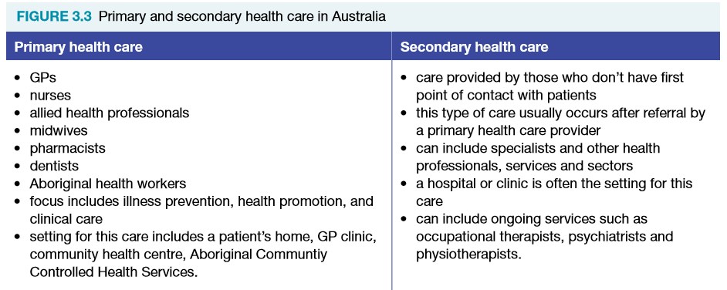
RANGE AND TYPES OF HEALTH FACILITIES AND SERVICES
Major types of health care in Australia are:
Primary health care
Secondary health care
Hospitals
They provide a broad range and type of facilities and services

Slide 7
Range and types of health facilities and services CONT…

Slide 8
RANGE AND TYPES OF HEALTH FACILITIES AND SERVICES CONT…
Most prescription drugs are subsidised through the Commonwealth Government’s Pharmaceutical Benefits Scheme (PBS) 1986.
The amount of subsidy depends on a patient’s level of eligibility.
From 1 January 2018, the patient contribution under the general rate is a maximum of $39.50 for each medicine.
The patient contribution for concession card holders, such as low-income earners, war veterans and invalids, is $6.40.
Some people who are chronically ill or require regular long-term medications are protected from excessive cost by the PBS Safety Net.
The PBS Safety Net caps the amount a family will pay for PBS subsidised medications in a calendar year - aims to ensure no-one is precluded for financial reasons from access to the medicines they need.
People who do not have a government concession card become eligible for the Safety Net Concession Card when $1521.80 (in 2018) has been spent on PBS medicines.
PBS medicines can then be purchased at a lower price, usually $7.15 per prescription for the rest of the year.
People who hold a government concession care – eligible for a Safety Net card when they have spent $384.00 (in 2018) on prescriptions – all PBS medicines for rest of the year are then free.

Slide 9
Responsibility for health facilities & services CONT…
Health –care facilities and services in Australia are provided by government organisations and arrange of private and community groups.
There are five levels of responsibility:
Commonwealth Government
State and Territory Governments
Private Sector
Local Government
Community Groups
Pharmaceuticals are funded by both Commonwealth Government and non-government sources

Slide 10
Responsibility for health facilities & services
COMMONWEALTH GOVERNMENT
Formation of national health policies and the control of health system financing through the collection of taxes.
Provides funds to the state and territory governments for health care
Directly responsibly for special community services:
Health programs and services for war veterans and Aboriginal community
Contributes major funds to:
High level residential care
Medical services
Health research
Public hospitals
Public health activities

Slide 11
Responsibility for health facilities & services CONT…
STATE AND TERRITORY GOVERNMENTS
Responsibility for providing health and community services
Principle functions include:
Hospital services
Mental health programs
Dental health services
Home and community care
Child, adolescent and family health services
Women’s health programs
Health promotion
Rehabilitation programs – for eg following heart surgery
Regulation, inspection, licensing and monitoring of premises, institutions and personnel
Contribute major funds to:
Community health services
Public hospitals
Public health activities

Slide 12
Responsibility for health facilities & services CONT…
PRIVATE SECTOR
Wide range of services such as:
Private hospitals
Dentists
Alternative health services (eg chiropractors)
Privately owned and operated – approved by the Commonwealth Department of Health
Many religious organisations, charity groups and private practitioners run such services
Private organisations – The Heart Foundation and Cancer Council receive funding from both state governments and the Commonwealth Government

Slide 13
Responsibility for health facilities & services CONT…
LOCAL GOVERNMENT
Health responsibilities vary from state to state
Mainly concern:
Environmental control
Range of personal, preventative and home care services
Monitoring of:
Sanitation and hygiene standards in food outlets
Waste disposal
Building standards
Immunisation
Meals on Wheels
Antenatal clinics
State department controls some of these services – local councils are responsible for implementing them

Slide 14
Responsibility for health facilities & services CONT…
COMMUNITY GROUPS
Formed largely on local need basis – address problems specific to an area or region
Where concerns exist nationally - groups are more extensive, usually highly structured and linked in the provision of information, knowledge and support.
Egs of prominent community groups are Cancer Council Australia and support groups run by state-based cancer councils, such as Cancer Council NSW; Carers Australia and state-based members of the National Network of Carers Association, such as Carers NSW; Dads in Distress; Family Planning NSW; and Diabetes Australia.

Slide 16
Equity of access to health facilities and services
Access to health services and facilities is essential to health and well-being.
The cornerstone of Australia’s health care system is Medicare. Medicare is designed to allow simple and equitable access to all Australian citizens regardless of location and socio-economic status.
Supporting programs, such as the Medicare Safety Net (the amount of what people need to pay is capped) and Pharmaceutical Beneﬁts Scheme (government subsidising medicines), are also in place to promote equity of access.
Although, in principle, equity of access is the intention, some individuals and groups ﬁnd it diﬃcult to access appropriate health services and facilities – ATSI and Rural and Remote.
Medicare does not fully cover, or provide access to, a range of medical services that are vital for maintaining good health. This places people of low SES at a disadvantage. EG speech therapy and physiotherapy.

Slide 17
Equity of access to health facilities and services
Access to health services has also been hampered in recent years by overcrowding and lack of bed availability in public hospitals.
Royal Flying Doctors, e-Health records and Telehealth technology has been introduced to address inequity
People from non-English speaking backgrounds and diﬀerent cultures might also not take full advantage of the services available to them.
Actively involving these communities in the establishment and delivery of their health services will result in more eﬀective care and improved health choices.

Slide 18
Health care expenditure V expenditure on early intervention & prevention

Slide 19
Health care expenditure vs early intervention and prevention
Health-care expenditure - allocation of funding and other economic resources for the provision and consumption of health services.
Includes expenditure by Australian state and territory governments, as well as private health insurance, households and individuals.
In 2016–17, the Australian Federal Government budget included:
$71.4 billion on health programs
$22.7 billion on Medicare
$17.9 billion on hospitals
$10.4 billion on the Pharmaceutical Benefits Scheme.

Slide 20
Health care expenditure vs early intervention and prevention CONT…
Health-care expenditure has steadily been increasing and will continue to do so while the focus is on ‘curative’ medicine (rather than preventing it)
Eg - costs more to ‘cure’ a disease such as coronary heart disease once it has developed than it does to fund measures to prevent the illness occurring.
Early intervention might focus on education, healthy eating practices, weight control and active lifestyle activities.
Curative measures such as treatment of heart disease, stroke, clogged blood vessels, kidney failure, blindness and foot/leg amputation are more costly.
Funding for health promotion and illness prevention has increased in recent years.

Slide 21
Health care expenditure vs early intervention and prevention CONT…
Health-care expenditure still far exceeds expenditure on illness prevention and health promotion - due to an emphasis on curing illness (dominating the allocation of public health resources and spending).
The new public health model focuses on the social factors that lead to ill health.
Places the emphasis on health promotion as the most cost-effective to address the social issues of health.
Governments, individuals and communities are being made more accountable for their expenditures.
People whose health is sound due to positive health behaviours (exercising, not smoking, healthy eating and so on) resent paying increased taxes to support those who choose in-appropriate lifestyles.
Insurance companies recognise the problem - charge higher premiums for smokers who wish to be covered for life insurance.

Slide 22
Health care expenditure vs early intervention and prevention CONT…
Lifestyle factors could cause up to an estimated 70% of all premature deaths.
More than 90% of Australia’s health expenditure is allocated to treating and curing illnesses.
It often takes years for prevention measures to translate into a reduction in the incidence of lifestyle-related diseases.
Preventative programs for cardiovascular disease, cancer and traffic accidents have been visible over the past two decades:
Eg - QUIT, SunSmart, the ‘Girls make your move’ initiative, national cervical and breast screening programs, Stop Revive Survive and drink-driving campaigns.
Training programs for GP’s - made them more aware of the importance of preventative health and promoting positive lifestyles.
Together with treatment, early intervention and prevention programs seem to have contributed to marked falls in mortality and morbidity rates from these problems.

Slide 23
Health care expenditure vs early intervention and prevention CONT…
Strategies that could be used to prevent illness and death in the community include:
Educating school children about positive health behaviours
Better coordination among the various levels of government
Restrictions on advertising
Legislation
Higher taxes on products such as alcohol and tobacco
The provision of support programs to help people give up addictive habits such as smoking and high alcohol consumption.

Slide 24
Impact of emerging new treatments & technologies on health care
Impact of emerging new treatments & technologies on health care includes many benefits, but also an increase in cost and raises questions of equity of access
New treatments and technologies include:
HPV vaccine (cervical cancer)
Keyhole surgery
Genetic testing – identification of disease earlier
Improved mechanics of replacement knees, hips, heart valves etc
New HIV drugs and chemotherapy (discs in brain rather than into veins etc)
Artificial organs such as kidneys, prosthetics
Ultrasound, MRI used for imaging
These improve early detection of diseases and illnesses. Also improve treatment and prevention which in turn improves quality of life and life expectancy
These treatments come at a cost. Only accessible to people of higher SES (unless funded through Medicare)
Less available in rural and remote areas

Slide 25
Health insurance: medicare and private health
Medicare is health insurance that ensures all Australians have access to free or low-cost medical, optometric and hospital care. Australians are also free to choose private health services.
Medicare was introduced in Australia in 1984 as a national system of health care funding.
It is designed to protect people from the huge costs of sickness and injury by providing free or subsidised medical care, and free hospital treatment in public hospitals. All Australian residents are eligible for Medicare beneﬁts.
Medicare is funded from general taxation revenue plus an additional contribution known as the Medicare Levy.
The Medicare Levy is 2% of each taxpayer’s income, and people pay it in addition to their ordinary income tax.
Individuals and families on higher incomes may have to pay a 1-1.5% surcharge in addition to the Medicare Levy if they do not have private health insurance.
The government introduced this change in the hope of encouraging more ﬁnancially able people to take out private health cover, and thus ease the pressure on the public health system

Slide 26
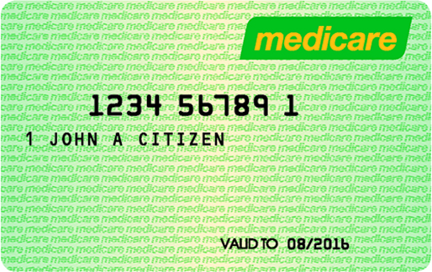
Health insurance: medicare and private health CONT…
Medicare provides individuals with access to:
Free treatment as a public patient in a public hospital
Free or subsidised treatment by medical practitioners, including GPs, specialists, and some specified services of optometrists and dentists.
Regardless of what doctors or specialists charge, every Australian is covered for 85% of an amount that is set down by the government as a common (scheduled) fee (some doctors charge more).
Many doctors bulk bill patients - means the patient pays nothing and the doctor receives up to 100% (85% in the case of specialists) of the scheduled fee from Medicare.
Medicare benefits also cover optometrist services and oral surgery, but not private dentistry, physiotherapy, chiropractic treatment and appliances.

Slide 28
Health insurance: medicare and private health CONT…
The ‘extra’ insurance of Private Health allows people to cover private hospital and ancillary expenses (such as dental, physio and chiropractic services)
People choose private health insurance for a number of reasons:
Shorter waiting times for treatment
Being able to stay in hospital of their own choice
Being able to have a doctor of their own choice in hospital
Ancillary benefits (dental etc)
Private rooms in hospital
Insurance while overseas

Slide 29
Health insurance: medicare and private health CONT…
In1998, to decrease the burden on the public health system, the Commonwealth Government introduced a rebate for people who have private health insurance.
The rebate is income-tested across four tiers, or bands, of income.
Medicare levy surcharge was introduced (on top of the 2% Medicare Levy) on individuals who earn more than $90,000 (2018 amount) and families who earn $180,000 or more (2018 amount), and do not have an appropriate level of hospital insurance.
A further change was the lifetime health-care incentive, which was introduced from 1 July 2000. This incentive gives lower lifetime premiums to people who join a health insurance fund early in life and maintain their hospital cover, compared with the premiums for someone who joins after age 30.
These policies are aimed at attracting people to private health insurance.

Slide 30
Health insurance: medicare and private health CONT…

