Slide 1
Health Promotion Based on the Five Action Areas of the Ottawa Charter
STUDENTS LEARN ABOUT:
Levels of responsibility for health promotion
The benefits of partnerships in health promotion, eg government sector, non-government agencies and the local community
How health promotion based on the Ottawa Charter promotes social justice
The Ottawa Charter in action
STUDENTS LEARN TO:
Argue the benefits of health promotion based on:
Individuals, communities and governments working in partnership
The five action areas of the Ottawa Charter
Investigate the principles of social justice and the responsibilities of individuals, communities and governments under the action areas of the Ottawa Charter
Critically analyse the importance of the five action areas of the Ottawa Charter through a study of TWO health promotion initiatives related to Australia’s health priorities

Slide 2
Health Promotion Based on the Five Action Areas of the Ottawa Charter
Five action areas of the Ottawa Charter
Building Healthy Public Policy
Creating Supportive Environments
Strengthening Community Action
Developing Personal Skills
Reorientating Health Services
Health promotion is a combination of science, medicine, practical skills and beliefs aimed at maintaining and improving the health of all people
Health promotion based on the five action areas are vital to the success of health promotion in Australia. It promotes social justice and improves the health outcomes of Australians
It ensures health promotion is done in partnership as the relevant sectors support each other in achieving better health outcomes
It recognises the various determinants of health and the spread of responsibility between individuals, communities and governments
Australia’s health promotion based on the five action areas of the Ottawa Charter is currently achieving results for many health promotion initiatives including:
Close the Gap
National Chronic Disease Strategy
Road Safety
National Binge Drinking Strategy
Aged Care Access Initiative

Slide 3
Levels of Responsibility for Health Promotion
Australian governments, communities and individuals all play a role in responsibility for health promotion. Health promotion should involve all levels of responsibility to achieve the best health results
Individuals play an important role in developing personal skills in relation to health
Communities are central in strengthening community action and creating supportive environments
The government is vital in building healthy public policy, creating supportive environments and reorienting health services
Non-government organisations, both Australian and international
Investigate the responsibilities of individuals, communities and governments under the action areas of the Ottawa Charter
 | Governments | Communities | Individuals
Building Healthy Public Policy | All levels of government are responsible for the creation and maintenance of policies that aim to improve health. E.g.) the close the gap statement of intent | Contribute towards the development of health policies and are involved in caring the policies out. E.g.) ATSI community involvement in the development and implementation of ‘close the gap’ | Act in accord with the policies delivered. E.g.) not smoking in public areas

Slide 4
Levels of Responsibility for Health Promotion
 | Governments | Communities | Individuals
Creating Supportive Environments | Responsible for the planning, implementation and management of infrastructure. E.g.) location of hospitals, parks, community centres. Council approve developments, remove waste etc | Help maintain healthy environments and promote healthy behaviours. E.g.) clean up Australia day, fun runs, maintain parks, fields and ovals, YMCA gyms etc | Make better health choices using and maintaining the environment. E.g.) putting rubbish in the bins provided.
 | Governments | Communities | Individuals
Strengthening Community Action | Engage with community groups in the creation of policies. E.g.) allowing communities to provide feedback on policies before signing them | Contribute to and take ownership of policies being empowered to act and implement them. E.g.) Aboriginal community controlled health services | Promote community activities that promote health, be involved in community actions. E.g.) promote fun runs, engage in community discussions around health

Slide 5
Levels of Responsibility for Health Promotion
 | Governments | Communities | Individuals
Developing Personal Skills | Develop policies and provide funding towards developing personal skills. E.g.) K-10 PDHPE compulsory, advertisements (2 & 5) etc | Run education and training programs to develop personal skills in relation to health. E.g.) community health centre education (pre-natal classes, brochures etc) school education system, Quit helpline etc | Seek to develop their own skills in relation to health. Enabled to take charge of their own health E.g.) research behavioural choices for health, act on advice from GPs and health practitioners, enrol in community programs etc
 | Governments | Communities | Individuals
Reorientation of Health Services | Fund, research and create policies around prevention and health promotion. Looking at all the determinants of health and not just curative services. E.g.) TV advertisements, training of primary health sector to promote health as well as cure. | Conduct research, and be involved in the promotion of health. E.g.) cancer council conducts research around cancer, but also promotes better health choices in relation to the prevention of cancer. | Seek to make healthy life choices, and help others to do the same, including participation in health promotion. E.g.) participating in jump-rope-for-heart or getting advice from a GP on quitting smoking

Slide 6
The Benefits of Partnerships in Health Promotion
Argue the benefits of health promotion based on:
Individuals, communities and governments working in partnership
Partnerships are between many groups including both the government sector and non-government agencies, along with local communities and the individual.
Health promotion demands coordinated action by all concerned:
Governments
Health and other social and economic sectors
Non-governmental and voluntary organisations
Local authorities
Industry
Media
All people are involved as individuals, families and communities. Professional, social groups and health personnel have a responsibility to mediate between different interests in society for the pursuit of health

Slide 7
The Benefits of Partnerships in Health Promotion
Individuals and communities should be involved in the development of health promotion programs – ensures their needs are met and empowers them to act in accordance with the promotion
Individuals and communities should be involved in the creation, implementation and analysis
Individuals and communities can be involved in activities such as:
Data analysis
Community meetings
Consultations
Surveys
The government sector and non-government agencies should work together with individual and communities. Not only do individuals and communities help identify health issues but they need to improve their capacity to improve their health
The sharing of information is vital. Government and non-government agencies need to share research findings, funds, and connections should be shared so more people benefit..
This helps ensure more efficient health promotion as research is not doubled up and funding can be dispersed across multiple action areas.
Partnership in health promotion enables health to be promoted through: ‘advocacy, legislation, policy change, programs, community projects, consultative community meetings, surveys and the analysis of local health data.’

Slide 8
The Benefits of Partnerships In Health Promotion
The benefits of partnerships in health promotion include:
Addresses needs of individuals and communities
More comprehensive health promotion
Better results in health promotion goals
Empowers individuals to act
More efficient health promotion (no doubling up and reduced wasted time/money)

Slide 9
How Health Promotion Based on The Ottawa Charter Promotes Social Justice
Health promotion aims to reduce inequities in health status, ensuring equal opportunities and resources for health.
This enables people to achieve the best health possible as they have a supportive environment, access to information, life skills and opportunities for making healthy choices

Slide 10
How Health Promotion Based on The Ottawa Charter Promotes Social Justice
Investigate the principles of social justice under the action areas of the Ottawa Charter
 | Equity | Diversity | Supportive Environments
Building Health Public Policy | Public policy is designed with the aim of producing equity in health status. Eg) Medicare provides access to health services for socioeconomically disadvantaged people | Public policy accounts for the diversity of our population, seeking to provide for all people groups. Eg) The ‘close the gap’ initiative aims to remove the health inequity for ATSI people in 1 generation. | Policy should aim to produce an environment that supports healthy choices. Eg) no smoking in pubs and clubs

Slide 11
How Health Promotion Based on The Ottawa Charter Promotes Social Justice
 | Equity | Diversity | Supportive Environments
Creating Supportive Environments | An environment is not supportive if it does not seek to provide equity. Eg) increasing access to health facilities for rural and remote people. | In order to be supportive, the environment must also cater for the diversity of the people in that environment. Eg) providing translators for specific groups in specific community health centres/hospitals etc | Creating environments that encourage healthy choices is vital in health promotion. Eg) ensuring good parks for outdoor activities

Slide 12
How Health Promotion Based on The Ottawa Charter Promotes Social Justice
 | Equity | Diversity | Supportive Environments
Strengthening Community Action | Equity both with and between communities is important in health promotion. Communities of people suffering inequity in health need to be utilised and empowered in order to improve their health. Eg) ATSI involved in the development and implementation of health promotion for ATSI. | Each community has its own diversity and needs to be consulted in health promotion. Eg) large Jewish population in Bondi, Lebanese in Bankstown etc should be empowered in relation to health promotion initiative specific for them. | Communities that become empowered need an environment that supports their healthy choices. This requires access and availability of services and facilities. Eg) bushwalks being maintained in the blue mountains to encourage locals to walk

Slide 13
How Health Promotion Based on The Ottawa Charter Promotes Social Justice
 | Equity | Diversity | Supportive Environments
Developing Personal Skills | All people should have access to education and skill development regardless of socioeconomic, sociocultural and environmental determinants. Eg) PDHPE | Programs should be personalised to cater for the diversity in our population (ethnic, socioeconomic, geographic etc). Eg) health pamphlets in multiple languages utilising images | People share their skills and knowledge within their environment making it more supportive.Eg) parents educate and model for their children, who do the same in their peer groups

Slide 14
How Health Promotion Based on The Ottawa Charter Promotes Social Justice
 | Equity | Diversity | Supportive Environments
Re-orienting Health Services | Health services must address the inequities in health. Eg) mental health promotion and services in rural and remote locations | Health services must meet the diverse needs of the communities they are in. Eg) promoting balanced diet amongst ATSI people | Health services must help provide a supportive environment. Eg) Multi Purpose Service Program for rural and remote people
This is how health promotion based on the Ottawa Charter promotes social justice principles.

Slide 15
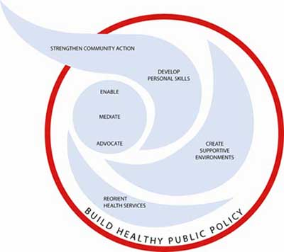
The Ottawa Charter In Action
The Ottawa Charter was developed in 1986 at the First International Conference on Health Promotion. The Charter recognised the many determinants of health and developed five (5) action areas to be used in health promotion to address these determinants. The five action areas are:

Slide 16
The Ottawa Charter In Action
Build Healthy Public Policy – policy development at all levels seeks to promote health. It includes: legislation, fiscal measures, taxation, and organisational change. Health, income and social policies are used to foster equity and ensures safer and healthier goods and services, healthier public services, and cleaner more enjoyable environments. Policies need to identify obstacles to health and seek to remove them, making the healthier choice the easiest one.
Create Supportive Environments – there is a link between people’s health and their environment, requiring a socioecological approach to health. Reciprocal maintenance of environments is the guiding principle. Work and leisure should promote health, not demote it. Thus health promotion should create safe working environments that are enjoyable, assess health impacts of developing infrastructure (buildings, energy etc), and protect natural and built environments.
Strengthen Community Actions – community action is strengthened through communities being involved in setting priorities, making decisions, planning strategies and implementing them to improve health outcomes. The process’ goal is to empower communities, which improves outcomes of health promotion.

Slide 17
The Ottawa Charter In Action
Develop Personal Skills – requires the provision of information, education and life skill development. This increases options and control for individuals over their own health. It is essential to equip people for life long learning and to develop skills for coping with ill health. This is done through school, home, and community settings.
Reorient Health Services – health promotion is the responsibility of governments, institutions, professionals, community groups and individuals. Reorienting health services is about the shift towards a system which promotes health, rather than curative services. Health services need to support the needs of individuals and communities to promote health, connecting the health sector with social, political, economic and physical environments. This requires greater health research and professional education and training. The shift is to focus on the needs of the entire individual, not just their injury, illness or disease.
Argue the benefits of health promotion based on:
The five action areas of the Ottawa Charter
Australia bases its health promotion on these five (5) action areas. The benefits of such an approach include:
Better results of health promotion
Health promotion that addresses all the determinants of health
Greater empowerment of individuals and groups
Health promotion that is based on the principles of social justice

Slide 18
The Ottawa Charter in Action
Beyond Blue
National Tobacco Strategy

Slide 19
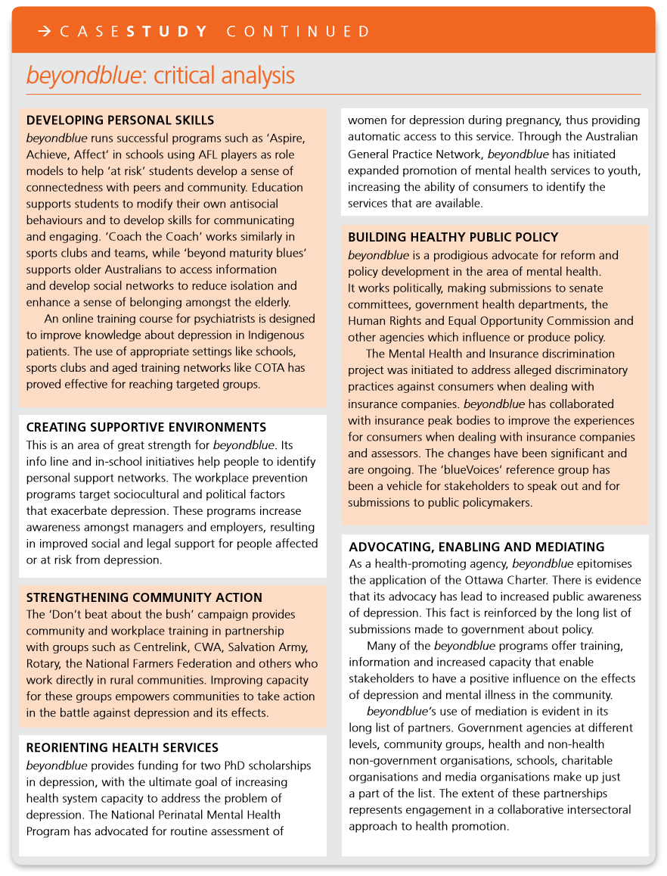

Slide 20
