Slide 1
HIGH LEVELS OF PREVENTABLE CHRONIC DISEASE, INJURY AND MENTAL HEALTH PROBLEMS
STUDENTS LEARN ABOUT:
Cardiovascular disease (CVD)
Cancer (skin, breast, lung)
Diabetes
Respiratory disease
Injury
Mental health problems and illness
STUDENT LEARN TO:
Research and analyse CVD, cancer and ONE other condition listed by investigating:
The nature of the problem
Extent of the problem (trends)
Risk factors and protective factors
The sociocultural, socioeconomic and environmental determinants
Groups at risk

Slide 2
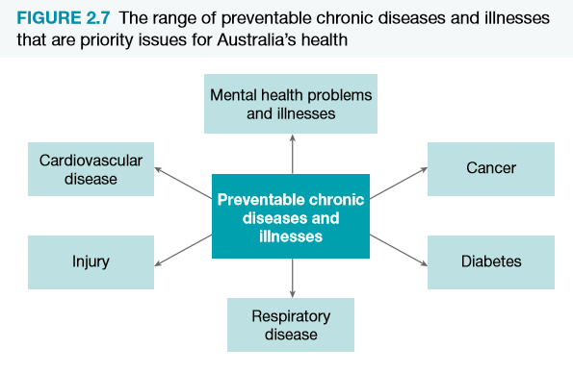
OVERVIEW
The following figure shows the chronic, but preventable, health problems that contribute significantly to the burden of disease and illness in the community.
It is possible to identify:
Risk factors for these diseases and illnesses
Determinants of health
and ways that behaviours can be modified to help reduce the impact.
If health authorities and governments give priority to combating the high prevalence of such diseases and illnesses, the health status of Australians is likely to be improved.

Slide 3
CARDIOVASCULAR DISEASE (CVD)
OVERVIEW:
Refers to damage to or disease of the heart, arteries, veins and/or smaller blood vessels.
Is a major health and economic burden on Australia
One of the leading causes of sickness and death in Australia (almost 30% of all deaths in 2015)
Significant differences in incidence and prevalence among population subgroups
For eg Males are more likely than females to die from the disease
Indigenous people die from the disease at twice the rate of the total population

Slide 4
CARDIOVASCULAR DISEASE (CVD) NATURE OF THE PROBLEM
3 main forms of this disease are:
Coronary Heart Disease – poor supply of blood to the muscular walls of the heart by its own blood supply vessels, the coronary arteries
Stroke – interruption of the supply of blood to the brain
Peripheral Vascular Disease – disease of the arteries, arterioles and capillaries that affect the limbs, usually reducing blood supply to the legs.
CVD is most evident as:
Stroke
Heart attack
Angina
Heart failure
Peripheral vascular disease
Atherosclerosis is the underlying cause of most of these conditions

Slide 5
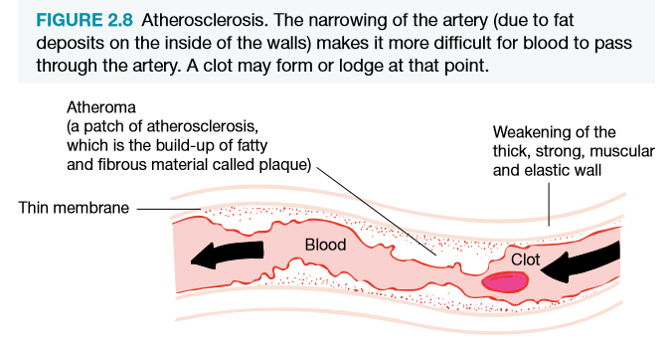
CARDIOVASCULAR DISEASE (CVD) NATURE OF THE PROBLEM CONT…
ATHEROSCLEROSIS – build up of fatty and/or fibrous material on the interior walls of the arteries.
Build up (often plaque – caused by presence of cholesterol) hinders flow of blood to the body’s tissues – also increase blood pressure
Can occur in any artery – greatest threat when it occurs in arteries leading to the brain, eyes, legs or heart.

Slide 6
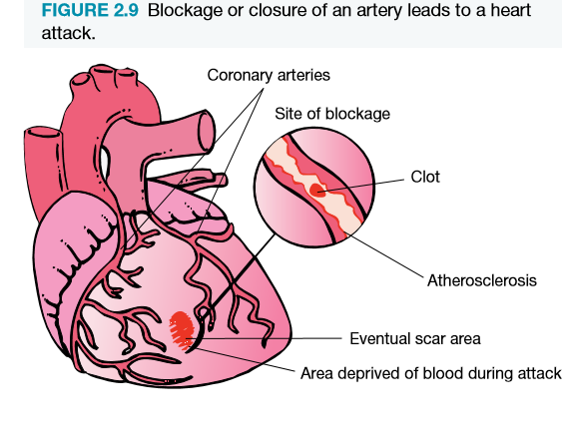
CARDIOVASCULAR DISEASE (CVD) NATURE OF THE PROBLEM CONT…
ARTERIOSCLEROSIS – hardening of the arteries. Is a degenerative disease associated with the process of ageing
As the fatty or fibrous deposits build up – arteries become harder and less elastic
CORONARY HEART DISEASE – also called ischaemic heart disease manifests as a heart attack or angina
HEART ATTACK – also known as a myocardial infarction, coronary thrombosis and coronary occlusion
Caused by complete closure of a coronary artery atherosclerosis or a blood clot

Slide 7
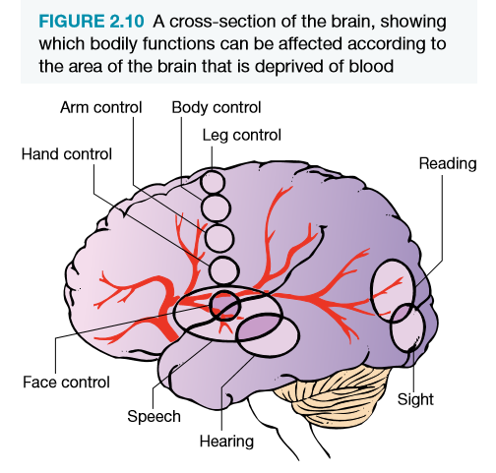
CARDIOVASCULAR DISEASE (CVD) NATURE OF THE PROBLEM CONT…
ANGINA PECTORIS – chest pain that occurs when the heart has an insufficient supply of oxygenated blood (not really a disease - more a symptom of oxygen deprivation)
Generally caused by coronary atherosclerosis
STROKE – a blockage of the blood flow to the brain (known as a cerebrovascular accident)
occurs from an interruption of blood supply (clot) or burst blood vessel
Hypertension is a risk factor

Slide 8
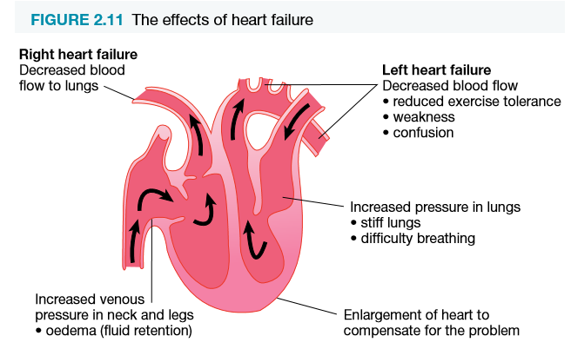
CARDIOVASCULAR DISEASE (CVD) NATURE OF THE PROBLEM CONT…
HEART FAILURE – inability to cater for the demands placed on heart during everyday life
Atherosclerosis, heart attacks, high blood pressure, defective heart valves and infections – affect the hearts ability to supply oxygen rich blood
Heart is unable to compensate for the damaged caused by one of the above problems

Slide 9
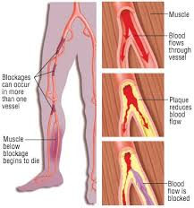
CARDIOVASCULAR DISEASE (CVD) NATURE OF THE PROBLEM CONT…
PERIPHERAL VASCULAR DISEASE – is the result of reduced blood flow to the legs and feet (usually due to atherosclerosis and/or arteriosclerosis)
Usually affects the arteries, arterioles and capillaries of legs and feet and results in cramping feeling and tingling sensations.
Can lead to gangrene and amputation of foot or limb
9/10 people with PVD are smokers

Slide 10
CARDIOVASCULAR DISEASE (CVD) THE EXTENT OF THE PROBLEM
National Heart Foundation – 1 in 6 Australians are affected by CVD (more than 4.2 million people)
Major cause of death for many decades
AIHW trends in cardiovascular deaths (2017) reports in 2015 it was the second leading cause of death (45 400 or 29% of total deaths)
From 1980 – 2015 – steady decline in CVD death rates
MORTALITY
Coronary Heart Disease – leading cause of death in the population overall (12% of all deaths in 2015)
Death rate has decreased by more than one third
Stoke is the next leading cause of death – 7% of all deaths in 2015
Death rates are declining and continue to fall – mainly due to:
A reduction in the levels of risk factors
Improved medical care and treatment

Slide 11
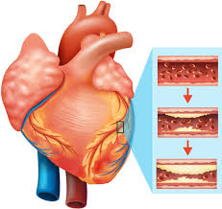
CARDIOVASCULAR DISEASE (CVD) THE EXTENT OF THE PROBLEM CONT…
MORBIDITY
CVD is a leading cause of disability – around 1.4 million Australians estimated to have a disability associated with CVD
Accounted for 6% of hospitalisations in 2013-14 (of these 31% were due to Coronary Heart Disease)

Slide 12
CARDIOVASCULAR DISEASE (CVD) RISK FACTORS AND PROTECTIVE FACTORS FOR CVD
NON-MODIFIABLE RISK FACTORS
Family history
Gender (men more affected than women) – thought to be due to the hormone oestrogen – it is a protective factor
Advancing age
MODIFIABLE RISK FACTORS
Smoking – risk is doubled by heavy smoking
Raised blood fat levels – diet high in saturated fat can raise blood cholesterol levels
High blood pressure – can overload the heart and blood vessels
Obesity and overweight conditions – contribute to high blood pressure, high blood cholesterol and diabetes
Abdominal obesity
Physical inactivity – increase obesity, high blood pressure and high fat levels

Slide 13
CARDIOVASCULAR DISEASE (CVD) RISK FACTORS AND PROTECTIVE FACTORS FOR CVD CONT…
Other risk factors also exist – not considered as important as they occur as a minority. These include:
Diabetes – this condition damages blood vessels and arteries tend to develop atherosclerosis as a result
Contraceptive pill

Slide 14
CARDIOVASCULAR DISEASE (CVD) RISK FACTORS AND PROTECTIVE FACTORS FOR CVD CONT…
PROTECTIVE FACTORS INCLUDE:
Regular physical activity
Eating a diet low in saturated fat, cholesterol & salt
Low consumption of alcohol
Maintaining a healthy weight
Appropriately managing stress
Avoiding exposure to tobacco smoke

Slide 15
CARDIOVASCULAR DISEASE (CVD) THE SOCIOCULTURAL, SOCIOECONOMIC & ENVIRONMENTAL DETERMINANTS

Slide 16
CARDIOVASCULAR DISEASE (CVD) GROUPS AT RISK
Tobacco smokers
Family history
Hypertension
High fat diet
Aged 65 and over
Males
Blue-collar workers (labourers and tradespeople who may have higher levels of smoking, alcohol consumption and high fat diets)

Slide 17
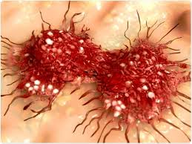
CANCER OVERVIEW
In 2017 – it was estimated that 134 174 cases of cancer would be diagnosed in that year.
Although survival rates are improving (due to early detection strategies and improved treatments), the incidence of several types of cancer is increasing

Slide 18
CANCER NATURE OF THE PROBLEM
Cancer – refers to a diverse group of several hundred diseases with a common feature – the uncontrolled growth and spread of abnormal body cells.
Involves mutation that is believed to originate from a single cell whose genetic material has been influenced or damaged by some foreign agent. This continues and forms a tumour.
Two types of tumour:
Benign tumours – not cancerous. Slow growing and are usually surgically removed
Malignant tumours – cancerous. Spread to other parts of the body and invade healthy tissues. Cause sickness and death.
Metastases – secondary or new tumours. May develop some distance from the original malignant tumour
Around 90% of cancers are products of an individual’s environment and lifestyle.
Carcinogens – agents that are known to cause cancer:
Chemicals, pollution, radiation, cigarette smoke, dietary factors and alcohol

Slide 19
CANCER NATURE OF THE PROBLEM CONT…

Slide 20
CANCER EXTENT OF THE PROBLEM
Prevalence of cancer in the Australian population is increasing.
Cancer Australia estimates:
One in two males and females will develop cancer before the age 85
Cancer contributed to 19% of the total disease burden in Australia.
INCIDENCE
Is the only major cause of death in Australia that is increasing in incidence in both sexes.
Most significant increases in:
Breast, skin and melanoma, prostate cancer
Main reasons include:
Ageing population
Better detection
New diagnostic technology and screening programs
Better reporting of cancer

Slide 21
CANCER EXTENT OF THE PROBLEM CONT…
Most common cancers in Australia are:
Non-melanoma skin cancers
Most frequently occurring life-threatening cancers include:
Prostate, colorectal, melanoma and lung cancer in men
Breast, colorectal, melanoma and lung cancer in women
Cancers occur more frequently in males – except among young and middle aged women (25 – 54). This age group is 3 times higher than males due to prevalence in female cancers (cervix, breast, ovary and uterus)

Slide 22
CANCER EXTENT OF THE PROBLEM CONT…
MORTALITY
All forms of cancer accounted for around 30% of all deaths in Australia 2017 (more male than female deaths)
Lung cancer – major cause of death. Declined in males and increased in females. Male rates are still 3 times higher than women
Overall mortality fell slightly from 1991 – 2017
Cervical cancer decreased – due to success of National Cervical Cancer Screening Program
Cancer mortality rates could be reduced by changes to lifestyle, increased knowledge and awareness of risk factors and symptoms, effective screen and early detection

Slide 23
CANCER EXTENT OF THE PROBLEM CONT…

Slide 24
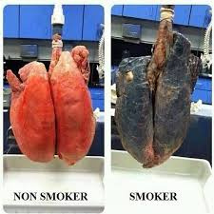
LUNG CANCER
Currently the leading cause of deaths in Australia for men and women (largely preventable)
Most commonly occurring type of cancer
Female death rate is increasing (whilst it is lower than men)
10 times more likely developing lung cancer among smokers than non-smokers
Non-smokers (occupational hazards, air pollution and other environmental factors)

Slide 25
BREAST CANCER
Second most common cause of cancer-related death in Australian women (only exceeded by lung cancer)
Identified as the underlying cause of death in 2016 for 2976 women – affects 1 in 8 women
Risk and incidence increases with age
No know cause – however a number of factors increase the risk:
Increasing age
Family history
High fat diet
Obesity
Menstruation starting at an early age
Late menopause
Late first pregnancy or not having children
Regular self examination (women over 30) and mammographic screening (women over 50) are vital to reduce mortality

Slide 26
SKIN CANCER
Skin cancer and sun spots – most common of all skin diseases affecting Australians
Skin cancer rates are the highest in the world
Incidence – due to prolonged exposure to UV radiation
Approx. 50% of lifetime exposure occurs in early childhood and adolescent years
More common types (not usually fatal – known as non-melanoma:
Basal cell carcinoma
Squamous cell carcinoma
Malignant melanoma deaths could be avoided through skin protection and early detection
Most common in both sexes – 10-59 years
Malignant melanoma will spread to other parts of the body if undetected and not treated

Slide 27
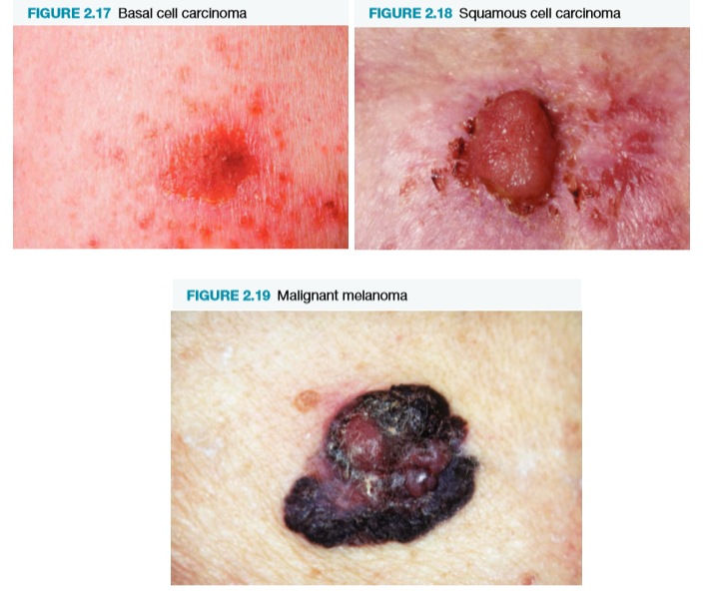
SKIN CANCER CONT…
According to Cancer Council of Australia – over 2000 Australians die from melanoma and non-melanoma skin cancer each year.

Slide 28
RISK FACTORS & PROTECTIVE FACTORS FOR CANCER (LUNG, BREAST & SKIN)
MAJOR RISK FACTORS
Lung Cancer
Tobacco smoking
Occupational exposure to cancer-causing agents (carcinogens like asbestos)
Air pollution
Breast Cancer
Family history
High fat diet
Early onset menstruation
Late menopause
Obesity
Benign breast disease
Late first pregnancy or childlessness
Skin cancer
Fair skin, red hair and blue eyes combined with residence in high sun exposure areas
High number of hours in sun
Prolonged exposure – especially as a child/adolescent
Number and types of moles on skin

Slide 29
RISK FACTORS & PROTECTIVE FACTORS FOR CANCER (LUNG, BREAST & SKIN) CONT…
MAJOR PROTECTIVE FACTORS
Lung Cancer
Avoid exposure to tobacco smoke and hazardous materials such as asbestos
Breast Cancer
Diet high in fruits and vegetables, low in fat
Practise self-examination
Regular mammograms if over 50 years
Skin Cancer
Avoid exposure to strong sunlight
Reduce exposure – wear hat, sunscreen, protective clothing and sunglasses

Slide 30
THE SOCIOCULTURAL, SOCIOECONOMIC & ENVIRONMENTAL DETERMINANTS

Slide 31
GROUPS AT RISK CANCER
Cancer is a significant cause of death in all age groups
Groups at higher risk of developing various cancers:
Lung Cancer
Cigarette smokers
Exposure to occupational or environmental hazards
Blue-collar occupations
Men and women aged over 50 years
Breast Cancer
Women who have never given birth
Obese
Over 50 years
Direct relative with breast cancer
Women who don’t practise self examinations
Early menstruation, late menopause
Skin Cancer
Fair skin
Lower latitudes (live closer to the equator)
Outdoor occupations
Too much time in sun without protection

