Slide 1
Initial planning considerations
Students learn about:
Performance and fitness needs (individual, team)
Schedule of events/competitions
Climate and season
STUDENTS LEARN TO:
Describe the specific considerations of planning for performance in events/competitions

Slide 2
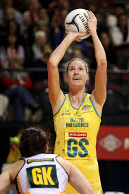
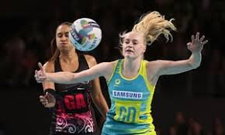
INITIAL PLANNING CONSIDERATIONS
The initial planning considerations focuses on the specific sport of the athlete/s.
The sport is broken down to identify specific components of fitness that are more fundamental.
These components of fitness then become the focus for planning training programs as they must be developed in both the individual and the team.
Some sports have different positions, with different fitness requirements, thus a focus on the individual is also needed.
Sports and positions within them have specific performance requirements, and some have specific skill sets that need to be developed.
For eg - in netball a GD does not need to be a great shooter.

Slide 3
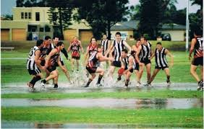
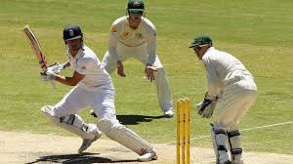
INITIAL PLANNING CONSIDERATIONS CONT…
The type of competition needs to be analysed
Some sports have a six (6) month period of competition, followed by an off season (e.g. Cricket)
Some sports have a small number of major competitions at various times and locations throughout the year (e.g. Tennis)
The schedule of events/competition needs to be examined in the initial planning considerations for improved performance.
Climate and season should also be considered.
Cricket is a summer sport and is played for long periods of time in the heat
AFL is a winter sport.
These sports have different planning considerations simply because of the weather, not just because they are different sports.

Slide 4
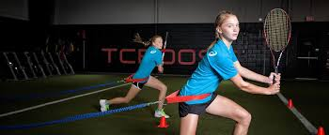
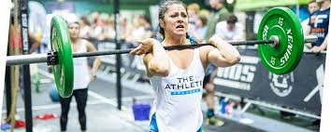
Performance and fitness needs
The performance and fitness needs considered are both sport and athlete specific.
Sport specific - because the components of fitness should be relevant to the sport, and the performance requirements identify the skills and other components used in the sport needing development.
Athlete specific - so that each individual athlete improves for their specific role in competition and meet their own specific goals and starting points.

Slide 5
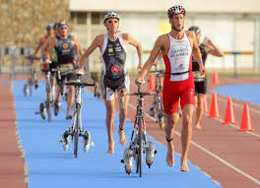
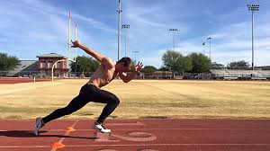
Sport specific performance and fitness needs
The athlete’s sport should be broken down into its various components and the key components of fitness identified.
Both the skill and health related components of fitness should be identified, so that training can focus on those most relevant to the sport.
For eg - a triathlete would focus on their cardiovascular fitness
100m sprinter should focus on reaction time and power.
In team sports, the sport specific performance and fitness needs are essentially the performance and fitness needs of the team.
An AFL team will all need good cardiovascular endurance, power, muscular endurance, coordination.
Will also have performance needs such as the ability to tackle well, kick accurately, and communicate effectively.
These are all team performance and fitness needs.
In addition to these, other team needs could include: tactics and strategy, leadership roles, training days etc.

Slide 6
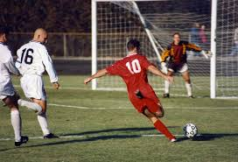
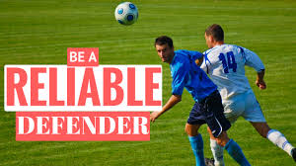
Athlete specific performance and fitness needs
Each athlete begins the training year with their own levels of fitness, injuries, and goals for the season.
Individuals have different roles in the teams strategies and tactics - often specialise in particular positions.
For eg - a football striker needs to be fast, and fit, as well as coordinated.
Need to have very accurate shooting skills and an ability to create space and make well timed runs that provide opportunities to score.
A center back does not need to have the same accuracy in shooting or the ability to make well timed runs.
They need to be able to predict athlete’s movements, make effective tackles and perform accurate and effective passes.

Slide 7
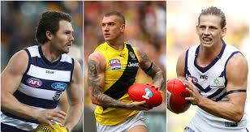
Elite and recreational/amateur differences
ELITE ATHLETES
Have much more detailed and higher level performance and fitness needs.
Will complete a wider range of fitness and performance tests to determine their performance and fitness needs
For eg - Elite AFL player may need to complete level 20 in the beep test and be able to take marks under pressure from opposition.
RECREATIONAL/AMATEUR ATHLETES
Would not complete as many tests and would often have more general low level performance and fitness needs.
For eg - may need to only achieve level 8 in a beep test, and want to work on their ability to catch and kick a ball with no pressure.
They may only need to perform for 15 minutes and be regularly substituted off the field.
Their goals (not have detailed goals, broken down into sub goals) may be to develop relationships and learn everyone's name, rather than be performance focused.

Slide 8
Schedule of events/competitions
When planning training programs - initial consideration will include the schedule of events/competitions.
When creating a training calendar/schedule – identify when major events and competitions are held (athlete needs to peak their performance for competition).
Careful planning of training leading up to, during and after events/competitions is vital for an athlete to perform their best when it counts.
No good peaking during the off or pre-seasons.
The schedule of events/competitions is used to guide the creation of a year or more long training program.
Will vary considerably between sports – depending on seasons/weekly comps/finals etc.
A single athlete may have a larger number of scheduled events/competitions than others.
For eg - a Rugby League player in the NRL will have weekly competitions
May also play in major events such as the state of origin, and international competitions
May also play in the rugby 9’s competition during pre-NRL season.
Their schedule should note the location of events, as many major events/competitions occur in different locations, both within a country and around the world.

Slide 9
Elite and recreational/amateur athletes different schedule of events/competitions
Schedule of events/competitions becomes more complex for elite athletes compared to recreational/amateur participants.
Elite athletes have a larger array of events/competitions that they can compete in, including club, representative, state and international levels of competition.
Many recreational/amateur athletes do not make schedules of competition, they simply know when they are competing and turn up.
They may not create any form of schedule or detailed training program around the schedule.
For eg - Comparing elite football players with recreational/amateur players.
An elite football player would be playing in a national competition.
Plays in the A-League.
Compete in the Asian Champions League and play for Australia in multiple international games
These competitions all overlap and form a complex matrix of events/competitions. Therefore, the need for a schedule is high.
Recreational/amateur players plays in the local comp each week with finals at years end – not as complex or demanding

Slide 10
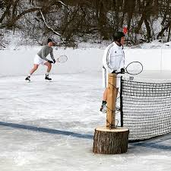
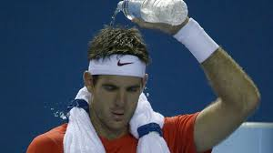
Climate and Season
Climate and season are important when planning training programs.
Many sports have a season in which they are played.
Football (AFL, NRL) is played during the winter season
Cricket is played throughout summer
There are a number of sports that do not have specific seasons
Such as tennis and golf
These sports have various major competitions throughout the year, and do not focus on specific seasons.

Slide 11
Climate and season cont…
Climate and season is important - it determines the type of environmental conditions in which the sport will be played.
The climate and season then affect how to best prepare for the sport.
A sport played in summer, should be prepared for by training in the heat with summer like conditions.
Climates also need to be considered - each location has a different climate, and should be prepared for in a similar climate.
Considerations concerning climate may also include the altitude the sport competition is played at, or which area of the world.
Tennis competitions are held at various locations around the world, each requiring specific preparation according to the climate and season where the competition is held. There is a similar situation around athletics, world cups and Olympic competitions.

Slide 12
Elite and recreational/amateur differences
Elite athletes will have to consider a wider range of climates and seasons in their planning.
Have to travel around the country for their national competition and around the world for the international competitions - moves them into different climates and seasons, depending on the location.
For eg - a professional football player, may have a regular competition in England, compete in the Europe cup, but then be required to travel to Asia or Australia for international competitions.
The recreational/amateur participant does not have the same issues.
Do not travel large distances
Only have to consider the climate and season at the local level where they play.
The climate may change with the weather, but it will not have the same amount of variation as an elite player has to adapt to.

