Slide 1
MEASURING HEALTH STATUS
STUDENTS LEARN ABOUT:
Role of epidemiology
Measures of epidemiology (mortality, infant mortality, morbidity, life expectancy)
STUDENTS LEARN TO:
Critique the use of epidemiology to describe health status by considering questions such as:
What can epidemiology tell us?
Who uses these measures?
Do they measure everything about health status?
Use tables and graphs from health reports to analyse current trends in life expectancy and major causes of morbidity and mortality for the general population and comparing males and females

Slide 3
MEASURING HEALTH STATUS
Australians enjoy relatively high levels of health compared to many other nations. Statistics reveal that we have a relatively long life expectancy, declining death rates and reasonable access to health care.
Epidemiology has a vital role in determining the priority areas for Australia’s health.
Health priority issues are those health issues that are of greatest concern to governments and support organisations due to the effect they have on the overall health of Australians and the burden of health on the economy.

Slide 4
MEASURING HEALTH STATUS cont..
Health status is the pattern of health of the population in general over a period of time.
We measure health status through the process of data and information collection knows as epidemiology, which is the study of disease in groups or populations to identify patterns and causes.
This information is collated annually by governments/organisations such as:
Australian Bureau of Statistics (ABS)
Australian Institute of Health and Welfare
Non government agencies (such as the Cancer Council and the Heart Foundation)

Slide 5
ROLE OF EPIDEMIOLOGY
Epidemiology is “the study of the patterns and causes of health and disease in populations and the application of this study to improve health.” Data is collected from hospitals, GPs, health care practitioners, surveys and census information.
WHAT CAN EPIDEMIOLOGY TELL US?
The basic health status of Australia in terms of quantifiable measures of ill health.
This data is gathered and used to provide:
trends in disease incidence and prevalence along with information about:
ethnic, socioeconomic and gender groups.
Epidemiology uses data on death rates, birth rates, illnesses, injuries, treatments provided, work days lost, Hospital usage, and money spent by both consumers and the government.
WHO USES THESE MEASURES?
Researchers
Health department officials
Government
Health or medical practitioners
This data is used to help identify priority health issues and possible causes of disease or illness.

Slide 6
WHAT CAN EPIDEMIOLOGY TELL US?
Monitoring the major causes of sickness and death to identify any emerging issues and inequalities between group
Identifying areas of need so that speciﬁc prevention and treatment interventions can be speciﬁcally targeted
Determining priority areas for the allocation of government funding
Monitoring the use of health care services and facilities evaluating the eﬀectiveness of any prevention and treatment programs
Monitoring the use of health care services and facilities

Slide 7
Who uses epidemiology?
Policy developers at all levels of government
The manufacturers of health products
The providers of health service
Individual consumers

Slide 8
DO THEY MEASURE EVERTHING ABOUT HEALTH STATUS? (Limitations)
Epidemiology has proven to be an effective approach but it has some limitations
For example, epidemiological statistics:
Doesn’t always show the significant variations in health status among population groups (ATSI and Non-ATSI)
Doesn’t accurately indicate quality of life (distress, impairment, disability, handicap etc)
Cannot provide whole health picture (data on mental health are incomplete or non-existent)
Fail to explain ‘why’ health inequities persist
Doesn’t account for determinants that shape health (social, economic, environmental & cultural)

Slide 9
BROARDENING THE FRAMEWORK OF EPIDEMIOLOGY
Despite limitations – it provides valuable scientific information about disease and associated risk factors
Health authorities have acknowledged the need to adopt a measurement approach that focuses on the health of populations more than the diseases of individuals
To address inequities in health – need to go beyond the disease and risk factors to the environmental and social frameworks in which individuals live
For eg – the higher rates of morbidity and mortality in rural and remote populations are directly related to the social and environmental context of these communities

Slide 10
MEASURES OF EPIDEMIOLOGY:
Mortality (death rates): indicates how many people die in a particular population, how they died and over what period. Expressed per 100 000.
Infant mortality: indicates the number of infant deaths in the first year of life per 1000 live births
Life expectancy: indicates the number of years a person is expected to live.
Morbidity (disease and sickness rates): examines the prevalence and incidence of disease and sickness in a specific population

Slide 11
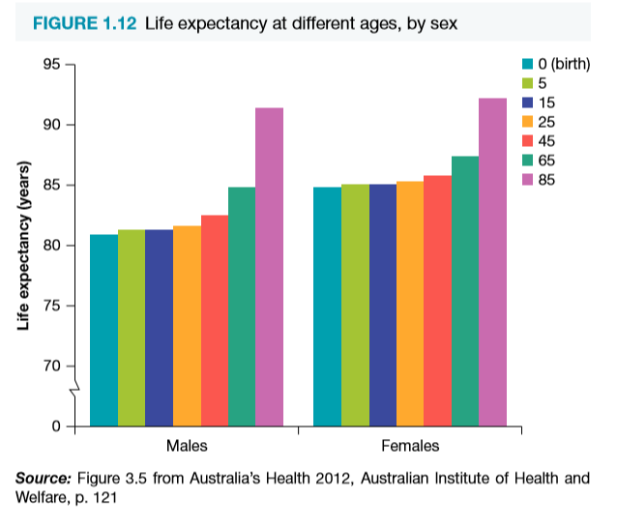
USE TABLES AND GRAPHS FROM HEALTH REPORTS
LIFE EXPECTANCY
Life expectancy is the length of time a person can expect to live. It can be defined as the number of years of life a person of a particular age has remaining.
Australia’s life expectancy is increasing for both males and females
Females have a higher life expectancy than males.
Australia is 6th in the world for males and 7th for females.
For people born in 2008-2010, average life expectancy at birth was 84.0 yrs for female and 79.5 yrs for male.
Life expectancy is greater now than it was a few decades ago and is increasing due to lower infant mortality, declining death rates for CV disease, declining death rates from Cancer and a fall in deaths from traffic accidents.

Slide 12
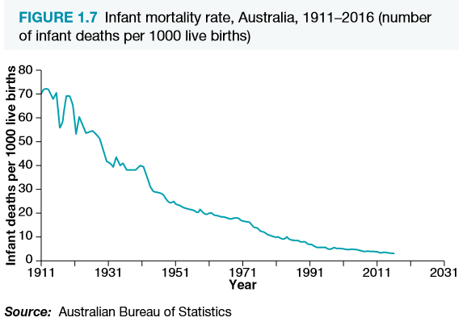
INFANT MORTALITY
Infant mortality rate is the number of infant deaths in the first year of life per 1000 live births.
This measure is considered to be the most important indicator of the health status of a nation, and can also predict adult life expectancy.
Infant mortality can be divided into:
Neonatal (deaths in the first 28 days of life)
Post-neonatal (deaths in the remainder of the first year of life)
The decline in the infant mortality rate over recent decades can be attributed to:
Improved medical diagnosis and treatment of illness
Improved public sanitation
Health education
Improved support services for parents and newborn babies and children

Slide 13
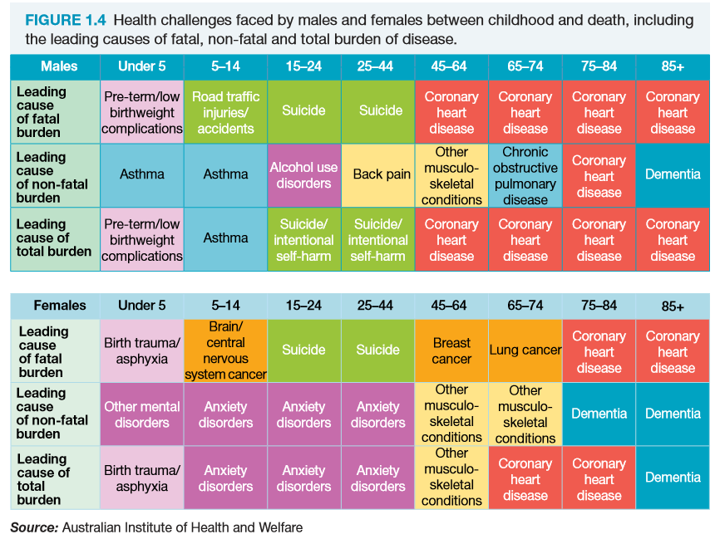
MORTALITY
Mortality is the number of deaths in a group of people or from a disease over a specific time period, usually one year.
In Australia overall – the main causes of death are cancers, CV disease and respiratory diseases. For some of the leading causes of death, such as heart disease, strokes and some types of cancer, the death rates are falling.

Slide 15
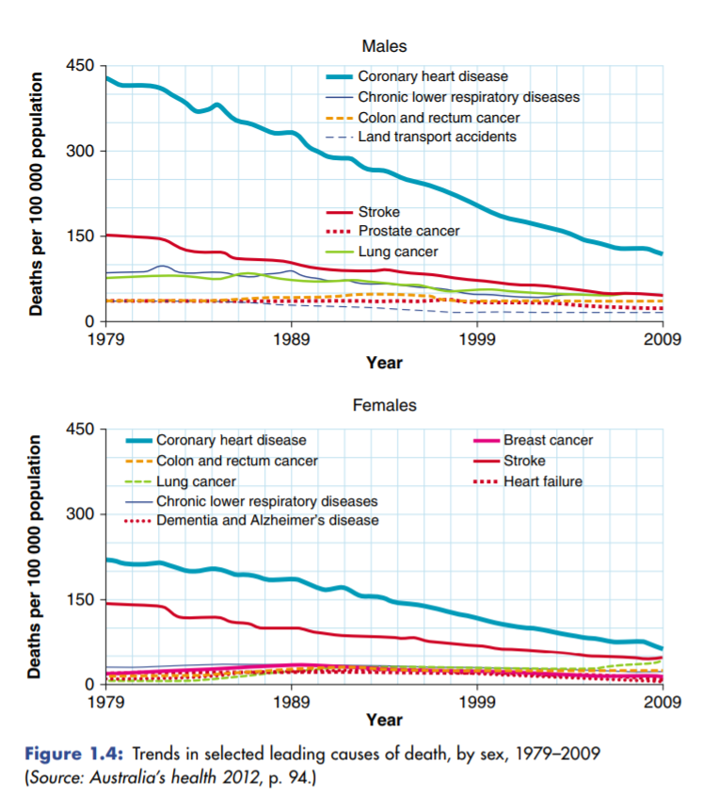
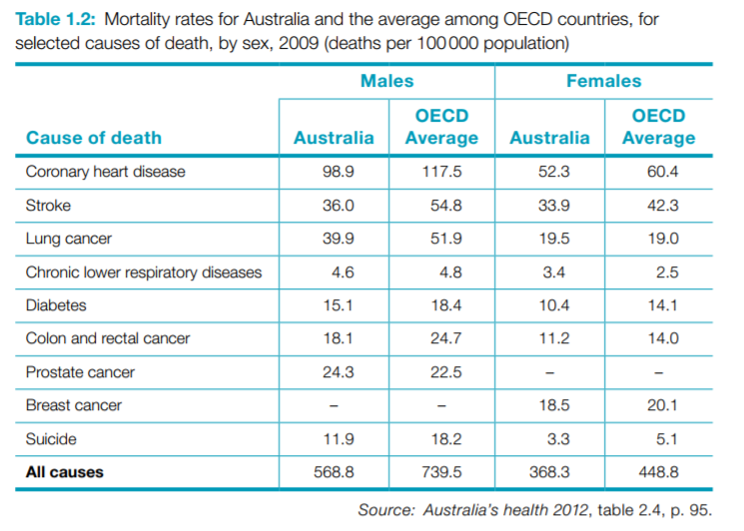

Slide 16
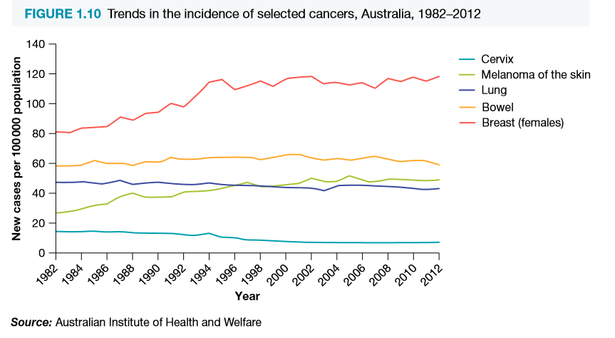
MORBIDITY
Morbidity (sickness) refers to patterns of illness, disease and injury that do not result in death. Illness, disease and injury are all conditions that reduce our quality of life, either temporarily or permanently.
Morbidity measures and indicators include:
Hospital use (the cause and number of admissions to hospital)
Doctor visits and Medicare statistics (services claimed on Medicare)
Health surveys and reports
Disability and handicap

Slide 18
PAST TRIAL/HSC QUESTIONS
What are the measures of epidemiology used to describe the health status of Australians? (3 marks) (Trial HSC Question)
Describe the limitations of epidemiology (4 marks) (HSC Question)

Slide 19
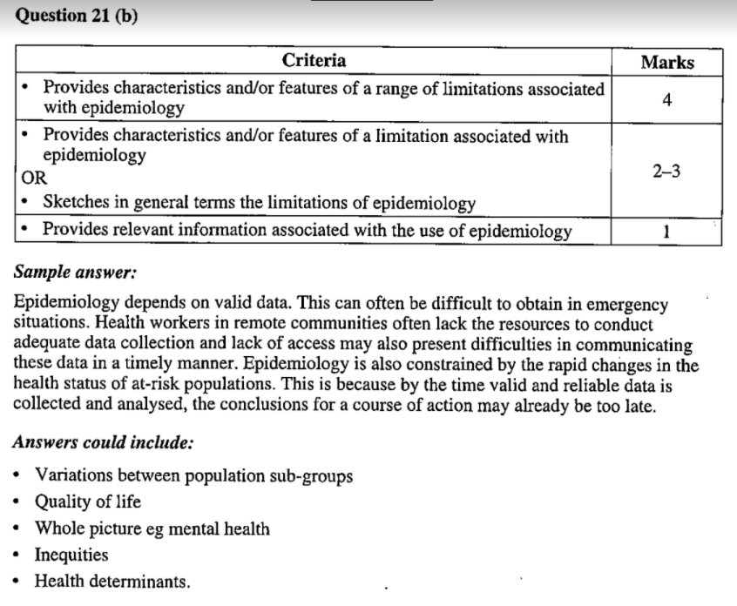
ANSWERS
Question 1 (3 marks)
Question 2 (4 marks)

