Slide 1
How can nutrition and recovery strategies affect performance

Slide 2
Overview
How can nutrition and recovery strategies affect performance examines the relationship between performance and nutrition, and recovery strategies.
This is possibly the most important aspect of sports performance, separating the elite and the amateur or recreational athlete.
Nutrition includes both liquids and foods. Nutrition is also a recovery strategy as taking particular nutrients at certain times helps to speed up recovery after training or a game etc.
Your performance is affected by your health so focusing solely on performance is not advantageous
Supplementation in sport has become a big business, with many non-elite athletes and exercise enthusiasts getting on the band wagon. You particularly need to consider if supplements are beneficial to performance at all, or if they are simply a money making ploy.

Slide 3
Nutritional considerations
Nutritional considerations include pre, during, and post performance needs. Nutrition is vital to bodily functions and should always be in balance.
As athletes place more stress on their bodies and use their bodies more than others, they require greater amounts of vegetables, fruit, dairy, protein, fats and grains.
An athlete may benefit from other nutritional considerations before, during and after a performance. Such as:
Carbohydrate loading before endurance events
The consumption of glucose and electrolytes during events lasting longer than 60 minutes
Replacing glycogen and fluid lost after performance.

Slide 4
Pre - performance
Before competition an athlete should ensure they are well hydrated.
Hydration is vital to performance and an athlete needs to ensure they drink a minimum 2-3L the day before competition, then drink 500mL in the morning of the competition, and a further 250mL 30min before competition provided hydration has been maintained throughout the day.
Before competition an athlete should not try to eat anything new as it could have a negative impact on their performance.
Consuming around 100g of complex carbohydrates 304hrs before competition.
For example - a bowl of porridge, a dark wholemeal bread or muesli.
Amount of food consumed before competition should decrease in size as you approach the start time
Moving from a full meal to a small snack, such as a muesli bar 1-2 hrs before competition and only liquids after this time.

Slide 5
Pre - performance
Carbohydrate loading is the process used by athletes to ensure glycogen stores in muscle and the liver are at their maximum. They do this by tapering training levels and consuming large amounts of complex carbohydrates in the week before competition. Carbohydrate loading benefits performance that would normally deplete glycogen stores and delays the onset of fatigue caused by a greater reliance on fat to produce ATP in the aerobic energy system.
Carbohydrate loading will allow for higher aerobic intensities being maintained for longer, can help ensure glycogen stores remain for a late burst of speed in the lactic acid energy system.
Carbohydrate loading will only benefit sports that go longer than 60min, such as soccer, rugby, or Australian Rules Football.

Slide 6
During performance
During performance you need to maintain hydration and for extended periods of exercise, taking opportunity to replenish blood glucose levels.
Dehydration decreases concentration and the body’s ability to function. It is recommended that athletes consume approx. 1L throughout every hour of activity.
More frequent consumption is ideal
Sports performance can be assisted by consuming sports drinks such as Gatorade or PowerAde during performance to replenish glucose. This additional glucose is transported through the bloodstream to the muscles for use in either the aerobic or lactic acid systems. This delays fatigue as it spares muscle glycogen that can be used in later performance.
Salts in sports aid in holding in fluids and replace salt lost through sweat (sodium and potassium)
Example – An AFL player might consume Gatorade to replace fluid and salt lost through sweat, and in order to gain glucose to aid performance by delaying fatigue caused by glycogen depletion.

Slide 7
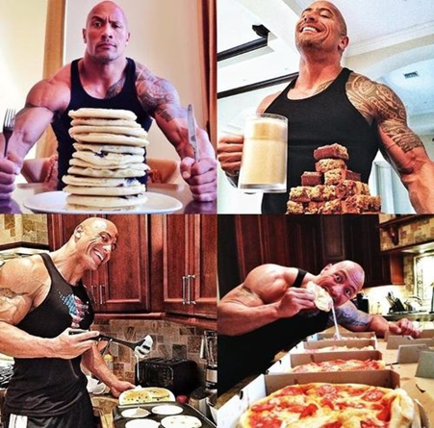
Post-performance
The goal of nutrition post-performance is to restore the bodies fuel stores and provide the nutrients required for muscular repair and recovery. The nutrients needed are: water, carbohydrates and protein.
It’s important for an athlete to know their sweat rate and to replace any fluid lost during competition. Athletes can calculate their sweat rate by weighing themselves before and post-performance and keeping track of the fluid they consume. They can then subtract their end weight from their pre-performance weight; minus the fluid consumed to find how much sweat they lost during the competition. Athletes should then consume all the fluid lost over the first hour post-event and then continue to maintain hydration.
Each kilogram of weight loss indicates 1L of fluid loss

Slide 8
Post-performance
Carbohydrates are consumed in order to restore glycogen stores that have been lost in both muscle and liver. Initially high GI foods can be eaten, but a large meal of complex carbohydrates 1-2hrs post-performance is recommended. Further carbohydrates will need to be consumed over 24-48hrs in order to restore and possibly increase glycogen stores.
Protein should be consumed 1-2hrs post-performance to help repair damaged tissue. This is particularly important for power and strength based activities and contact sports, where body tissue is frequently damaged.
In addition to this, a good sleep is vital for recovery. The body repairs itself and recovers during sleep. Sleep is still THE BEST recovery strategy available.

Slide 9
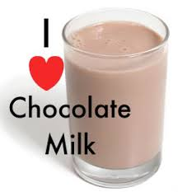
Post-performance
Compared to plain milk, water, or most sports drinks – Chocolate Milk:
It has double the carbohydrate and protein content, perfect for replenishing tired muscles.
Its high water content replaces fluids lost as sweat, preventing dehydration.
Plus it packs a nutritional bonus of calcium, and includes just a little sodium and sugar additives that help recovering athletes retain water and regain energy.
Drinking plain water after exercise replaces sweat losses.
Chocolate milk provides carbohydrate replenishment to your muscles.

Slide 10
Compare the dietary requirements of athletes in different sports
Soccer
General
Players will need 5-8 grams carbohydrate per kg of body weight a day to fuel training sessions and prepare for matches.
Pre Competition
Eat high carbohydrate food 2-4 hrs prior, eg) pasta or rice
Light carbohydrate snack 1-2 hrs prior to top up fuel stores, eg) yoghurt, muesli bar
During Competition
Players with high workloads benefit from half time snack, eg) chopped fruit
Players should access fluids as frequently as possible (keep a bottle in the goals, injury breaks and formal breaks). Sports drinks are beneficial.
Post Competition
A recovery meal that contains carbohydrates, protein and fluid within ~60 minutes, eg) chicken and rice soup or mash potato and lean beef with a water to replace fluids lost.

Slide 11
Compare the dietary requirements of athletes in different sports
Gymnastics
General
Low body mass is advantageous, therefore eating nutritious food with energy over energy foods is recommended.
Eating disorders and low iron levels can be an issue. Restrictive diets are not recommended.
Pre Competition
Light carbohydrate meal to keep the stomach settled 1-2 hrs prior to warm up, eg) fruit and yoghurt
During Competition
Easy to digest foods easy on the stomach with carbohydrates for performance (especially if multiple performances throughout the day), eg) fruit and nuts.
Gymnasts should drink water between performances.
Post Competition
Carbohydrate snack should be eaten straight after cool down, followed by a meal with carbohydrate and protein for recovery.
They should also replace fluid lost with water.

Slide 12
Compare the dietary requirements of athletes in different sports
When we compare the dietary requirements of athletes in the two sports, soccer performance lasts longer and benefits from sports drinks and greater intake of carbohydrate than gymnastics. However, gymnastics requires a leaner physique and strength, therefore, benefiting from greater intake of protein. Given gymnastics can include multiple performances a day for more than 1 day, requirements will be specific to the event.
Further dietary requirements of various sports can be found HERE

