Slide 1
12PDHPE HSC COURSE
Core 2
Factors affecting
Performance
Focus Question 3
How can nutrition and recovery strategies
affect performance?

Slide 2
Students learn about:
Nutritional considerations
-pre-performance, including carbohydrate loading
-during performance
-post-performance
Supplementation
-vitamins/minerals
-protein
-caffeine
-creatine products
Recovery strategies
-physiological strategies, eg cool down, hydration
-neural strategies, eg hydrotherapy, massage
-tissue damage strategies, eg cryotherapy
-psychological strategies, eg relaxation.
Students learn to:
Compare the dietary requirements of athletes in different sports
considering pre-, during and post performance needs
Critically analyse the evidence for and against supplementation for improved performance
Research recovery strategies to discern their main features and proposed benefits to performance.

Slide 3
Nutritional Considerations
Programs designed to improve performance must be supported by solid nutritional practices.
What are some factors that may influence nutritional considerations for athletes?
TYPE OF SPORT/ACTIVITY
TIME OF SEASON/COMPETITION
GOALS TO BE MET
ENERGY
REQUIREMENTS
HYDRATION
REQUIREMENTS
LEVEL OF COMPETITION

Slide 4
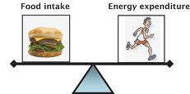
Nutritional Considerations
Being aware of the most appropriate time for food intake and having recovery strategies in place to recoup expended energy. While complete nutritional balance is essential for optimal physical performance, the specific roles of
carbohydrates and hydration are the two most important considerations
Foods not only contain nutrients that power essential body functions, but are the life source of energy supply. Because different foods have differing amounts of energy (carbohydrate supplies 16 kJ/gm, protein supplies 17 kJ/gm, and fat 37 kJ/gm), the type of food consumed prior to competition directly affects the quantity of energy available.
Which type of food is best prior to competition?

Slide 5
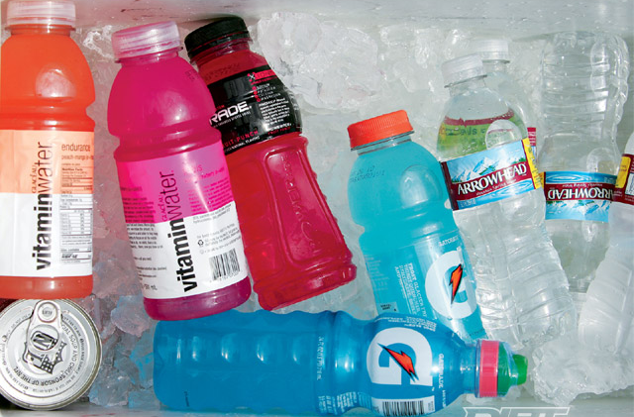
Nutritional Considerations
Hydration involves supplying sufficient water to the body’s cells.
Fluid is also important because it is the body’s medium for cooling heated muscles and ultimately preventing dehydration. It assists in temperature regulation by transporting heat to the outside of the body. It is also important because it prevents damage to organs by diluting toxic waste, aiding oxygen transport to cells, assisting transport waste from the body, and helping eliminate carbon dioxide via the blood plasma.
Thus, a deficiency in fuel or fluid supply contributes to a substandard performance and can place the health of the athlete at risk.

Slide 6
Pre-performance
Undertaking physical activity alters a person’s need for energy, nutrients and fluids. By understanding the dietary needs of athletes and planning eating strategies for before, during and after activity, individuals can:
enhance their recovery
maximise physiological responses from training,
as well as improve their performance.
Prior to an event
Food should be consumed one-four hours before competition
This prevents hunger, ensures the athlete is well hydrated, provides and restores fuel for muscle glycogen stores
Helps the athlete to feel confident
Why would our glycogen stores be a consideration during pre-performance?

Slide 7
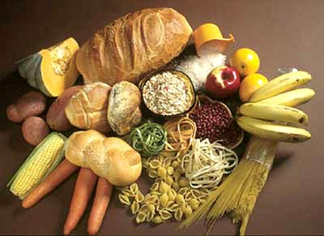
Pre-performance
One major recommendation is that athletes should increase their carbohydrate intake.
This is essential as carbohydrates are broken down into glycogen
Glycogen is the fuel for the lactic acid and aerobic system
Carbs should make up 70% of athletes diet
Carbs should be complex (not simple). EG, pasta and breads
Athletes should decrease their fat intake as it’s the last store of energy utilised
Water is another must as they loose fluid during training and competition – do not wait until you’re thirsty. Continuously hydrate.

Slide 8
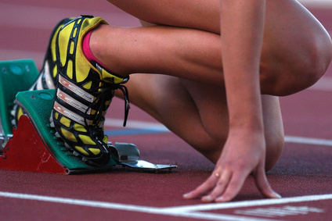
Pre-performance
Muscle glycogen is the most important fuel source for short-term, high-intensity exercise (such as sprinting) as well as during prolonged exercise tasks (such as marathon running).
As muscle levels of glycogen decline, the body will become increasingly reliant on blood glucose, which is derived from its limited stores in the liver. As exercise progresses beyond two hours, the body becomes progressively more dependent on its fat stores.
For events last less then 90 mins, training should cease 36hrs before event and athletes should consume 7 grams of carbohydrates per body kg.

Slide 9
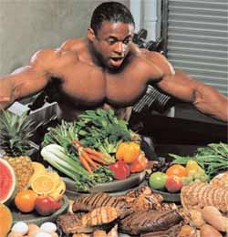
Pre-performance
For events last less then 90 mins, training should cease 36hrs before event and athletes should consume 7 grams of carbohydrates per body kg.
Athletes are advised to adjust the amount of carbohydrate they consume for fuelling and recovery to suit their exercise level:
Light intensity exercise (30 mins/day) 3–5g/kg/day
Moderate intensity exercise (60 mins/day) 5–7g/kg/day
Endurance exercise (1–3 hrs/day) 7–12g/kg/day
Extreme endurance exercise (more than 4 hrs/day) 10–12g/kg/day
For events lasting longer then 90 mins, athletes may benefit from carbohydrate loading

Slide 10
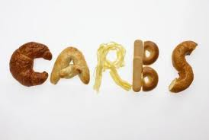
Pre-performance
Carbohydrate loading
This is a strategy involving changes to training and nutrition that can maximise muscle glycogen stores prior to endurance competition.
The technique originally involved a three-day to four-day carbohydrate ‘depletion phase’ and a three-day to four-day ‘loading phase’.
Ongoing research has demonstrated that the depletion phase is no longer necessary and it is now thought that a two-day high-carbohydrate diet (10–12 grams of carbohydrate per 1 kilogram of body mass)
This combined with an exercise taper is sufficient to elevate muscle glycogen levels. It has been demonstrated that this extra supply of carbohydrate improves endurance exercise by allowing athletes to exercise at their optimal pace for a longer time.

Slide 11
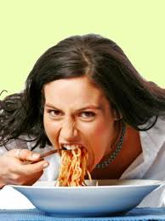
Pre-performance
Carbohydrate loading
Before a competition the athlete should taper exercise and eat a diet high in carbohydrates
This provides the athlete with enough energy for optimal performance
This should be implemented 24 hours before a non-endurance event and 72 hours before an endurance event
http://www.youtube.com/watch?v=U7RhE_TuPRo

Slide 12
Pre-performance
Goals of pre-event meal:
• top up glycogen stores in muscle and the liver especially
after an overnight fast)
• ensure an adequate level of hydration
• prevent hunger
• assist in the psychological preparation of the athlete
through routine or ritual
The following slides contain two different examples of pre-game meal options, look through both and determine reasons why certain foods would be reccomended.

Slide 13
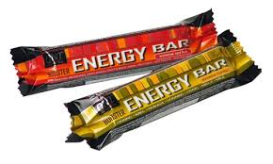
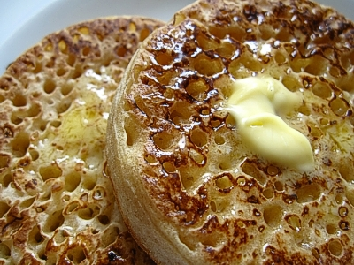
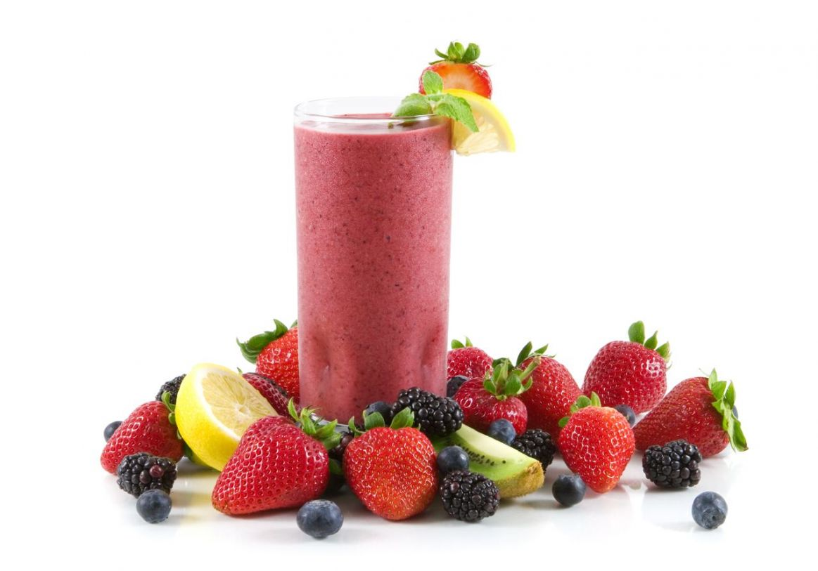
Pre-performance
3-4hrs pre-Event | 1-2hrs pre-Event | Under 1hr pre-Event
Cereal, low fat milk | Fruit smoothie | Fruit juice
Fruit salad, low fat yogurt | Energy bar | Cordial
Backed beans on toast | Fruit | Sports drink
Crumpets with honey | Sports drink | Energy bar
Backed potato
Bread rolls
Energy bar

Slide 14
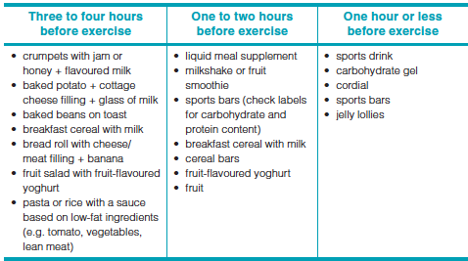
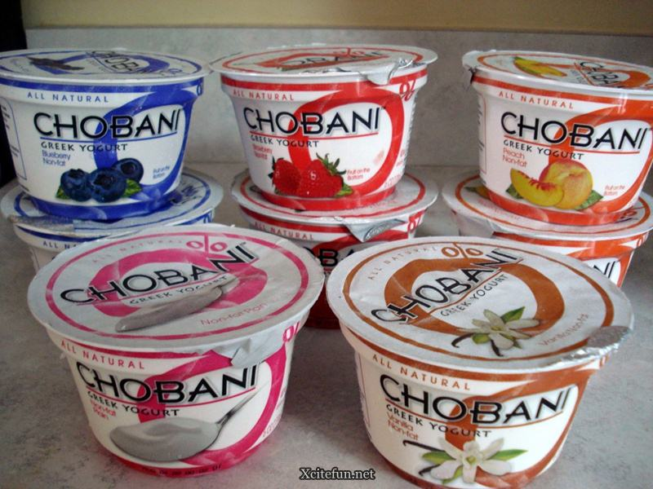
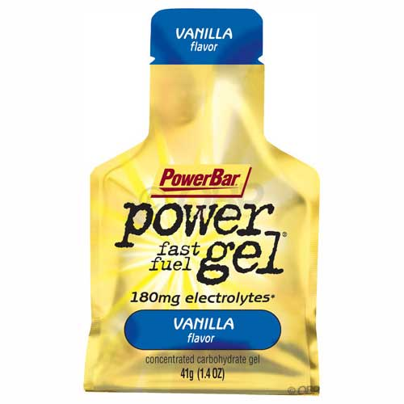
Pre-performance

Slide 15
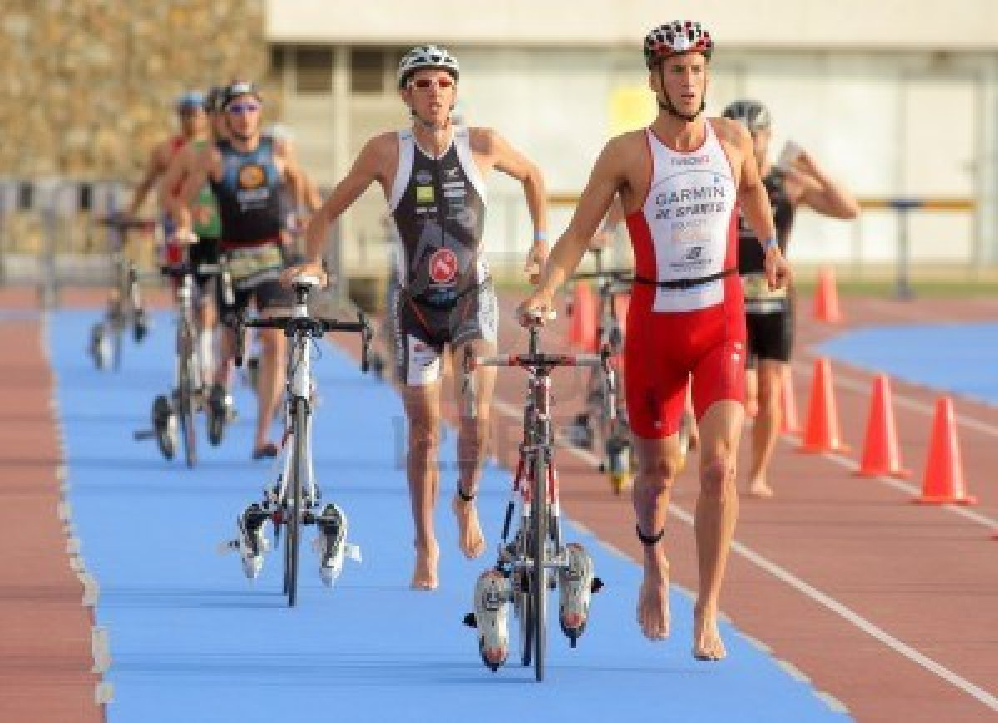
Pre-performance
Foods to be avoided prior to an event
Spicy food = abdominal pain and gas
Alcohol = impairs coordination and dehydrates the athlete
High fat and protein foods = slow digestion and can make the athlete feel sluggish
High fibre foods = abdominal cramping
Sweet foods = causes an insulin reaction lowering blood sugar levels
Activity - design your own pre-performace eating plan for a triathlete

Slide 16
During performance
The goal of nutrition intake during exercise is to:
minimise the fluid deficit
in the case of exercise of moderate to high intensity lasting longer than 60 minutes, provide an additional fuel source for the muscles and central nervous system.
Intake of carbohydrate during exercise provides an additional fuel source and has the potential to improve exercise capacity in situations where muscle or liver glycogen stores may limit performance.

Slide 17
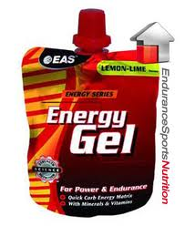
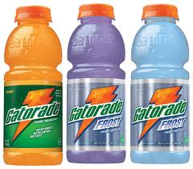
During performance
Regular fluid intake is important especially in events over 30 minutes
Endurance athletes should consume 30-60g of carbohydrates per hour
These carbohydrates should be easy to digest eg.
bananas
jelly beans
energy gels
sports drinks

Slide 18
During performance
Endurance events, particularly in hot and possibly humid conditions, can have a significant impact on the body’s fuel and fluid supplies. In these events, the need for carbohydrate and electrolyte replacement depends on a number of factors including intensity, duration, humidity, clothing type and individual
sweat rates.
Electrolytes are salts and minerals, such as sodium, potassium, calcium and magnesium, that are important for many body functions such as chemical breakdown and nerve conduction. Electrolytes can be lost through perspiration during
exercise.

Slide 19
During performance
Nutritional considerations for performances need to address the following.
- The aim is to conserve muscle glycogen and maintain blood glucose levels.
• Carbohydrate supplementation is needed to avoid glycogen depletion. Be aware that at exercise intensities above 75 per cent of aerobic capacity, liquid carbohydrate feeding (sports drinks) can delay glycogen depletion by up to 30 minutes.
• Glycogen supplementation is not needed for low-intensity, short-duration
exercise.

Slide 20
During performance
• Adequate hydration by regular fluid intake must be maintained. Athletes should have a fluid replacement plan that matches their body’s requirements and the exercise duration and intensity.
It is suggested that 200–300 mL of fluid, preferably in the form of a sports drink, be taken in every 15–20 minutes during exercise. Sports drinks contain liquid carbohydrate and serve both to hydrate and energise.
• An athlete should not wait until thirst develops before replenishing lost fluid.
Dehydration is an excessive loss of water.

Slide 21
During performance
To prevent dehydration. The following are the most important.
• Hydrate before, during and after physical activity. Thirst is not a good indicator of the body’s need for fluid; by that time, dehydration has already started to take effect.
• Drink every 15 to 20 minutes while running. Runners lose between three and five cups each hour, so it is important never to miss an opportunity to ‘top up’.
Drink water or low-carbohydrate concentration
• sports drinks. Cool plain water or sports drinks that have four to eight per cent carbohydrate concentration are recommended. Concentrations higher than eight per cent are not recommended because they slow the body’s absorption rates.

Slide 22
During performance
Ensure that you have trained properly and acclimatised to race conditions. Trained and acclimatised athletes are able to control their body temperature more effectively than those who are untrained and who have failed to acclimatise
• Wear clothing that ‘breathes’. Light ‘airy’ clothing promotes heat loss through convection and evaporation.
• Avoid activity in times of high temperature and high humidity.
body heat cannot be lost through evaporation because the air is already saturated. Exercise is considered safe when the temperature is below 30°C and the relative humidity is below 90 per cent.

Slide 23
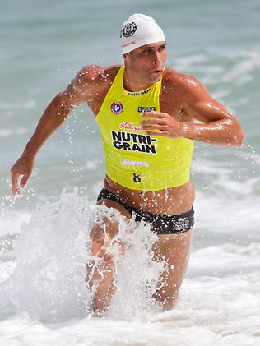
Triathlon – Ultimate endurance
Triathlon is an activity that combines swimming, cycling, and running in one event. The Olympic, or “standard” distance in triathlon is a:
1500 metre swim
40 kilometre bike
10 kilometre run.
Australia has cemented on both an Olympic level & Iron Man having has world champions named in both disciplines of triathlon.
Ironman Triathlon is
3800m swim
180km bike
42km run
What nutritional considerations would a triathlete
need?

Slide 24
Triathlon – Ultimate endurance
Recovery
Timing of Meals
Carb
Loading
Weight Management
Pre Race
During event
Travel

Slide 25
Post Performance
From a nutrition standpoint, the goals of recovery are as follows:
• Refuel carbohydrate (energy) stores.
• Rehydrate to replace fluids and electrolytes lost in sweat.
• Repair and regenerate damaged muscle tissue.
• Revitalise and maintain good immune function.
A post-performance nutritional plan aims to return the body to its pre-event
state as quickly as possible, enabling full training to resume in preparation
for the next phase of competition. This is best achieved through proactive
recovery
Proactive recovery emphasises immediate refuelling and rehydration that continues until a pre-event state is obtained.
This means that refuelling and rehydration begin immediately and continue for 8–12 hours following the performance. This enables optimisation of body repair and regeneration processes.

Slide 26
Post performance meals/snack
Fruit salad
Energy bar
Sports drinks
Sandwich with meat filling
Liquid meal supplements
pasta/rice/breads

Slide 27
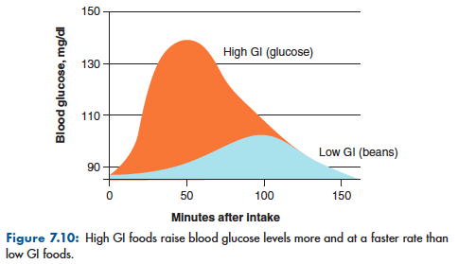
Post Performance
Important for restoration of liver glycogen stores, repair muscle tissue and replace food
The meal post event should be high in carbohydrates and protein.
Carbohydrates should be taken immediately after event. An intake
high in carbohydrate and inclusive of food and drinks with a high glycemic index (GI) is most beneficial.

Slide 28
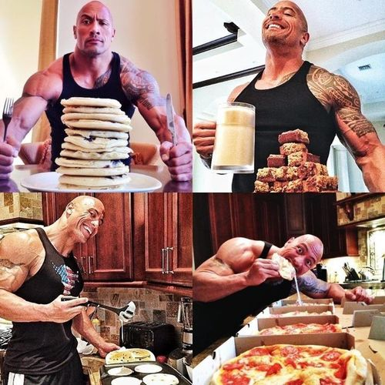
Post Performance
The night meal after the event should be high in carbohydrate and protein to assist with muscle regeneration and glycogen stores
Ideally, athletes should drink to a plan based on their own sweat rates during training and competition. While water is always a good fluid to choose, sports drinks can have the advantage of supplying carbohydrate during and after the event, as well as sodium (electrolytes) to help in the absorption of the fluid into the body.
• active rest that enhances the manufacture of red blood cells, new proteins and specific cellular components damaged by stress-related movements.

Slide 29
Hydration
Unless fluid losses are replaced during exercise, an athlete will become dehydrated. Dehydration impairs performance by causing the following:
increased heart rate
impaired heat regulation
increased perceived exertion (i.e. exercise feels harder than usual and the athlete fatigues earlier)
reduced mental function
reduced skill level
stomach upset
All levels of dehydration impair performance and the magnitude increases as the degree of dehydration increases.
FACT: When you are 2% dehydrated, you work at 90% of your maximal effort.

Slide 30
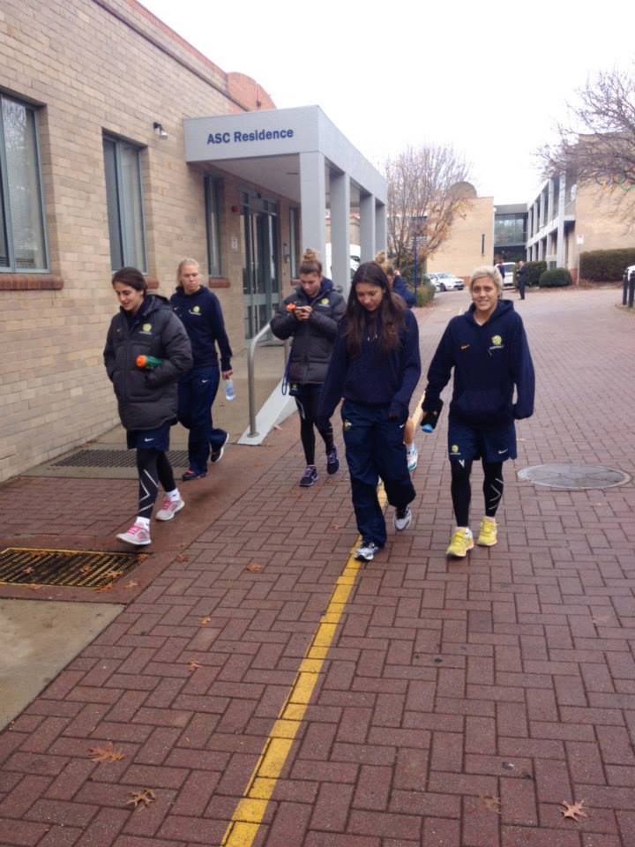
Hydration
In order to minimise dehydration, athletes need to drink enough during exercise to match their sweat losses.
Sweat loss can be determined by weighing athletes before and after exercise. Each kilogram of weight loss indicates 1 litre of fluid loss. Adding the amount of fluid consumed during the exercise session, gives total fluid loss for the session.
For example, if an athlete finishes an exercise session 1 kg lighter and has consumed 1 litre of fluid during the session, total sweat loss equals 2 litres.
Once an athlete's average sweat loss is known, a plan can be prepared to enable the athlete to match sweat losses in subsequent exercise sessions.

Slide 31
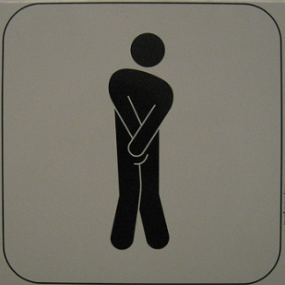
To pee or not to pee?
What does pee indicate?
While testing fluid levels, the amount of urination expected if liquids have been consumed is actually expected to be minimal.
This is a sign that fluid has been absorbed by the body and is being used where it is needed the most.

Slide 32
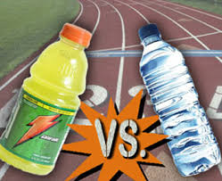
Water vs Sports Drink
WATER IS BEST, one, because its free but more importantly, it can be easily absorbed by the body
HOWEVER…
Hydration tests amongst athletes have shown the following…
For low-moderate exercise, water performed just as well as sports drinks in terms of rehydrating the athlete.
For high intensity and/or endurance events.. SPORTS DRINKS were more effective, as they contain important extras like carbohydrates and electrolytes to promote hydration because they're specifically designed for athletes.

Slide 33
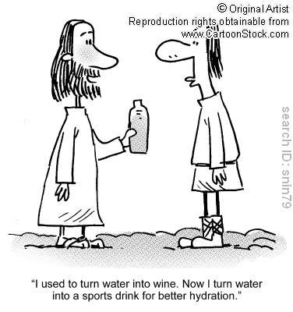
Water vs Sports Drinks
But here's a warning!!! If you're drinking sports drinks as part of your everyday routine you'll end up putting on weight.
In the case of any sorts of drinks that have got carbohydrates or nutrients in them, if you're having too much of any of those sorts of drinks and you're not active then that can affect your weight and your body fat levels.
But what are these electrolytes you speak of?

Slide 34
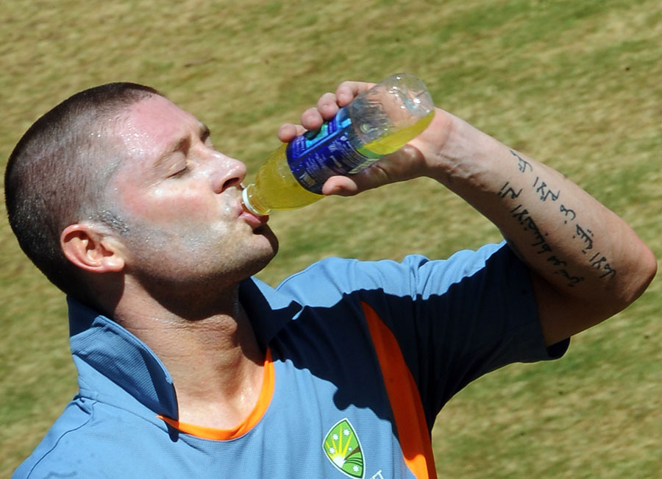
Hydration
Hydration tips
Make sure you're well-hydrated before you exercise — start drinking about two hours before.
Top up your fluids during exercising
Weigh yourself before and after. Losing a kilo is the equivalent of a litre of fluid, and you need to drink one-a-half times that to replace it.
If you're exercising hard and looking for peak performance then sports drinks are the go for you. But if like most of us you're into the moderate exercise, then water will hydrate you just fine and there's a little bonus with that — it's free!

Slide 35
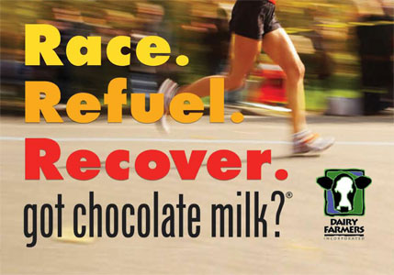
GOT MILK?
Does chocolate milk have any benefits for exercise?

Slide 36
GOT MILK?
Compared to plain milk, water, or most sports drinks,
It has double the carbohydrate and protein content, perfect for replenishing tired muscles.
Its high water content replaces fluids lost as sweat, preventing dehydration.
Plus it packs a nutritional bonus of calcium, and includes just a little sodium and sugar additives that help recovering athletes retain water and regain energy.
Drinking plain water after exercise replaces sweat losses.
Chocolate milk provides carbohydrate replenishment to your muscles.

