Slide 1
Improving Performance
HSC Option 4

Slide 2
How do athletes train for improved performance?

Slide 3
Syllabus Content
Students Learn About
Students Learn To
Strength training
resistance training, eg elastic, hydraulic
weight training, eg plates, dumbbells
isometric training
Analyse TWO of the training types by drawing on current and reliable sources of information to:
examine the types of training methods and how they best suit specific performance requirements
design a training program
describe how training adaptations can be measured and monitored
identify safe and potentially harmful training procedures.

Slide 4
Strength Training
The main goal of strength training is to increase the maximum force that a particular muscle group can generate.
When strength training you are required to work against some form of resistance and exercise the muscles regularly.

Slide 5
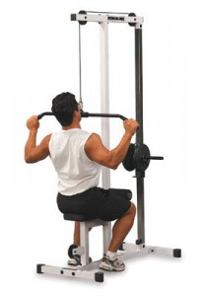
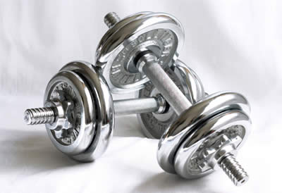
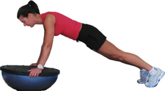
Strength training can take many different forms:
Resistance training using hydraulic and elastic
resistance
Weight training using plates and dumbbells
Isometric training applying a static force

Slide 6
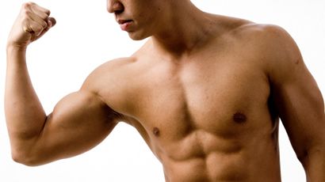
During strength training, elements of isotonic, isometric and isokinetic contractions can be used.
People begin strength training programs for a variety of reasons which include:
To develop muscular strength or endurance
Develop power
Weight Loss
Gain muscle definition =
Muscular Hypertrophy

Slide 7
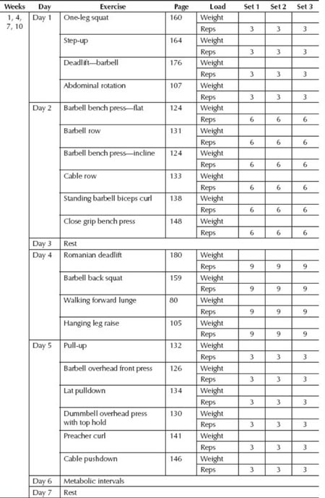
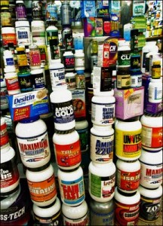
Strength training programs can be tailored to the specific needs of the individual.
Fitness centres will typically devise a training program that will cater for the needs of the client. Strength training merchandise is also available on the market (books, magazines etc) to assist people.

Slide 8
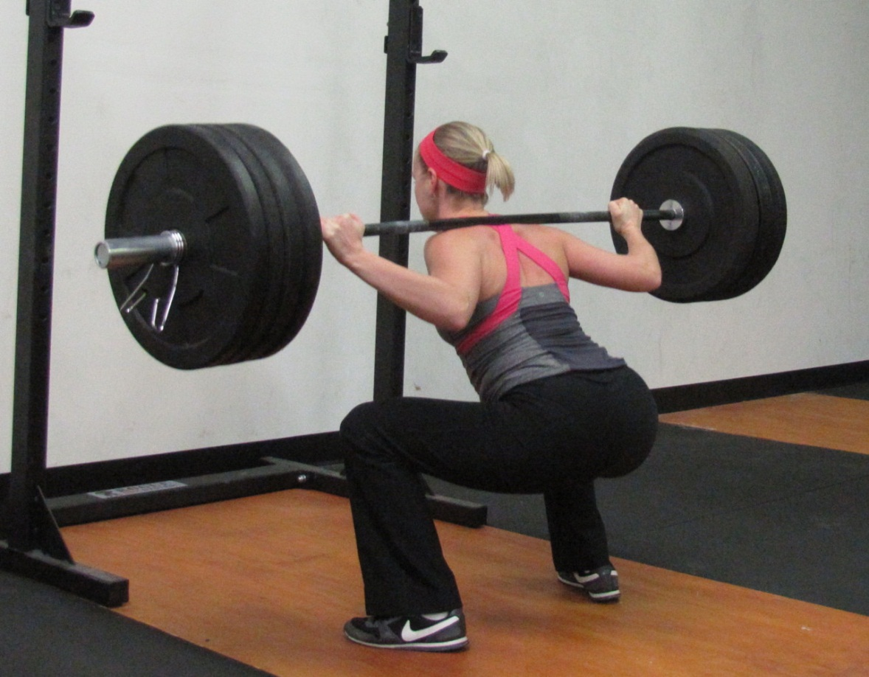
Types of Strength Training
Maximum or absolute strength
The maximum amount of weight that can be lifted just once (one repetition maximum).

Slide 9
Elastic strength (power)
The ability to exert maximum force in a short period of time; the product of strength and speed; common in explosive sports involving sprinting, jumping or throwing.
Endurance strength
The capacity to exert a force repeatedly over an extended period of time. Required in activities such as rowing.

Slide 10
There are three different types of muscular contractions:
Isotonic
A force against an external load that remains constant throughout the movement.
Isometric
A force performed at a constant angle against an immovable load
Isokinetic
A force generated during movement at a pre-set, fixed speed throughout the range of motion around the joint.

Slide 11
A muscle will only strengthen and hypertrophise if it has been forced to work beyond its customary intensity – that is, if it has been overloaded (progressive overload).
Muscles can be overloaded by progressively increasing the following variables:
Intensity (decreasing the number & length of rest periods)
Resistance (lifting more weight)
Number of repetitions
Number of sets
Speed of muscular actions
SPECIFICITY must also be adopted, strength training must target the specific muscle groups involved in the sport.

Slide 12
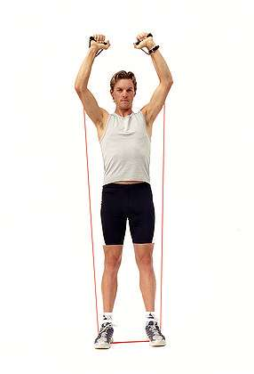
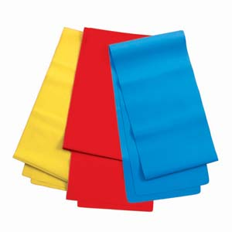
RESISTANCE TRAINING – Elastic & hydraulic
Resistance training can be achieved through the use of hydraulic or elastic resistance.
Elastic resistance gives the greatest resistance towards the end of the movement

Slide 13
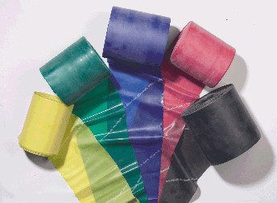
Elastic resistance bands are also practical and inexpensive.
Smaller muscle groups that are hard to train with traditional free-weight exercises can be targeted with resistance bands.
Resistance bands come in a range of colours that represent the stiffness or resistance of the band.

Slide 14
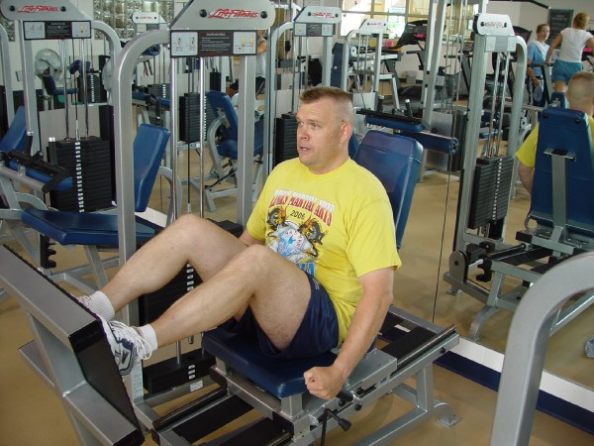
Hydraulic resistance equipment utilises isokinetic contractions allowing for a fixed amount of resistance throughout the movement.
It also makes it possible for the athlete to perform strength training and cardiovascular training at the same time.

Slide 15
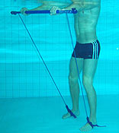
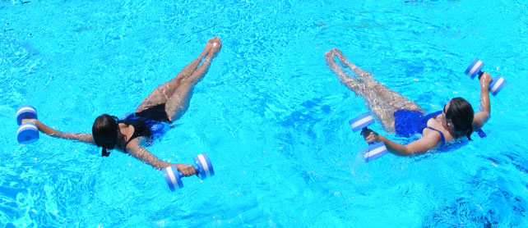
Hydraulic resistance training can also be carried out using a swimming pool where each effort is opposed by the density of the water (effort is opposed by viscosity)
Hydraulic machines are very expensive, making access to them limited as many gyms cannot afford them.

Slide 16
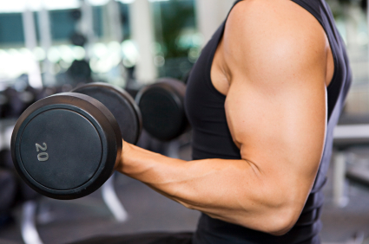
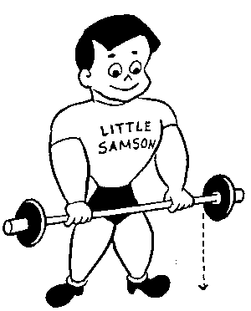
Weight Training
Weight training is the most common form of strength training for athletes and involves isotonic training.
Weight training involves the manipulation of reps, sets, tempo, exercise types and weight used to help increase the desired strength, endurance, size and shape.
Exercise completed during weight training involve equipment such as barbells, dumbbells, weight stacks and plates to increase the force of gravity.
Exercises that are isotonic in nature also involve both concentric and eccentric contractions.

Slide 17
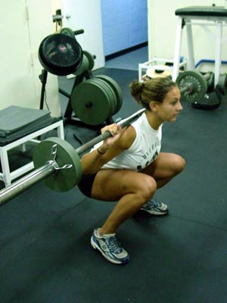
Isometric training
Isometric training or exercises are those in which the joint angle remains constant and there is no lengthening of the muscle. An example is holding a half-squat position for a period of time.

Slide 18
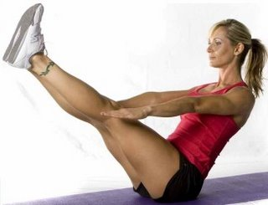
Studies have shown that isometric strength training increases maximum strength by 5% per week by isometrically contracting a muscle group for 6 seconds once per day over 5 days per week. Repeating the contraction 5-10 times per day produced greater strength gains.
Isometric exercises can be performed anywhere as equipment is not required. Isometric Strength training may incorporate the use of free-weights and pin-loaded weights by holding the muscular contraction at a fixed point, for example holding a squat at the concentric phase of the movement.
Because static contractions rarely occur in sporting events this type of strength training is unsuitable.
BUT isometric training is a very useful rehabilitation tool.

Slide 19
Syllabus Content
Students Learn About
Students Learn To
Aerobic training
continuous/uniform
fartlek
long interval

Slide 20
Aerobic training
Aerobic capacity will be improved by a training program that is designed to progressively overload the cardiovascular and respiratory systems.
The program should be specific to the sport or event, that is, runners run and swimmers swim.
Types of aerobic training include
Continuous/uniform training
Fartlek training
Long interval training

Slide 21
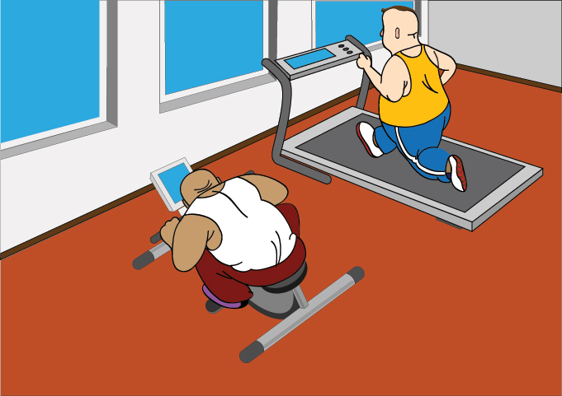
Continuous/ _ _ _ _ _ _ _ _
Continuous/uniform training is long, slow distance training (running, swimming or cycling).
Continuous/uniform training involves sustained, low-intensity exercise at a steady rate, without the use of rest breaks.
This type of training develops the endurance of the respiratory and cardiovascular system rather than speed.
When completing this type of training, the athlete is required to work in the ‘steady state’ zone, which is approximately 70-75% of MHR.

Slide 22
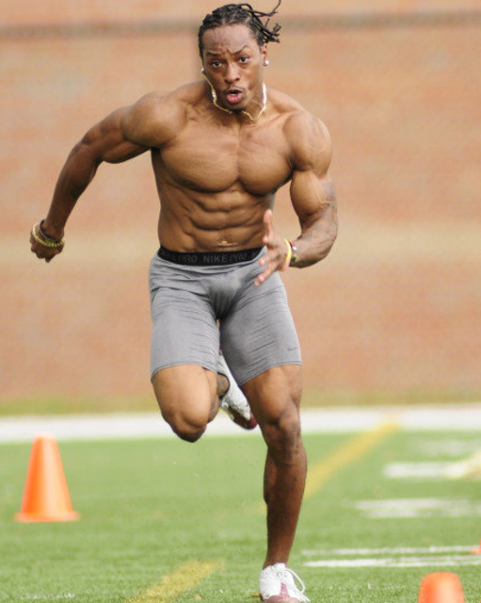
High intensity continuous training has been shown to improve lactate tolerance and VO2 max. This intensity level varies from athlete to athlete, but is approximately working at 90%+ of MHR. Work rates equal to or slightly above the lactate threshold (LT2) produce the best results.
The duration of the training session depends on the fitness of the athlete, but should be for approximately 25-50minutes for best results.
Continuous training involves working for longer than is the case in the performance or competition, and at a uniform intensity.
Remember, when training, more is not always better!!

Slide 23
fARTLEK
Fartlek is a Swedish term meaning ‘speed-play’ and is a variation of continuous training.
In this type of training, athletes vary the pace at which they run and may also vary the terrain.
Typically this would involve some uniform pace exercise interspersed with short sprints and returning to steady state to recover.
Inclusion of uphill and down hill or stair work assists in providing the variation required.
This type of training is a more demanding form of aerobic training and aims to have athletes work both aerobically and anaerobically.

Slide 24
An example of Fartlek training would be to cycle for 45 minutes, with the inclusion of 10 reps of high intensity spurts of 30-60 seconds.
By its nature fartlek training helps to improve VO2 max and is very beneficial for athletes requiring changes of pace and for team games.

Slide 25
Long Interval
Long interval training involves periods of work interspersed with periods of recovery.
To achieve a specific effect there are a number of variables that can be manipulated, these include:
Duration of each interval and rest period
Intensity of interval
Duration of recovery interval
Number of work/rest intervals per session

Slide 26
The key to effective and specific overload is the work:rest ratio. For aerobic training, long intervals are used with a work:rest ratio of 1:1. each exercise interval would typically be 2-5minutes in length and be done at sub-maximal pace. The number of intervals to be completed would be 4 to 8 repetitions.
Long interval training allows work of high quality to be performed as the recovery periods delay the onset of fatigue. Also the athlete can complete more work than in the equivalent continuous training session.
Effective long interval training depends on identifying the level of fitness of the athlete, a period of continuous training may be required to build aerobic fitness before introducing intervals.

Slide 27
Syllabus Content
Students Learn About
Students Learn To
Anaerobic training (power and speed)
developing power through resistance/weight training
plyometrics
short interval

Slide 28
In developing the anaerobic system, consideration must be given to activities that tax the ATP/PC ( _ _ _ _ _ _ _ _ _ ) system and the lactic acid system. Each of these systems operates without oxygen to replenish the body with a readily available energy form of ATP.

Slide 29
Developing power through resistance/weight training
Resistance training builds power through recruiting and enlarging muscle fibres.
To increase power using resistance training, movements need to be performed quickly, causing preferential recruitment of fast-twitch fibres.
Power is a combination of speed and strength

Slide 30
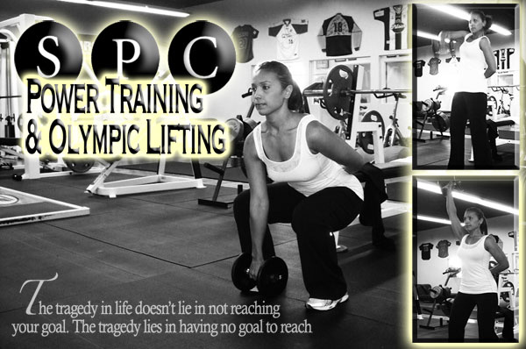
Power can be developed by using free weights, machines and medicine balls.
When using free weights, an athlete aims to perform the exercise explosively.

Slide 31
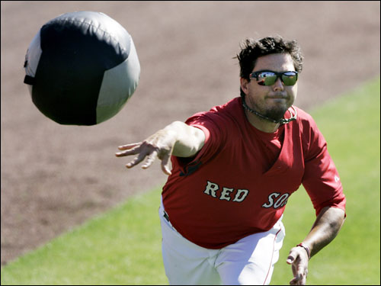
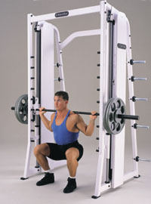
Examples – using a smith machine allows the athlete to perform bench press throws to develop power.
Medicine balls can also be used, and have the advantage of being able to mimic sport-specific actions such as overhead throw (soccer), lateral pass (rugby)

Slide 32
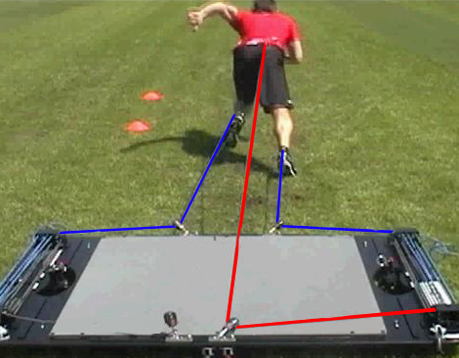
Guidelines for developing power through resistance training include the following:
Load - 50% of 1RM for a trained athlete (high maximal strength) & 20-40% of 1RM for a developing athlete (continue to work on maximal strength).
Reps - 1-5
Sets – 3-5
Speed – fast but controlled
Recovery - > 3 minutes

Slide 33
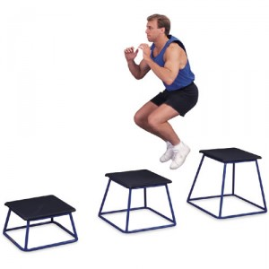
PLYOMETRICS
Plyometric exercises involve fast, powerful movement using a pre-stretch or counter movement that involves the stretch-shortening cycle (SSC).
SSC is an eccentric contraction of a muscle followed by an immediate shortening (concentric contraction) of that same muscle.
Plyometrics should be performed when an athlete is non-fatigued, so this type of training is programmed in to the early parts of a training session.

Slide 34
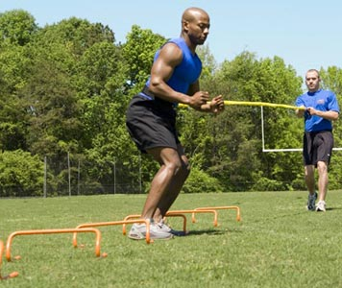
For team sports 1-2 plyometric sessions per week is sufficient, with at least 48 hour recovery period between sessions.

Slide 35
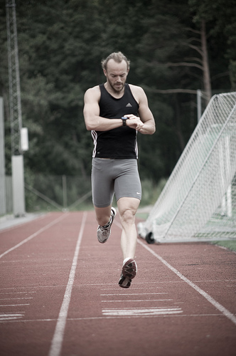
SHORT INTERVAL
Interval running is an example of short interval training, enabling the athlete to improve the workload by combining heavy bouts of fast running with recovery periods of slower jogging.
During the heavy fast run, lactic acid is produced and a state of oxygen debt is reached.

Slide 36
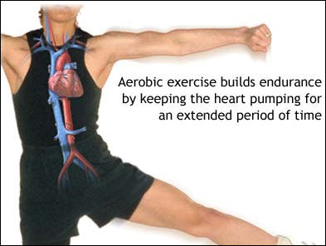
During the interval recovery period, the heart and lungs are still stimulated as they try to pay back the debt by supplying oxygen to help break down the lactates.
This enables the following adaptations : strengthening of heart muscles, improved oxygen uptake, improved buffers to lactates

Slide 37
Anaerobic intervals involve short periods of high-intensity work. The manipulation of the duration, intensity and rest period will determine what is being trained – the alactacid energy system, the lactic acid energy system or speed.
- Up to 6 seconds : targets alactic power
- 6-25 seconds: improves alactic capacity
- 25-40 seconds : incorporates lactic power
40-60 seconds : improves lactic capacity
Recovery rates will be influenced by the training status of the athlete. Elite athletes will recover faster.

Slide 38
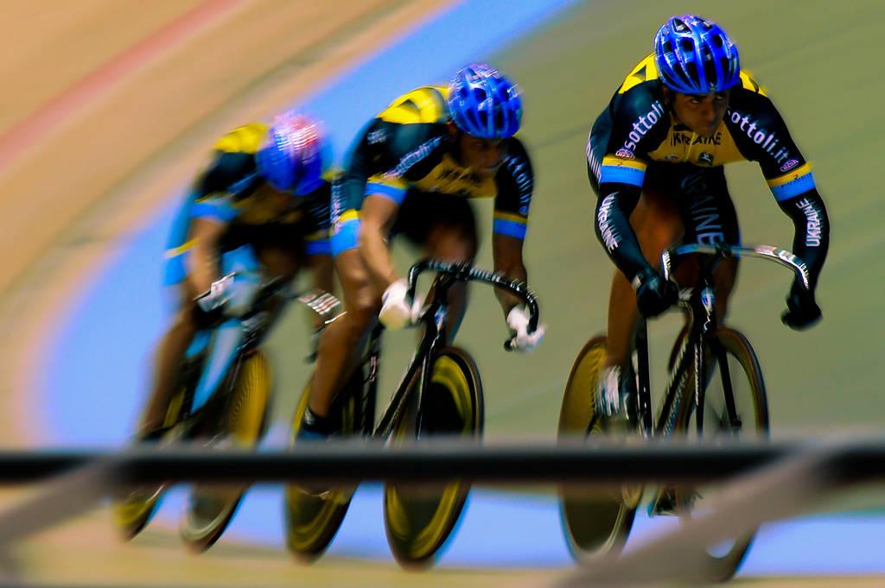
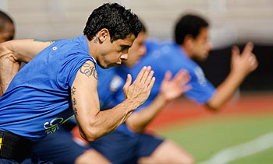
Circuit training is a form of interval training.

Slide 39
Syllabus Content
Students Learn About
Students Learn To
Flexibility training
static
dynamic
ballistic

Slide 40
Flexibility is joint specific and is defined as the range of motion about a joint.
Flexibility is limited by the structures in and around joints, such as bones, muscles, ligaments, tendons and overlying skin.
Regularly scheduled stretching programs over 2-5 days per week, for 15-30 minutes per day, will improve flexibility in a few weeks.
Stretches can be held for 10-30 seconds, and are repeated twice.

Slide 41
Static flexibility training
Static flexibility training is achieved by the athlete moving slowly and steadily into a position beyond the point of resistance in order to stretch the muscle.
Stretches should be held for _____________________
Performed correctly, without any jerky movements, this is a safe method of gaining flexibility.
Proprioceptive neuromuscular facilitation ( _ _ _ ) is a form of static stretching and is the most effective method of improving flexibility.
Notes:
10-30 seconds

Slide 42
In PNF stretching the muscle is stretched as in static stretching; however, it is then contracted isometrically for 6-10 seconds against a resistance, which is often a partner. The muscle is then relaxed and stretched to its maximum. This allows a greater range of movement and improved flexibility.
http://www.youtube.com/watch?v=HpatAJI0-pU

Slide 43
Dynamic flexibility training
Dynamic stretching involves movement.
While not generally used to improve flexibility it has a useful application in warm up routines. The movements replicate those required in a sport or activity and stimulate elongation of tissues by increasing temperature.
Examples are torso twists and arm circling, which can be performed before competing in team sports or swimming.

Slide 44
Ballistic flexibility training
Ballistic stretching involves using momentum to force muscles up to and past their normal range of motion.
The exercises typically involve swinging or bouncing movements and great care is required as tearing of muscles can occur.
This type of stretching is NOT recommended as a safe way to improve flexibility.
If done, it should only be completed by already flexible athletes and after a comprehensive warm up.
http://www.youtube.com/watch?v=tMu025E5g7Y

Slide 45
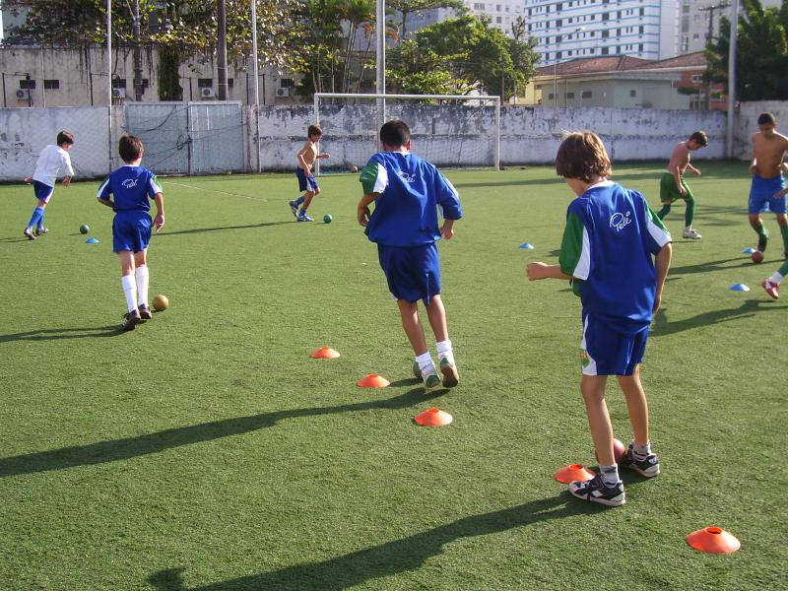
Syllabus Content
Students Learn About
Skill training
drills practice
modified and small-sided games
games for specific outcomes, eg decision-making, tactical awareness.

Slide 46
Most individual and team sports require the athlete to be able to perform skills competently.
Training and participation are not always concerned with aerobic or anaerobic capacity, strength or flexibility. Long periods of time are spent by coaches and athletes on improving the performance of basic and complex skills involved in the sports.
Even a marathon runner needs to develop skills to run; it is not merely a matter of developing max VO2.
It is important for the coach to plan activities in a training session that challenge the athlete

Slide 47
The following questions should be considered by the coach:
What is the purpose of the drill; that is, is it for skill, team strategy or conditioning?
Can participants perform the drill?
How many people are involved?
What equipment is necessary?
How is it set up?
How much time will be spent on it?
What level of performance is expected?

Slide 48
Athletes are motivated to perform if training is kept interesting and challenging.
A variety of drills for the practise of particular skills will aid this process.
Modifying well-learned drills by adding defence, obstacles or other variables adds variety to the training session, and makes it more game like. Variety can also be provided by employing a number of different practise methods (such as individual, team and pairs) under a range of conditions (such as minor games, small games, skill practise and full games)
Demonstrations and explanations should be clear, concise, and feedback about performance should be given frequently and appropriately.

Slide 49
Drills practise
Skills are developed through repetition, observation and visualisation. Drills practise, either individually or in groups allows this to happen.
Drills can be designed to practise a specific movement or technique; for example, kicking or throwing a ball or completing a forward roll.
Drills practise forms an effective part of individual training when not practising with a team or partner. Examples of this include hitting a tennis ball against a brick wall or shooting a basketball.
Drills is well suited for particular sports where individual skills need to be precise, such as gymnastics or athletics

Slide 50
Modified and small-sided games
Modified and small-sided games provide variety and are an important and effective component of training.
Well-designed games on small fields with fewer players can ensure each player experiences maximum involvement.
Modified games enable time-efficient skill practise. They also provide a valuable forum to develop various important game-related skills, such as decision making, reaction and vision skills. They can place a player in a game-related situation with a desired outcome by focusing on specific skills (such as passing and catching) or specific aspects (such as fitness or evasion skills).
Varied levels of pressure can be applied by changing the format; for example, 2 versus 3.

Slide 51
Games specific outcomes
Specific outcomes can be applied to modified or small-sided games and this can be used for practise in larger or actual game play situations. In this case the coach would identify a specific outcome to be achieved by the team or certain groups of players

Slide 52
Decision Making
By performing skills in a competitive environment the athletes would be placed in situations requiring quick decisions to be made.
Games can be directed at allowing attackers to develop and practise deception skills and, in turn, allowing defenders to read the attempts at deception. Small- sided games assist here.
Decision making opportunities are created by varying field dimensions, varying the position on the field of a start and alternating numbers in attack and defence.

Slide 53
Tactical Awareness
To raise tactical awareness, the focus of modified and small-sided games could be on important tactical aspects, such as maintaining possession, delaying the opposition or pressuring or manoeuvring to regain possession.
Moments of transition- where a ball changes possession- are important as they cause defenders to become attackers and provide opportunities to outnumber defenders.
Games beginning with a turnover situation provide opportunities to practise simple tactics. They may also involve the use of specific set plays or team patterns in certain areas of the field.
Tactics in this situation may be a more complex system based on exploiting a predictable response by a defender.

Slide 54
http://www.youtube.com/watch?v=6DgNGB0aIiw
http://www.youtube.com/watch?v=MWt1KZIseO8

Slide 55
What are the planning considerations for improving performance?

Slide 56
Syllabus Content
Students Learn About
Students Learn To
Initial planning considerations
performance and fitness needs (individual, team)
schedule of events/competitions
climate and season
Describe the specific considerations of planning for performance in events/competitions. How would this planning differ for elite athletes and recreational/amateur participants?

Slide 57
Careful planning will ensure that an athlete is appropriately prepared for competition.
Consideration needs to be given to the various aspects that, when combined, will make a difference to the success of the athlete and/or the team.
These aspects can be divided into performance and fitness needs, the competition schedule and the climate and season.

Slide 58
Performance and fitness needs
Whether, the coach is preparing a single training session or a program for a year, the coach’s ability to plan, organise and implement a training session will often determine the involvement and commitment of the participants. This is for both beginners and elite athletes and as such coaches need to consider fitness level, skill level and goals.
The coach should gather information about the athletes in order to appropriately address their specific needs. This can be done through surveys to determine previous experiences and goals for the season and aspirations. The age of the athlete and level of competition should also be taken into account.
Different approaches are required to cater for the age and expectations of the athlete.

Slide 59
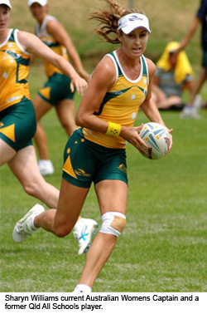
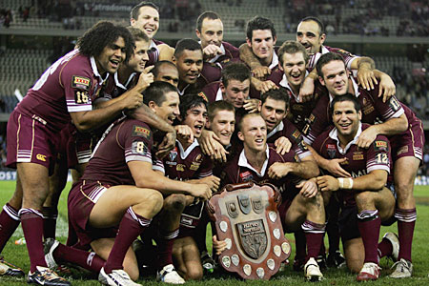
Schedule of events/competition
Initial planning considerations for many teams and individual sports must take into account the schedule of particular events and competitions, and it is essential to optimise the performance of athletes around these.
Planning is affected by the:
Competition structure
Phases of competition
Special events in the season
Availability of resources
Motivations and attitudes of the athletes
Demands of the sport
climate

Slide 60
An annual plan should be based around the build up to a specific event or, as with some sports, a series of events. the aim of this is to produce the best performance at the appropriate time.
Highlighting these events on a calendar enables training to be divided into a series of cycles, each with a specific focus. For example, a team in a team sport competition generally aims to reach the final series, along the way adapting training for particular games. In the final series a particular approach will be taken to maintain maximum performance.
Optimum performance is structured around the athlete’s schedule of event and competition.

Slide 61
Climate and season
A coach needs to take a sensible approach to training and competition in adverse weather. Planning should involve variations to a program to cater for potential adverse conditions.
The yearly training plan should take into account the season where each phase falls and anticipate the likely weather patterns.
Adverse weather conditions (such as when it is too hot or too cold) may mean changing the training time or the length of the session.
Alternate venues can be considered and booked in advance. These venues include gyms, pools and indoor courts. ‘Classroom’ sessions may be held to review tactics and plan ahead.

Slide 62
Acclimatisation to conditions can also be part of the planning for a season. Elite athletes may attend training camps in conditions similar to those in which they may be competing. Athletes competing at altitude will often travel to these areas up to a week in advance to acclimatise.
Plans to take into account the climate should also encourage individuals to do all they can to minimise the effects of adverse weather on themselves. For example, athletes should ensure that their clothing and headwear is appropriate, that they have ensured their hydration levels are adequate and that they have acclimatised to the exertion levels required in the prevailing conditions.

Slide 63
Syllabus Content
Students Learn About
Students Learn To
Planning a training year (periodisation)
phases of competition (pre-season, in-season and off-season phases)
subphases (macro and microcycles)
peaking
tapering
sport-specific subphases (fitness components, skill requirements)
Develop and justify a periodisation chart of the fitness and skill-specific requirements of a particular sport.

Slide 64
The division of the training year into certain periods must be considered when designing a yearly training program. This is called periodisation.
In each period there are subtle and important differences that exist.
Peaking for major events must also be taken into consideration.
A long term training plan is required so that the coach and athlete can set goals and work towards the achievement of those goals over the year.
Long and short term goals should be decided on in consultation between the coach, athlete and team.
It is not uncommon for athletes to train all year round. Even though the cricket season is in summer, cricketers train in the winter. Athletes of the winter sports- rugby, soccer, netball, AFL- train during the summer months. This is done to maintain fitness and in some cases, skill levels.

Slide 65
Phases of competition
The total training program of athletes can be broken down into three distinct phases:
Post-season or off season (transition)
Pre-season (preparatory)
In-season (competition)

Slide 66
Post-season training
Post-season (or off-season) training varies from sport to sport, but has the following general aims:
To prevent weight gain
To maintain the aerobic fitness base (low intensity)
To maintain strength (increase endurance, strength and power)
To maintain a reasonable sports skills level (participate in games)
To repair injuries
To recuperate physically and mentally
An off-season involves post-season competitions in an athlete’s sport (or a similar sport) and also involves recreational and social activities for fun and enjoyment.

Slide 67
For example, an endurance runner might focus more on aerobic capacity maintenance than on strength, a spin bowler might focus more on skill development, a tennis player with an injury might concentrate on rehabilitation and mental strategies, and a netball team might play in a touch football competition to maintain ball skills.
Variety is the key to post-season training.
Post-season training is usually of low intensity, but of high volume (a large number of long sessions). This time also allows athletes to concentrate on areas in which they might be weak.

Slide 68
Pre-season training
Pre-season training usually occurs 8-12 weeks before the start of the season or competition.
The predominant energy systems are used in the sport are increased to maximum capacities.
The principal difference between post-season training and pre-season training is the intensity.
The post-season weights program should be continued during pre-season.
A shift is made from low intensity, high volume training to high intensity (progressive overload), low volume training.
Sports specific skill training is also intensified.
If specific components of fitness or skill are required, significant time should be allocated to practising these in pre-season.

Slide 69
In-season training
The general aim of the in-season training program is to maintain the fitness, strength and skills developed during the pre-season.
There is an increased emphasis on game-like skills and strategic development, and on practise opposition.
Practise should still be of sufficient volume and intensity to maintain strength and endurance throughout the season.
The involvement of athletes in actual games and game-like practises allow less emphasis on aerobic capacity and strength conditioning at training. Drills with components of game skills and fitness are important.
The only exception is athletes who do not receive much game time. They might need to engage in alternative high-intensity conditioning or skills practise during the week for 3 days.

Slide 70
Subphases: Macro & microcycles
Yearly training programs can be divided into phases of competition, it can be broken down further to allow a coach to plan a comprehensive yearly training program.
Macrocycles are large blocks within a cycle of training that usually last for 3-6 weeks and vary throughout the year depending on the phases of the competition and training outcomes required.
Microcycles are smaller blocks within a macrocycle. Microcycles usually last for 7-10 days. These allow for the manipulation of training volumes, intensities and recovery.

Slide 71
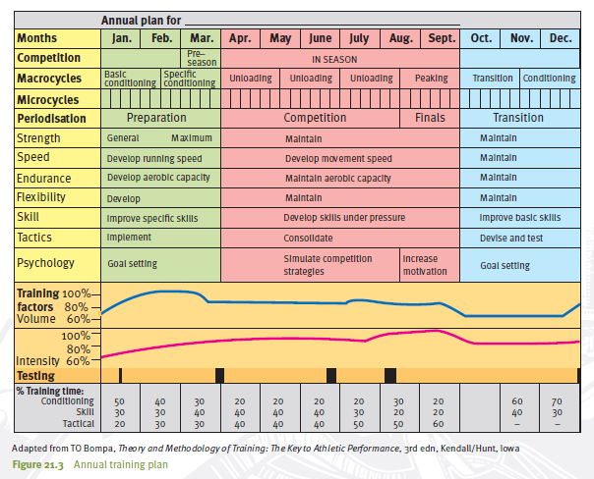

Slide 72
Figure 21.3 provides a great detail of information for a coach wishing to construct a yearly training plan.
Note how each daily training session in a microcycle (7-10 days) forms an important part of the larger cycle through training in the macrocycle (3-6 weeks, and that these longer cycles vary in content throughout the year; depending on the phases of the competition and the training outcome required.
Also note how different types of training are emphasised at different stages of the year.
The transition period or post-season is a period of low impact and regeneration. The unloading phases in the macrocycle refer to a decreasing extent of training, but an increase in intensity.
It is hoped that performance will follow the intensity curve (that is, will peak at the end of the season), with a decrease in the volume (amount and duration) of training.

Slide 73
Peaking
As competitions begin, the training regimen should be adjusted to achieve peak performance, both physically and psychologically. The peak performance might be required in September for a rugby league player (for the grandfinal) or in a few years time for a swimmer (say, the 200m final at the Olympics).
Coaches design training programs that take into consideration the development of fitness, skills, tactics and competition throughout the season, all aimed at peak performance at particular times of the year.

Slide 74
Peaking for performance results from the athlete’s ability to adapt to various training methods and types. It does not occur ‘overnight’ and it must be planned.
It involves a sequential, cumulative training program that focuses on preparing the athlete for a peak performance. The peak performance is a temporary state that occurs when the psychological and physical capacities of the athlete are at a maximum, and when the technical and tactical preparation is optimal.
Peaking is an optimal state of athletic readiness aimed at the highest possible performance. It is characterised by:
Good health
Adaptability to training
Quick recovery
Functional synergism (everything acting together)
Extreme efficiency
Adaptability to stress
Self-confidence
High motivation and aspirations

Slide 75
tapering
To achieve peak performance in major competitions, many athletes reduce aspects of their training sessions in the weeks leading up to the event.
This allows the body and mind to have a break from vigorous physical exertion, and provides an opportunity to heal injuries and recharge energy reserves.
Tapering can be achieved by decreasing the volume or intensity of training.
Reducing training volume, but maintaining intensity, is preferable during the taper.
It should be accompanied by rest and good nutrition.

Slide 76
The time to begin tapering varies from sport to sport.
A taper period of approximately 7-10 days appears to be appropriate for most sports.
A taper period of at least two weeks is recommended for swimmers, and a period of one to two weeks for runners.
Tapering in swimming improves performances , with increases noted in both max VO2 and arm strength.
In running events, however, no charges occur in performance , although slight improvements in leg power are evident.
Tapering allows for muscle glycogen stores to be increased in preparation for a match, reduced volume of training prior to the game must be accompanied by a high-carbohydrate diet.
Speed, endurance, strength and power cannot be improved within 3 days of a match.

Slide 77
Any training session held in the 36 hours before competition needs to be brief and intense, so as not to significantly deplete glycogen stores.
Tapering each week for matches could induce gradual detraining during the course of the season.
The coaching staff need to ensure that a well planned periodised program helps prevent loss of previously acquired adaptations.
The following changes might occur in athletes during the taper period:
Increase in VO2 max
Increase in muscular strength
Decrease in blood lactate levels
Healing of minor injuries
Disappearance of soreness
Replenishment of glycogen stores
Not all of these will occur in all athletes in the taper period; in fact, none might occur in some athletes.

Slide 78
Sport specific sub-phases (fitness & Skill)
The phases of competition require different approaches in order to effectively prepare an athlete for competition.
The preparation phase (pre-season) begins with a general conditioning program. This develops to the later stages where emphasis is more focused on the specific requirements of the sport and on skill and strategy practises.
The competition phase is marked by an emphasis on skill and strategy development while continuing with specific conditioning for the sport. Much of this conditioning can be achieved through intense skill practises and small-sided games.

Slide 79
It is important to mix conditioning and skill practise through the competition phase. Planning should emphasise the different aspects across the macrocycle, microcycle and even individual session.
Figure 21.4 demonstrates macrocycles in the competition phase where one aspect of training is given greater emphasis.
Using a systematic approach to plan the pattern of the cycles within a phase of competition, the coach is able to find the correct balance between fitness and skill requirements for the athlete.

Slide 80
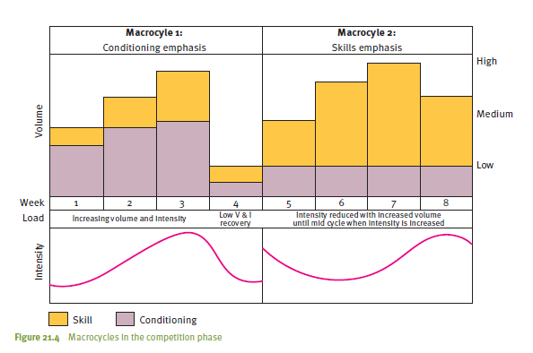

Slide 81
Syllabus Content
Students Learn About
Students Learn To
Elements to be considered when designing a training session
health and safety considerations
providing an overview of the session to athletes (goal-specific)
warm up and cool down
skill instruction and practice
conditioning
evaluation
Examine different methods of structuring training sessions
Design and implement a training session for a specific event. Evaluate the session by considering questions such as:
did the activities match the abilities of the group?
what was the reaction of the group?
how could the session be modified?

Slide 82
Elements to be considered when designing a training session
When designing a training session, a number of elements need to be considered as part of the planning process.
Adhering to these elements ensures that sessions are challenging, productive and within health and safety guidelines.

Slide 83
Health and Safety Considerations
Consideration needs to be given to safety, ensuring that athletes can participate safely.
Equipment and facilities need to be well maintained (routinely checked for faults)
Coaching practices need to also be based on safe practices to minimise the risk of injury to participants (assess the training environment for any obstructions that may cause injury).
Weather considerations also need to be taken into account.
Athletes need regular rest and drink breaks

Slide 84
Providing an overview of the session to athletes (goal-specific)
At the beginning of a training session, it is common for the coach to provide a brief overview of what will be expected of the athletes in the training session. This ensures that the intentions of the coach and the expectations of the players are channelled in the same direction
The overview psychologically prepares the athletes for the training session.
The coaches instructions must be clear, concise, factual, well times, constructive, positive and informative

Slide 85
An overview also provides the opportunity for a forum, where specific issues may be raised with the players such as: recording of player attendance/absence, assessment of injuries, discussion of previous performance etc.

Slide 86
Warm-up
The objective of the warm-up is to prepare the athlete physically and mentally for the demands of the training session.
An effective warm-up consists of the following phases:
1. Aerobic work, general warm up - jogging or skipping until the body begins to warm/sweat
2. Flexibility/Stretching – This is important in ensuring that the required muscle groups are extended beyond the range that is required of them in the sport.
3. Callisthenics- General body exercises such as push-ups and sit-ups
4. Skill Rehearsal- Athletes perform the skills and drills required in the game.

Slide 87
The cool-down concludes the training session where body temperature, circulation and respiratory rates are returned to their pre-exercise state.

Slide 88
Skill Instruction and Practice
After the warm-up and stretch, the Coach explains what will happen in a series of drills to follow.
Explanations need to brief so that the effect of the warm-up is not lost.
The practice of skills and strategies is usually the main part of the in-season training session.

Slide 89
New skills should be introduced, demonstrated and taught directly after the warm-up while the athletes are still fresh.
This section of the training session will consist of a number of skills taught in a variety of drills. These drills will resemble game like situations.

Slide 90
Conditioning
General fitness conditioning should occur after skill practice to avoid the practices being adversely affected by fatigue or poor light.
Fitness conditioning should last for about 15-20 minutes.
Conditioning will be specific to the components required in the sport, for example, speed, power or acceleration.

Slide 91
Evaluation
Evaluation is an appraisal of performances after the training session.
It is normally carried out during and after the cool-down and involves the coach and players reporting on the value of the session.

Slide 92
Players are given the opportunity to express their issues or opinions that may have arisen during the training session.
Evaluation of the training session is followed by a brief reminder of the date, time, venue of the next training fixture.
It is important that the training session finishes at the arranged time.

Slide 93
Syllabus Content
Students Learn About
Students Learn To
Planning to avoid overtraining
amount and intensity of training
physiological considerations, eg lethargy, injury
psychological considerations, eg loss of motivation.
Analyse overtraining by considering questions such as:
how much training is too much?
how do you identify an overtrained athlete?
what do you do if you identify an overtrained athlete?
how can overtraining be avoided?

Slide 94
Planning to avoid overtraining
Sometimes, because of poor scheduling or high levels of dedication, an athlete can suffer from chronic training stress, leading to performance deterioration.
Overtraining is a chronic psychological and physiological condition caused by training loads that are too demanding for an athlete to manage.

Slide 95
Overtraining develops as a result of subjecting the athlete to high intensity training practices when they are in a state of fatigue.
High-intensity training requires a longer period of regeneration and refreshment than does moderate training.
High intensity training + insufficient recovery = OVERTRAINING.
The onset of overtraining can be recognised by a lack of motivation and poorer performances.

Slide 96
Amount and intensity of training
Overtraining is caused by too much training, so adjustments need to be made in relation to the amount and intensity of the training.
Some individuals may have a lower training stress threshold and will show signs of overtraining earlier..

Slide 97
Overtraining can be prevented by careful panning in terms of training volume and intensity projections that are established in the periodisation chart.
The intensity level needs to be varied from activity to activity and from training session to training session.
Recovery strategies need to be an integral part of training.

Slide 98
Physiological considerations (lethargy, injury)
Lethargy and injury need to be taken into consideration when assessing whether an athlete is overtraining.
It is natural for athletes to experience periods of tiredness and fatigue during a training program. This can normally be corrected by more rest, alternative training practices (variety), good diet (high in carbohydrates).

Slide 99
Overtraining should be suspected when a rapid decline is evident in performance, and has not been rectified by the above strategies after a few days.
Look at table 21.3

Slide 100
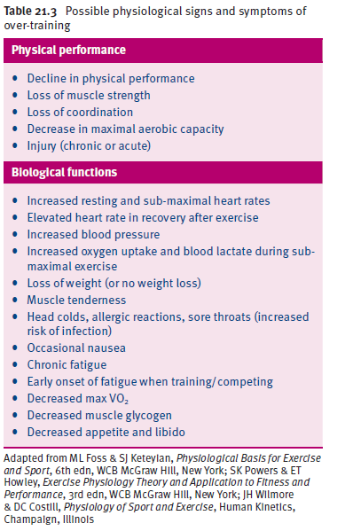

Slide 101
Psychological Considerations
The most important psychological considerations relate to motivation or lack of it.
When physical stability is threatened, emotional factors become heightened and can affect an athletes health and well-being. The result is a loss of motivation, loss of enthusiasm for training and the loss of competitive desire.
Symptoms may include: increased nervousness, poor concentration, irritability or anger and depression.

Slide 102
Strategies that may improve the mental well-being of athletes suffering overtraining may include the reduction or cessation of training, active rest, relaxation techniques, change of routine and environment and positive reinforcement.
The prevention of the overtraining state is best achieved through being careful not to exceed an athlete’s stress tolerance, and adapting the volume and intensity of training to each individual.

Slide 103
Prevention of Over Training
Every possible attempt should be made by the coach and athlete to avoid over training.
With increasing pressures to perform, however, many athletes and coaches push too far.
Also it is difficult to measure what volume or intensity of training is beneficial or harmful to an athlete.
To help prevent over-training, the following measures should be taken:
Ensure proper nutrition
Ensure adequate rest and recovery between workouts
Monitor training loads
Vary exercise intensities
Monitor physiological changes (for example, increased heart rate, increased oxygen consumption and blood lactate levels)
Use psychological strategies (for example, mental rehearsal and relaxation)
Keep a training diary that monitors feelings

Slide 104
Damage done by over training cannot be undone in a couple of days. It takes weeks, or even months.
Athletes need a marked decrease in the training regimen, or perhaps even complete rest.

Slide 105
What ethical issues are related to improving performance?

Slide 106
Syllabus Content
Students Learn About
Students Learn To
Use of drugs
the dangers of performance enhancing drug use, eg physical effects, loss of reputation, sponsorship and income
for strength (human growth hormone, anabolic steroids)
for aerobic performance (EPO)
to mask other drugs (diuretics, alcohol)
benefits and limitations of drug testing
Justify the reasons drugs are considered to be unethical and carry a range of risks for the athlete
Argue issues related to drug testing such as:
at what level of competition should drug testing be introduced?
which drugs should be tested for?
what are the pros and cons of drug testing?
what should be the consequences of drug use?

Slide 107
Use of Drugs
Performance enhancing drugs (PED) are substances that can improve an athlete’s performance in a particular sport or activity.
The focus of elite athletes is to improve their performance and to find strategies that will make them excel in their field … PED are prevalent, with an increasing number of elite athletes being caught out through drug testing measures.
Drug use in sport, or doping carries serious health risks and has the potential to jeopardise an athlete’s future in the sport.

Slide 108
PED may be used for a variety of reasons such as building muscle, dulling pain, reducing weight, lowering stress or masking other substances.
Diagram – Effects of performance enhancing drugs on the body
A US survey (regarding the taking of PE substances) of 198 athletes found that 99% said they would be willing to cheat if they got away with it. If the drug gave an elite athlete 5 years at the top and then killed them, half the respondents said they would still take it.

Slide 109
The Dangers of Performance Enhancing Drugs
The use of PED can significantly affect the long-term health of an athlete.
The health implications of drug use include liver tumors, cancer, high blood pressure, kidney tumors, depression, gynaecomastia (breast enlargement), baldness, testicular atrophy and fluid retention.
Changes are also apparent in social, psychological and emotional behaviours.
An athlete’s reputation, sponsorship endorsements and income generating potential can also be affected by the use of drugs in sport.

Slide 110
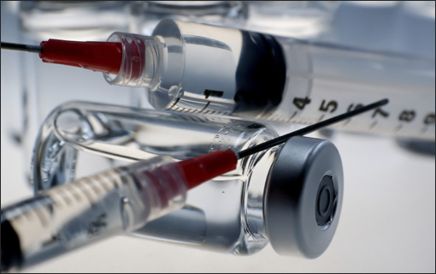
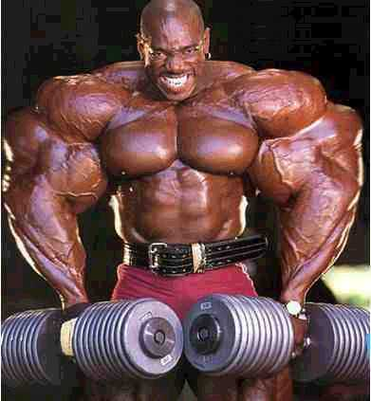
Steroids in particular are related to mood swings, irritability, aggression, acne, sexual arousal, confusion and memory loss.

Slide 111
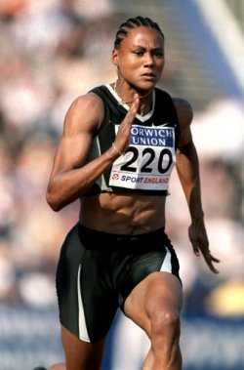
Other drugs such as alcohol and diuretics result in reduced concentration and reaction time, as well as affecting important sporting abilities such as coordination.
The use of performance enhancing drugs in sport is banned and may result in the athlete being expelled from their particular sport for an extended period of time.
If found guilty of taking performance enhancing drugs, an athlete may also be stripped of their accomplishments, i.e. 100 m sprint gold medal winner

Slide 112
Using Drugs for Strength (human growth hormone, anabolic steroids)
Human growth hormone (HGH) and anabolic steroids are drugs usually associated with a desire to improve strength and power in sports such as weight-lifting, body building, shot-put etc.
HGH and anabolic steroids are synthesised hormones that increase appetite, bone growth and protein synthesis. These functions all contribute to the rapid development of muscle tissue.

Slide 113
Anabolic Steroids
Steroids can be anabolic (tissue building) or androgenic (producing male characteristics).
It is impossible to produce a steroid that is completely anabolic or androgenic – for example, females who take anabolic steroids to improve strength will also have the adverse effect of developing unwanted male features such as facial and body hair.

Slide 114
Steroids increase the body’s ability to stimulate protein synthesis in the muscle cells, while simultaneously arresting its breakdown. This increases the body’s ability to utilise protein and prevent its degeneration.
Steroid use has been an issue in sports such as weight-lifting, bodybuilding, track and field (especially field events) and some team events where aggression is an advantage.

Slide 115
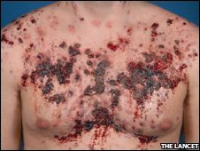
The effects of steroids depend on the dosage, regularity and time period of use. Effects may include:
Testicular atrophy
Increased or decreased libido (sex drive)
Liver damage
High Blood Pressure

Slide 116
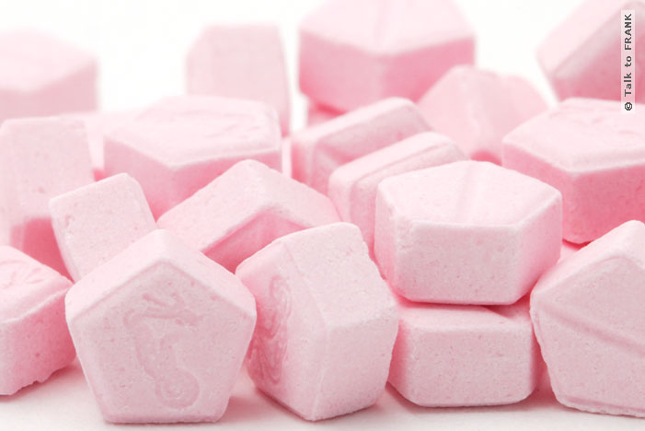
The effects for women include:
Infertility, clitoral hypertrophy & sore nipples
Increased Sex drive
Masculine appearance (facial hair, deepening voice)
Increased aggressiveness

Slide 117
Human Growth Hormone (somatotropin)
Is a naturally occurring substance that increases the rate at which amino acids are transported to skeletal muscle cells.
This hormone is produced naturally by the body that is responsible for growth.
Taking artificial forms of the hormone can lead to increased muscle size and strength. It also assists in the mobilisation of fat, making it available as a source of energy – more glycogen available for the later stages of an endurance event.

Slide 118
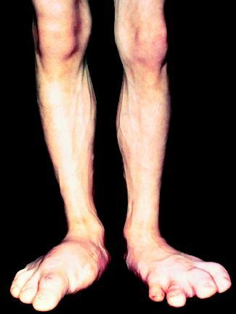
The long-term effects of using artificial growth hormone are serious and include:
Overgrowth of the face, hands and feet (acromegaly)
Gigantism
Heart Disease
Diabetes
Disfigurment from bony overgrowth

Slide 119
For Aerobic Performance (Erythropoietin)
Is a natural hormone that stimulates red blood cell production. It is naturally secreted from the kidneys when oxygen levels are low.
EPO was originally developed for people with anemia and kidney deficiencies to help them manufacture extra red blood cells.
EPO acts on bone marrow, stimulating red blood cell production.
It is a form of blood doping because the increased number of blood cells allows athletes to absorb more oxygen, improving their stamina.

Slide 120
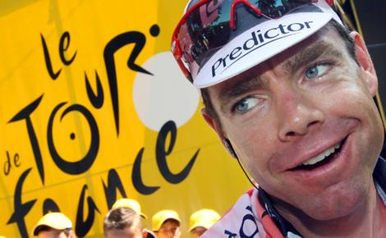
Athletes whose performance would benefit from EPO are those who participate in endurance based activities, where sustained effort is required, such as marathons, triathlons and distance cycling.
Studies suggest that taking EPO can improve oxygen supply by as much as 10%, resulting in a performance increase of 20-30%. Translated into minutes, a 5% performance boost would have been the difference between placing 1st and 145th in the 2008 Tour De France.

Slide 121
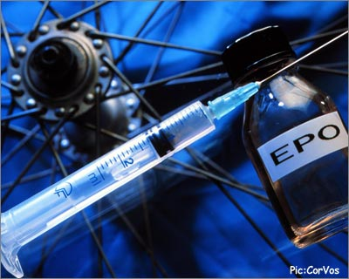
There are side effects associated with the use of EPO. These include:
Thickens the blood making blood flow difficult. The heart has to work harder to keep the blood flowing and blood clots are likely – this increases the risk of heart attack and strokes.
Studies have reported that as many as 100 athletes have died prematurely during the past decade, most from heart attack possibly due to EPO abuse.

Slide 122
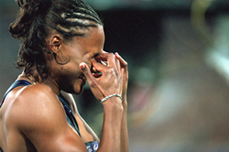
To Mask Other Drugs (diuretics, alcohol)
Diuretics are drugs that increase the rate of excretion of water from the body via urination.
Diuretics are used by some athletes because it speeds up weight loss and may eradicate traces of banned substances (i.e. steroids) from the body. This is why they are banned.

Slide 123
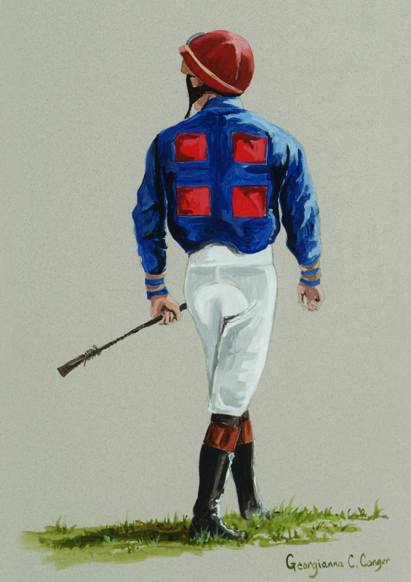
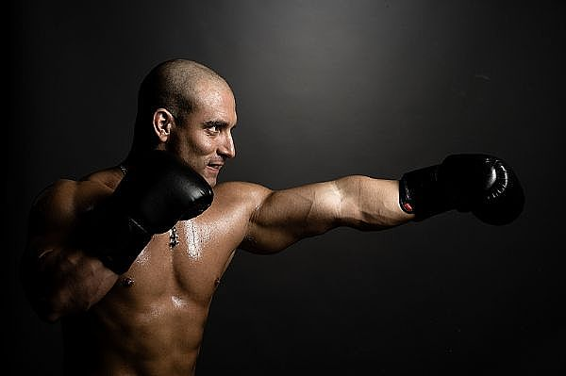
They have played a role in sports such as boxing, racing and weightlifting, where weight reduction is often essential.
Apart from the interruptions to training caused by frequent urination, there are other detrimental effects to diuretics, including:
Dehydration
Dizziness and possible fainting
Headaches
Heart and kidney failure

Slide 124
Alcohol is prohibited during competition only as it is a depressant, that slows down bodily functions.
Alcohol is a diuretic that actively encourages the body to lose more water than it takes – masks any drugs consumed by the athlete.
Alcohol consumption may also increase an athlete’s self-confidence, which may result in the athlete taking risks that they normally wouldn’t take.

Slide 125
Alcohol is contained in may cough elixirs, some athletes have been known to take cough elixirs to mask drug abuse.
The effects of alcohol depend on the quantity consumed, the athlete’s body size and the length of time between drinks.
Alcohol causes dizziness and loss of coordination, loss of inhibition, slowed reactions, vomiting.

Slide 126
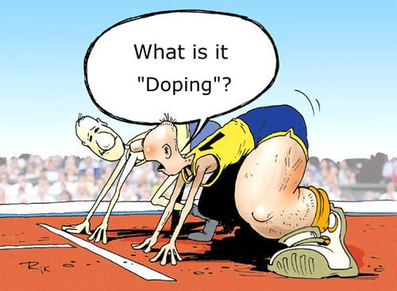
Benefits and Limitations of Drug Testing
Drug testing procedures are highly sophisticated and reliable.
The Australian Sports and Drug Agency (ASDA) is responsible for testing in Australia.
Drug testing involves the testing of urine of athletes. This is done either randomly, in bulk (large amount of athletes at a time) or according to their finishing positions.

Slide 127
The drug tests are designed to detect and deter the abuse of performance enhancing drugs by competitors.
Drug testing ensures equal playing field amongst the competitors, where the athlete has been victorious because of their training etc.
Testing procedures for drug abuse in sports are strict and the testing procedures must be closely adhered to so that all athletes receive the same treatment.

Slide 128
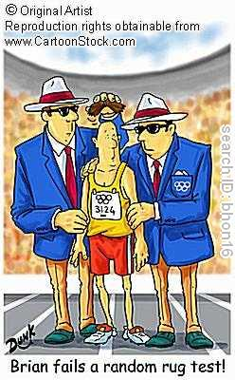
For the testing procedure to be of benefit it is vital that the urine sample actually comes from the athlete, so the testing officer must be able to see the urine flowing from the athlete into the bottle.
Drug testing is no longer restricted to being conducted only during competitions, it can now be carried out throughout the year, with random testing occurring any time, any place.
Tens of millions of dollars are spent on drug testing yearly.

Slide 129
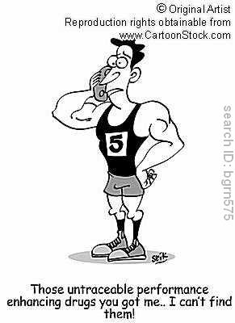

Slide 130
Syllabus Content
Students Learn About
Students Learn To
Use of technology
training innovation, eg lactate threshold testing, biomechanical analysis
equipment advances, eg swimsuits, golf ball
Describe how technology has been used to improve performance
Argue ethical issues related to technology use in sport such as:
has technology gone too far?
has access to technology created unfair competition?

Slide 131
The Use of Technology
Coaches have at their disposal a number of techniques that can aid training, skill development and performance.
These various aids are designed to correct technique, create resistance, offer support or padding and improve performance.
Many of the aids have revolutionised how sports are played and trained. Most have also made the work of the coach easier because they enable coaches to more closely simulate game or competition situations or to evaluate athletic performance.

Slide 132
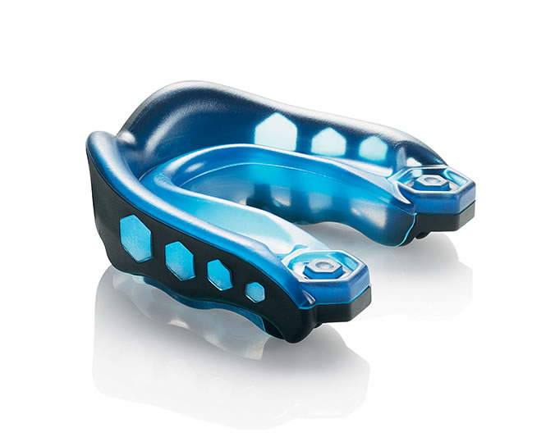
Some of the aids are as simple socks that absorb moisture. Others are high-tech $5 million pursuit bikes.
Whether simple or complex, sports technology presents numerous opportunities and dilemmas.

Slide 133
Training Innovation
Institutes of sport and research centres have, as a result of considerable public funding, developed sophisticated methods of measuring and analysing physiological progress as a result of training.
Two areas where there have been considerable training innovation are in lactate threshold testing and biomechanical analysis.

Slide 134
Lactate Threshold Testing
Lactate analysis has been used by many athletes and physiologists over the last decade as a tool for predicting endurance performance.
The higher an athlete’s VO2 max or the higher the pace at which the lactate threshold occurs, the fitter the athlete.
The lactate threshold is the best indicator of endurance performance as, generally, the athlete who achieves this at the higher level will be faster and more efficient in endurance based events.
Frequent lactate threshold testing is an effective measure of improvements due to training.

Slide 135
There is a range of equipment and a number of ways that you can establish an athlete’s lactate threshold. The most accurate and reliable method is testing blood samples during graded exercise tests in a laboratory.
This is conducted by using either a treadmill, bicycle ergometer or rowing machine, where blood samples are taken at graded levels of intensity.

Slide 136
Other testing protocols includes the use of a portable lactate analyser which enables the coach to measure both the aerobic and anaerobic conditioning of an athlete.
With this information, a coach can plan, control and monitor the training of athletes with a precision not available before.
Lactate testing provides the important information that enables the coach to individualise the intensity of each athlete’s workout, and control the training so the athlete is able to reach performance objectives.

Slide 137
Biomechanical Analysis
Many coaches film the performances of athletes and teams so they can evaluate the performance of individuals later using biomechanical analysis.
Filming of the performance also allows the coach to concentrate more attentively during the actual competition.
Some coaches have assistants who analyse these recordings.

Slide 138
Biomechanical analysis may involve the use of video analysis, photography, use of comparative images and slow motion replays.
These analytical methods allows the performance of skills to be subjected to a high degree of scrutiny.
Movements are explored in detail, problems identified and ways of making the movement more biomechanically efficient recommended.

Slide 139
Data can also be gathered during and after the performance by replaying the footage. Data can be gathered such as how many tackles an individual made, how many forehand winners were executed, the percentage of conversions made etc.
The strengths and weaknesses of the opposition can also be evaluated.

Slide 140
Equipment Advances, e.g. swimsuits, golf ball
Significant progress has been made in swimsuit development since the 1980’s – it has reached a stage where questions are being asked about the influence of technology on an athlete’s performance.
1980’s – saw the introduction of light, thin extremely light fitting swimsuits, designed to minimise contact area with the water and even repel water.

Slide 141
1992 – After the Olympics, contrasting stripes were printed onto close fitting swimsuits to generate two currents: one slow, one fast. When the fast and slow currents interact, vertical vortexes or spirals are formed, resulting in the increased speed of water flow.
2000 Olympics, swimsuit designers had created a swimsuit that imitated the skin of a shark. The cut and seams on the suit were designed to cover the whole body without impeding the swimmer. Body scanning took measurements to design individual suits which improved streamlining.

Slide 142
The most recent developments have produced widespread calls for the banning of high tech swimwear.
The speedo LZR exponentially increased this and more recently at the 2009 World Championships a new range of suits by Adidas, Arena and Jacked saw an unprecedented 46 world records broke.

Slide 143
The new swimsuits are made from a special ultra-lightweight water repellent material that, through compression, reduces skin vibration and offers low drag friction while improving buoyancy. Internal stabiliser supports hold the swimmer in the best position in the water and overall the design optimises the shape of the swimmer.
As of January 2010 these suits will be restricted by the issuing of new rules that restrict body coverage, buoyancy levels and the actual materials used.

Slide 144
The golf ball used today is larger and technology has been able to embed it with the most appropriate number and size of dimples for maximum elevation and distance given the clubhead speed applied by the golfer.
Golf balls no longer curve as much as they used to. Players are now able to swing as hard as they like and the ball goes straight to the flag.

