Slide 1
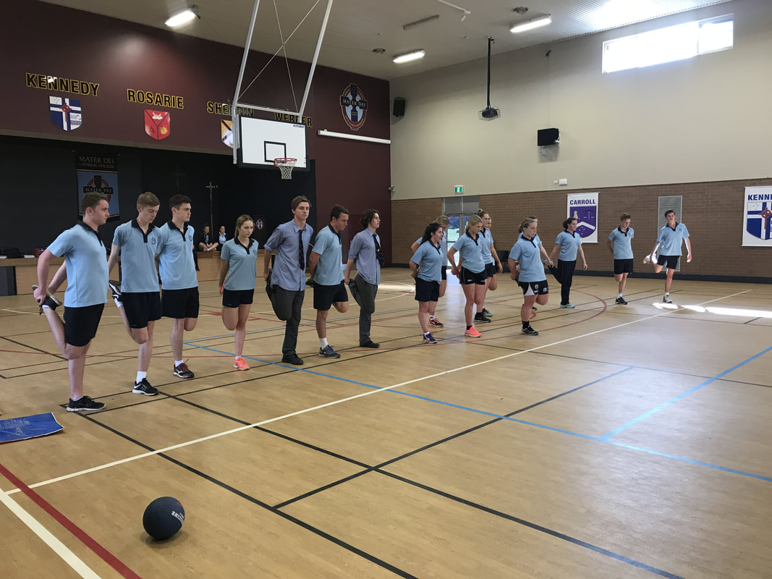
Physical Preparation
Students learn about:
Pre-screening
Skill and technique
Physical fitness
Warm up, stretching and cool down
Students learn to:
Analyse different sports in order to determine priority preventative strategies and how adequate preparation may prevent injuries
Notes:
NOTE:
To change the image on this slide, select the picture and delete it. Then click the Pictures icon in the placeholder to insert your own image.

Slide 2
PHYSICAL PREPARATION - OVERVIEW
When people think of physical preparation for sport, they normally think of a warm-up – it is more than that
It looks at whether the body is physically prepared for particular sports competitions and levels.
This includes:
The pre-screening of would be athletes to ensure they do not have any health or medical conditions that need to be catered for in a training program.
Also refers to the athlete’s skill execution and technique.
Can the athlete complete the skill correctly and repeatedly?
Poor technique leads to injury and needs to be corrected in order for the athlete to be prepared for training or competition.
It is also important to examine the physical fitness levels required for the competition and training schedule.
Athlete’s should have the right fitness levels (both health related and skill related components should be considered) for their particular sport and performance level.
This is not to say that physical preparation does not include the warm up, stretching and cool down, it is just not limited to it.

Slide 3
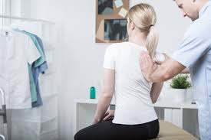
PRE-SCREENING
Prescreening for exercise has three (3) stages
The first stage being compulsory
The other 2 optional, but recommended.
STAGE 1 - PRE-SCREENING QUESTIONNAIRE
Can be completed with a professional or self-administered.
Aim is
“to identify those individuals with a known disease, or signs or symptoms of disease, who may be at a higher risk of an adverse event during physical activity/exercise.”
THE QUESTIONNAIRE CONSISTS OF SEVEN (7) QUESTIONS:
Has your doctor ever told you that you have a heart condition or have you ever suffered a stroke?
Do you ever experience unexplained pains in your chest at rest or during physical activity/exercise?
Do you ever feel faint or have spells of dizziness during physical activity/exercise that causes you to lose balance?
Have you had an asthma attack requiring immediate medical attention at any time over the last 12 months?
If you have diabetes (type I or type II) have you had trouble controlling your blood glucose in the last 3 months?
Do you have any diagnosed muscle, bone or joint problems that you have been told could be made worse by participating in physical activity/exercise?
Do you have any other medical condition(s) that may make it dangerous for you to participate in physical activity/exercise?
YES to any of these questions means the person is at high risk for undertaking exercise and needs to be cleared by a medical practitioner before training can begin.

Slide 4
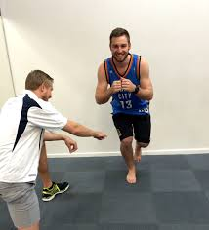
PRE-SCREENING CONT…
STAGE 2 - PRE-SCREENING QUESTIONNAIRE
The second stage of the pre-screening questionnaire aims
“to identify those individuals with risk factors or other conditions to assist with appropriate exercise prescription,” and is administered by an exercise professional such as an Exercise Physiologist.
This stage has 12 questions that look at family history, behavioural risk factors, and underlying medical conditions such as hypertension that could make exercise riskier.
If a person has risk factors then their training and exercise should be catered to their health needs. This often means beginning training at lower intensities and processing more slowly.

Slide 5
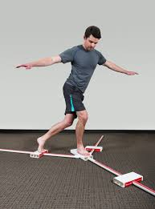
PRE-SCREENING CONT…
STAGE 3 - PRE-SCREENING MEASUREMENTS
The aim of the stage 3 measurements is
“to obtain pre-exercise baseline measurements of other recognised cardiovascular and metabolic risk factors.”
The measurements taken include:
BMI
Waist girth
Resting blood pressure
Fasting lipid profile
Fasting blood glucose
These measurements are taken by an exercise professional and help guide the them in exercise prescription.
Pre-screening enhances the well-being of the athlete because it helps guide the exercise professional in exercise prescription that caters to the specific needs of the individual.
Also ensures those who are at high risk of suffering a heart attack or stroke during exercise are first cleared by their medical practitioner, and have correct supervision and prescription of exercise to avoid harm.
Pre-screening is important, because physical activity is very beneficial for all people, including those of higher risk categories, and the pre-screening ensures proper precautions and liberties are taken.

Slide 6
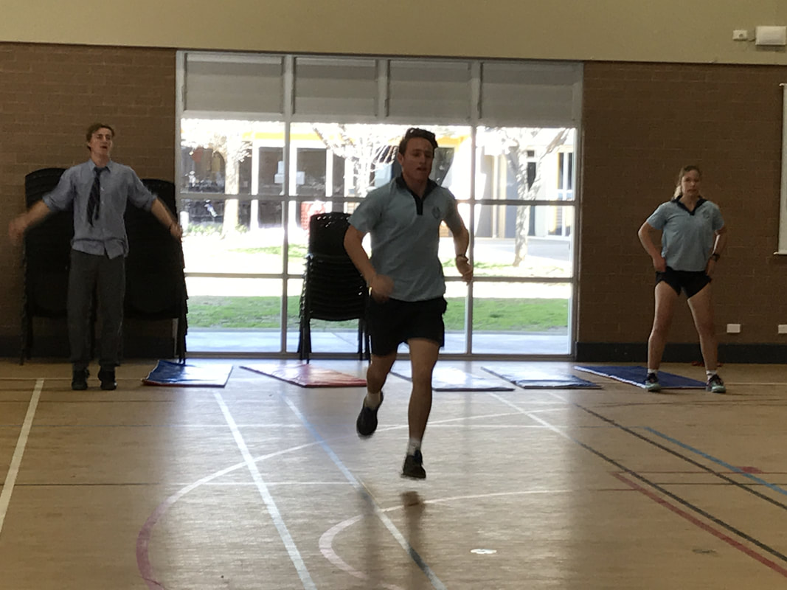
SKILL AND TECHNIQUE
Skill and technique are vital for sports participation safety.
High level skill and good technique help prevent injury and enhance the well-being of the athlete.
SKILL
There are three stages of skill acquisition:
Cognitive
Associative
Autonomous
At the beginning stages of skill acquisition, the athlete is focused on the skill at hand. Regardless of the skill, if the athlete has lower skill levels then they will focus on the skill. This can result in greater injury.
For example, an unskilled football player, may be dribbling a soccer ball looking down the whole time and collide with a defender, or even his own player resulting in an injury. Or he may be distracted and step on the ball spraining his ankle.
More skilled autonomous athlete can focus on their surroundings and still perform the skill well.
Can dodge players and see what is coming in front of them. If hitting a cricket ball, can respond quickly to the particular ball, adjust action and perform the skill safely without being injured.

Slide 7
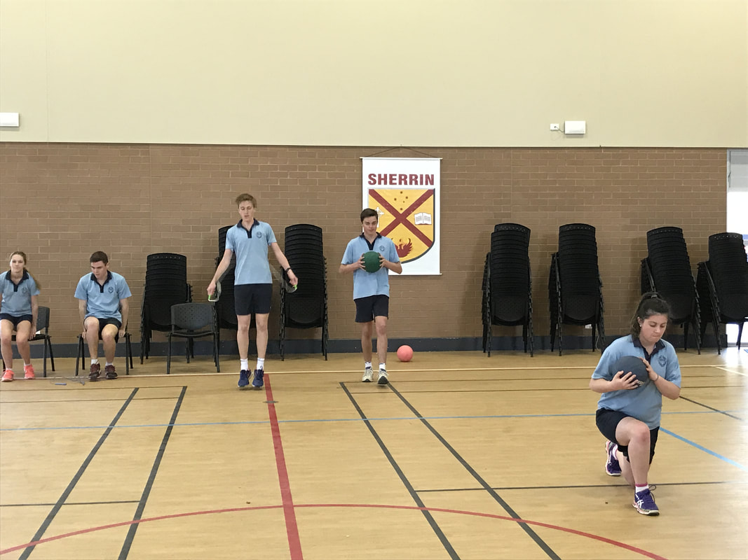
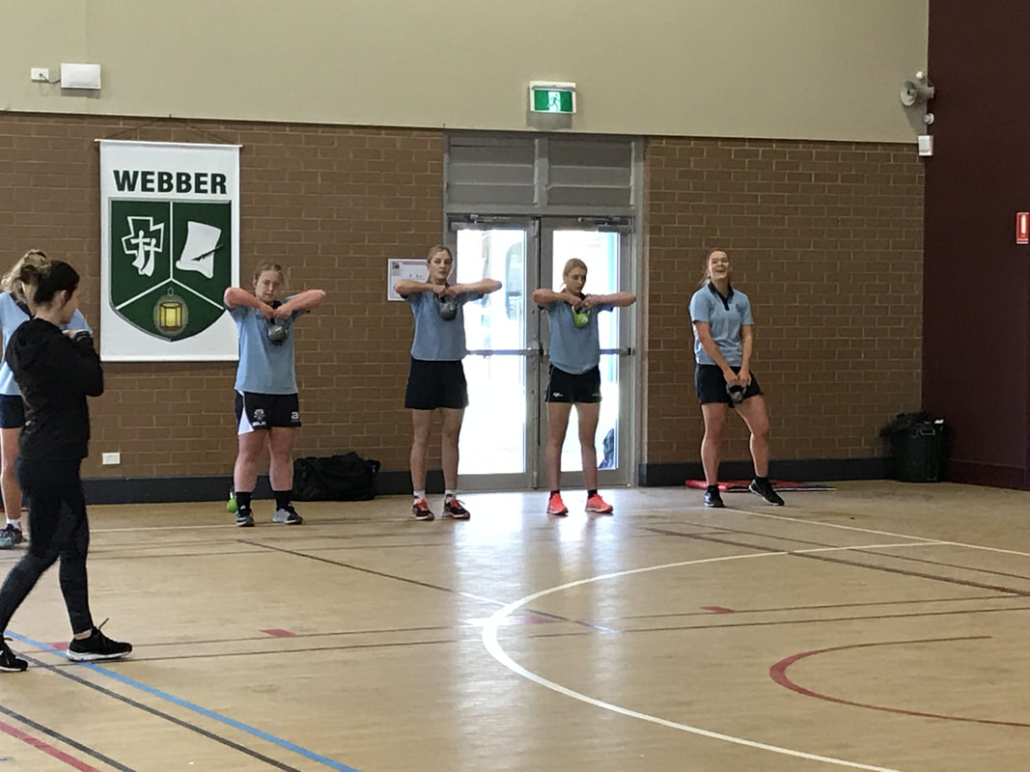
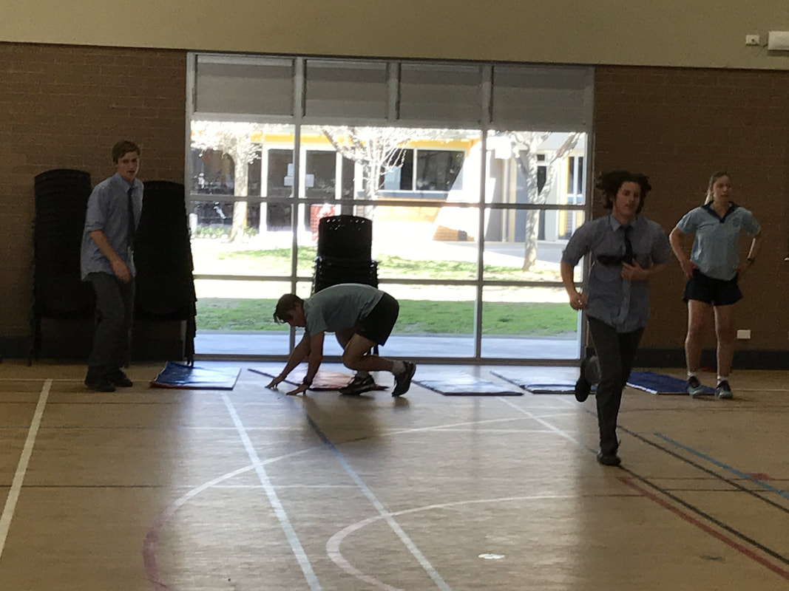
SKILL AND TECHNIQUE CONT…
TECHNIQUE
Technique is one of the greatest indicators for sports injury.
Poor technique leads to higher injury rates, especially overuse injuries.
Good technique protects against injury and produces a better performance.
Someone with good technique is biomechanically efficient.
This means they can produce more power, and greater accuracy with less effort. This protects against injury.
For example, a tennis player with good technique for their serve is more consistent with their first serves, but also suffers less injury because they are putting less strain on their body. This prevents injury to the back or shoulder.
A player with poor technique generates unnatural forces that pull the body or its joints in directs they are not designed for.
This is non-efficient movement, requiring greater effort from the athlete and causing more injuries.
A cricket bowler with poor technique is more likely to injure their neck, back or shoulder.

Slide 8
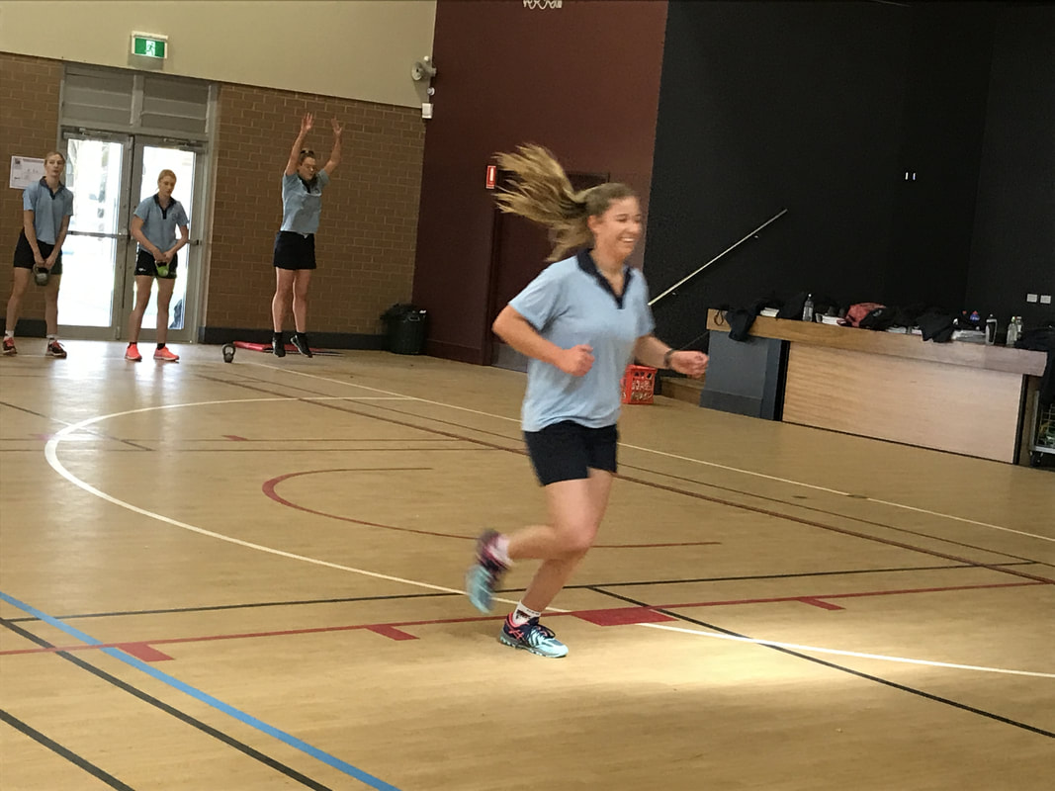
PHYSICAL FITNESS
In order to be physically prepared for competition an athlete’s physical fitness needs to be at a level that can manage the demands of the competition.
Physical fitness helps reduce injuries in sport and is specific to the sport. The athlete needs to be physically fit in all the components of fitness as they are required in their sport.
There are eleven (11) components of physical fitness, five (5) health and six (6) skill related (from Preliminary).
HEALTH RELATED COMPONENTS OF PHYSICAL FITNESS
Cardiorespiratory endurance
Muscular strength
Muscular endurance
Flexibility
Body composition
SKILL RELATED COMPONENTS OF PHYSICAL FITNESS
Power
Speed
Agility
Coordination
Balance
Reaction time

Slide 9
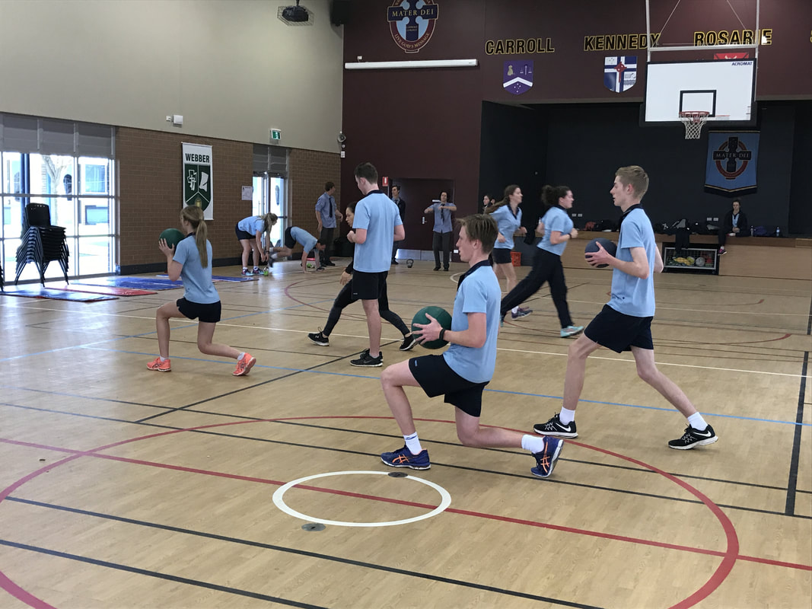
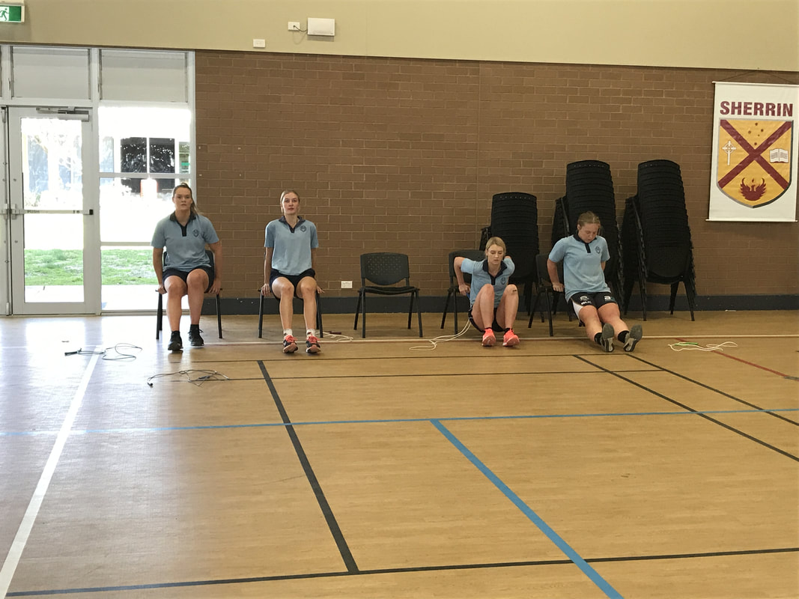
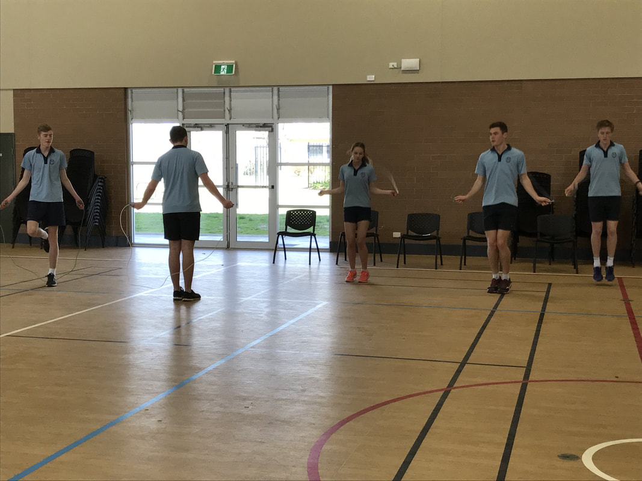
PHYSICAL FITNESS
Each sport has specific key components of fitness that are required for safe and good performance.
For example, a gymnast requires excellent muscular strength, muscular endurance, coordination, balance and flexibility. If any of these are lacking they are more likely to have an injury, such as a fracture occur.
For most sports – good cardiorespiratory base is required to avoid fatigue.
Fatigue affects technique – poor technique increases the likelihood of injury.
For eg - an athlete who is not physically fit is more likely to sprain an ankle, strain a muscle or suffer an abrasion to the skin.
Each sport is specific in its physical fitness requirements and should be analysed individually.
This is particularly important as you do the learn to “analyse different sports in order to determine priority preventative strategies and how adequate preparation may prevent injuries.”
The specific components of physical fitness required will be used more frequently in training in order to look after the athletes well-being and prevent injury.
This would become a priority preventative strategy – ensuring the athlete has the appropriate physical fitness required for their sport of choice.

Slide 10
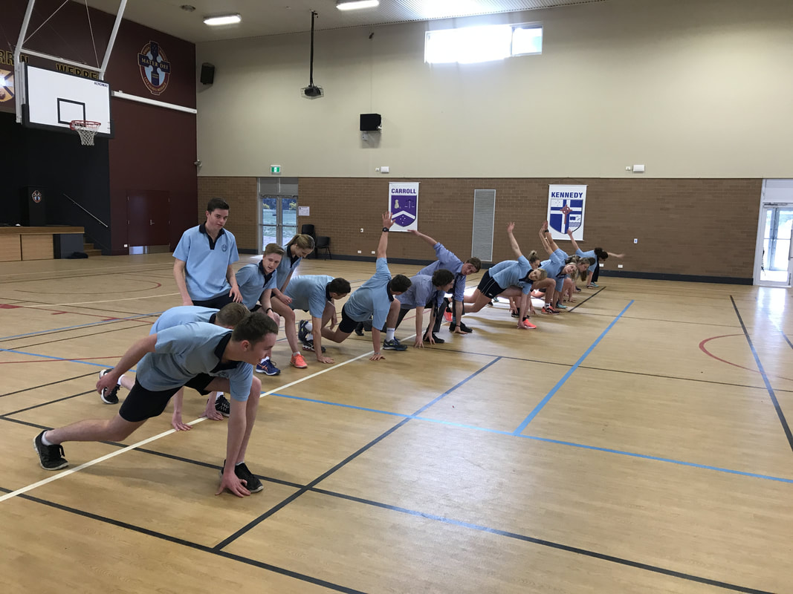
WARM UP
A warm up should prepare the body for the physical activity ahead.
Warm up is important for safe participation.
Should begin with general whole body movements that are low in intensity and slowly increase this intensity to what will be required during performance.
If the athlete needs to do a 100% flat out sprint, they should slowly progress to this intensity in the warm up: from a light jog, to running, to sprinting.
A warm up should begin without any equipment.
If the athlete is participating in a sport such as football, then the football should not be added into the warm up until towards the end, when the body already has blood flowing to the working muscles.
Warm ups will often finish with a small mini game to fully replicate the movements required in the sport.
Performing without a proper warm up (minimum of 5-7 minutes) increases the risk of injury to the athlete.

Slide 11
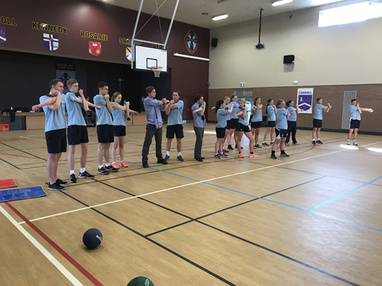
STRETCHING
Stretching as part of a training program increases the athlete’s flexibility, which helps to prevent injury and promote wellbeing.
These comments are related to a flexibility program, where stretching is done routinely just like resistance training.
Warm up and Stretching
Stretching in a warm up should be specific to the sport.
There are many different types of stretching:
Ballistic
Static
Dynamic
PNF.
Stretching in a warm up should use the correct type of stretching for the sport. If the sport requires continual movement throughout the activity, such as in football, netball, tennis etc then dynamic stretching is the more appropriate form.
If your sport is gymnastics or dance and you are required to hold a pose such as the splits, then static stretching is preferred.
This is not to say that the types of stretching cannot be combined, as dance and gymnastics also frequently require movement throughout the range of motion and dynamic stretching does help performance.
Static stretching has been shown to decrease power and force output from the muscle, and can decrease performance in sports that require them.

Slide 12
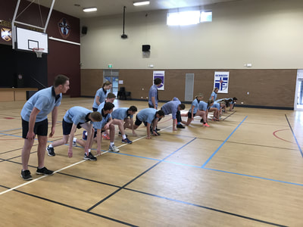
STRETCHING CONT…
Stretching should always be used as part of the cool down.
During the cool down, a combination of stretching types may prove beneficial. It may help speed up recovery and decrease DOMS (Delayed Onset Of Muscle Soreness).
Ballistic stretching is the exception and should not generally be used in a cool down.

Slide 13
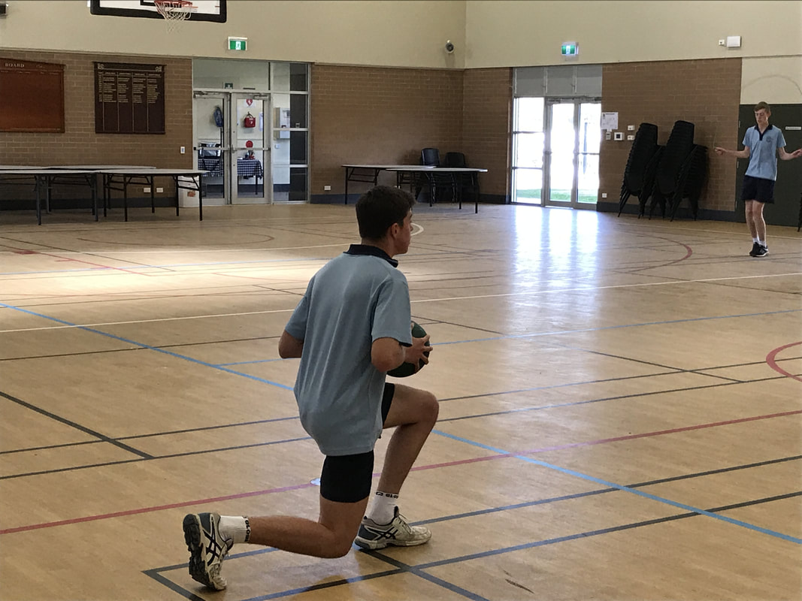
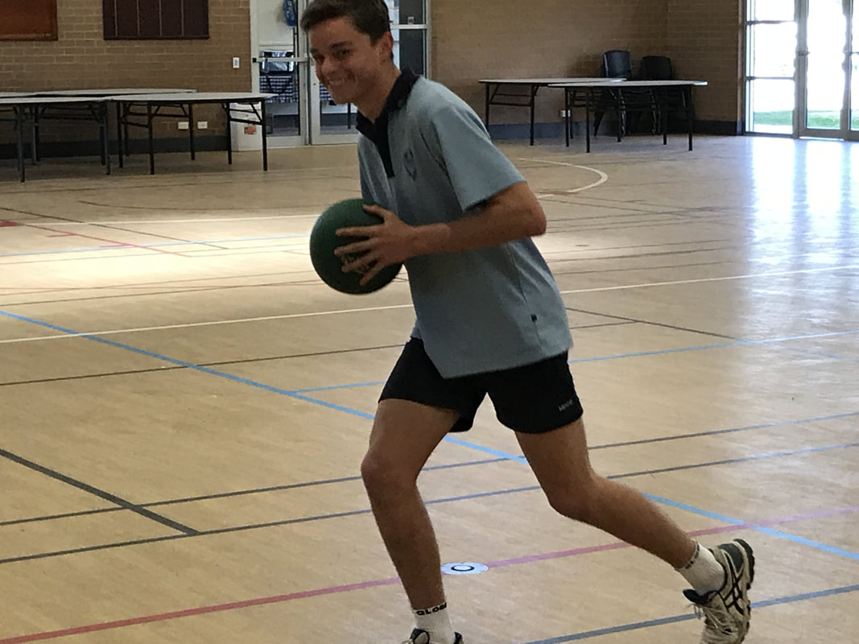
COOL DOWN
A cool down should slowly bring the athlete back to a pre exercise metabolic state. Begin at a vigorous intensity and slowly decrease in intensity.
The aim is to continue to move the blood back to the heart as the heart decreases in rate back to a pre exercise level.
Ensures that waste products are removed before exercise is stopped - resulting in less carbon-dioxide and lactic acid in the muscles.
Helps to reduce the muscle temperature and deliver nutrients required for repair.

