Slide 1
Planning a Training Year (Periodisation)
STUDENTS LEARN ABOUT:
Phases of competition (pre-season, in-season and off-season phases
Subphases (macro and microcycles)
Peaking
Tapering
Sport-specific subphases (fitness components, skill requirements
STUDENTS LEARN TO:
Develop and justify a periodisation chart of the fitness and skill-specific requirements of a particular sport

Slide 2
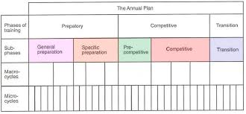
PLANNING A TRAINING YEAR (PERIODISATION)
Is important to use periodization - to structure the year and ensure the athlete peaks in performance at the right time.
Periodisation is the process of breaking the year down into smaller time periods in order to structure the training program effectively.
Periodisation has three main subphases that combine to make the training year:
Macrocycle
Mesocycle
Microcycle
The training year will often have the three (3) phases of competition:
Pre-season (Preparatory)
In-season (Competitive)
Off-season (Transition)
The development of a year long training program will utilise the concepts of peaking and tapering to help ensure the athlete is performing their best when it is required.

Slide 4
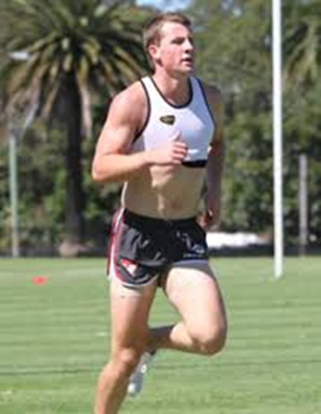
PHASES OF COMPETITION – PRE-SEASON
Also known as the preparation phase - is the period before competition where the trainer focuses on developing the basis or fundamentals required in the sport.
If the pre-season phase is long enough (6-10 weeks) is will be broken into general and specific mesocycles.
General mesocycle - training will usually focus on general body fitness, including muscular strength, muscular endurance, cardiovascular endurance, and general body conditioning.
As the program transitions into the specific phase of preparation, training begins to focus on more sport specific aspects of training.
This will include the development of sport specific skills, such as power, speed, ball control, or specialised movements.

Slide 5
PHASES OF COMPETITION – IN-SEASON
In-season/competition phase can be short or long - depending on the type of sport.
For eg - Tennis competition phase may only last 2-4 weeks during a tournament
Netball goes for six (6) months - during this phase of competition, training shifts its focus to strategy and tactics, while still maintaining skill and sport specific fitness levels.
The volume of training during competition often decreases, especially during competitions that have matches every 2-3 days such as a tennis tournament.

Slide 6
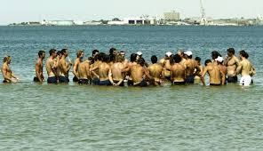
PHASES OF COMPETITION – OFF-SEASON
Off-season/transition phase of competition immediately follows the competition and focuses on relaxation and recovery.
Training volume and intensity decrease, and may even become non-existent for a period of time.
Allows the athlete to recover from the intensities of competition, before they once again begin to increase training volume and intensity in the pre-season.
These three (3) phases of competition are used by trainers and coaches in order to ensure the athlete is peaking at the correct time.

Slide 7
SUBPHASES - MACROCYCLE
Macrocycle - is the larger training cycle and normally encompasses the whole year.
Can be both larger or smaller than this, depending on the sport.
For eg, - An athlete training to win the olympics will have a four (4) year macrocycle in order to qualify for and then peak during the olympics.
A football player will focus on a single year macrophase.
Athletes will often set macrocycle goals that they wish to achieve.

Slide 8
SUBPHASES - MESOCYCLE
Mesocycle – is a smaller chunk of time and can consist of a few weeks or a few months.
Often mesocycles match up with the three (3) phases of competition (pre, in and off season).
For eg, one mesocycle may be 4 weeks of general pre-season training.
Mesocycles join together to create the macrocycle.
The macrocycle goals are broken up into smaller goals that are to be achieved during each mesocycle.

Slide 9
SUBPHASES - MICROCYCLE
Microcycle - is smaller still - often a single week of a training program.
Is often used to focus on a singular aspect that adds together with other macrocycles in order to achieve mesocycle goals which accumulate to achieve the macrocycle goals.
Microcycle’s are particularly important for weekly competitions as the athlete or team prepare for their next match.
Microcycle that works as the building blocks to create the year long training program using periodisation.

Slide 11
PEAKING
Is when the athlete is performing at their absolute best during competition.
When planning a training year the coach or trainer attempts to have the athlete peak for the most important competitions.
Peaking can be difficult - especially in a sport that has a long in-season such as Rugby, AFL, netball, cricket, or football.
Peaking requires the athlete to have:
great general body conditioning
good sports specific conditioning
great skill execution combined with strategy and tactics that enable them to perform at their best.
Peaking also needs the athlete to be mentally focused and have optimum arousal levels in order to perform at their best.

Slide 12
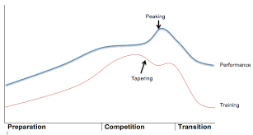
PEAKING CONT…
Just before the competition - training will taper down in order to allow nutrient levels to be at the optimum levels and in order for the athlete to fully recover from training before the competition.
Peaking is often short lived but has a number of identifiable characteristics:
Aesthetically pleasing movements
Speedy recovery
Optimum fitness performance
Great tactical awareness and predictability
Self-confidence
Mental focus and toughness
When all of these are present, the athlete has peaked and is ready to perform their best.

Slide 13
TAPERING
Tapering - the reduction of training volume and intensity just prior to competition - allows peaking to occur.
The high volume and intensity of training also causes impairments in performance.
Strength and plyometric training causes small muscular tears - which result in the muscles producing less force and power.
Tapering allows the body to repair these normal small “injuries” by reducing training volume and intensity. This helps the body to recover fully in order for the athlete to perform their best.
Coaches or trainers will taper training 2-4 weeks prior to competition. Allows the body to repair while at the same time not causing a large decrease in training that there is a reduction in training benefits, such as cardiovascular endurance.
Also allows the body to completely replace nutrients (carbohydrates, fats, protein, as well as vitamins and minerals) required for competition. These are replenished during the rest period.

Slide 14
SPORT SPECIFIC SUBPHASES
Refers to the selection of what is focused on during the subphases of competition in order to cater specifically for the relevant sport.
Refers to the meso and microcycles that combine in order to achieve the larger goals of the athlete or team.
Each sport has specific components of fitness, skills tactics and other variables that need to be focused on throughout the year of training.
For eg - A triathlete will always have a larger focus on cardiovascular endurance than a 400m sprinter, or a basketball or netball player.
A netball player will need to have micro and mesocycles that will focus on the skills of catching, passing and shooting, along with fitness components of speed, agility and power.
These differences in sports require sport-specific subphases to be developed by trainers and coaches in order to best prepare the athlete for competition.

Slide 15
SPORT SPECIFIC SUBPHASES CONT…
Sport-specific subphases will change throughout the year as training moves through the different phases of competition.
During the pre-season:
Often a general conditioning mesocycle that will focus on cardiovascular endurance for most sports as well as strength and size for sports that require it, such as rugby league.
As the year progresses in the specific preparation phase, the differences in sport requirements in training grow and sport-specific subphases are developed.
During the competition phase:
Sports such as football will maintain cardiovascular endurance, speed and agility, while focusing on skill development and team strategies and tactics.
A rower may still spend plenty of time further developing their cardiovascular endurance and need spend only a smaller amount of time on synchronisation with other rowers and stroke technique.
Further differences also arise as each athlete is catered for within their sport. Each athlete may have their own sport-specific subphase in order to develop aspect of their game or skills that are lacking compared to others.

Slide 16
DEVELOP AND JUSTIFY A PERIODISATION CHART
In HSC PDHPE you are required to develop and justify a periodisation chart of the fitness and skill-specific requirements of a particular sport.
The following image is a periodisation chart developed for football (soccer).
The periodisation chart developed has specific components of fitness, both skill and health related, and identifies when each component is developed, maintained or rested.
The chart focuses on the key components most relevant to football.
These include the basics needed for most sports such as:
Strength
Cardiorespiratory endurance
Muscular endurance.
These are used frequently in football as it is a sport that goes for 90 min, requiring good cardiorespiratory endurance, and involves the player shielding the ball and tackling each other requiring strength etc.

Slide 18
DEVELOP AND JUSTIFY A PERIODISATION CHART – MICROCYCLE
The more specific components relevant for football include:
Speed – needed to get to the ball first or pass opposition
Agility – needed to change directions frequently
Power – needed for long passes, clearances, shooting, explosive sprints
This chart also has a section for focusing on skills within the sport, e.g. shooting, passing etc.
A microcycle (next slide) has also been planned out in a table.
This is how the developed periodisation chart is broken down into weekly chunks that focus on the relevant fitness components as they are developed.
Note in the chart that the rest periods are highlighted showing how this developed periodisation chart avoids overtraining.

