Slide 1
PLANNING TO AVOID OVERTRAINING
STUDENTS LEARN ABOUT:
Amount and intensity of training
Physiological considerations eg lethargy, injury
Psychological considerations eg loss of motivation’
STUDENTS LEARN TO:
Analyse overtraining by considering questions such as:
How much training is too much?
How do you identify an overtrained athlete?
How can overtraining be avoided?

Slide 2
PLANNING TO AVOID OVERTRAINING - OVERVIEW
Overtraining leads to poor performance and leads to injuries, particularly overuse injuries
It is when an athlete does high intensity training, in high volumes.
Often this comes in the athlete training too often and not including enough rest between sessions of high intensity.
This affects their recovery and prevents physiological adaptations from occurring.
Athlete’s who suffer from overtraining become:
Fatigued
Tired
Lethargic
This feeling becomes to a lack of motivation in the athlete, and can also lead to injury through poor technique and overuse.

Slide 3
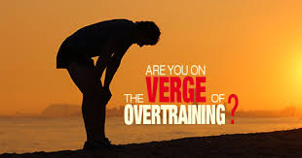
AMOUNT AND INTENSITY OF TRAINING
Leads to overtraining when the athlete completes high intensity training too often/in large amounts.
Particular forms of training (strength training) require 48 hours of rest for the muscles in order to recover and adapt appropriately to the training.
Large volumes of training at high intensity cause overtraining because the athlete does not have enough time between training sessions to recover from the previous training session.
More likely to suffer from overtraining, leading to poor performance, decreased motivation and higher risk of injuries.

Slide 4
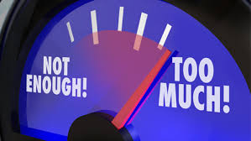
HOW MUCH TRAINING IS TOO MUCH?
There are some general guidelines, but everything is always athlete specific.
Individual aspects including:
Stress from work or family
Medical conditions
Nutrition
Sleep
Use of recovery strategies
All contribute to an athlete’s risk of suffering from overtraining.
As a general rule - athletes should not be completing high intensity training every day.
In order for physiological adaptations to occur - training intensities should be in the relevant training zones and need to only occur 3 times a week.
Types of training should be examined - ensure the amount and intensity of training does not place too much stress upon the athlete.
For example, a Rugby League player should not be developing their strength, power, speed, agility and body composition all at the same time. This would require a large amount of high intensity training.

Slide 5
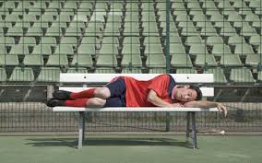
HOW MUCH TRAINING IS TOO MUCH CONT…
What do you do if you identify an overtrained athlete?
Reduce the amount and intensity of training sessions.
May need to take a complete break from training - to recover fully from their training session.
If overtraining is identified early - a change in frequency, intensity and time may be adjusted.
Often overtraining is not identified until after injuries begin to occur – in this case, rehabilitation should occur and testing be done before the athlete returns to normal training and competition.

Slide 6
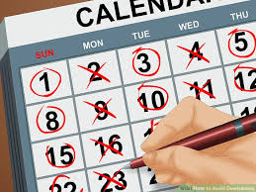
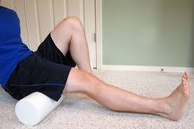
HOW CAN OVERTRAINING BE AVOIDED?
Have a good balance in the amount and intensity of training.
Planning a training year ensuring the athlete has regular rest periods (weekly) is vital.
Inclusion of recovery sessions and skills or tactical training – allows recovery from higher intensities.
Monitor each athlete closely looking for the signs and symptoms of overtraining.

Slide 7
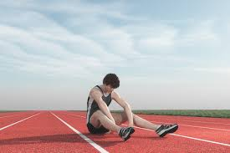
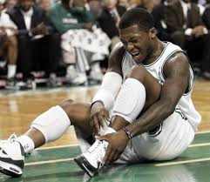
PHYSIOLOGICAL CONSIDERATIONS
Two focus areas:
Lethargy
Injury
For Injury – need to understand how it is caused at the muscular level.
Every high intensity training session causes minor injuries to muscle cells - these are usually micro-tears (often felt as delayed onset muscle soreness or DOMS), and they require time to heal.
These micro-tears usually stimulate the physiological adaptations that occur from training - but if they have not fully recovered before the next training session the small “injuries” are re-injured and become larger. The longer this goes on the larger the injury and this can lead to other injuries.
For lethargy - the constant low level pain wears the athlete out.
The small tears also cause muscular weakness, decreasing performance and strength.
As these build up over time, the muscles become constantly weak, making normal activities draining on the athlete.
Nutrition – important consideration for recovery. Leads to further feelings of lethargy as there is not enough energy within the body to recover properly

Slide 8
HOW DO YOU IDENTIFY AN OVERTRAINED ATHLETE? – PHYSIOLOGICAL CONSIDERATIONS
SIGNS OF AN OVERTRAINED ATHLETE:
Frequent error in performance
Poor performance (decreased endurance, strength, power, speed etc)
Illness
Injuries
Poor technique
Increased resting heart rate
Excessive thirst
SYMPTOMS OF AN OVERTRAINED ATHLETE:
Pain
Lack of energy (lethargy)
Headaches
Cramping
Loss of appetite

Slide 9
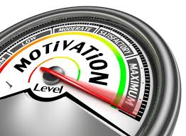
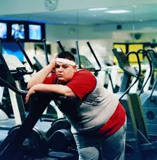
PSYCHOLOGICAL CONSIDERATIONS – LOSS OF MOTIVATION
An overtrained athlete will lack motivation.
They will be:
Tired
No longer feel like training
Lose focus of their goals and no longer want to do the hard work to get there.
Is different to lethargy because lethargy is about a lack of energy to train, while a lack of motivation is not wanting to train or compete.
Often lethargy will lead to a lack of motivation due to the body being tired and suffering frequent or constant pain. This leads to our emotions become elevated (hence why we are grumpy when tired or hungry).

Slide 10
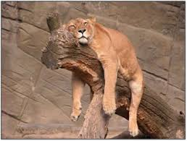
HOW DO YOU IDENTIFY AN OVERTRAINED ATHLETE? – PSYCHOLOGICAL CONSIDERATIONS
SIGNS OF OVERTRAINING:
Moody and irritable
Responds poorly to criticism/on field banter
Gives up when competition gets hard/abandons struggles against opponents
SYMPTOMS OF OVERTRAINING:
Lack of motivation
Depression
Sensitive to criticism
Confusion during competition

