Slide 1
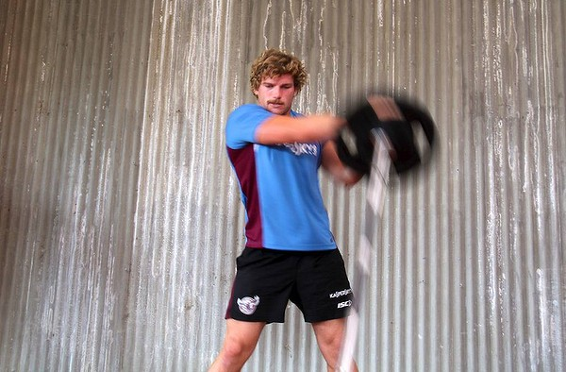
Principles of Training
In order for a training program to be effective, a coach needs to consider the principles of training.
The objective of training is to improve performance, and the body needs to respond to physical, psychological and environmental stressors
Definitions you need:
Maximal effort - exercise at the highest intensity possible. This can only be sustained for a short period of time (sprinting)
Sub Maximal effort - exercise at a rate less than maximal intensity which can be maintained for longer (jogging)
Most fitness tests use the sub maximal test.

Slide 2
Principles of Training
Progressive Overload
The principle of progressive overload implies that a training effect is produced when the system or tissue is worked at a greater level that it is normally accustomed to working
Reversibility
Principal of training states that the effects of training are reversible
Warm up & Cool down
Warming up and cooling down are important components of all training and performance sessions. The warm up aims to prepare the body in readiness for the activity
Principles of Training
Training Threshold
The principle of training thresholds relates to levels of exercise intensity that are sufficient to produce a training effect.
Variety
The principle of variety states that athletes need to be challenged by not only the activity but also by the implementation of the activities
Specificity
The principle of specificity implies that the greatest gains are made when activity in the training program replicates the movements in the game or activity.

Slide 3
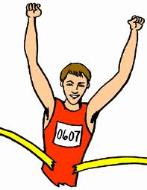
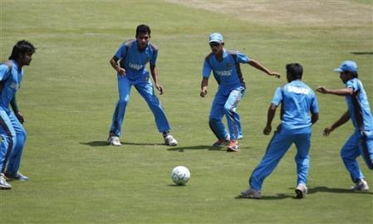
Specificity
This principle states that the training activity should be specific to the:
Task requirements
Energy systems
Muscle groups
Components of fitness
For example, a marathon runner needs to develop
Running styles/actions
Aerobic energy system
Predominately leg muscles (not shoulders)
Train for endurance – not power
There is a place for cross training, ie training that is not always specific to the activity. This aids with motivation, helping aerobic fitness, recovering from injury, assist muscle balance. E.g. Cricketers might warm up with a game of soccer

Slide 4
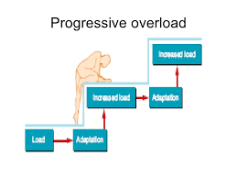
Progressive Overload
Progressive Overload
The overload principle implies that gains in fitness (adaptations) occur only when the training load is greater than normal and is progressively increased as improvements in fitness occur.
Examples of overload principle:
Aerobic Training – application of the overload principle is reflected in the heart’s ability to pump more blood to the working muscles (cardiac output)
Strength Training – application of the overload principle results in the hypertrophy of muscle

Slide 5
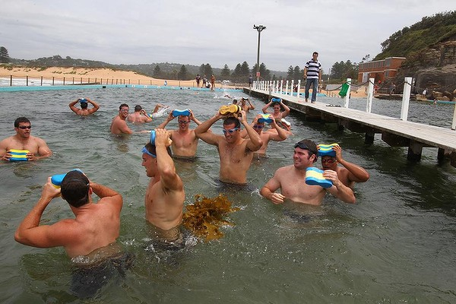
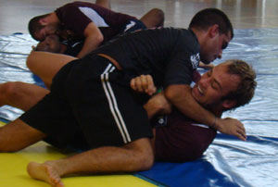
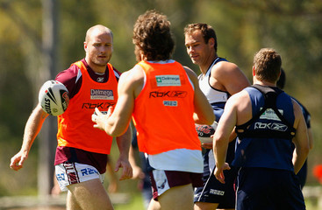
Variety
Variety – To become a professional, athletes need to train for many hrs over many years. This can become very repetitious and boring (especially in endurance events such as marathon running and swimming)
Whilst variety will not necessarily make an athlete perform better, it does make training more fun and interesting. Used for psychological purposes.
For example, Rugby League
many warm ups will use different types of sports – might play soccer to start off
different focuses for each session- some fitness, some tackling, some set plays, pool work
coaches can take players to different venues – sand climbs for preseason, gym, overseas trips

Slide 6
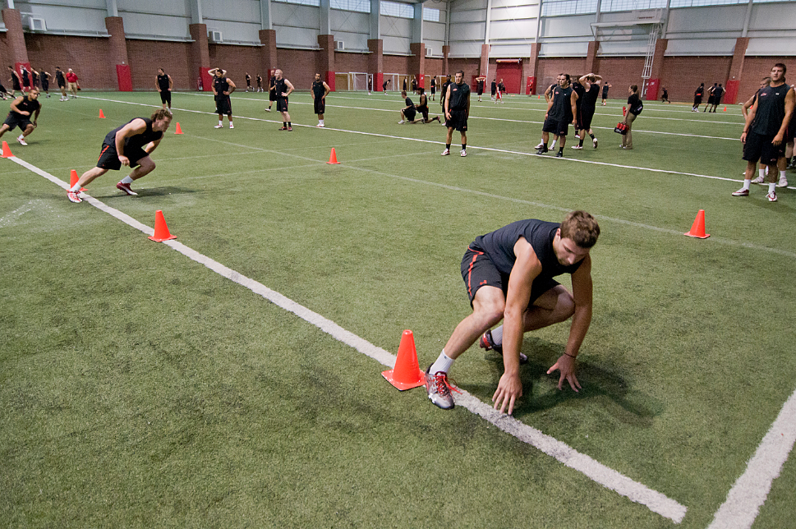
Reversibility
Reversibility
The effects of training are reversible. So, if a person stops exercising, or fails to train at a high enough intensity, the training effects will be lost.
The speed of this principle varies. Most people will loose benefits after 2 weeks of no training. In general, the faster the gains, the faster the losses.
For most athletes, the off season is the time where reversibility occurs the most. Some athletes continue during off season to maintain some fitness

Slide 7
Training Thresholds
Training Thresholds – are usually explained in terms of max HR in relation to volume of oxygen uptake (VO2 max).
During training, 3 factors are important in relation to thresholds:
HR – beats per minute
Ventilation – air breathed in 1 min
Blood lactate – by product of the lactate system
All these increase in proportion to intensity of exercise
 | 100 |  |  | Anaerobic
 | 90 |  |  | Training
 | 80 |  | aerobic | Zone
Max HR | 70 |  | training |  |  | anaerobic
 | 60 |  | zone |  |  | training
 | 50 |  |  |  |  | threshold
 | 0 | Aerobic training threshold
 |  | 50 | 55 60 70 | 80 90 100
 |  |  | Max VO2(%)

Slide 8
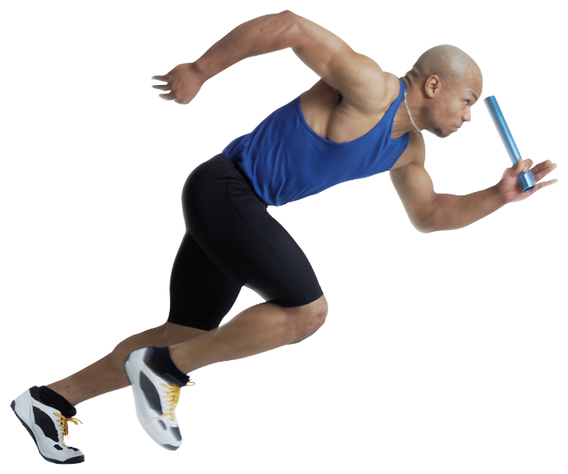
Training Thresholds
The point where lactic acid begins to accumulate can be described as the Anaerobic Threshold. The threshold is the maximum intensity (speed/power/effort) that an athlete can maintain and still have no increase of lactate acid.
Training the anaerobic threshold:
Accelerates glycolosis (conversion of glucose to glycogen and glycogen to pyruvic acid)
Increased use of fast twitch muscles
Generally at 75-80% of VO2 max and 85% of HR
Aerobic Training thresholds – intensity that the body needs for improvement in the bodies ability to use oxygen during exercise.
This usually occurs at 70% of max HR and 50-60% of VO2 max
Activity – in your own words, define the term ‘ anaerobic threshold’.
2. What kind of athletes want to train their anaerobic threshold?

Slide 9
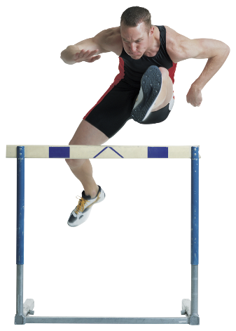
Warm Up & Cool down
Warm Up involves getting the body ready for the training activity.
Warm up:
Increases blood flow to working muscles
Increases body temperature making muscles, ligaments, tendons more elastic
Extra elasticity reduces likelihood of injury
Activates motor neurons (switches players on of the task)
Most warm ups include small aerobic activity and stretching followed by specific activity for the session or game.
Cool Down is effectively the same as the warm up but in reverse.
The cool down:
Allows for active recovery (gives time for body to return blood to heart rather than blood pooling in muscles)
Allows the oxygenated blood to flush out the waste products formed during activity.
Should also incorporate a session of stretching which reduces msucle soreness and aids recovery.
Activity – in small groups, design an appropriate warm up for:
14 yr old basketballer
70yr old lawn bowler
16 yr old rugby league player

Slide 10
Application of training principles
Anaerobically - training needs to be near max intensity
Short duration, but frequent sessions (maybe 4 per wk)
To overload anaerobic system, increase length of sprints or more reps of sprints
Intensity determined by HR, pace or lactate threshold
Aerobic – basically opposite to above but:
Lower intensity
Long duration , fewer sessions
Overload achieved by increasing distance or lowering time to complete set distance
Strength - should be specific to the predominant energy system and for the muscles and movements used.
Gains in strength should follow progressive overload

Slide 11
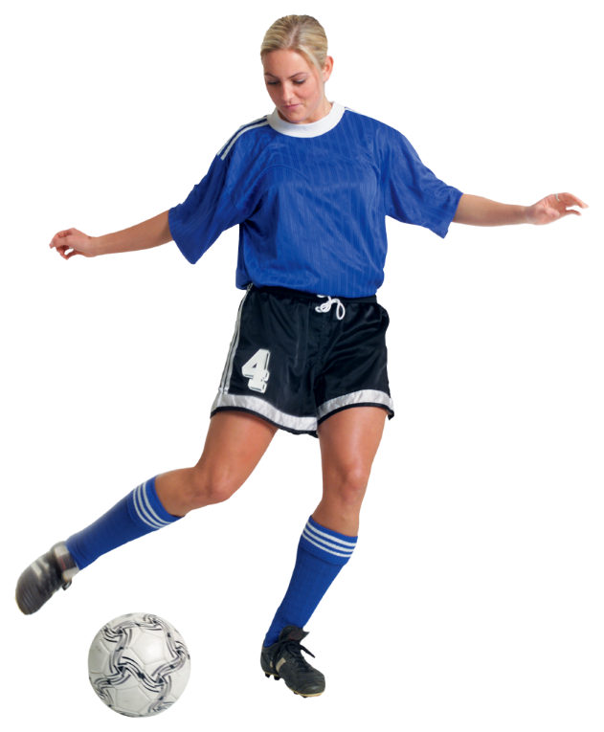
Application of training principles
Activity
Explain each principle in your own words and give an example of how they can be applied to a training program for a sport of your choice.

