Slide 1
Psychological Strategies to Enhance Motivation and Manage Anxiety
Concentration/attention skills
Mental rehearsal/visualisation/imagery
Relaxation techniques
Goal setting

Slide 2
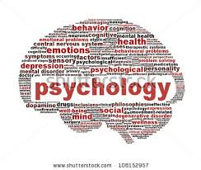
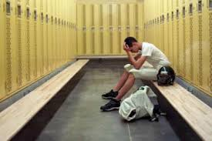
Psychological Strategies
There are many psychological strategies to enhance motivation and manage anxiety that athletes use. They are often done before competition to help the athlete release nerves and focus on the task they are about to perform. Psychological strategies to enhance motivation and manage anxiety can also be used within competition during moments of high pressure. Such moments include free throws in basketball, taking a penalty shot in football, or a conversion in rugby.

Slide 3
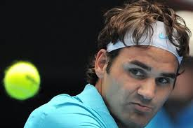
The strategies used by athletes include a range of concentration skills that help the athlete to focus on the competition. Athletes also use metal rehearsal of the skill before execution, and can use this during rehabilitation to reduce the loss of coordination that comes with siting on the side-line for extended periods of time. Relaxation techniques are also used to help calm nerves and develop body awareness. And goal-setting is frequently used before and during training programs in order to determine aims and check progress.
Psychological strategies to enhance motivation and manage anxiety
concentration/attention skills (focusing)
mental rehearsal/visualisation/imagery
relaxation techniques
goal-setting

Slide 4
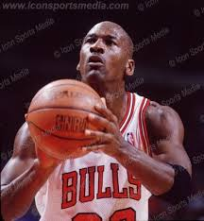
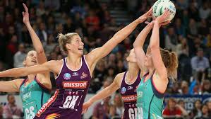
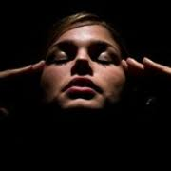
Concentration Skills
Concentration or attention skills refers to an athlete’s focusing on doing, rather than how to do. Attention or focus can be improved by blocking out distractions and using positive self-talk. The more the athlete focuses on the completing the skill with the correct technique, the better their focus is and the better their skill execution will become. This is apposed to focusing on the outcome of the skill or how to perform the skill.
Different types of concentration are needed for different sports. Sports that are high in skill level require intense focusing in order for the skill to be completed well. Sports with lower skill levels then require less intense attention as the skill is more easily completed. Other sports that have a longer duration require sustained focus, and obviously sports that are short do not require attention or focus to be sustained for long periods.

Slide 5
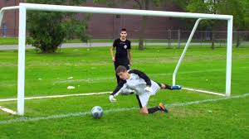
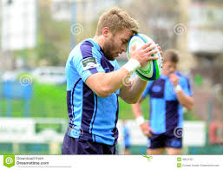
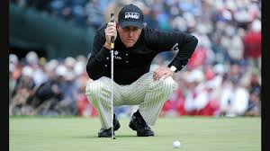
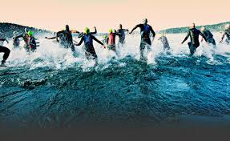
For example sports such as golf or diving require intense focusing, while sports such as Iron Man require sustained attention. There are many sports that require a combination of the two types of focus, these are sports such as soccer or rugby that are played for an extended period of time, but have shorter periods that require intense concentration to complete complex skills.

Slide 6
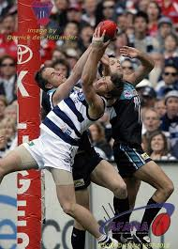
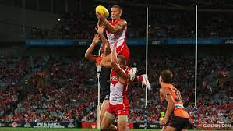
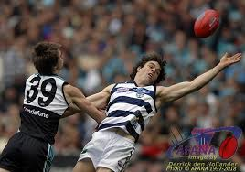
Attention Skills
Attention skills also need to be able to vary throughout a competition. The athlete may need to focus on the execution of a particular attacking skill at one point and then on their defensive position at another.
In Rugby League for example, a player may need intense concentration as they perform their role in a set play, catching a bomb under pressure or convert a try, while they will need less intense, but sustained concentration throughout the game as they make tackles and do one out runs.

Slide 7
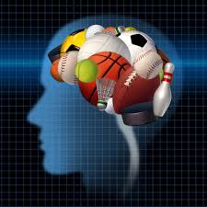
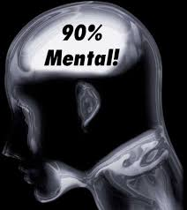
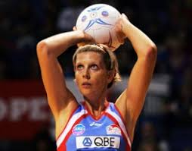
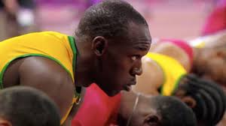
Mental Rehearsal/Visualisation/Imagery
Mental rehearsal (also known as visualisation or imagery) is when the athlete pictures the movement or skill in their mind. Mental rehearsal requires the athlete to take their own perspective/view and imagine completing the skill perfectly, while ensuring they visualise the complete scenario. That is, to visualise the sounds, colours, movements, defender etc that will be present when the actual skill is executed.

Slide 8
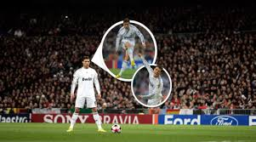
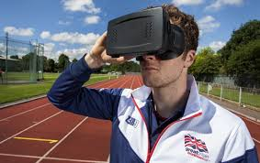
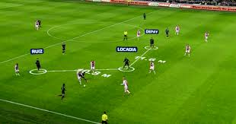
Mental Rehearsal/Visualisation/Imagery
Mental rehearsal is often done just before performance as it helps improve concentration. This includes both before the competition begins and during competition just before a particular skill is executed. For example. many basketball players will mentally rehearse their free throw before taking it, and weight lifters visualise a successful lift before their attempt. A football player may also use imagery before the game begins to help them focus and get their body prepared for what is required during the match.

Slide 9
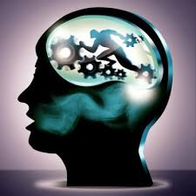
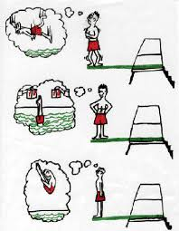
Visualisation is also useful as a form of practice, especially when physical practice is not possible. Often injured, or sick athletes will rehearse their performance using visualisation techniques. Studies have shown that mental rehearsal can help maintain current levels of skill execution, though it will not increase the level.
Mental rehearsal improves performance by: optimising arousal, and improving concentration. However, rehearsal must be realistic, only have successful performances, and be rehearsed from the athlete’ perspective while completing the skill or performance.

Slide 10
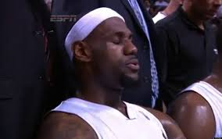
Relaxation Techniques
Relaxation techniques are used to reduce anxiety and manage arousal levels. There are many techniques available to the athlete, but the more common techniques are: centred breathing, progressive muscular relaxation, listening to music, and mental relaxation.
Centred breathing is the process where an athlete focuses on lengthening their breathing to reduce their respiratory and heart rate. Often used in Yoga, centred breathing is a relaxation technique often beginning with the athlete counting their breath in and out slowly increasing the length of inspiration and expiration. Centred breathing releases anxiety and can decrease arousal levels.

Slide 11
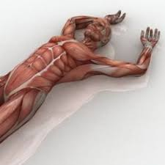
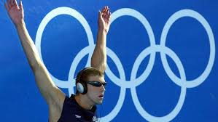
Progressive muscular relaxation is the process where the athlete moves from one end of their body to the other progressively contracting and then relaxing their muscles. Normally the process will begin at the toes, with the athlete contracting the muscles controlling their toes, and then their foot, lower and upper leg, before moving along the torso towards their arms, neck and head. Progressive muscular relaxation relieves anxiety and can decrease arousal levels.
Music has often been used to control athlete’s levels of arousal and anxiety. Music can be used to relax and calm the athlete; as well as to psych them up. Music can increase the athlete’s arousal levels if they are too low for performance or can increase them, depending on the type of music listened to.
Mental relaxation is the process where an athlete focuses on reducing their respiratory rate and emptying their mind of thoughts and distractions in order to focus on the task at hand. This helps to focus the athlete and receive anxiety before performance.

Slide 12
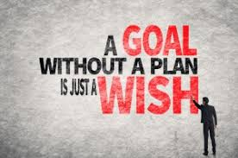
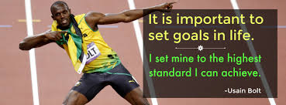
Goal Setting
Goal setting helps improve an athlete’s motivation and enables them to measure progress. Goals can be either performance or behaviour oriented and can be both long and/or short term.
Setting long-term goals is important as they give the major purpose to training and performance. Short-term goals should be used to help monitor progress and provide benchmarks as the athlete progresses towards the long-term goals.
Setting performance goals that relate directly to performance helps the athlete to focus on particular aims or objectives to achieve as they improve their performance. Some examples include: running 100m in less than 10 sec or a soccer player getting all their shots on target forcing the goal keeper to make a save.

Slide 13
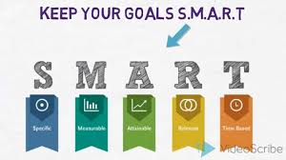
Other goal setting needs to focus on behaviour as this can impact motivation, training output and performance. Examples of behaviour goals include: completing 3 training sessions per week outside of team training, or ensuring adequate sleep every night.
Goal setting needs the goals to be specific, measurable, attainable, relevant, and time specific. An example of this is running 100m in less that 10 sec within the next 6 months is specific, can be measured, is attainable if you are already running 100m in the low 10s, relevant if you are in a sport that requires running 100m quickly, such as a sprinter and time specific.

