Slide 1
RECOVERY STRATEGIES
STUDENTS LEARN ABOUT:
Physiological strategies
Cool down, hydration
Neural strategies
Hydrotherapy, massage
Tissue damage strategies
Cryotherapy
Psychological strategies
Relaxation
STUDENTS LEARN TO:
Research recovery strategies to discern their main features and proposed benefits to performance

Slide 2
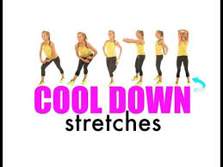
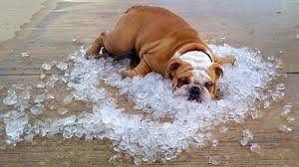
PHYSIOLOGICAL STRATEGIES
COOL DOWN
A cool down after training or competition helps to remove waste products and return the body back to its pre-exercise state.
Is a series of low intensity exercises completed straight after training or competition.
Help speed up recovery by continuing the muscle pump needed to take fluid back to the heart and avoids fluid retention in the used muscles.
The continued removal of fluid helps to remove waste products.
Exercises could include:
light jog
slow swim
need to be specific to the sport and the major muscles used.

Slide 3
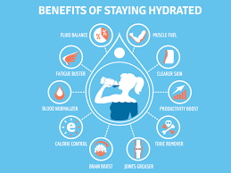
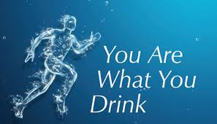
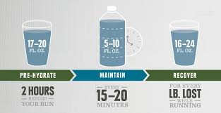
PHYSIOLOGICAL STRATEGIES
HYDRATION
Is the consumption of enough liquid after competition to replace any fluids lost during training or competition.
Hydration often involves drinking 500mL of a sports drink, such as PowerAde, and plenty of water (2-3L) over the next 24hrs.
Speeds up recovery by enabling the bodies physiological processes to function well, as dehydration can slow down or even stop some of the recovery processes.
Hydration also provides more volume to the blood to assist in the removal of waste products.
Water is also required in the storage of glycogen, which needs to be restored after exercise.

Slide 4
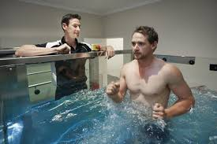
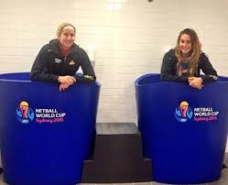
NEURAL STRATEGIES
Neural strategies focus on the nervous system and relieving tension.
Are useful for sports that generate large amounts of muscle tension, such as American Football or Rugby Union.
HYDROTHERAPY
Hydrotherapy is a neural strategy that involves water immersion.
There are multiple forms of hydrotherapy, which include:
Contrast immersion – where an athlete moves between warm and cold-water immersion.
Causes vasodilation and vasoconstriction, helping to remove waste products and deliver nutrients required for recovery.
Even temperature immersion – where the athlete is immersed in warm water to assist with the removal of lactates and improves metabolic activity.
Hydrotherapy in warm water helps to relax the nervous system and the muscles they control.
Relieves tension and helps speed up recovery.

Slide 5
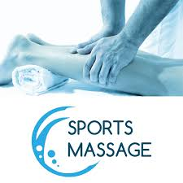
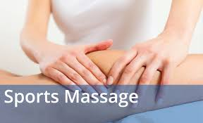
NEURAL STRATEGIES
MASSAGE
Massage reduces muscle tension and relaxes the nerves.
Helps with mental relaxation, which can lead to a decrease in muscular tension.
The benefits of massage for recovery are still not adequately supported by evidence.
Proposed benefits include:
removal of waste products
increased nutrient delivery
mental relaxation
minimising the effects of fatigue.
There are various forms of massage including:
Swedish
Myofascial
Trigger point
Sports - specifically developed to help remove waste products and reduce tension in the muscle.

Slide 6
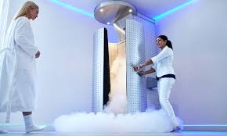
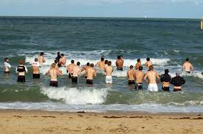
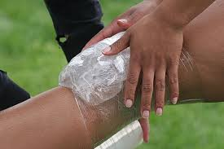
TISSUE DAMAGE STRATEGIES
Tissue damage strategies aim to speed up recovery by restoring damaged tissue, particularly muscle.
This damage is often found in highly strenuous activities such as rugby league and Australian Rules Football.
CRYOTHERAPY
Cryotherapy is one of the tissue damage strategies and involves the many forms of cool treatments, including:
ice pack
cold-water immersion
cryogenic chambers
Cryotherapy removes heat from the damaged tissue, decreases inflammation by causing vasoconstriction and decreases pain.
Ice packs placed directly over an injury speed up recovery and should be used over 24-48hrs for soft tissue injuries.
Ice slows down metabolism by lowering the local temperature.
This decreases the demand for oxygen and decreases waste products.
The decrease in inflammation also reduces secondary damage caused by the inflammation.

Slide 7
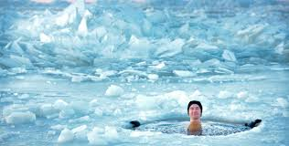
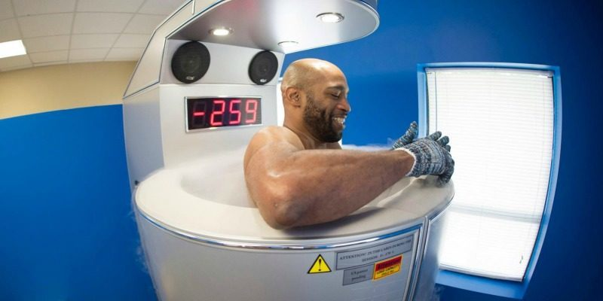
TISSUE DAMAGE STRATEGIES
COLD WATER IMMERSION
Cold-water immersion, such as an ice-bath, aims to reduce fluid build up in the body caused by tissue damaged in exercise.
It involves the athlete being submersed in water that is 4-12ºC for 3-5 min at a time with a short rest period out of the water before re-submersion often 4-5 times.
Athletes report less pain after short periods of cold-water immersion, but repeated use can impair performance.
CRYOGENIC CHAMBERS
Cryogenic chambers are cooled to -110ºC and athletes enter them for a short time (<3min).
The aim is to reduce body temperature in order to release endorphins, which relieve pain.
Another one of the tissue damage strategies is the use of compression garments and bandaging. This aims to reduce inflammation and speed up recovery.

Slide 8
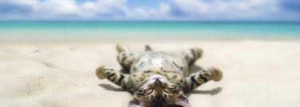
PSYCHOLOGICAL STRATEGIES
Psychological strategies focus on mental processes and are used to either calm the athletes brain activity or to stimulate them.
They frequently aim to reduce anxiety in order to allow the brain to relax, but can be used to focus the athlete’s thoughts on the upcoming event.
RELAXATION
Relaxation is used to help decrease heart and respiration rates, while directing the athletes focus either away from or towards competition or training, depending not the context.
An anxious athlete may use relaxation techniques before competition in order to reduce nervousness and allow them to focus.
Some athletes will chose to focus on something other than competition in order to help relieve their anxiety.
After competition, particularly during a transition or off-season phase, athletes will use relaxation and other psychological strategies in order to help rejuvenate their whole body, including their mental function.
Other psychological strategies used include:
Debriefing
rest days
Sleep
Psychological recovery strategies are important, as training and performance place stress on an athlete’s mental and physical capacities
Improve performance by not allowing the athlete to be held back by past performances. They are particularly important after losing a major competition such as a grand final or the State of Origin.

