Slide 1
Rehabilitation Procedures
Students Learn About:
Progressive mobilisation
Graduated exercise
Training
Use of heat or cold
Students Learn To:
Examine and justify rehabilitation procedures used for a range of specific injuries, eg hamstring tear, shoulder dislocation

Slide 2
Overview
Rehabilitation procedures are procedures used by sports physiotherapists and exercise physiologists in the care and management of sports injuries.
Progressive mobilisation is the gradual increase in pain free joint range of motion
Graduated exercise refers to the gradual increase in exercise intensity and the forces going through the injury area.
During rehabilitation, procedures help to ensure the athlete does not lose all fitness via the reversibility affect.
Instead some form of training will still be prescribed and monitored if at all possible.
The procedures for rehabilitation will also use heat and cold in the treatment of the injury.
Heat is used to increase flood flow and elasticity of the joint
Cold is used to decrease blood flow and inflammation around the injury.
Finally, you are asked to examine and justify the rehabilitation procedures for specific injuries.
We will look at hamstring strains and shoulder dislocations.

Slide 3
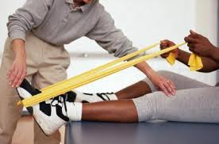
Progressive Mobilisation
Progressive mobilisation refers to the gradual increase in the joint range of motion/movement.
After an injury joints become stiff as muscles around the joint tighten. Progressive mobilisation slowly stretches the muscles allowing for a gradual increase in the range of motion at the joint.
This also helps increase the movement in the ligaments around the joint and should begin as early as possible in order to help prevent scare tissue and to reduce the recovery time.
The increase in joint range of motion should be as pain free as possible and involves both passive and active movement. Usually passive movement is first, especially if the injury is to a muscle across the joint.
Progressive mobilisation utilises dynamic, static and PNF stretching, but NOT ballistic.
Often begin with static stretching then progress to PNF stretches. Dynamic stretching is often used throughout rehabilitation with slow passive movements at the beginning and active and faster (not fast) movements at the end.

Slide 4
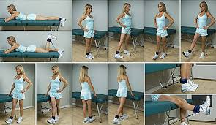
Graduated Exercise
Graduated exercise is used in rehabilitation to ensure exercise intensity and activities progress with healing and do not cause further injury.
Graduated exercise refers to the gradual increase in:
Range of motion
Intensity
and activities to help ensure the athlete’s recovery is as pain free as possible.
Graduated exercise will progress through three (3) stages:
Stretching
Conditioning
Total body fitness
These stages will overlap as the athlete recovers and is able to perform various activities.

Slide 5
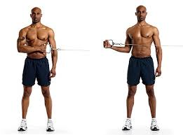
Stretching as Graduated Exercise
There are various forms of stretching:
Static
Proprioceptive neuromuscular facilitation (PNF)
Dynamic
Ballistic.
Ballistic stretching is generally avoided in rehabilitation as it can be unsafe and cause injury by bouncing too far in the stretch causing a muscle strain. This is particularly unwanted in rehabilitation of a muscle strain.
Static stretching is the least intense and provides the least gain. Often graduated exercises of stretching begin with simple static stretches, before moving onto PNF and dynamic stretching.
PNF stretching is the most common and usually the most beneficial. Gains in range of motion/movement are large, which helps prevent joint stiffness and promotes recovery.
Dynamic is usually utilised towards the end as it requires more control.

Slide 6
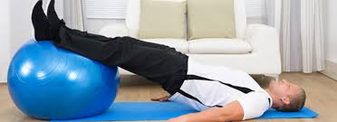
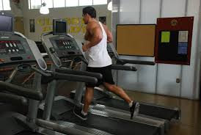
Conditioning as Graduated Exercise
Conditioning is the process of strengthening muscles and getting them back to their pre-injury levels in relation to:
Muscular strength
Muscular endurance
Speed
Power
Muscles often lose these while an athlete is injured, especially if it is a muscular strain.
Conditioning is always specific to the injury.
For Eg - an injured knee will require conditioning of the muscles around the knee:
Hamstrings
Quadriceps
Gastrocnemius.
All need to be strengthened again due to reversibility.
Graduated conditioning begins with the strengthening of the muscles and developing muscular endurance.
Exercises begin at low intensities and progressive overload is used to ensure the intensity slowly increases as muscular strength and endurance increase.
Once the muscles and have endurance back, muscular speed and power can also be redeveloped.
These come last as they cause more stress to muscles and joints requiring a greater level of recovery.

Slide 7
Total Body Fitness as Graduated Exercise
During injury – reversibility causes a loss of total body fitness and begins after 2-3 weeks.
If possible an athlete should be doing any exercise possible while injured:
Eg - Upper body training, while the athlete recovers from an injured ankle
Lower body training if they have just had a shoulder reconstruction.
Often it is possible for the athlete to do some form of training while injured. Even exercising using the “good leg” when recovering form a knee injury on the other leg.
This helps to slow down reversibility, and will not maintain previous total body fitness completely.
The athlete will need to restore previous levels of fitness across their body.
Pre and post injury testing becomes vital.
Post injury test should be compared with pre-injury results to determine if the athlete has fully recovered or at least recovered to a level ready to return to play.
Total body fitness refers to each aspect of both the health and skill related components of fitness. This helps ensure a complete recovery in each component, so that no weakness is present when the athlete returns to play after graduated exercise.

Slide 8
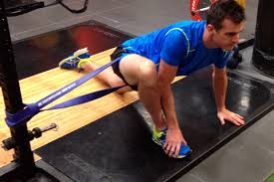
Training during Rehabilitation
During rehabilitation - training can be done to help slow down and limit the loss of fitness.
While the injury requires rest, this rest does not always have to be to the entire body.
For Eg - A knee reconstruction only requires that one (1) leg to be rested, and a shoulder dislocation requires only that arm to be rested. The rest of the body can still train to help prevent reversibility.

Slide 9
Training after Rehabilitation
Once rehabilitation is completed – the athlete still requires training before they can return to play.
The athlete may have regained muscular strength, muscular endurance, speed, power, flexibility, and have a full active range of motion, but they have not fully participated in their sport yet.
Sport specific components of fitness (such as coordination, and agility) have not recovered.
The athlete will have lost their ability to “read the game”, and may not be psychological prepared, or confident to return to play. These are regained through training and competition simulation.
Training after rehabilitation aims to:
Develop sport specific fitness components
Develop sport specific skills
Increase confidence
Safely return the athlete to play
Once the athlete is pain free and performing at pre-injury levels, performance should be assessed with objective and subjective performance measures to determine readiness to return to full competition.
Athlete should exhibit the characteristics of a skilled performer (kinaesthetic sense, anticipation, consistency, technique).

Slide 10
Use of Heat and Cold
Use of heat in rehabilitation
The use of heat in rehabilitation has a number of aims and is done in a number of methods. The aims or benefits of heat application include:
Increased blood flow (delivering nutrients and white blood cells, while removing waste)
Decreased pain
Increased flexibility (increases the elasticity of fibres, especially the new ones)
Decreased joint stiffness (increases fluid to the joint)
Increased tissue repair (by increasing blood flow)
The methods for using heat in rehabilitation include both superficial applications (less than 1 cm deep):
Heat packs
There are many different types of heat packs, including microwavable wheat bags, and chemically heated packs. They are applied to the injured area, much like an ice pack.
Hydrotherapy
A heated pool around 40 degrees that is used during rehabilitation. It uses heat to increased blood flow, flexibility etc, while at the same time using buoyancy to limit the force/weight on the injured area during exercise.

Slide 11
Use of Heat and Cold cont…
Infra-red lamps
Proceed heat via radiation. The lamp light it shone over the injury to provide heat.
Contrast Therapy
Athlete moves the injured area between an ice bath and a warm bath. This provides the benefits of the cold, and the heat.
Deep heat can be applied using:
Ultrasound
Is applied heat using sound waves – used on dense tissue such as bone or ligaments
Microwaves
Heat deeper tissue that has high water content – such as muscle and blood vessels. Area around the injury is heated to 40 degrees for less than 30 minutes

Slide 12
Use of Heat and Cold cont…
Use of cold in rehabilitation
The technical term is cryotherapy.
Cryotherapy “is the local or general use of cold in medical therapy.”
There are many methods used to apply cold for rehabilitation.
Purpose of using cold in rehabilitation is to reduce pain, blood flow/bleeding and inflammation. This is applied immediately after the injury occurs and after treatments/exercise during rehabilitation of the injury.
The use of ice-packs is well known and is usually applied to the injured area during the first 48 hours after an injury.
Other methods include:
Ice Massage
Ice is rubbed over the body or injured area for approx. 15 minutes.
Cold Water Immersion/Ice Bath
Immediately following an injury the athlete places their injured area into an ice bath for around 15 min at a time (depends on the area injured and how long the athlete can withstand the cold).

Slide 13
Use of Heat and Cold cont…
Contrast Therapy
The athlete moves the injured area between an ice bath and a warm bath.
Provides the benefits of the cold, then the warm bath increases blood flow to the area helping to remove debris and providing nutrients for repair.
This is not usually used immediately after injury, but more often during or after a session of rehabilitation.
Vapocoolant Sprays
These sprays are often used during games to provide an immediate cooling to the injured area.
Often used for minor injuries, where the player can continue to perform. They are particularly used to prevent muscle spasms around the injury.
Cryotherapy Machine
May be used in rehabilitation for larger injuries of the body. They cool the entire body, but do not target specific areas.

Slide 14
Rehabilitation Procedures for a Hamstring Tear
The rehabilitation procedures for a hamstring tear (aka strain) include:
Progressive ROM
Graduated exercise (stretching, conditioning, and total body fitness)
Training
and use of heat and cold.
A tear or strain is a tear to any one of the three hamstring muscles. Rehabilitation for a hamstring tear should be individualised, depending on the specific muscle injured and the classification of strain. However, there are some basic guidelines that can be followed.
Immediate Hamstring Tear Treatment
RICER (Rest, Ice Compression, Elevation, and Referral).
Apply for the first 48 hrs as appropriate care during the acute phase.
Once the injury has been assessed by a professional (Medical Practitioner, Physiotherapist, Specialist etc) and surgery completed if required, rehabilitation may begin.
Stretching and Increased ROM
No stretching of the hamstring during the initial acute period of injury.
Allows the injury to begin to heal before it is pulled at.
Once a professional has declared this to be over, stretching becomes the first rehabilitation procedure for a hamstring tear.

Slide 15
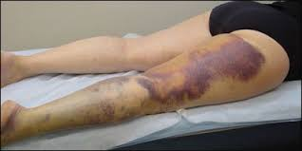
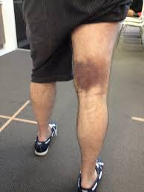
Rehabilitation Procedures for a Hamstring Tear cont…
Conditioning
General strengthening exercises should be pain free - begin with isometric contractions of the hamstring that are a low intensity.
Then progress through a range of dynamic activities as recovery continues. During these exercises it is important to minimise pain, and often cold therapy is used if pain occurs.
Total body fitness
Stationary equipment is used to maintain and/or enhance total body fitness. Arm ergometers can be used to help maintain cardiovascular fitness, but also rowing machines and cross trainers can be used, as long as the intensity keeps the hamstring pain free.
Athlete will progress to light jogging and before agility runs. Finally the athlete will progress to full sprints.
Training
Once the athlete has been given the clear from a professional, they may return to training. It will take a while for the muscular endurance and power produced by the hamstring to return. The athlete will also become more confident to use the hamstring to their full potential through training drills.
Use of heat and cold
Used throughout the recovery process.
Cold therapy is used when pain occurs - especially during the acute phase or after rehabilitation exercises.
Heat is not used in the acute phase - may be used to enhance blood flow to the hamstring before stretching or rehabilitation exercises in order to increase flexibility, and to provide blood flow to the area in order to speed up the healing process.

Slide 16
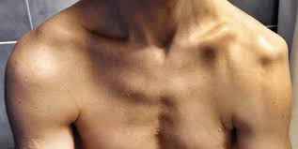
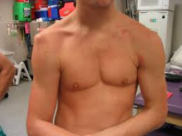
Rehabilitation Procedures for a Dislocated Shoulder
The rehabilitation procedures for a dislocated shoulder include:
Increasing ROM
Graduated exercise (stretching, conditioning, and total body fitness)
Training
Use of heat and cold.
Immediate treatment of a shoulder dislocation
Immobilisation of the shoulder and arm
Apply ice packs
Take to a professional (medical practitioner, specialist, physiotherapist, etc) to relocate shoulder
Wear a sling is usually worn for 5-7 days. If the athlete requires surgery then this should also be done before rehabilitation begins.
Range of motion/movement Stretching
Begin by increasing the range of motion at the shoulder.
Range of motion exercises include a range of stretches that are isometric, PNF and dynamic.

Slide 17
Rehabilitation Procedures for a Dislocated Shoulder cont…
Conditioning
Rehabilitation procedures include:
Strengthening the rotator cuff muscles (stabilise the joint) as soon as it is possible (pain free).
Shoulder abduction and lateral rotation of the shoulder are avoided as these are more likely to re-injure the shoulder.
Strengthening exercises begin with isometric contractions:
Extension
Adduction
External and internal rotations and abduction when possible
Are all done as isometric contractions.
Movements are then added to the strengthening routine as the shoulder progresses.
First movements are usually external and internal rotation exercises.
Progress to flexion, abduction and extension to strengthen the shoulder.
Exercises such as a shoulder press come at the end of the strengthening rehabilitation procedure for a dislocated shoulder.

Slide 18
Rehabilitation Procedures for a Dislocated Shoulder cont…
Once shoulder is strong and stable, general conditioning exercises may be added:
Light rowing on a machine
Progress to arm ergometry.
Swimming is not used until the end - need complete range of motion that is pain free
Total Body Fitness
Stationary bike could be used to help maintain some levels of total body fitness.
Running should be avoided during the early stages of rehabilitation because of the jolting through the body and the usual swinging of the arms.
As pain permits, the athlete will begin to engage in other activities such as jogging, running, or cross-training to develop total body fitness. After rehabilitation has been completed the athlete can resume normal training.
Training
Athletes need to get their timing back as well as develop their confidence and skills specific to their sport.
This is particularly going to be the case if the sport involves tackling, such as: rugby league, rugby union, or AFL.

Slide 19
Rehabilitation Procedures for a Dislocated Shoulder cont…
Use of Heat and Cold
Cold therapy is used throughout the rehabilitation procedure
Cold is often used in the acute phase of the injury, which includes the relocation of the shoulder, and after surgery if needed.
Cold may also be used after rehabilitation exercises to help reduce the inflammatory response.
Heat may be used initially to help warm up the shoulder before stretching exercises or the initial isometric and dynamic strengthening activities.
This is to promote elasticity around the shoulder, and increase blood flow before exercises begin.

