Slide 1
Sports Policy and the Sports Environment
STUDENTS LEARN ABOUT:
Rules of sports and activities
Modified rules for children
Matching of opponents (eg growth and development, skill level)
Use of protective equipment
Safe grounds, equipment and facilities
STUDENTS LEARN TO:
Critically analyse sports policies, rules and equipment to determine the degree to which they promote safe participation, eg heat rules, rugby union scrum rules

Slide 2
You are required to understand the rules and policies that govern sports participation and the need to ensure the facilities and grounds are safe.
You will look at why there are rules for sport, how these are modified for children, and debate how to best match opponents.
You will also be asked to know why we use protective equipment and the importance of maintaining: grounds, equipment and facilities to promote athlete wellbeing.
The learn to tells us that you need to be able to critically analyse this information to determine if sports policy and the sports environment do, and if so how much, promote the safety and the wellbeing of the athlete.

Slide 3
RULES OF SPORTS AND ACTIVITIES
The rules of sports and activities are designed in order to promote safety and the wellbeing of the athlete.
Rules of sports and activities help promote fair play, which helps to prevent injury as well. (They need to be enforced by referees and umpires).
Each sport has its own set of rules that are designed specifically for that sport to keep the athlete safe. Sport rules cover a wide range of aspects relating to the game, including:
The size of the field/court
The length of the competition
Number of breaks
What equipment must be used (including the size)
What constitutes a foul or unfair play etc

Slide 4
RULES OF SPORTS AND ACTIVITIES
Many team sports are played over two (2) halves and on a field 100m long and 50m wide (dimensions may vary).
As the sport increases in intensity (futsal, basketball or netball), the court becomes smaller and there are more frequent breaks.
This helps ensure the safety of the athletes by having adequate access to water and that their bodies get a chance to refresh before competition continues.
Other rules (legal and illegal contact) help promote the wellbeing of the athlete.
These rules are particularly important in contact sports such as AFL or Rugby Union. These sports have rules about the areas where contact can and cannot be made, such as no contact above the shoulders.
Many such sports adapt their rules as new movements and injuries occur in games.
For example, Rugby League have banned the use of “chicken winging”, which uses the arm to force the opposing player to the ground, but also causes shoulder injuries.

Slide 5
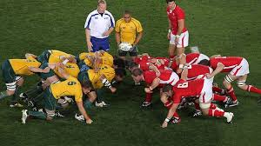
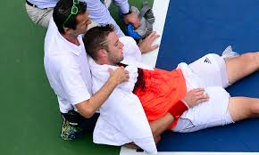
RULES OF SPORTS AND ACTIVITIES
Critically analyse sports policies, rules and equipment to determine the degree to which they promote safe participation, eg heat rules, rugby union scrum rules
Medical research lead to changes in the rules around scrums in rugby union. The biggest change and contribution being the “Stop-touch-pause-engage” rule, that helps reduce the movement in the scrum and has decreased the number of spinal injuries occurring in the sport.
Another example mentioned in your syllabus are the policy rules around heat. Many sports have rules around heat, as do schools and clubs. Many of the policies can be accessed at Smart Play including beat the heat endorsed by Sports medicine Australia.

Slide 6
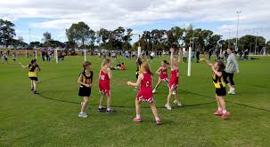
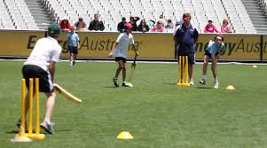
MODIFIED RULES FOR CHILDREN
Children and young athletes require modified rules to cater for their specific needs.
Underdeveloped sweat glands and poor ability to regulate body temperature.
Children are also smaller and need to have activities and sports catered to their size.
The modified rules for children include:
Ball sizes
Field sizes
Duration of competitions
Smaller distances
Closer and smaller goals.
These modifications help make participation in sports safer for the child and enhance their wellbeing.
Gives children greater access to fluids, less distance to run, and balls that they can actually kick without placing too much stress on their body.

Slide 7
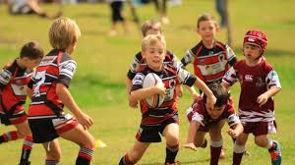
MODIFIED RULES FOR CHILDREN cont…
Closer goals or hoops, make it easier for children to score goals and provide positive feedback to enhance enjoyment.
Rule changes in cricket and modified games such as “Kanga Cricket” also enhance enjoyment by ensuring each child gets to face two (2) overs and also gets a chance to bowl.
Sports have their own specific modifications to rules to cater for children.
For example, in rugby league, children under 15 are not allowed to tackle above the arm pits, or lift a ball carrier off the ground in a tackle. They are also not allowed to push or pull in a scrum.

Slide 8
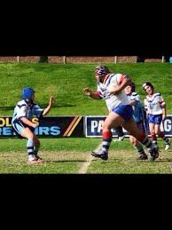
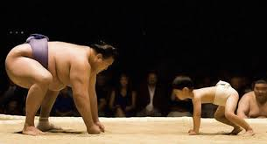
MATCHING OPPONENTS
Matching opponents in competitive sports can be a complex or simple process depending on the type of sport.
There are four (4) main ways of matching opponents:
Age
Size
Sex
Skill level
The first two (2) relate to the growth and development of the athlete.

Slide 9
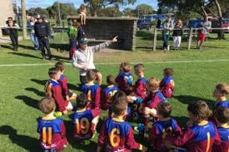
MATCHING OPPONENTS
Matching Opponents by Growth and Development
Age
Most sports begin by matching opponents through age groups.
Most clubs begin at under 6 and then progress each year until under 16 or 17, then age often progresses by 2 or 3 years until under 21.
After 21 years of age, athletes compete in an opens competition, until they reach an older age and can compete in masters competitions, such as the masters games.
Matching opponents by age is done to group athletes together both psychologically and physically.
Athletes at age 8 tend to approach their sport with a similar psychological capacity and decision making in relation to the sport.
They are also often of a similar size and skill level.
This results in a safer sporting environment for the athlete, minimising injuries and enhancing wellbeing.
Age is limited in its ability to reduce injuries and to appropriately match opponents as children and young athletes grow and develop at varying rates and have varying levels of skill.
It is not fair or safe to match a cognitive learner against an autonomous athlete for any sport, let alone AFL or sumo wrestling for example.

Slide 10
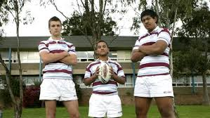
MATCHING OPPONENTS cont…
Size
Many sports match opponents by age and also by size.
Combat sports, such as:
Boxing
Mixed martial arts
Greco-Roman wrestling.
Size has also been used to match opponents in particular rugby competitions.
Matching opponents by size helps to reduce the risk of injury as athletes are not forced to compete against people to much bigger than them.
For eg - It is not safe to ask a 40Kg 13 year old to tackle an 80Kg 13 year old, even though they are the same age.
Matching opponents by their growth and development helps to promote safety in sports as player compete against people of the same age and similar size to help prevent injuries.
This is limited though, as many sports also require great skill. Athletes competing against each other with varying skill levels can also lead to injury.

Slide 11
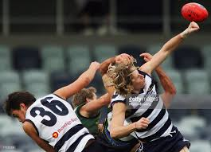
MATCHING OPPONENTS cont…
Matching Opponents by Skill Level
Athletes have varying skill levels regardless of age and size.
Often age and size influence skill level, and that is one of the reasons why they are so useful in matching opponents.
Skill level should also be used to match opponents in sport to promote the athletes wellbeing.
Almost every sport matches opponents using skill levels by grading teams.
Ensures that the first grade team that is highly skilled, play against other highly skilled athletes of the same age.
Many combat sports use a grading system.
Martial arts use a belt system that the athlete progresses through, that indicates skill level. Eg A 15 year old athlete competing in a Kung Fu tournament will only compete against athletes with the same belt, whether that be green, grown or black. This helps to ensure safety in the sport and promotes the athlete’s wellbeing.

Slide 12
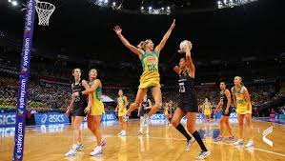
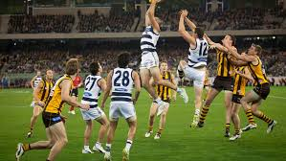
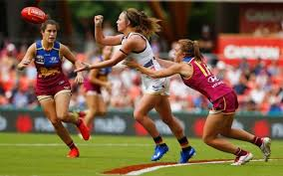
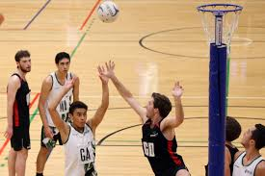
MATCHING OPPONENTS cont…
Matching Opponents by Sex
Most sports competitions also match their athletes by sex.
Boys play boys, girls play girls and men play against men, while women play women.
This is also done for safety reasons, to promote the wellbeing of the athlete.
Males have more testosterone than females and so develop larger and stronger muscles.
Eg - There is an Opens Women’s and Opens Men's competition for tennis. It would not be fair for them to compete against each other, especially given that men can serve up to 30 Km/h faster than there female counterparts. This could inflict injury and therefore, separate competitions are created.

Slide 13
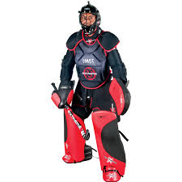
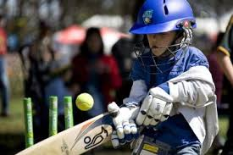
USE OF PROTECTIVE EQUIPMENT
Helps to promote athlete safety and well being.
Protective equipment is purposely designed to help protect the athlete from injuries that may otherwise occur.
Many sports have rules that govern compulsory equipment, while other athletes choose to wear certain protective equipment for their safety.
Protective equipment can refer to equipment that players wear, or other forms of protective equipment.

Slide 14
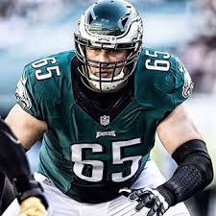
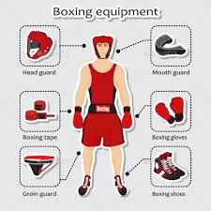
USE OF PROTECTIVE EQUIPMENT cont
Protective Equipment Players Wear
Most protective equipment falls into this category.
Equipment such as:
Shin pads
Mouth guards
Face masks
Shoulder pads
are all examples of equipment worn by athletes.
Some of which are compulsory, including:
Mouth guards in Rugby Union
Shin pads in football
Face masks for the catcher in baseball.
Other personal protective equipment is not compulsory such as:
Shoulder pads in Rugby League
Face shields for ice-hockey (goal keeper has to wear a mask).

Slide 15
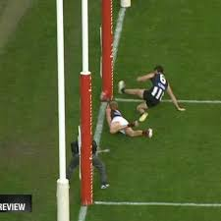
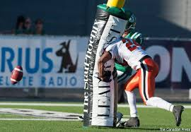
USE OF PROTECTIVE EQUIPMENT cont…
Many sports have equipment that is not often thought about when thinking about protection.
There are many examples of equipment that is not worn by athletes:
Mats that athletes land on in sports like gymnastics and athletics (high jump, pole vault etc)
Padding around poles in netball, and all AFL, Rugby codes
Goal posts in ice-hockey that move when a player crashes into them
Soft balls used for indoor cricket.

Slide 16
CRITICALLY ANALYSE EQUIPMENT TO DETERMINE THE DEGREE TO WHICH THEY PROMOTE SAFE PARTICIPATION
Protective equipment is all designed specifically for the sports or activities involved.
Shin pads used in football are not the same as the leg pads used in cricket or the padding used for the goal keeper in ice-hockey.
Each sport has their own piece of protective equipment designed for that sport. This equipment promotes safe participation in their particular sports.
For example, the use of helmets in cricket has prevented many head injuries that could be lethal. Padding on netball posts has also prevented injuries from contact with the pole during the game.
These types of protective equipment improve the safety of the sport, decrease injury risk and promote athlete wellbeing.

Slide 17
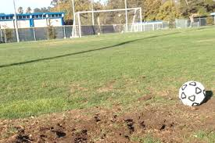
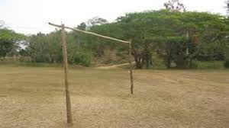
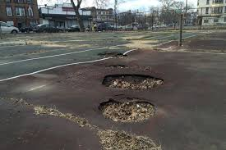
SAFE GROUNDS EQUIPMENT AND FACILITIES
Safe grounds equipment and facilities are important for sport and physical activity in order to be conducted with minimal risk of injury.
If grounds, equipment and facilities are not maintained in a safe and working order then the risk of injury to the athlete increases.

Slide 18
SAFE GROUNDS EQUIPMENT AND FACILITIES cont…
SAFE GROUNDS
Sports and activities are held on various types of “grounds”.
Many are played outside on fields:
Soccer
AFL
Rugby League
Cricket etc.
While others are played inside on a court:
Basketball
Badminton
Volleyball etc.
These are many different types of grounds for other activities such as marathon running, athletics, or cycling.
It is important that these grounds are kept in a safe order.
It is dangerous to the athlete to play sports on fields that are uneven or have divots or holes in them.
Other grounds may have water on them that makes them slippery, which is especially dangerous if the athlete is required to jump and change direction frequently.
Grounds need to be kept safe and checked regularly in order to maintain safety for the athlete.

Slide 19
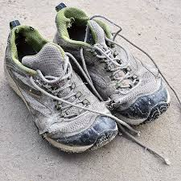
SAFE GROUNDS EQUIPMENT AND FACILITIES cont…
SAFE EQUIPMENT
Sports and physical activity require equipment to be performed.
Equipment needs to be kept in working order and includes equipment such as:
Bicycle in a triathlon
Shoes worn for all types of sports.
Bicycles need to be regularly serviced and checked before use, and shoes are replaced frequently as the soles wear out and the shock absorption decreases.
If equipment is not well maintained injuries result. This can be overuse injuries from running in old shoes, or acute injuries from being kicked in the shins through broken shin-pads.
Broken bats, sticks or other equipment can also lead to injuries that could be avoided through maintenance of equipment to promote safety.

Slide 20
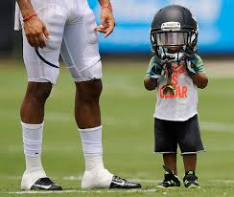
SAFE GROUNDS EQUIPMENT AND FACILITIES cont…
SAFE EQUIPMENT cont…
All equipment should suit the athlete using it - especially for children and young athletes who use modified equipment to promote their safety.
Smaller cricket bats, hockey masks and balls should be used to ensure the safety of the athlete.
Other sports are very technical and the correct equipment helps decrease the occurrence of overuse injuries – such as tennis and golf, where having the right sized and weighted racket or club can reduce injury.

