Slide 1
SUPPLEMENTATION
STUDENTS LEARN ABOUT:
Vitamins/minerals
Protein
Caffeine
Creatine products
STUDENTS LEARN TO:
Critically analyse the evidence for and against supplementation for improved performance

Slide 2
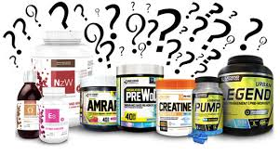
Supplements
Supplement intake is routine for many competitors because it is believed to improve athletic performance. However, while perhaps supplying a psychological boost, supplements may be of little value if the diet is already well balanced in terms of nutritional requirements.
What are the common supplements used to enhance performance?

Slide 3
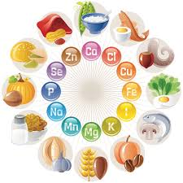
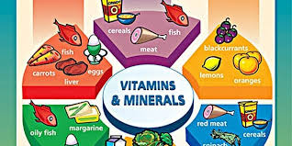
Vitamins & Minerals
Vitamins are inorganic compounds that are essential to maintaining bodily functions.
They do not contain energy, but they function as catalysts that help the body use energy nutrients. In this capacity they assist such functions as energy release, metabolic regulation and tissue building.
Minerals are inorganic substances found in the body that are necessary for it to function adequately.
Like vitamins, minerals belong to the group of micronutrients that are essential
for the body to function properly, but do not provide energy. Iron and
calcium are the two minerals that are most commonly deficient in athletes,
and inadequate supplies will affect performance and contribute to health
problems

Slide 4
Vitamins & Minerals Problems
What is ‘sports anemia’?
Iron is found in haemoglobin, which comprises most of the red blood cells
in the body. These cells collect and transport oxygen, delivering it to where
it is needed. Diminished haemoglobin levels affect performance because
the muscle cells are deprived of oxygen, which is needed to break down the
Nutrients and produce energy.
A condition commonly associated with activity is ‘sports anaemia’. Most
frequently experienced in the early stages of heavy training programs, it is
characterised by a lack of energy and general fatigue. The condition tends to
subside if training is gradual, progressive and supported by a balanced diet.
It is unknown exactly why ‘sports anaemia’ develops. However, it is thought
to be attributable to either a lower iron intake relative to the boost in exercise,
or the body’s use of protein for functions other than red blood cell production.
Again, a balanced diet is an excellent source of iron. High amounts are found
in lean meat, while grain products and dark, leafy green vegetables such as
spinach and lettuce are other valuable sources.

Slide 5
Vitamins & Minerals
The main vitamins that athletes need are water-soluble vitamins. The main sources of these vitamins are fruits and vegetables, wholegrain
Vitamins & Minerals assist with the:
formation of haemoglobin
Immune system
muscle contraction
helping to activate enzymes for energy
Some athletes that may need supplementation:
Female athletes (calcium and iron)
Vegetarians (iron)
highly physical people (sodium and magnesium due to sweat)

Slide 6
Protein
Protein supplements have had strong favour with weight-lifters, body builders and strength athletes for a long time.
Many athletes believe that protein supplements are important because of their muscle building qualities, with higher intake positively affecting muscle size.
Protein’s primary importance to the body is its structural role in holding the cells together and in the growth, repair and maintenance of body tissue. It also has a functional role in hormone production and nervous system transmissions.
Protein is composed of various types of amino acids. It can be a
source of energy under extreme conditions, when carbohydrate and fat supplies are in very short supply or exhausted.

Slide 7
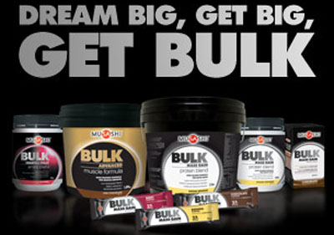
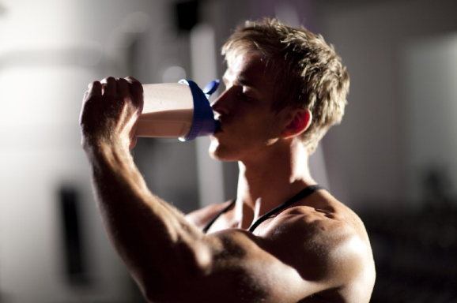
Protein
On average, an Australian diet, 12 to 15 per cent of the recommended intake should consist of protein. Studies indicate that this level is easily achieved, with most people attaining 150 per cent of the recommended intake. Athletes, because of their
high energy usage, may consume amounts in excess of this.
On the whole, research supports the idea that most athletes do not need or benefit from protein supplementation as they meet requirements easily within their balanced diet.

Slide 8
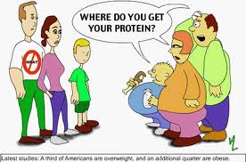
Protein
Furthermore, excess protein can negatively affect health. High amounts of protein can increase the amount of calcium excreted in the urine and possibly contribute to osteoporosis. Unlike carbohydrates that can be stored in the body, excess protein must be eliminated. The processing and filtration of additional urea can interfere with kidney function. Diets high in protein such
as those containing large amounts of meat and dairy foods can contribute to obesity as a result of their high fat content

Slide 9
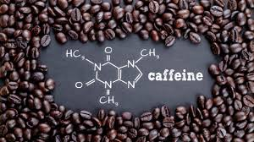
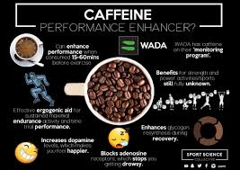
Caffeine
As little as 2–3 milligrams per kilogram body weight is enough
to potentially improve performance.
Caffeine is a mild diuretic but during exercise this diuretic effect falls off dramatically and will not exacerbate dehydration during exercise.
Athletes should also be aware that caffeine may reduce sleep quality and quantity, which may adversely affect their recovery.
Caffeine has ergogenic aid properties, which means that it improves performance by assisting specific metabolic processes (metabolises fat fast to produce more energy).

Slide 10
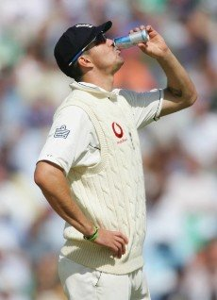
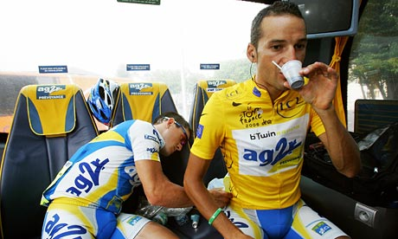
Caffeine
A diuretic is a drug that increases the amount of fluid (water and
urine) passing from the body.
An ergogenic aid is a substance or practice that improves or is
believed to improve physical performance.

Slide 11
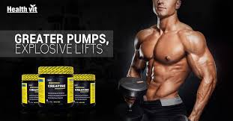
Creatine
Creatine is a compound that occurs naturally in the body. It is found mainly in the muscle tissue in the form of creatine phosphate, which provides a ready source of ATP to the working muscle.
The body has a maximum, or ceiling, amount of creatine it can store and once this maximum is reached it will break down the excess creatine into creatinine and excrete it through the urine.
By supplementing creatine, athletes are trying to enhance the efficiency of the ATP-PC system to provide energy during high-intensity activities.

Slide 12
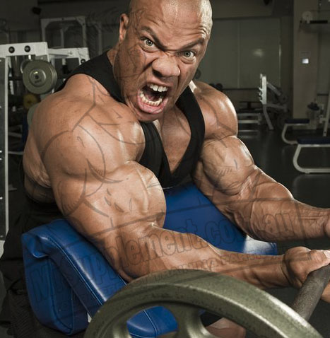
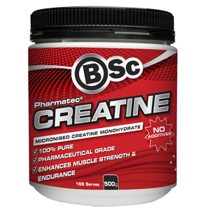
Creatine
Studies have shown that while creatine is able to improve the recovery rate (faster resynthesis of ATP) it does not extend the length of time a performance can be maintained.
It is likely to only be of benefit to athletes who are undertaking explosive short-duration activities with short rest periods in between, rather than one off sprints or endurance events.

Slide 13
Activity
In your workbooks, state point FOR and AGAINST supplementation
Case FOR supplementation | Case AGAINST supplementation

