Slide 1
TAPING AND BANDAGING
STUDENTS LEARN ABOUT:
Preventative Taping
Taping for Isolation of Injury
Bandaging for Immediate Treatment of Injury
STUDENTS LEARN TO:
Demonstrate taping and bandaging techniques, including taping the ankle, wrist and thumb
Evaluate the role taping plays in both the prevention and treatment of injury

Slide 2
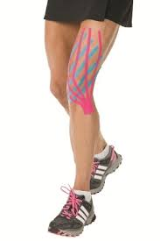
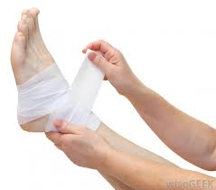
TAPING AND BANDAGING - OVERVIEW
Taping and bandaging help in the prevention and management of injury.
Helps reduce the range of motion at a joint - provides the athlete with a sensation from the tape pulling on the skin, which tells the athlete to reduce the range of motion.
Provides support and helps prevent re-injury to an area of weakness. Helps to isolate the injury reducing use of the injured area and helping recovery.
Bandaging is used in the immediate treatment of injury.
Helps to reduce inflammation, and provides some support to the injured area - is an aspect of the RICER treatment for soft tissue injuries.
You are required to learn how to tape ankles, wrists and the thumb, and to evaluate if taping works to prevent or treat injury. This requires you to know points for and against taping and to make a judgment regarding its effectiveness.

Slide 3
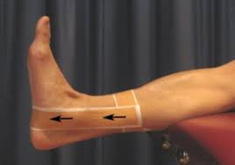
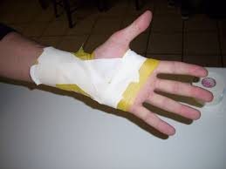
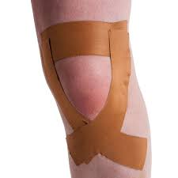
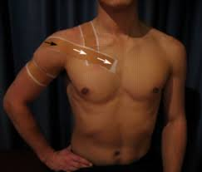
PREVENTATIVE TAPING
Preventative taping is when the athlete tapes a joint, such as the ankle, in order to prevent injury from occurring.
Athletes who use preventative taping often have a history of injury in the joint taped.
The most common joints taped include:
Ankle
Knee
Shoulder
Wrist
Taping used to prevent or treat injury is usually done using a rigid tape, such as Elastoplast, that does not stretch as this tape provides the best results for the prevention and treatment of injury.
Works by providing feedback to the athlete by pulling on the skin when the tap is stretched, providing a sensation. This sensation provides feedback to the athlete to stimulate the muscles around the joint and to reduce the movement in order to prevent injury.
Preventative taping also works as a placebo. It allows the athlete to be confident in their movements, which helps in skilled athletes is biomechanically efficient, making them less likely to suffer injury.

Slide 5
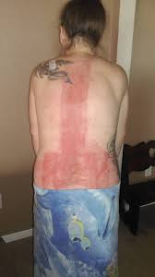
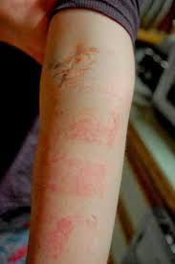
PREVENTATIVE TAPING CONT…
A systematic review published in The Journal of Science and Medicine in Sport found that ankle sprains decreased by approximately 70% when preventative taping was used.
This significantly increases the wellbeing of the athlete especially when ankle sprains account for 10-28% of sports injuries.
Most studies conducted focus on re-injury in athletes with a history of injury. However, the few studies that look solely at preventing injury have found that taping can reduce the injury rate by almost 50%.
Taping does have its down side. Long term taping can lead the athlete to becoming reliant upon the tape to provide the support for the joint.
Long term taping can also decrease stabilising muscle strength and weaken the joint. For this reason, taping should be used as a short term prophylactic (preventative) measure.
Other issues with taping include irritating the skin and reducing the athlete’s proprioception - reducing their ability to know where their body is and when to adjust it in response to the environment or internal forces.
This reinforces the idea that taping is used for short periods of time when returning from injury, and not as a continual preventative.

Slide 6
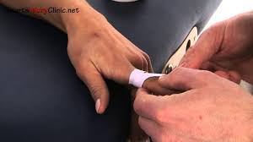
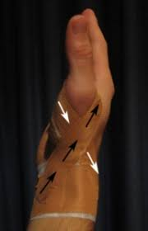
TAPING FOR ISOLATION OF INJURY
Taping is not just used to prevent injury, but also in the treatment of injury.
Taping for isolation of injury is about reducing pain during exercise and preventing further injury as the athlete is rehabilitated and begins to return to play.
Many common sports injuries benefit from taping as part of the treatment.
Injuries such as:
Sprained ankles
Patellofemoral syndrome
Sprained knees
Fingers
Thumbs
Wrists
all benefit from taping during rehabilitation and early return to play.
The goals of taping in the treatment of injury include:
Limit range of motion
Provide proprioceptive feedback to stimulate muscles for stability
Increase stability of the joint
Shift anatomic parts into the correct position e.g. patella
Compress soft tissue to reduce inflammation

Slide 8
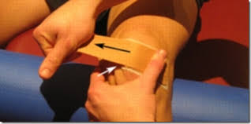
TAPING FOR ISOLATION OF INJURY CONT…
Taping helps reduce the occurrence of re-injury as the athlete returns to play.
Reduces the range of motion at the joint, provides structural support by increasing the stability of the joint and provides feedback for the athlete before pain.
Taping can be used to for patellofemoral syndrome, reducing pain and helping align the patella properly.
It is also used in dressing wounds, by applying pressure to reduce inflammation and bleeding, such as for a laceration on the hand sustained during an ice-hockey match.
Once again there are limitations but overall taping plays a key role in the treatment of injury.

Slide 10
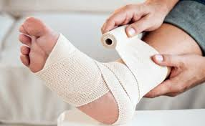
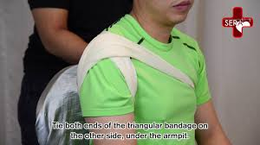
BANDAGING FOR IMMEDIATE TREATMENT OF INJURY
Bandaging for immediate treatment of injury is part of the RICER (Rest, Ice Compression, Elevation, Referral) first aid treatment for soft tissue injuries.
Plays an important role - helps to decrease bleeding and inflammation, while also providing support, especially if the injury is at a joint.
The use of compression bandaging for immediate treatment of injury applies pressure to the injured areas and helps force fluid away from the area, or restricts fluid coming to the areas, reducing inflammation.
This helps prevent damage from too much inflammation, which can damage tissue.
Bandaging applies pressure to the injured area, which also reduces bleeding.
Helps decrease the debris needing to be cleaned up by the immune system, which speeds up recovery allowing a faster return to play.

Slide 11
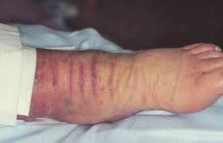
BANDAGING FOR IMMEDIATE TREATMENT OF INJURY CONT…
The bandage also helps reduce movement, limiting re-injury, and providing support for the injured area.
In applying the bandage, it should go across the joint, connecting two (2) or more bones on either side. This along with the pressure applied from the bandage provides stability and support to the joint.
Bandaging for immediate treatment of injury will also restrict movement, but not so much as to impede rehabilitation.
Bandaging should allow for regular muscle contraction and a fair range of motion to promote rehabilitation.

