Slide 1
Types of training and
training methods

Slide 2
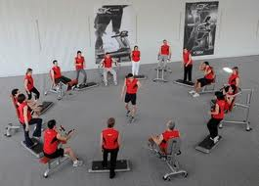
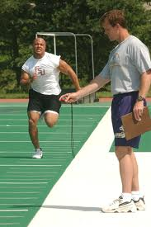
Types of training and training methods
4 types of training (and training methods)
Aerobic (continuous, fartlek, aerobic interval, circuit)
Anaerobic (anaerobic interval)
Flexibility (static, ballistic, PNF, Dynamic)
Strength (isometric, isotonic, isokinetic)

Slide 3
Aerobic Training
Aerobic training uses the aerobic system as the main source of energy supply. It includes a number of training types including: continuous, fartlek, aerobic interval, circuit.
Continuous Training
Continuous training means there is a sustained effort without rest intervals.
Performed consistently for at least 20 mins.
Usually of moderate intensity (65-80% of max HR).
Goal is to make body more efficient at using oxygen
Trains larger muscle groups (quads, core)
FITT
Frequency – 1-2 times
Intensity – 65-80%
Time – 20 to 120mins
Type – continuous
Examples – swimming, joggling, cycling, power walking, aerobics

Slide 4
Aerobic Training
Aerobic training uses the aerobic system as the main source of energy supply. It includes a number of training types including: continuous, fartlek, aerobic interval, circuit.
Continuous Training
Two types of continuous training:
Long, slow distance training: Standard for individuals who need to improve general condition. 60-80% of maximal heart rate, focus on distance rather than speed.
High intensity work of moderate duration.
Very demanding, only well-conditioned athletes use this training and even then, intervals of relief are required. Requires work at or near competition pace and is essential for leg speed. 80-90% of maximal heart rate.
Activity - continuous run – 12min/beep test

Slide 5
Fartlek Training
Fartlek – Swedish for speed play
Involves varying intensity of effort
Periods of intense work is followed by easier effort
Because the efforts are continuous, it is aerobic training
By pushing the limits during the periods of intense running, athletes are improving their anaerobic threshold.
Fartlek training works both the aerobic and anaerobic systems which is a common requirement for most sports.
FITT
Frequency – 1 wk
Intensity – 70% - max thresholds
Time – 20 to 60 mins
Type – Fartlek
Activities – run as a class in a straight line, one behind another. The last person needs to sprint to the front of the line

Slide 6
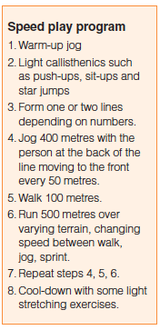
Fartlek Training
Fartlek is beneficial for pre-season training and in preparation for activities between pre-dominant energy systems for example, rugby, basketball and soccer.

Slide 7
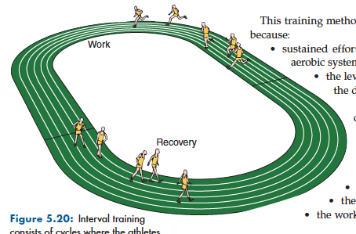
Aerobic Interval
Aerobic interval involves periods of effort and periods of rest
E.G. 10x100m sprints with 30 second breaks at 80% max effort
Interval training can be adapted to a variety of needs, depending on sporting needs.
FITT
Frequency – 1-2 times wk
Intensity – near vo2 max
Time – 1min on, 1 min off for 20mins
Type – interval
Activity – 10 x 40m sprints (sprint 40m then walk back and sprint again)
The overload principle can be applied by manipulating four variables:
Work intensity
Work time
Number of repetitions
Work-rest ratio

Slide 8
Circuit Training
Circuit training is an arrangement of activities that require an athlete to spend time at a station before moving to a new station.
Specific needs can be developed by changing the length of time at each station, the reps completed and the rest periods between stations
Activity – As a class, design a circuit training session.
The overload principle can be achieved by:
• increasing the number of stations
• increasing the time at each station
• increasing the repetitions at each station
• decreasing the time allowed for the circuit
• increasing the repetitions of the circuit
• determining the repetitions at each station on the basis of the individual’s
target zone for their heart rate response. Fitter athletes will do more repetitions
at each station than less fit athletes.

Slide 9
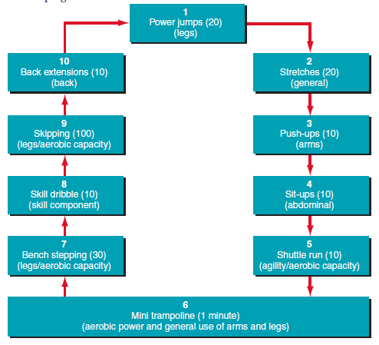
Circuit Training
The greatest benefits are achieved when:
• the overload principle is applied
• the skills at each station concentrate on the attributes needed for a particular
game/activity
• all fitness components essential to the particular sport or activity are developed
• record cards are kept to monitor improvement to keep athletes aware of
their progress.

Slide 10
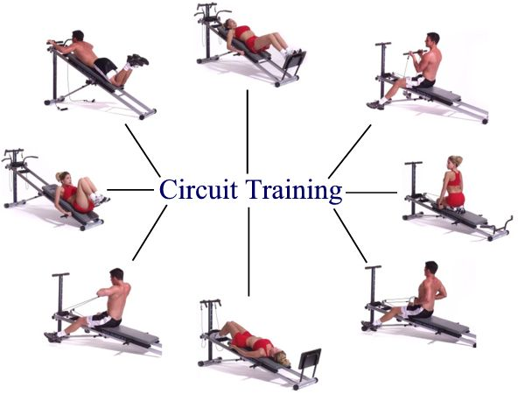
Class Activity
Designing and trialing a circuit
As a class or in small groups, design a circuit to improve aerobic capacity. Include
at least 10 activities and ensure a logical progression from one activity to the next.
Make a card for each activity in your circuit that names (and perhaps illustrates) what is to be done at each station. On each card indicate the number of repetitions of the movement that are required before progression to the next activity. Finally, perform your circuit as quickly as possible and record the time taken.

Slide 11
Anaerobic Training
Anaerobic Interval training – Most anaerobic interval training is aimed at developing the players speed or short bursts.
Does not call on oxygen to supply energy demands
Training involves high intensity activities for shorter durations
By increasing intensity or duration, athletes can improve their anaerobic threshold and build tolerance to lactic acid
Longer rests are given between intervals to enable the creatine phosphate to be replenished.
Enough time must be given otherwise it become aerobic training.
For example. 5 x 100m sprint should have 2-3mins recovery time between each.

Slide 12
Anaerobic Training
Anaerobic Interval training – Most anaerobic interval training is aimed at developing the players speed or short bursts.
Does not call on oxygen to supply energy demands
Training involves high intensity activities for shorter durations
By increasing intensity or duration, athletes can improve their anaerobic threshold and build tolerance to lactic acid
Longer rests are given between intervals to enable the creatine phosphate to be replenished.
Enough time must be given otherwise it become aerobic training.
For example. 5 x 100m sprint should have 2-3mins recovery time between each.

Slide 13
Flexibility Training
An athlete who is flexible is more likely to avoid injury as well as being able to perform skills at a higher level.
An effective flexibility program will:
Improve muscle co-ordination
Improve ability of muscles to stretch
Reduce the tightening of muscles
Muscle relax and recovery
Flexibility is affected by:
Age – muscles shorten as we age
Sex – females are generally more flexible
Temperature – increased body and air temp allow for better flexibility
Exercise – the more you exercise, generally more flexible

Slide 14
Flexibility Training
Static - also called passive stretching
Involves gradual lengthening of the muscle and held for 10-20 secs
Should be stretched til muscle is felt with tension
It is a safe and effective method as it is slow and sustained
http://www.youtube.com/watch?v=l0uwEPzVsqk
Ballistic – generally known as the bounce stretch
-Popular in 1950’s and 60’s but has since been discredited.
Involves stretching a muscle to its end point and then over stretching by bouncing
-Due to the force of the stretch, it can damage muscle fibres
http://www.youtube.com/watch?v=ep3Q1gzH8AQ

Slide 15
Flexibility Training
Dynamic – also called the range of movement (ROM) stretch
Involves rhythmical movements of major muscle groups to be used in the activity.
Stretching is generally slow, gentle repetition of movements
Each movements should be repeated at least 12 times.
E.G. Large arm circles of swimmers/high knees for hurdlers.
http://www.youtube.com/watch?v=v1q4l1bkKY4
PNF – Emerged from field of rehab.
Involves gently, static stretch followed by an isometric contraction against a resistance (often a partner) followed by another stretch.
This process is often repeated twice
http://www.youtube.com/watch?v=4GWlJMSAlu4

Slide 16
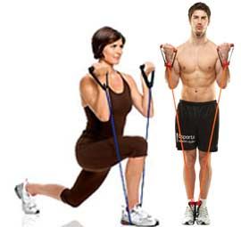
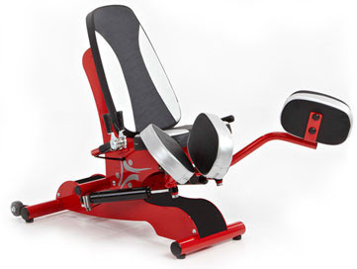
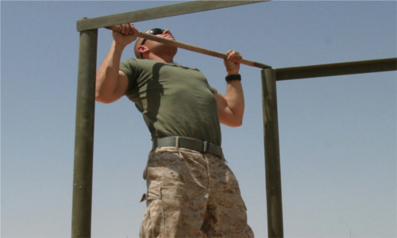
Strength Training
To develop strength, a resistance needs to be applied to a muscle to contract.
Strength training can also be called resistance training
Muscle enlargement and growth is called hypertrophy
Resistance can be:
body weight
Barbells/dumb bells
Weight machines
Hydraulic resistance machines
Elastic bands
Water (aqua aerobics)

Slide 17
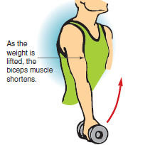
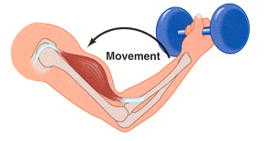
Let’s take it back to Year 11 (key terms)
Types of muscle contractions
When a muscle is stimulated, it contracts. This may happen in a number of ways. There are three principal types of muscle contraction — static (isometric) and dynamic (isotonic, isokinetic)
Isotonic – cause the muscle length to change as tension is developed in the muscle
Concentric
A concentric contraction is the most common type of muscular contraction. During this contraction, the muscle shortens, causing movement at the joint. Examples of concentric contractions are the contraction of the rectus abdominis to raise the trunk during a sit-up, or the biceps contracting to lift a weight.

Slide 18
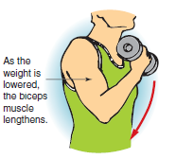
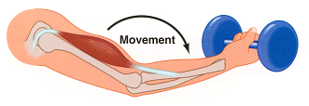
Let’s take it back to Year 11 (key terms)
Types of muscle contractions
Eccentric
An eccentric contraction occurs when the muscle lengthens while under tension. The action often happens with the assistance of gravity. Examples of eccentric contractions are the rectus abdominis extending to gradually lower the trunk during the downward action of a sit-up, or the biceps muscle fibres lengthening as the weight is returned to its original position

Slide 19
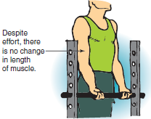
Let’s take it back to Year 11 (key terms)
Types of muscle contractions
Isometric
An isometric contraction occurs when the muscle fibres are activated and develop force, but the muscle length does not change; that is, movement does not occur. Isometric contractions are commonly seen in attempted movements where a resistance cannot be overcome. Examples are a weight-lifter trying to lift a weight that cannot be moved, or a person pushing against a wall. In each case, the effort is being made, but the muscle length does not change because the resistance is too great.

Slide 20
Let’s take it back to Year 11 (key terms)
Types of muscle contractions
Isometric
An isometric contraction occurs when the muscle fibres are activated and develop force, but the muscle length does not change; that is, movement does not occur. Isometric contractions are commonly seen in attempted movements where a resistance cannot be overcome. Examples are a weight-lifter trying to lift a weight that cannot be moved, or a person pushing against a wall. In each case, the effort is being made, but the muscle length does not change because the resistance is too great.

Slide 21
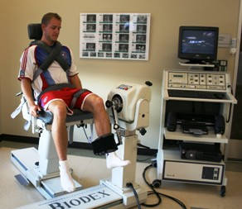
Key Terms
Types of muscle contractions
Isokinetic
An isokinetic contractions occur when tension is developed in a muscle throughout its entire range of motion. As the muscle shortens, the resistance is increased to maintain constant tension at all joint angles, and all speeds of movement. As maximal tension is developed throughout the entire range of motion, a muscle contracted isokinetically is comprehensively fatigued. For this reason, it is the most effective form of training fir the development of muscular strength.
Video
Recovery
Fast Athlete

Slide 22
Strength Training Definitions
Term | Defintion | Example
Lift | The description of how a weight is moved | Arm Curl/Leg press
Repetition | 1 execution of a lift | Doing 1 arm curl
No. Of reps | How many executions of an exercise are performed repeatedly | 10 leg presses
Set | 1 group of repetitions | 3x10 leg presses, followed by a break
Repetition max | The maximum amount of weight that can be lifted a specific number of times | 5 RM of 50kg means that the athlete can only lift 60kg 5 times
Training Frequency | Number of times training is done each week | 3 sessions each week
1RM | The maximun amount of weight that can be lifted a specific number of times | Mike can lift a maximum of 40 kg in 1 lift
Training Load | The resistance weight used (often expressed at RM) | Load is 10kg for arm curls

Slide 23
Strength Training Programs
Type | Weight | Reps | Sets | Speed | Rest
Strength | heavy | 2 to 6 | 3 to 5 | slow to medium | 3-5 mins
Power | heavy | 2 to 10 | 3 to 8 | fast | 3-5 mins
Endurance | light to medium | 15+ | 2 to 3 | medium | 1-3 mins
Lean Body Mass | medium to heavy | 6 to 10 | 3 to 10 | slow to medium | 1-3 mins
Page 35.

