Slide 1
Use of technology
STUDENTS LEARN ABOUT:
Training innovation (eg lactate threshold testing, biomechanical analysis
Equipment advances (eg swimsuits, golf ball)
STUDENTS LEARN TO:
Describe how technology has been used to improve performance
Argue ethical issues related to technology use in sport such as:
Has technology gone too far?
Has access to technology created unfair competition?

Slide 2
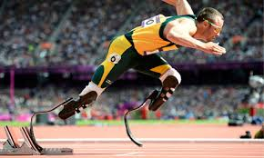
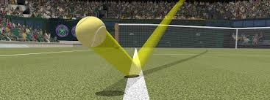
USE OF TECHNOLOGY
The use of technology in sport has increased dramatically over the last twenty (20) years.
At the elite level, training facilities now routinely include:
Gyms
biomechanic technology
physiological testing
indoor and outdoor facilities
plenty of training equipment.
There have been massive advances in the technology of equipment.
cricket bats have become larger and lighter, with larger “sweet spots”
tennis rackets are lighter and have longer handles
balls have changed from leather to synthetic
GPS devices are used at training and during competition, and much more.
The HSC PDHPE syllabus does not want you to focus on the use of technology advances, but whether the use of these technologies is fair. They must be considered from an ethical point of view. Technology often has a high cost and is not available to everyone, giving some athletes an advantage not available to others and not based on their abilities or efforts.

Slide 3
TRAINING INNOVATION
training innovation has developed many elite sports, which have become standard practice.
training innovations is the inclusion of specific tests such as:
the VO₂ max test
lactate threshold testing
biomechanical analysis of specific movements has become more common in a variety of sports to aid with technique/skill execution.

Slide 4
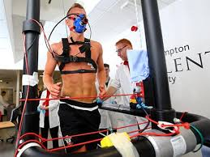
VO₂ max testing and how it improves performance
The VO₂ max test measures an athlete’s maximal oxygen consumption in L per Min per Kg of body weight, maximum heart rate, ventilation rate, and the efficiency of muscles.
The test also provides a predictor of lactate threshold.
The test is used to set heart rate training zones as a real measure of maximum heart rate is achieved.
provides feedback on the effects of training - allows the athlete to train more effectively to improve their cardiovascular endurance.
particularly beneficial in endurance sports such as: marathons, triathlons, or AFL.

Slide 6
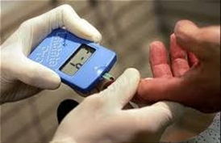
Lactate threshold testing and how it improves performance
Lactate threshold testing identifies an athlete’s lactate inflection point (the point when lactate begins to accumulate in the blood).
This test provides you with a lactate threshold heart rate and training pace.
helps the athlete to set training zones that are more accurate and beneficial
provides better results (especially in aerobic sports where you want to be as close as possible to the lactate inflection point without crossing into the anaerobic training zone).
also helps in anaerobic training to ensure training is forcing the body to deal with lactate overload and recover from it.

Slide 8
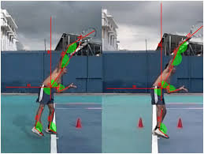
BIOMECHANICAL ANALYSIS AND HOW IT IMPROVES PERFORMANCE
Biomechanical analysis analyses the athlete’s technique to ensure their movement is efficient and safe.
analyses:
the force through joints
the force absorbed and produced by muscles
ensure technique is correct to produce the most efficient movement possible
that the technique will not lead to injury
huge benefit in sports that are particularly technical such as:
Cricket
Tennis
Golf
baseball
allows the athletes to compete longer with more efficient movement patterns, and to achieve better results due to a better technique.
saves energy and provides the athlete with an advantage over others

Slide 9
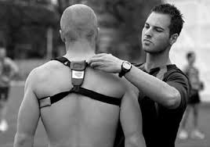
OTHER TRAINING INNOVATION
There are many other training innovations used in sport. These include:
heart rate monitors
GPS devices
video analysis
and much more
Ethics and training innovation
Many of the training innovations are expensive and can only be accessed by athletes or clubs who can afford the testing and equipment.
can create an unfair playing field, particularly when competition is between countries, where one country has access and the other does not
The ethical considerations revolve around equity of access and money, more than safety

Slide 10
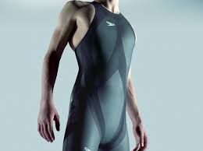
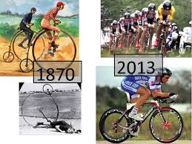
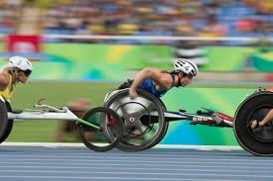
EQUIPMENT ADVANCES
Many equipment advances in sports have caused increases in sports performance that are not due to the athlete’s ability, but due to equipment advances.
Equipment advances can be in:
Clothing
protective equipment
general equipment
technological equipment.

Slide 11
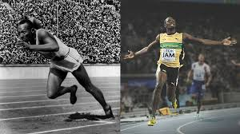
Clothing equipment advances
Clothing in sport has changed dramatically over time.
It is very light, and can be lose or skin tight, depending on the need for performance and safety.
For example, swim suits worn have changed to become whole body suits, and even went too far and added structural support (these suits were since banned from competition).
Clothing in many contact sports has also become tighter to make it harder for the opposition to grab hold of it when tackling (e.g. rugby codes).

Slide 12
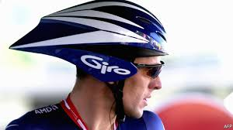
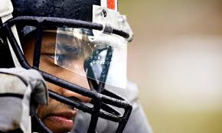
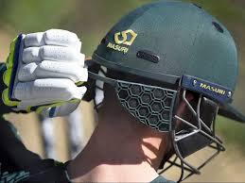
PROTECTIVE EQUIPMENT ADVANCES
Protective equipment in sports has become lighter (Cricket pads, helmets etc - allows for faster and more free movements).
Some sports have developed new protective equipment - stem guard in cricket.
Shin pads in football and shoulder pads in rugby have changed to allow better movement in competition.

Slide 13
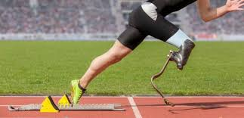
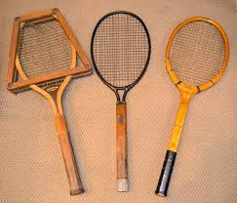
General equipment advances
This is where most advances have occurred in equipment. These types of advances include:
graphite golf clubs
tennis rackets are lighter, longer, have larger heads (stringed area), and nylon strings
cricket bats are larger and lighter
golf balls have specialised dimples and lighter
many sports have converted to synthetic balls over leather (football, rugby codes, AFL, NFL etc)
perspex backboards for basketball
perspex masks for ice-hockey

Slide 14
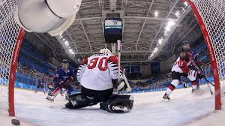
TECHNOLOGICAL EQUIPMENT ADVANCES
The Grand Slam tennis and many international tennis competitions now use “Hawkeye” technology that tracks the ball and is used to determine if the ball is in or out.
Ice-hockey use a light system over the goal to determine when the puck has crossed the line.
Cricket use many technologies, from video replays for run outs, to “Hawkeye” to determine LBW decisions.
Rugby league uses video replays to determine if a try has been scored.

Slide 15
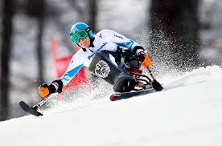
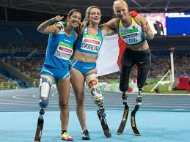
ETHICAL ISSUES RELATED TO TECHNOLOGY USE IN SPORT
There are a number of ethical issues related to technology use in sport
there are many who debate the place of technology in sport.
Things such as goal line technology and video replays for decisions normally made on the field affect the sport and how they are played.
Many technology advances have benefited people with disabilities.
The changes to wheelchairs, prosthetics and more that enable people with varying disabilities to participate in sport has been a great development, but this access is not the same to all athletes.

Slide 16
HAS TECHNOLOGY GONE TOO FAR?
There is no simple answer to this question.
This is one of the biggest ethical issues related to technology use in sport.
Technology should be used to improve sports performance.
Spectators and athletes want to see and improve their performance.
Improvements will become rare if technology is removed from it.
However, when technology leads to unfair competition its use should become limited.

Slide 17
HAS ACCESS TO TECHNOLOGY CREATED UNFAIR COMPETITION?
The ethical issues include equity of access.
Accessing technology is expensive (especially physiological testing or biomechanical analysis).
Some equipment is costly - if all competitors cannot access technology then the competition is unfair due to inequities in access to technology.
Most sporting competitions involve athletes or clubs who either can or cannot afford technologies.
All major sporting competitions such as: NBA, NBL, NFL, AFL, NRL, A-League, EPL, Champions League, etc have plenty of money to access technology.
The same goes for many elite individual sports such as golf and tennis.
International sports competitions do not have the same level of equity.
Individual athletes from poorer developing countries cannot always afford the same technologies as athletes from developed countries, especially from countries that place a high value on sport (America, England and Australia).

