Slide 1
WAYS TO CLASSIFY SPORTS INJURIES
DIRECT AND INDIRECT
SOFT AND HARD TISSUE
OVERUSE

Slide 2
OVERVIEW
This Dot Point focuses on the types of sports injuries and their management/treatment
Sports injuries can be classified both by the type of tissue injured and the way that they were injured.
This then determines how the injury is then treated.
Soft tissue injuries range from a scratch to a third degree spring or strain. How they are treated varies, but priority is given to:
Limit bleeding
Manage the inflammatory response
Hard tissue injuries require different treatment/management
Limiting bleeding is still a priority.
For hard tissue sports injuries immobilisation and early medical treatment is required for the best recovery possible.

Slide 3
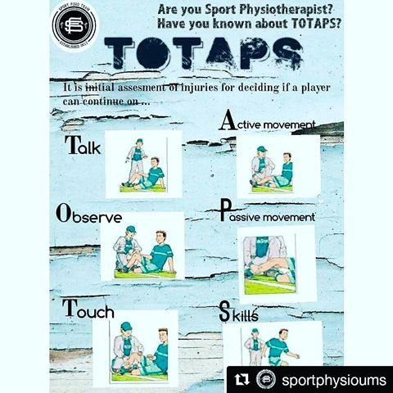
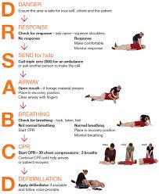
OVERVIEW CONT…
The assessment of injuries is also a pivotal point in this critical question.
It is important when sports injury occurs that the athlete is quickly assessed in order to determine if they can continue to play, or need to be removed from competition.
This is done by following DRSABCD and TOTAPS. These help to determine the nature and degree of injury that has occurred so that proper treatment can follow.

Slide 4
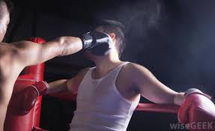
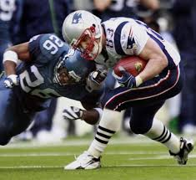
DIRECT AND INDIRECT
Direct and indirect are two (2) classifications for a sports injury.
In classifying sports injuries they can be either direct or indirect, never both.
DIRECT INJURY
A direct injury is an injury sustained at the site of external force
hit by a ball, bat, person.
These are very common injuries in sport
Blisters and abrasions are always direct injuries and bruises are frequently caused by direct external forces.
Eg: bruised leg from a cricket ball or a black eye from being punched during a boxing match

Slide 5
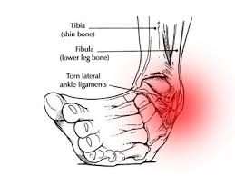
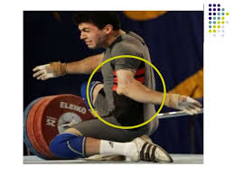
DIRECT AND INDIRECT CONT…
INDIRECT INJURY
An indirect injury is an injury sustained from an internal force
pulled hamstring, sprained ankle
Internal forces are often generated by muscles, but includes forces transferred from the outside
Fall onto your arm, but injury your shoulder.
Sprains and strains are always classified as indirect injuries as an external force does not cause tears in ligaments or muscles.
Other common indirect injuries are: dislocations and breaks.
An example is a dislocated shoulder after falling on your arm, or rolling your ankle causing a sprain.

Slide 6
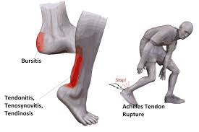
SOFT AND HARD TISSUE
Soft and hard tissue are two classifications for sports injuries.
you need to combine this classification with either direct or indirect for a full classification.
SOFT TISSUE
Occur to soft tissue in the body. Everything except bone and teeth.
Soft tissue include all:
Muscles
Ligaments
Tendons
Skin
Organs etc.
Soft tissue injuries can be direct such as a blister or bruise at the sight of external force, or they can be indirect injuries caused by internal forces such as a strain or sprain.
Example - a sprained ankle is a indirect soft tissue injury or a black eye from a punch to the eye is a direct soft tissue injury.

Slide 7
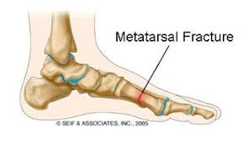
SOFT AND HARD TISSUE
HARD TISSUE
Hard tissue injuries are injuries to the bone or teeth
injuries of the skeleton.
Hard tissue injuries include breaks and dislocations, including lost teeth. Hard tissue injuries are less frequent than soft tissue injuries in sport, but are often more serious.
Eg - a dislocated shoulder from a poor tackle in rugby league, therefore also direct.
Remember you need to identify different types of injury.
Make sure the injury has two (2) classifications for a complete classification of the injury
Eg - a laceration of the leg from an ice-skate during a hockey game is a direct soft tissue injury.
Soft and hard tissue injury classifications are opposing and cannot be combined in the classification of sports injuries.

Slide 8
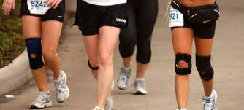
OVERUSE
Overuse injuries are caused by repetitive action and are a separate classification as they are not an acute injury (like direct and indirect are) but a long term injury.
They are much the same as indirect injuries because they are caused by internal forces.
Overuse injury develops over time due to the athlete not allowing enough time between performance for the body parts used in the repeated action to recover.
Overuse injuries begin as small injuries, often due to poor technique or constant repetition of particular movements, and develop into larger injuries because the athlete does not allow enough time to repair/recover from the smaller injury before it is re-injured.
The small injuries produce scar tissue because the body does not have enough time to reproduce the actual body tissue. This often occurs in muscle tissue.
This scar tissue then builds up because the body never gets a chance to repair and fix the tissue. This forms a weak area that is easily re-injured and often becomes a larger injury, even after recovery.
Overuse injuries include soft tissue injuries, such as tendonitis (e.g. tennis elbow) and hard tissue injuries, such as stress fractures.

